Slide 1
Life on the Campaign Trail
How Can We Use Systems of Equations to Solve Real-World Problems?
9th Grade Mathematics

Slide 2
Objectives
Students will be able to:
use investigation to determine the variables that influence the success of a campaign
use various methods to solve systems of equations involving campaigns (e.g., graphing, substitution, and elimination)
formulate a connection between math, campaign management, and other career paths that require the same skill set

Slide 3
KWL for Campaign Managers
K: What do you KNOW about campaign managers and their work?
W: What do you WANT to know about campaign managers and their work?

Slide 4
Zoom with Campaign Manager

Slide 5
How to Run a Smart Campaign
Stanford. (2016, October 14). How to run a smart campaign [video file]. Retrieved from https://www.youtube.com/watch?v=zbGzJ5gTm5E
Notes:
https://www.youtube.com/watch?v=zbGzJ5gTm5E

Slide 6
KWL for Campaign Managers
L: What did you LEARN about campaign managers and what they do?

Slide 7
Campaign Component Research
Use the Campaign Research Organizer to compile a list of campaign components.
Include:
The component’s average cost
The digital & physical sides of the component
How it’s used
Why it’s important
Other important information

Slide 8
Inverted Pyramid Discussion
In pairs, compare your and your partner’s lists of components. Highlight components in common.
In groups of four, continue comparing lists to narrow down possible components.
As a whole class, decide on 3–4 components to create equations.

Slide 9
Equation Components
Two equations
Virtual budget
Physical budget
The X variable represents ads (social media, tv, flyers, etc.)
The Y variable represents community interactions (speeches, podcasts, rallies, etc.)
Total budget

Slide 10
Flipgrid
Use Flipgrid to explain your equations and justify all components you used.
Watch and reply to at least two classmates’ videos.

Slide 11
Solving Systems
What is a system?
A system of equations is when you have multiple equations combined.
Methods to solve
Graphing, Substitutions, and Elimination
Types of solutions
One solution, No solution, or Infinite solutions

Slide 12
Graphing
Set both equations in slope-intercept form
Graph on a coordinate plane
Determine solution based off intersection
Write solution as an ordered pair
Examples:
$y=3x−4$ $y=−2x+1$

Slide 13
Substitution
Isolate a variable (if needed)
Substitute and solve for one variable
Substitute and solve for the other variable
Solution (x,y)
Examples:
$$2x+2y=8$$
$$x+y=−2$$

Slide 14
Elimination
Eliminate one variable:
Line up equal signs
Combine equations (eliminating one variable)
If unable to eliminate, multiply one or both equations to create additive inverses
Solve for remaining variable
Substitute into original equation to solve for other variable
Examples:
$$−3x+4y=12$$
$$3x−6y=18$$

Slide 15
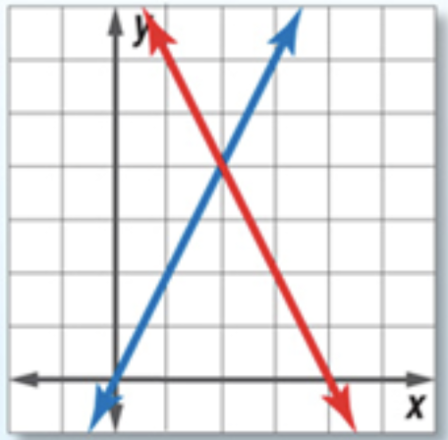
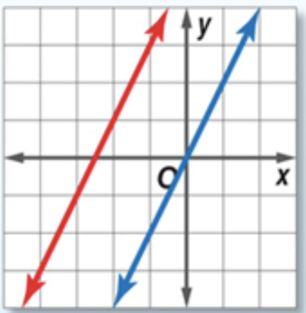
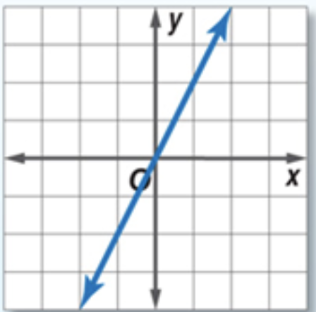
Types of Solutions
One solution | No solution | Infinite solutions
Intersects one time X equals a number Y equals a number | Parallel lines Variables cancel and solution does not make sense (e.g., 0=4) | Same line Variables cancel and solution makes sense (e.g., 4=4)

Slide 16
It’s your turn to manage a campaign!
With a partner, create a campaign plan for your candidate (you or your partner) that includes the following:
A clear campaign message
A justified budget (your system)
A digital product to display message and advertisements
Consult the rubric for specific details.
Katie White (2019 May). People. Pixabay.com. Retrieved from https://pixabay.com/illustrations/people-special-different-employment-4009327/

Slide 17
Voting Day
It’s time to present your campaign plan!
Clicker Free Vector Images (2012 April). Ballot. Pixabay.com. Retrieved from https://pixabay.com/vectors/ballot-box-vote-voting-election-32201/

