Slide 1
A Way With Words
What does an Editor do?
7th & 8th grade ELA Lesson

Slide 2
Essential Questions
What is the purpose of applying grammar and mechanics?
What does a copy editor do?
How can editing written work improve its quality?

Slide 3
Objectives for Today
Identify what editors do.
Identify and practice the skills needed to be an editor.
Create a news story that has been edited.

Slide 4
Your task:
Editing Marks
capitalize a letter
Change an uppercase Letter to lowercase
Insert word
Fix speilling
Delete or remove
¶ Indent paragraph
Reverse letters words or
Read the paragraph.
Edit or correct the paragraph by looking for punctuation and spelling errors, incomplete sentences, subject/verb agreement issues, and any awkward writing.
a

Slide 5
Edited Paragraph
Have you ever thought you might like to be an editor in a future career? Editors are great readers and they love to revise, finish, and review stories in newspapers, magazines, books, and multimedia sources. Editors are responsible for checking the facts, spelling, grammar, and punctuation in all types of publications. They look for ways to make the words better to improve the writing.

Slide 6

Think-Pair-Share
What did the paragraph tell you about the job of an editor?
Do you need these skills for the real world?

Slide 7
What careers are available for Editors?
In publications: newspapers, magazines, books, advertising, etc.
Video and film editing
In media editing: websites, blogs, digital publications
Communications editing: speeches, broadcast journalism
What does an Editor do?
Plan content for publication
Review and revise content
Source: US Bureau of Labor Statistics (2019)

Slide 8
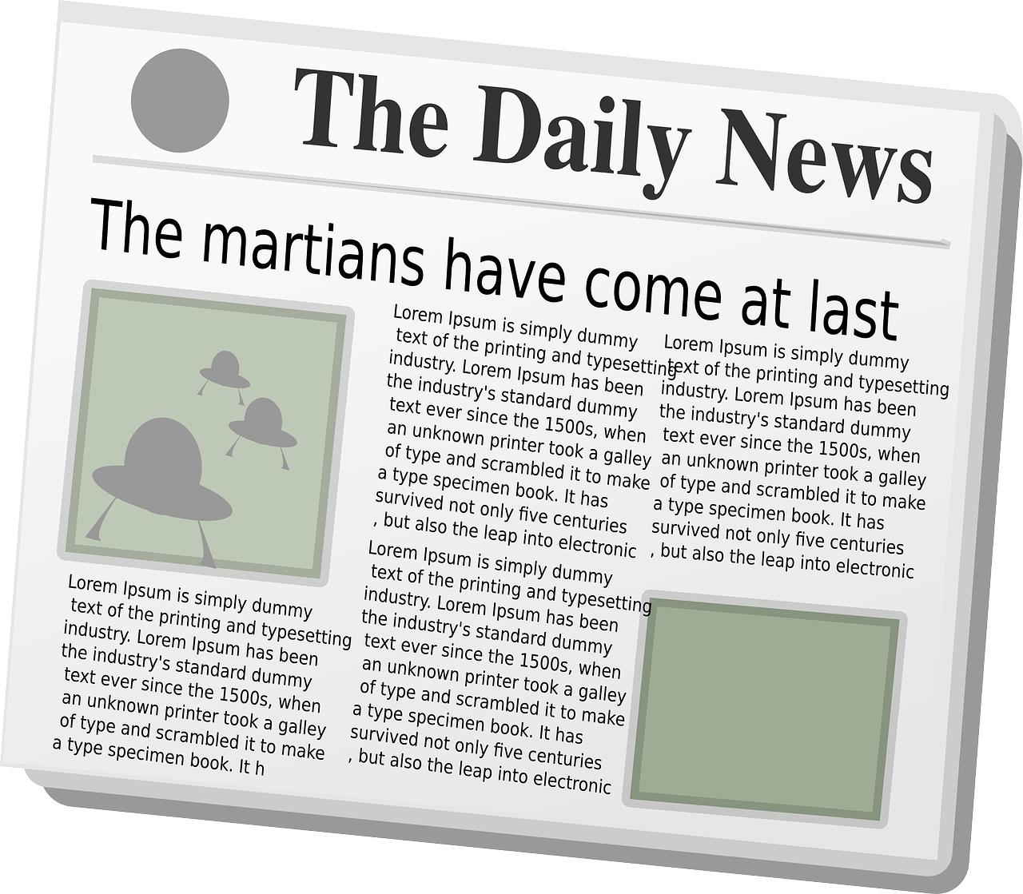
Elements of a News Story
ENGAGING HEADLINE
Byline (Reporter’s Name)
The Lead
A paragraph of the most important facts & information. Answers who, what, when,
where why, and how.
Supporting paragraph(s)
(more details)
Conclusion
Source: The inverted pyramid [writing] structure (n.d.) Journalism and journalistic writing. Purdue online writing lab. Retrieved from https://owl.purdue.edu/owl/subject_specific_writing/journalism_and_journalistic_writing/the_inverted_pyramid.html
OpenClipart-Vectors (2013, October 14). Newspaper. Pixabay. Retrieved from https://pixabay.com/vectors/newspaper-news-paper-journal-151438/
Notes:
Because readers typically don’t spend much time reading a news story, emphasize that reporters/writers prioritize important content within the first few lines.

Slide 9
Differences Between a News Story
& Other Types of Writing
Fact-based; no opinions
Short concise sentences
First paragraph contains most of the information
Includes the what, when, where, why, and how
Details can include quotes, eyewitness statements, and other supporting information
OpenClipart-Vectors (2013, October 14). Newspaper. Pixabay. Retrieved from https://pixabay.com/vectors/newspaper-news-paper-journal-151438/

Slide 10

Card Sort Activity
With a partner, match the element of the news story with its story part.

Slide 11
Card Sort Order
Headline: | Local Man Bites Dog
Byline: | Rhonda A. Reporter
The Lead: | Yesterday, March 22nd, in a stunning turn of events...
Supporting Paragraph #1: | Smith was taken to Mercy Hospital...
Supporting Paragraph #2: | Mrs. Javits, Viper’s owner, was quoted...
Conclusion: | It’s not unusual for postmen to be...

Slide 12

As you watch this interview, make notes in your organizer.
Freepik. Interview. Flaticon. Retrieved from https://www.flaticon.com/free-icon/interview_2298158?term=interview&page=1&position=9
Notes:
Have students fill out the notes organizer section of the handout.

Slide 13
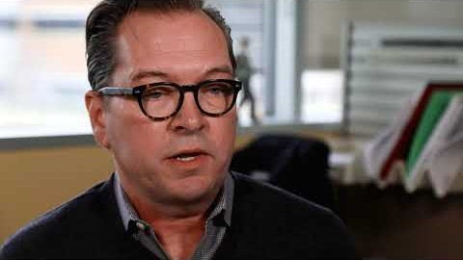
What Does it Mean to Be a Copy Editor?
K20 center. (2020, February 24). ICAP - A Way with Words. YouTube. Retrieved from https://youtu.be/QAn9e5s8AMM

Slide 14
Organize your notes into a news story with the News Story Template.
Freepik. Interview. Flaticon. Retrieved from https://www.flaticon.com/free-icon/interview_2298158?term=interview&page=1&position=9
Notes:
Students use the news story template to organize their notes into a story.

Slide 15

Be the Editor!
Using the writing checklist, edit your partner’s news story to improve it.
Offer suggestions for changes.

Slide 16

Exit Ticket
What is one thing you learned about being a copy editor?
What is one thing you can do immediately to improve your writing?

