Slide 2

Who’s Doing the Thinking? Writing with AI
Ethical Use of AI

Slide 3
Essential Question
How can AI be used ethically to support, rather than replace, thinking during the writing process?

Slide 4
Learning Objectives
Practice using AI as an ethical writing partner by composing an original argumentative essay.
Evaluate AI feedback.
Identify unclear ideas, gaps in evidence, or opportunities for improvement in my writing using AI.

Slide 5
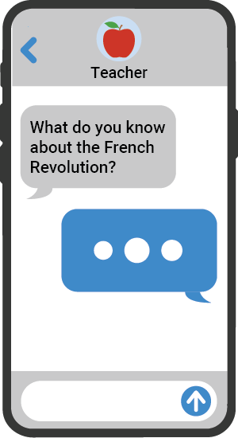
Quick Write
Think about a time when someone helped you with your writing.
When does “help” start to replace your own work?
How might this relate to AI?
Notes:
K20 Center. (n.d.). Quick write. Strategies. https://learn.k20center.ou.edu/strategy/1127

Slide 6

Think-Pair-Share
With a human partner, discuss a belief you each wrote about the following topics.
How to get started:
“I think AI is okay when…”
“I think AI goes too far when…”
“I’m unsure because…”
Notes:
K20 Center. (n.d.). Think-pair-share. Strategies. https://learn.k20center.ou.edu/strategy/139

Slide 7

Justified Ethical or Unethical
Read “Friction by Design.”
Flip over the handout and complete the table by determining whether the provided scenarios are ethical or unethical.
Use the article as evidence to support your reasoning.
Notes:
K20 Center. (n.d.). Justified true or false. Strategies. https://learn.k20center.ou.edu/strategy/174

Slide 8
Justified Ethical or Unethical
In your group, read “scenario one” and ask everyone to share whether they think it’s ethical or unethical.
Get into smaller groups depending on which side you chose and talk about your individual reasoning.
Come back to your main group and share both sides.
Repeat these steps for all scenarios.
  Remember to use evidence from the article to support your ideas.
Notes:
K20 Center. (n.d.). Justified true or false. Strategies. https://learn.k20center.ou.edu/strategy/174

Slide 9
Scenario 1: Group Work Shortcut
One group member uses AI to answer all the research questions for a social studies group project and refuses to explain how they got the answers or involve the other team members.
Notes:
K20 Center. (n.d.). Justified true or false. Strategies. https://learn.k20center.ou.edu/strategy/174

Slide 10
Scenario 2: Writing Coach
A student writes a rough draft of their personal narrative and uses AI to revise it to improve grammar, vocabulary, and sentence flow. The final version is significantly more polished than their usual writing, but they reviewed all the changes and agreed with them. They do not tell the teacher they used AI.
Notes:
K20 Center. (n.d.). Justified true or false. Strategies. https://learn.k20center.ou.edu/strategy/174

Slide 11
Scenario 3: Debate Coach
A student is preparing for a social studies debate. They use AI to generate arguments and counterarguments on both sides of the topic to help them practice. During the debate, they use some of the phrasing and examples from the AI-generated content.
Notes:
K20 Center. (n.d.). Justified true or false. Strategies. https://learn.k20center.ou.edu/strategy/174

Slide 12
Scenario 4: Study Buddy
A student uses AI to explain how to solve a math problem. They read the AI explanation, try the next problem on their own, and check their understanding by asking AI follow-up questions.
Notes:
K20 Center. (n.d.). Justified true or false. Strategies. https://learn.k20center.ou.edu/strategy/174

Slide 13
Scenario 5: Brainstorming Help
A student asks AI to suggest ideas for a science project. They choose one suggestion, research it further, and design their own experiment based on the idea.
Notes:
K20 Center. (n.d.). Justified true or false. Strategies. https://learn.k20center.ou.edu/strategy/174

Slide 14

CUS and Discuss
Let’s dig deeper into “Friction by Design.”
Circle: What is “friction?”
Underline: Why is friction important for writers?
Star: How can AI support (not replace) that process?
Notes:
K20 Center. (n.d.). CUS and discuss. Strategies. https://learn.k20center.ou.edu/strategy/162

Slide 15
Refine Your Argument
You’ve just done a lot of research and debate on the topic of AI and writing; now it’s time to refine your ideas and construct an argument.
Hint: Imagine you are writing this for someone who shares a view that is different from yours.

Slide 16
Refine Your Argument
Prompt: What role should AI play in the writing process?
Be sure to…
Make a clear claim about how AI should be used.
Acknowledge at least one counterargument or concern.
Use ideas from the scenarios, article, or discussion as evidence.
Explain your reasoning.

Slide 17
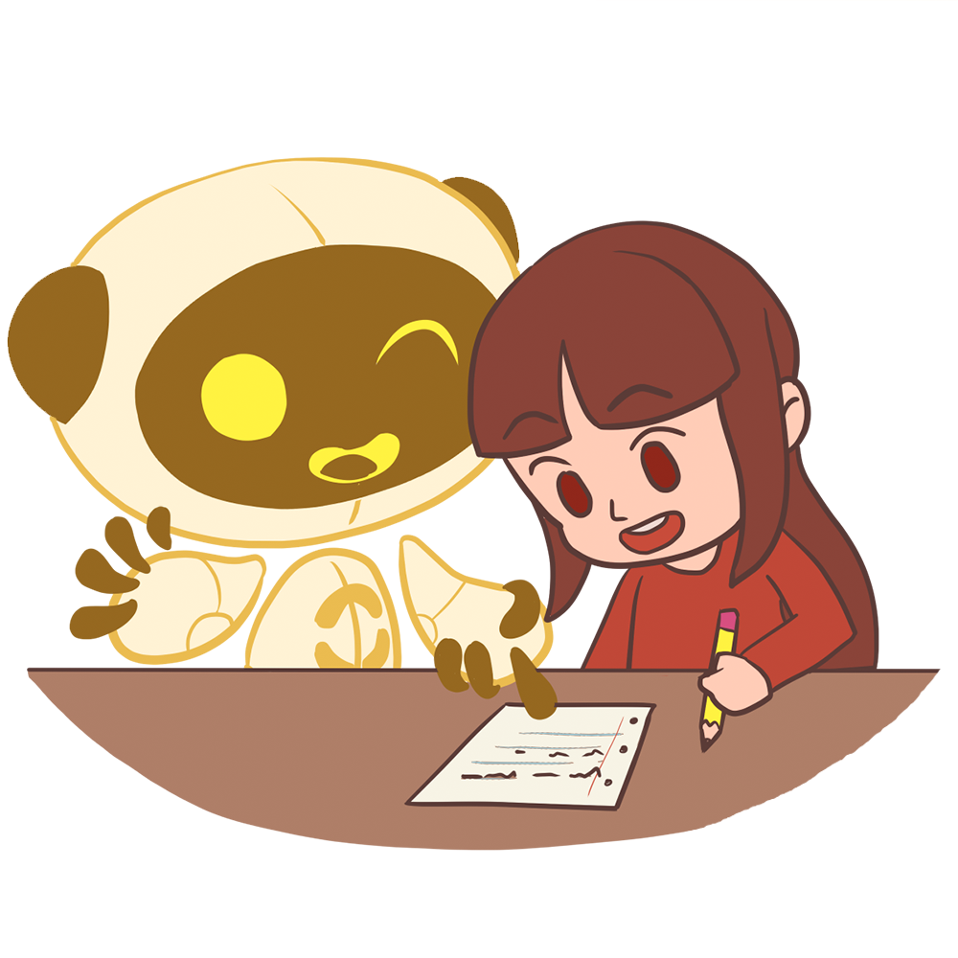
AI Writing Partner
Let’s learn how to use AI ethically during the writing process!
We will do 2 rounds of peer review.
  Round 1 - peer group
  Round 2 - AI chatbot
Goal: Learn how to prompt AI to help you understand your peers’ feedback.
Notes:
K20 Center. (n.d.). AI writing partner. Strategies. https://learn.k20center.ou.edu/strategy/5123

Slide 18
AI Writing Partner
Round 1
Trade drafts with a partner(s).
Provide written feedback.
Afterwards, talk with the writer and explain your feedback and/or any other comments about their paper.
Repeat as often as needed.
Notes:
K20 Center. (n.d.). AI writing partner. Strategies. https://learn.k20center.ou.edu/strategy/5123

Slide 19
AI Writing Partner
Round 2
Access an AI chatbot of your choice.
Upload your draft and prompt the AI chatbot to help you synthesize your peers’ feedback.
  Hint: Use the “Writing Partner Guide” to help in crafting a specific prompt.
Decide what to keep, adapt, or discard.
  Hint: You may need to refine your prompt several times to get the bot to do exactly what you want.
Notes:
K20 Center. (n.d.). AI writing partner. Strategies. https://learn.k20center.ou.edu/strategy/5123

Slide 20
AI Writing Partner
Share your experience and new draft with your group. Discuss the question below.
How did collaborating with your group differ from collaborating with an AI chatbot?
Notes:
K20 Center. (n.d.). AI writing partner. Strategies. https://learn.k20center.ou.edu/strategy/5123

Slide 21
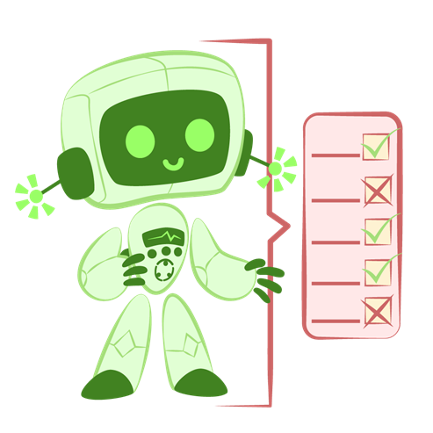
Critique the Bot
Before reflecting on your experience with AI as a writing partner, review what you’ve accomplished during this writing process.
Gather the following:
First Quick Write draft.
Peer feedback.
AI chat transcript.
Final draft.
Notes:
K20 Center. (n.d.). Critique the bot. Strategies. https://learn.k20center.ou.edu/strategy/3491

Slide 22
Critique the Bot
Read, analyze, and critique the AI generated feedback for your draft.
Did you notice any mistakes?
Do you agree/disagree?
Do you have any concerns or thoughts?
Notes:
K20 Center. (n.d.). Critique the bot. Strategies. https://learn.k20center.ou.edu/strategy/3491

