Slide 2
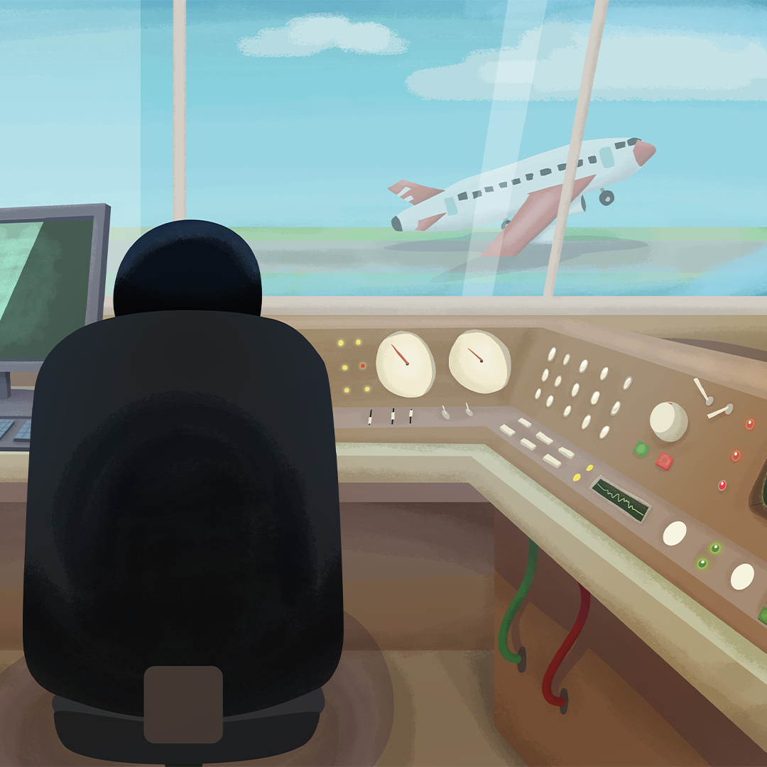
No Static in Our Stories
Digital Communications

Slide 3
Essential Question
How do digital signals make communication and storage more reliable, and why does it matter?

Slide 4
Learning Objectives
Students will explain why digitized signals are more reliable than analog signals for transmitting information.
Students will evaluate the advantages and disadvantages of digital transmission and storage.
Students will apply their understanding of digital communication to a real-world design challenge.

Slide 5

Chalk Talk: My Digital Day
List all the ways you send and receive information in a typical day.
  For example, texting, video calls, etc.
Each method involves sending a signal from one place to another.
Notes:
https://learn.k20center.ou.edu/strategy/197

Slide 6
Chalk Talk: My Digital Day
Review your initial list and distinguish which methods use analog signals or digital signals. You may color-code or mark each method.
Afterwards, discuss your reasonings aloud with your group.
Notes:
https://learn.k20center.ou.edu/strategy/197

Slide 7
Class Discussion
Which patterns or trends did you notice across the charts?
Which methods seem the most reliable or efficient, and why?

Slide 8
Signal Stations
Rotate through the stations and explore how analog and digital signals work.
At each station, record your observations and think about reliability, efficiency, and patterns.

Slide 9

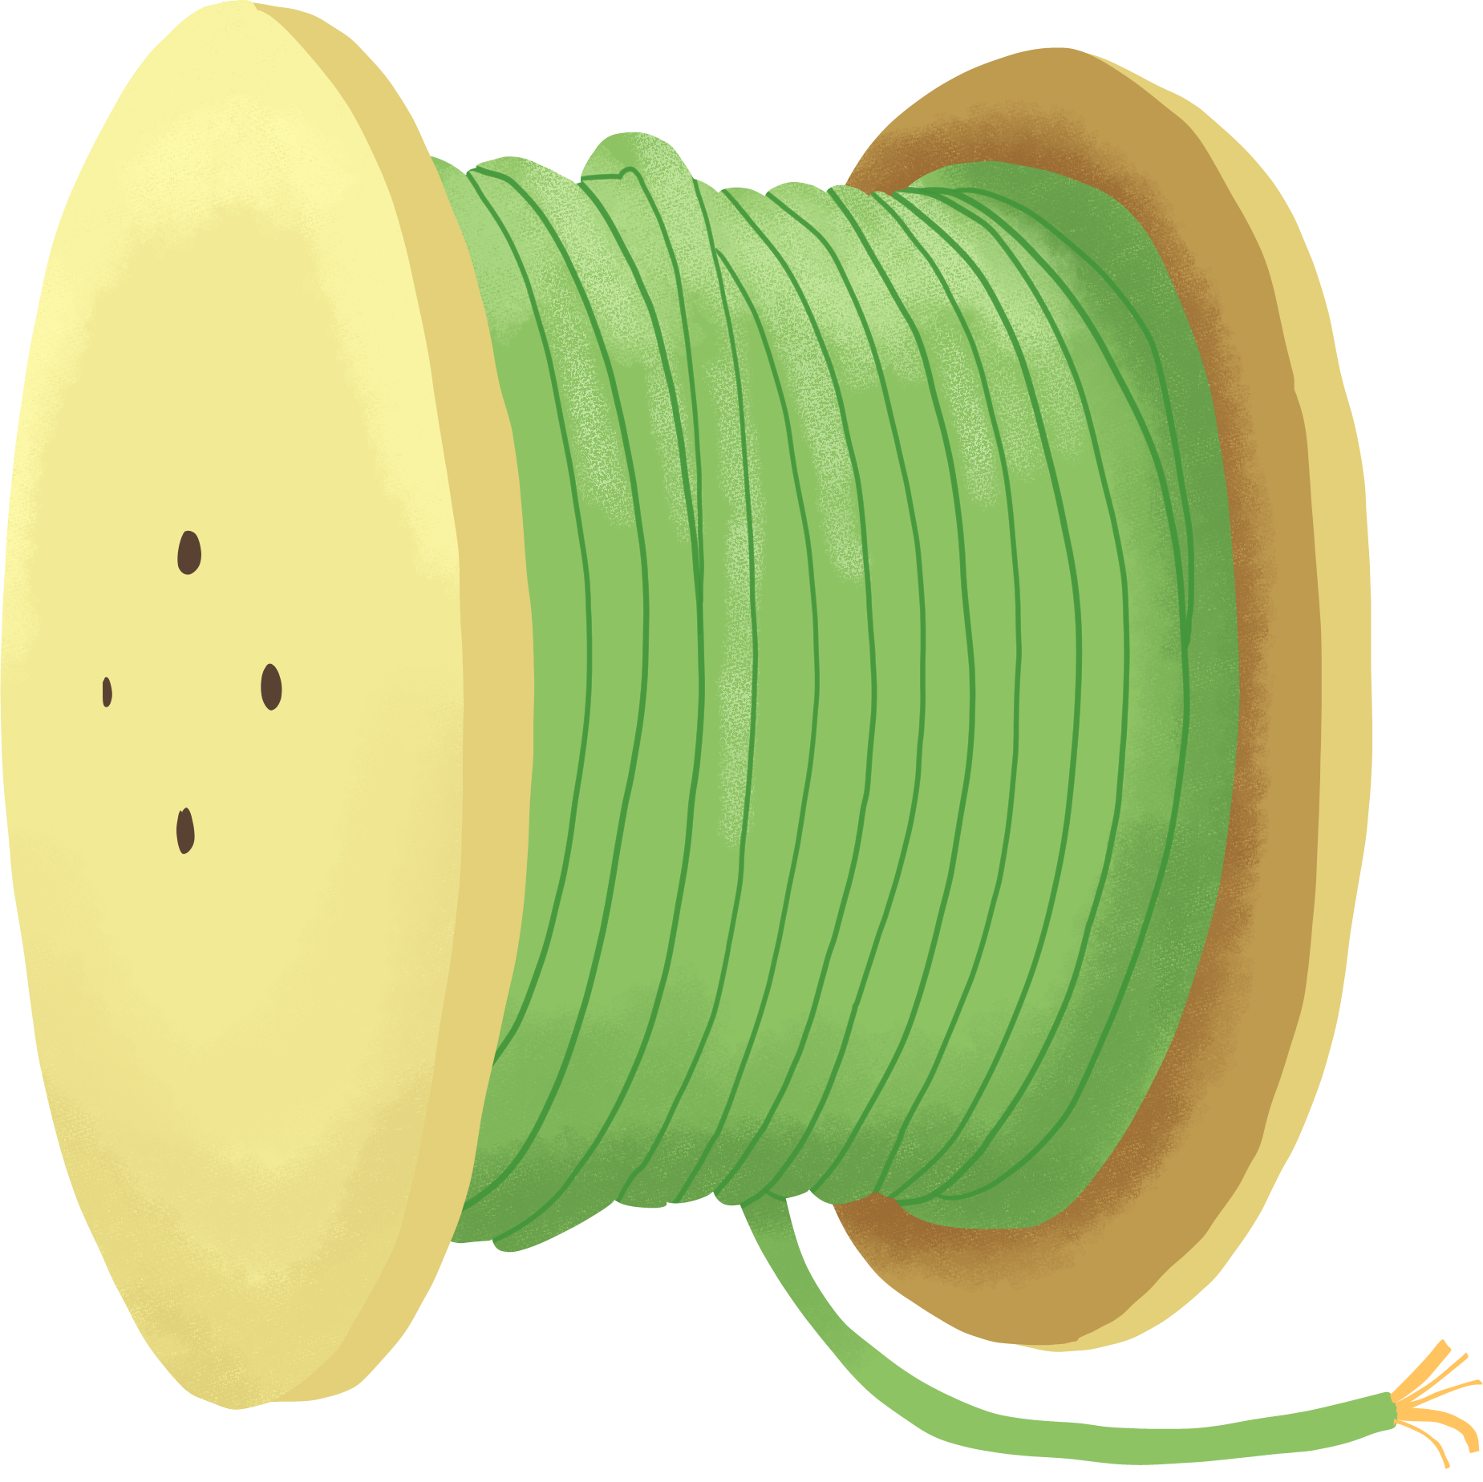


Station 1: Round 1
Stand in a circle or line. Pass an 8-word pattern by whispering; no writing!
Keep a steady rhythm as the pattern is passed person to person.
First person starts the pattern; last person says it aloud. Check the card to see how the message changed.
Notes:
This models analog signals, where small changes add up over time.

Slide 10



Station 1: Round 2
Convert each word to a number (Bear = 1, Pear = 2, etc.)
Pass the code silently by writing and showing it. You get 5 seconds to memorize it before passing it on.
Last person says the full sequence aloud. Compare with the original pattern.
Notes:
This models digital signals, where information is preserved through coding.

Slide 11

Station 2: Air Traffic Control Case Study
Communication is not always about convenience. Sometimes it’s about safety.
Air traffic controllers guide airplanes using different communication systems.
Today, you will analyze how these systems work in terms of digital and analog signals.
Notes:
This models digital signals, where information is preserved through coding.

Slide 12
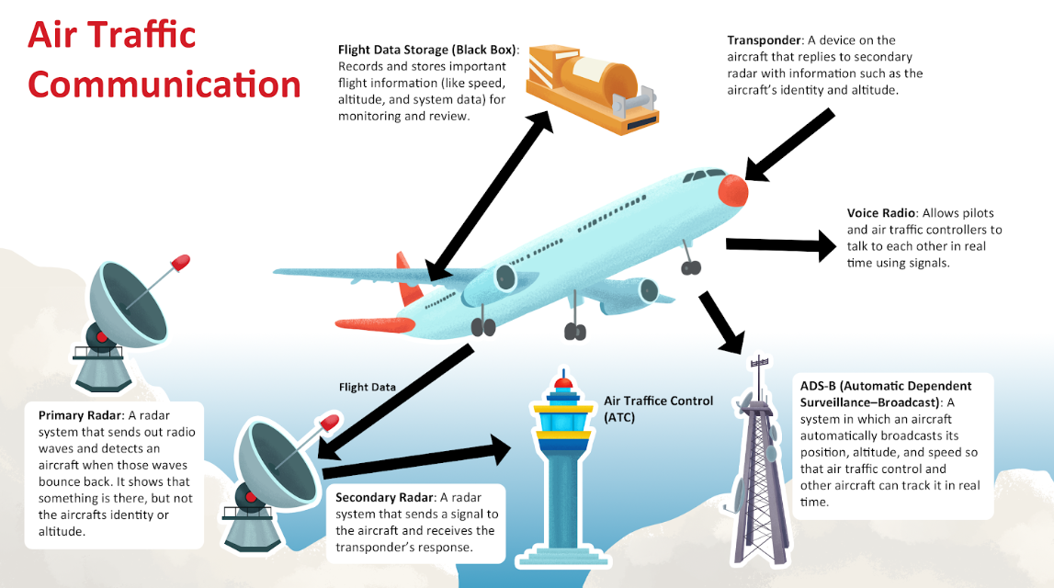

Slide 13
Station 2: What Your Group Will Do
Identify the Signal Type
Is it analog, digital, or a combination?
Evaluate Reliability
Rank the systems from most reliable to least reliable.
Reflection
Think like an Air Traffic Controller

Slide 14
Station 3: Glitch Lab
Read each real-world communication “glitch.”
Decide if the system is analog or digital.
Answer the questions associated with that particular glitch.
Notes:
This models digital signals, where information is preserved through coding.

Slide 15
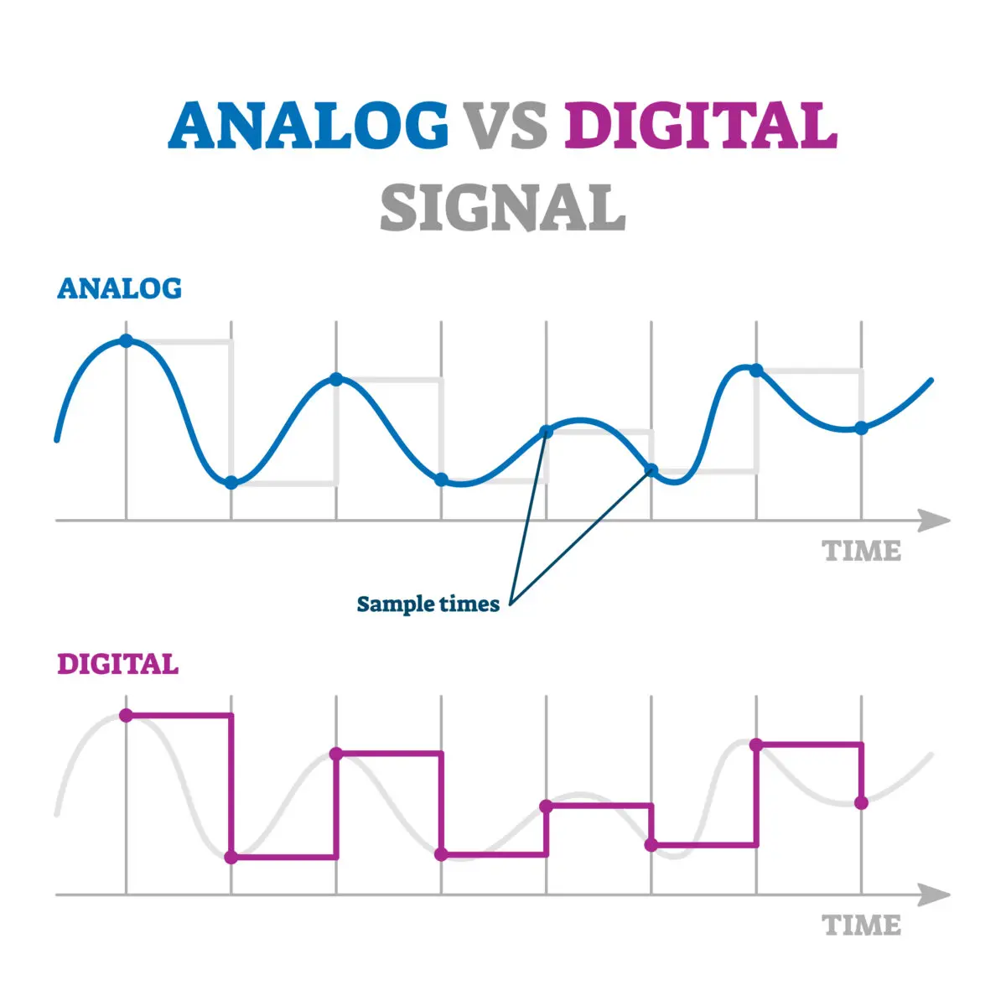
What is a Signal?
A signal is a way to send information from one place to another.
  Analog signal: Continuous, smooth, varies over time.
  Digital signal: Discrete, “stepped,” uses pulses to represent information.
Notes:
Talking points:
Think about your station 1 activity: the “whispered sequence” was like an analog signal. Small errors built up over time.
The “coded writing” was digital. Each step was exact and easier to pass reliably.
Student Note Prompt: Draw a quick waveform for analog and digital; label each.

Slide 16
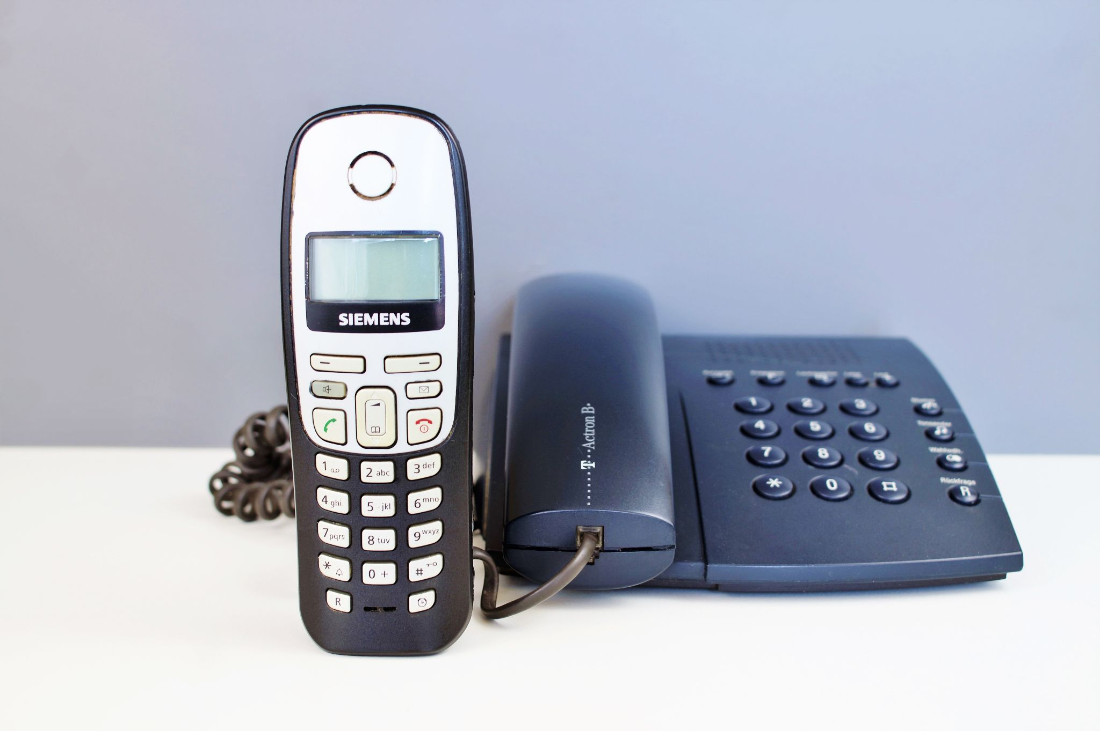
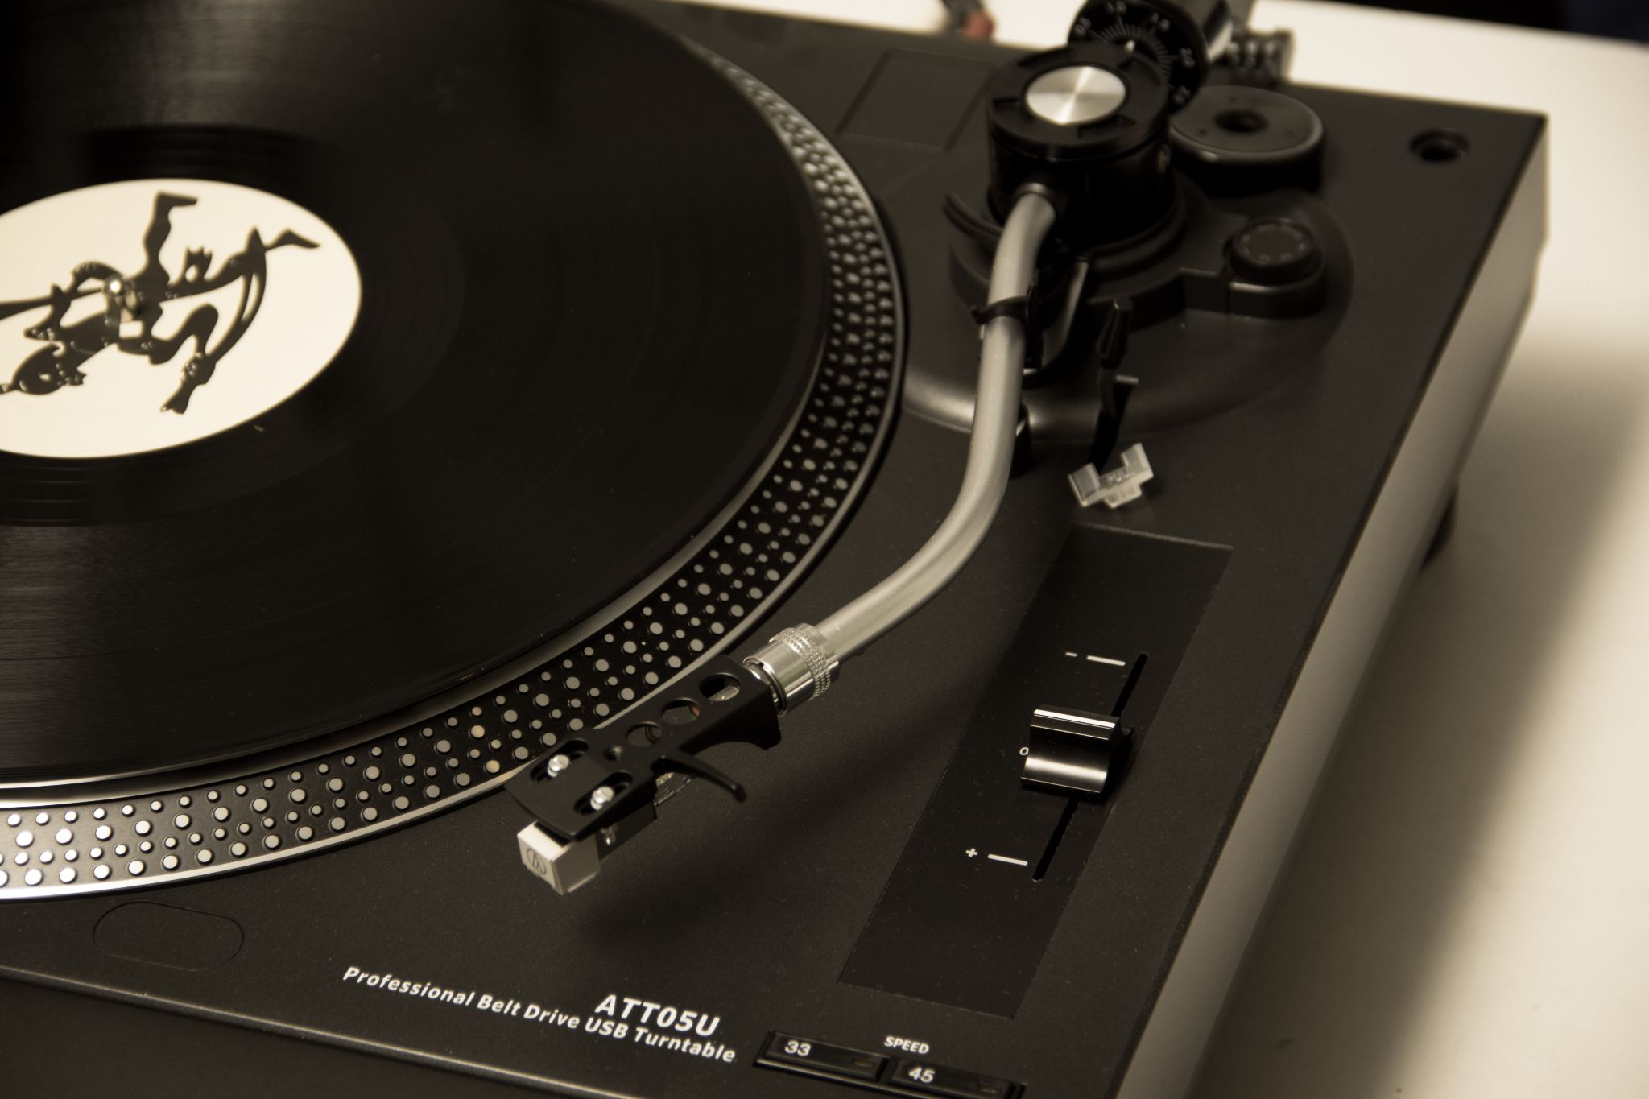

Analog Signals
Characteristics:
  Continuous; can vary in strength, amplitude, and frequency.
  Examples: human voice, landline phone, vinyl records.

Slide 17
Analog Signals
Strengths:
  Captures subtle details and variations (voice tone, music dynamics)
Weaknesses:
  Noise builds up → signal quality decreases over distance or time.
  Harder to store and copy without loss.
Notes:
Talking Points:
Refer to Station 1: errors accumulated in the verbal sequence. That’s similar to what happens in analog signals with interference.
In real-world systems, analog signals can fade, static can appear, or small errors can get amplified.
Student Note Prompt: List one analog example from your own life. What might go wrong with it?

Slide 18
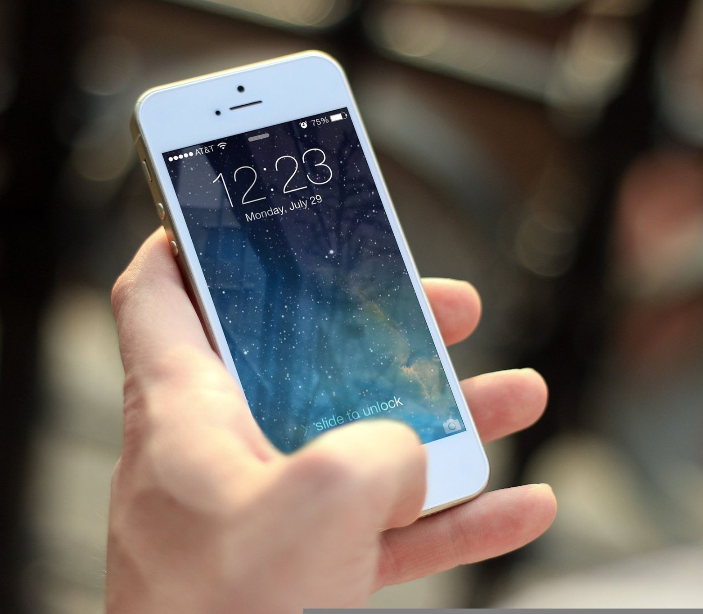

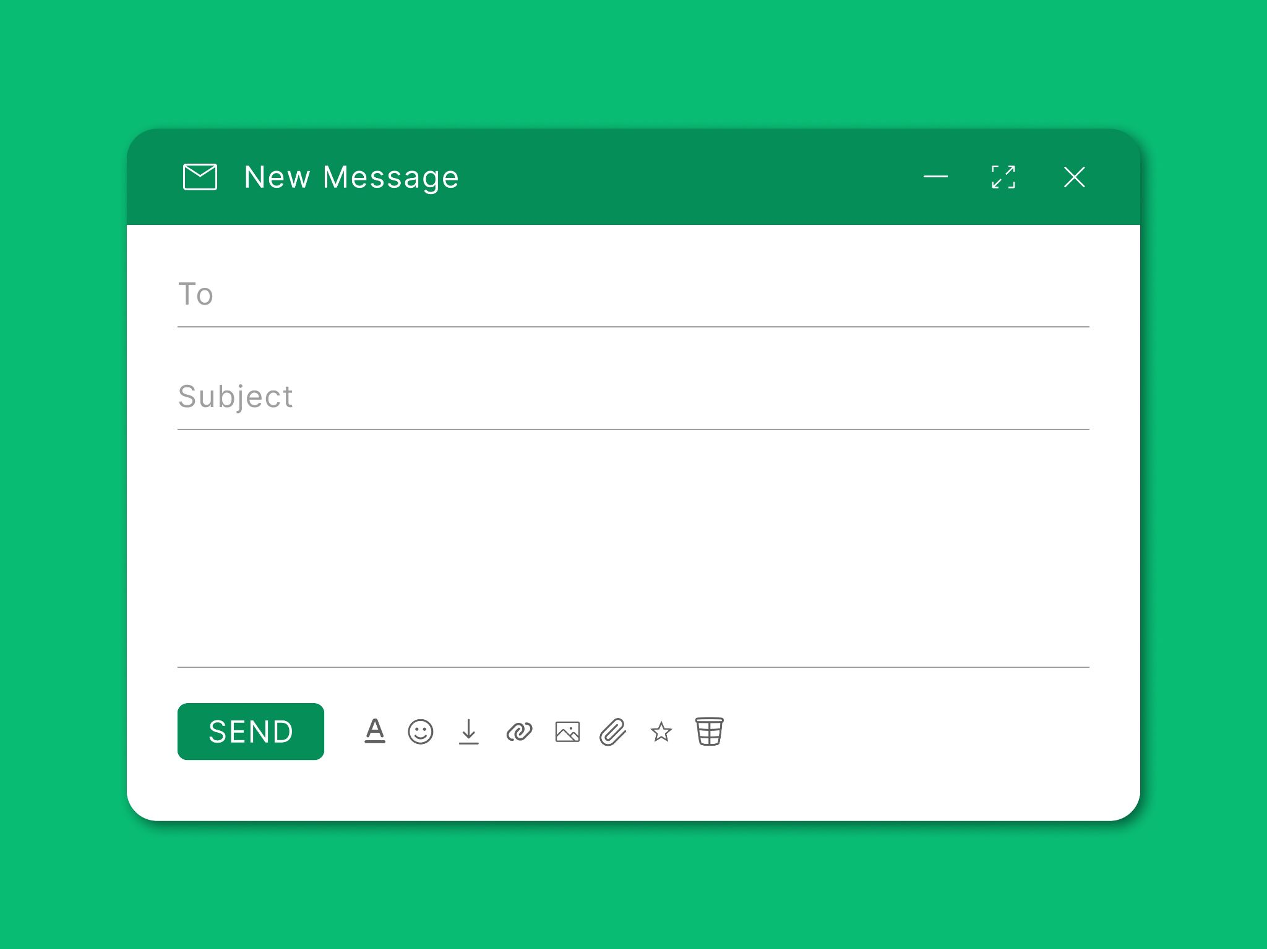
Digital Signals
Characteristics:
  Discrete pulses (on/off, 1s and 0s) represent information.
  Examples: texting, streaming video, emails.

Slide 19
Digital Signals
Strengths:
  Reliable: errors can be detected and corrected.
  Can be stored, copied, or transmitted repeatedly without losing information.
  Easier to encrypt or secure.
Weaknesses:
  Requires encoding/decoding.
  Can still be limited by network speed, hardware,
  or congestion.
Notes:
Talking Points:
Relate to Station 1 digital round: everyone got the sequence exactly correct.
Real-world example: your text messages or Spotify playlist remains unchanged, even after being copied millions of times.
Student Note Prompt: Draw a digital waveform. Write 2 advantages and 1 disadvantage.

Slide 20
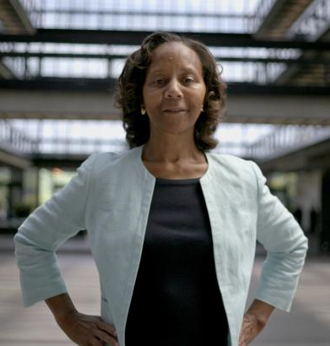
Connecting to Real-Life
Digital signals are behind almost everything we use every day.
Analog signals are still around.
Innovators like Marian Croak helped design systems that rely on digital signals for reliable communication.
Notes:
Prompt for students: Write one example of how digital signals make your communication more reliable.

Slide 21
Linking to Station Observations
How did your station activities show the differences between analog and digital?
Notes:
Student Note Prompt: Write one sentence linking station data to signal type reliability.

Slide 22
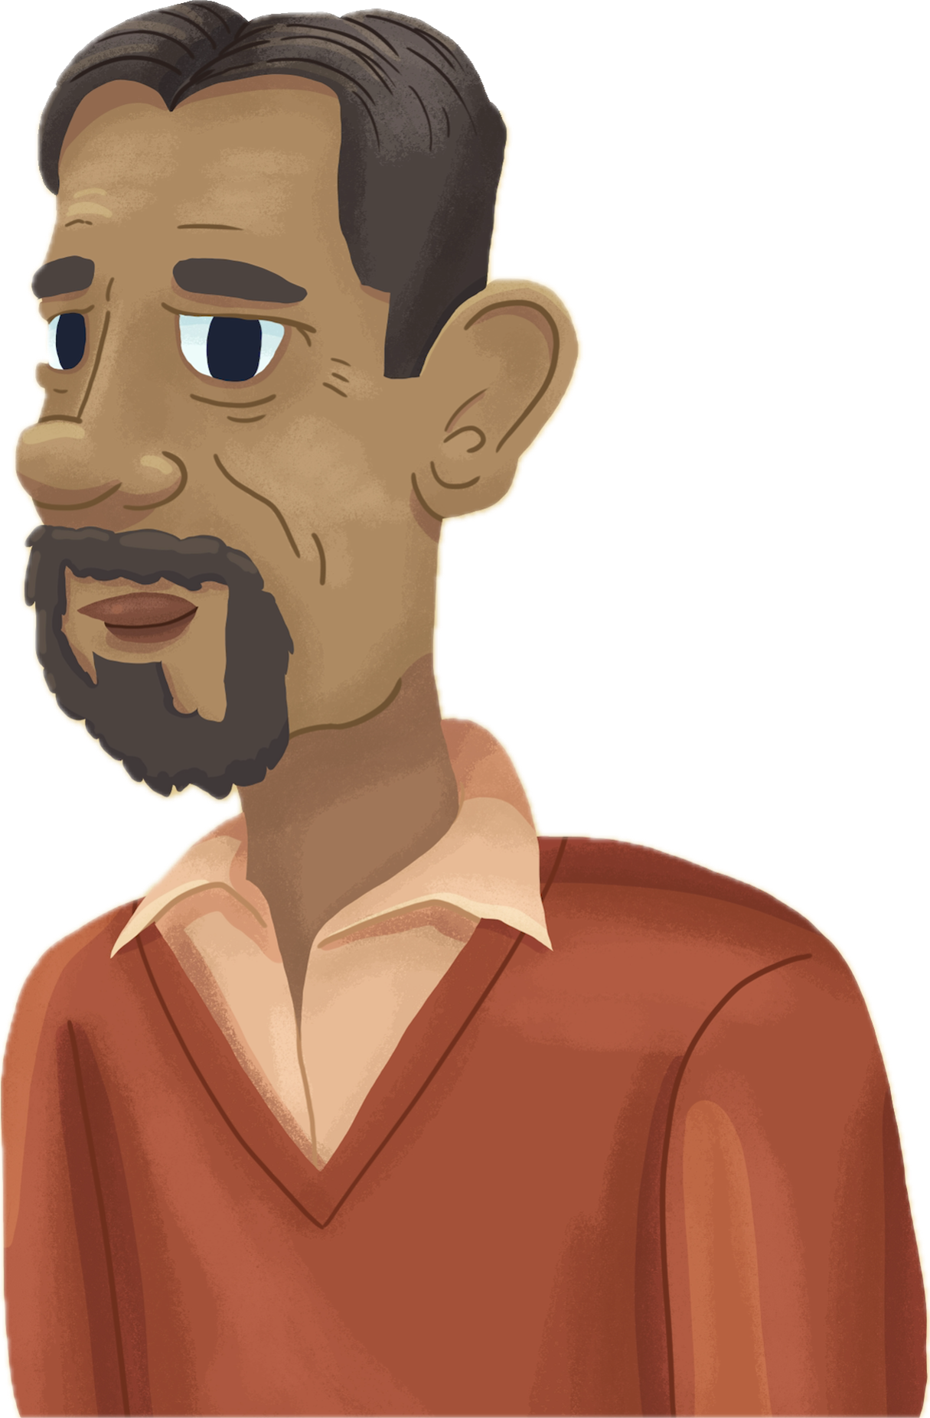
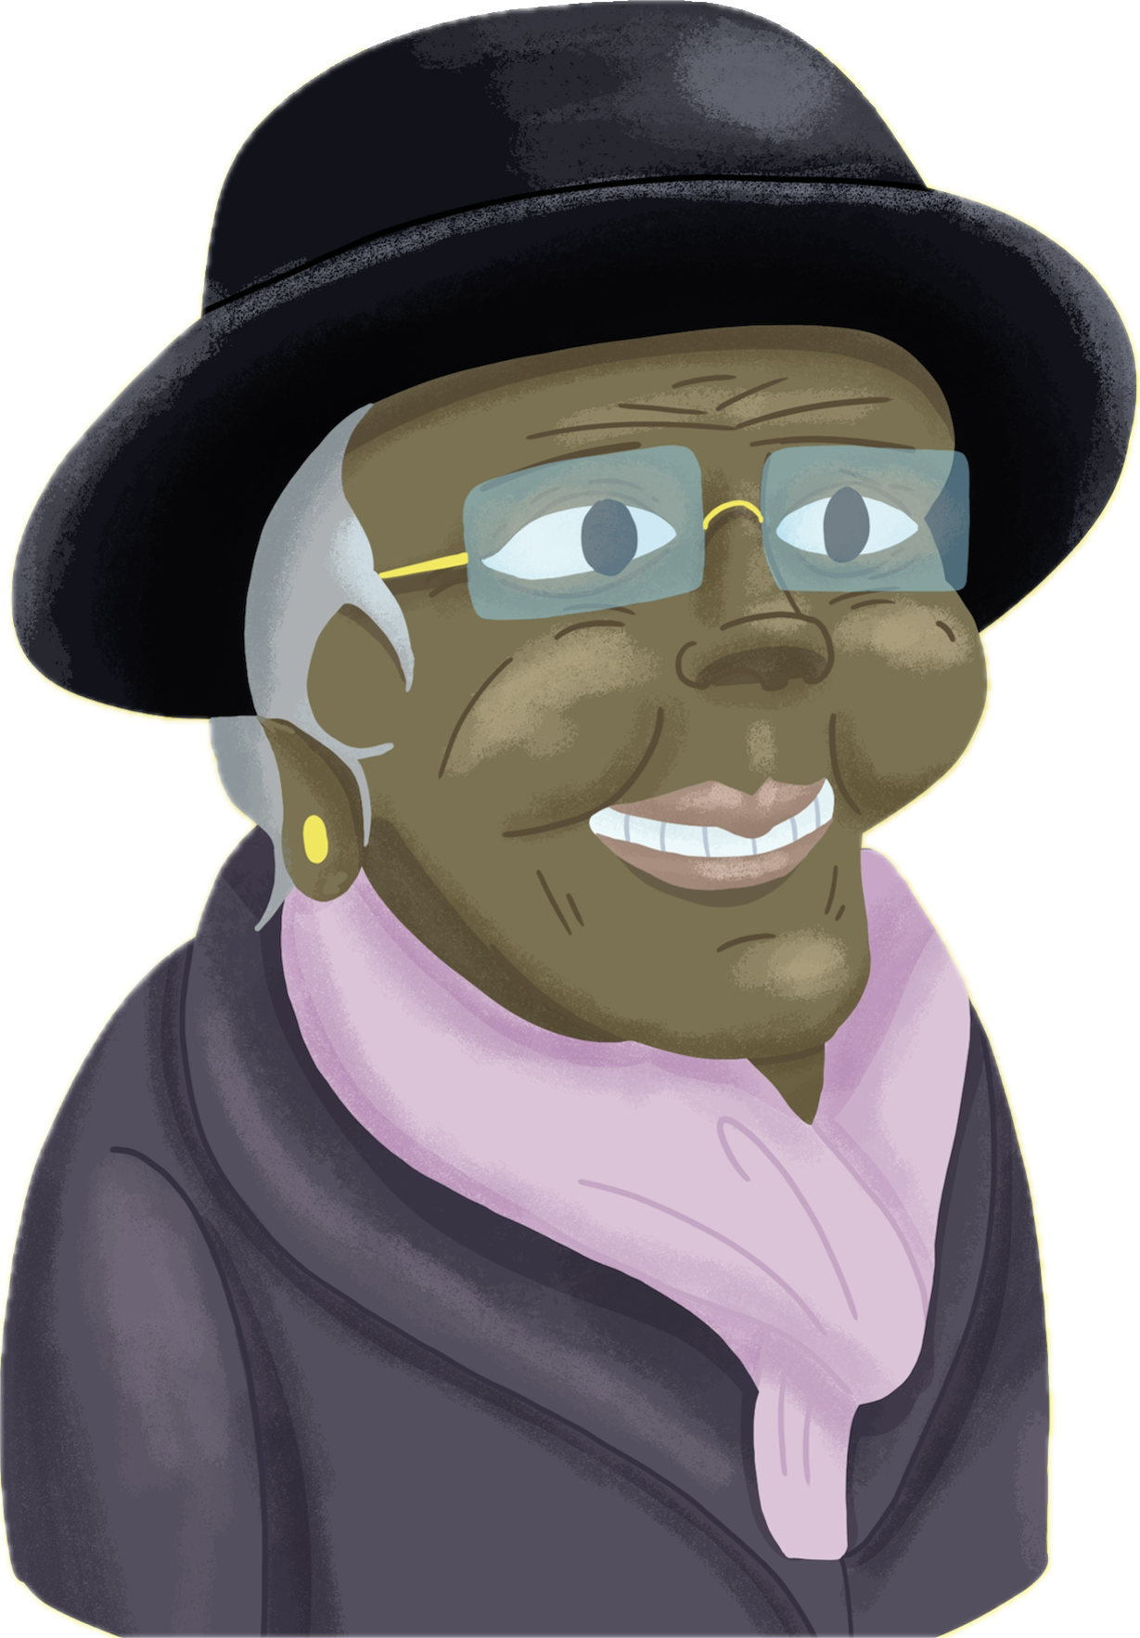

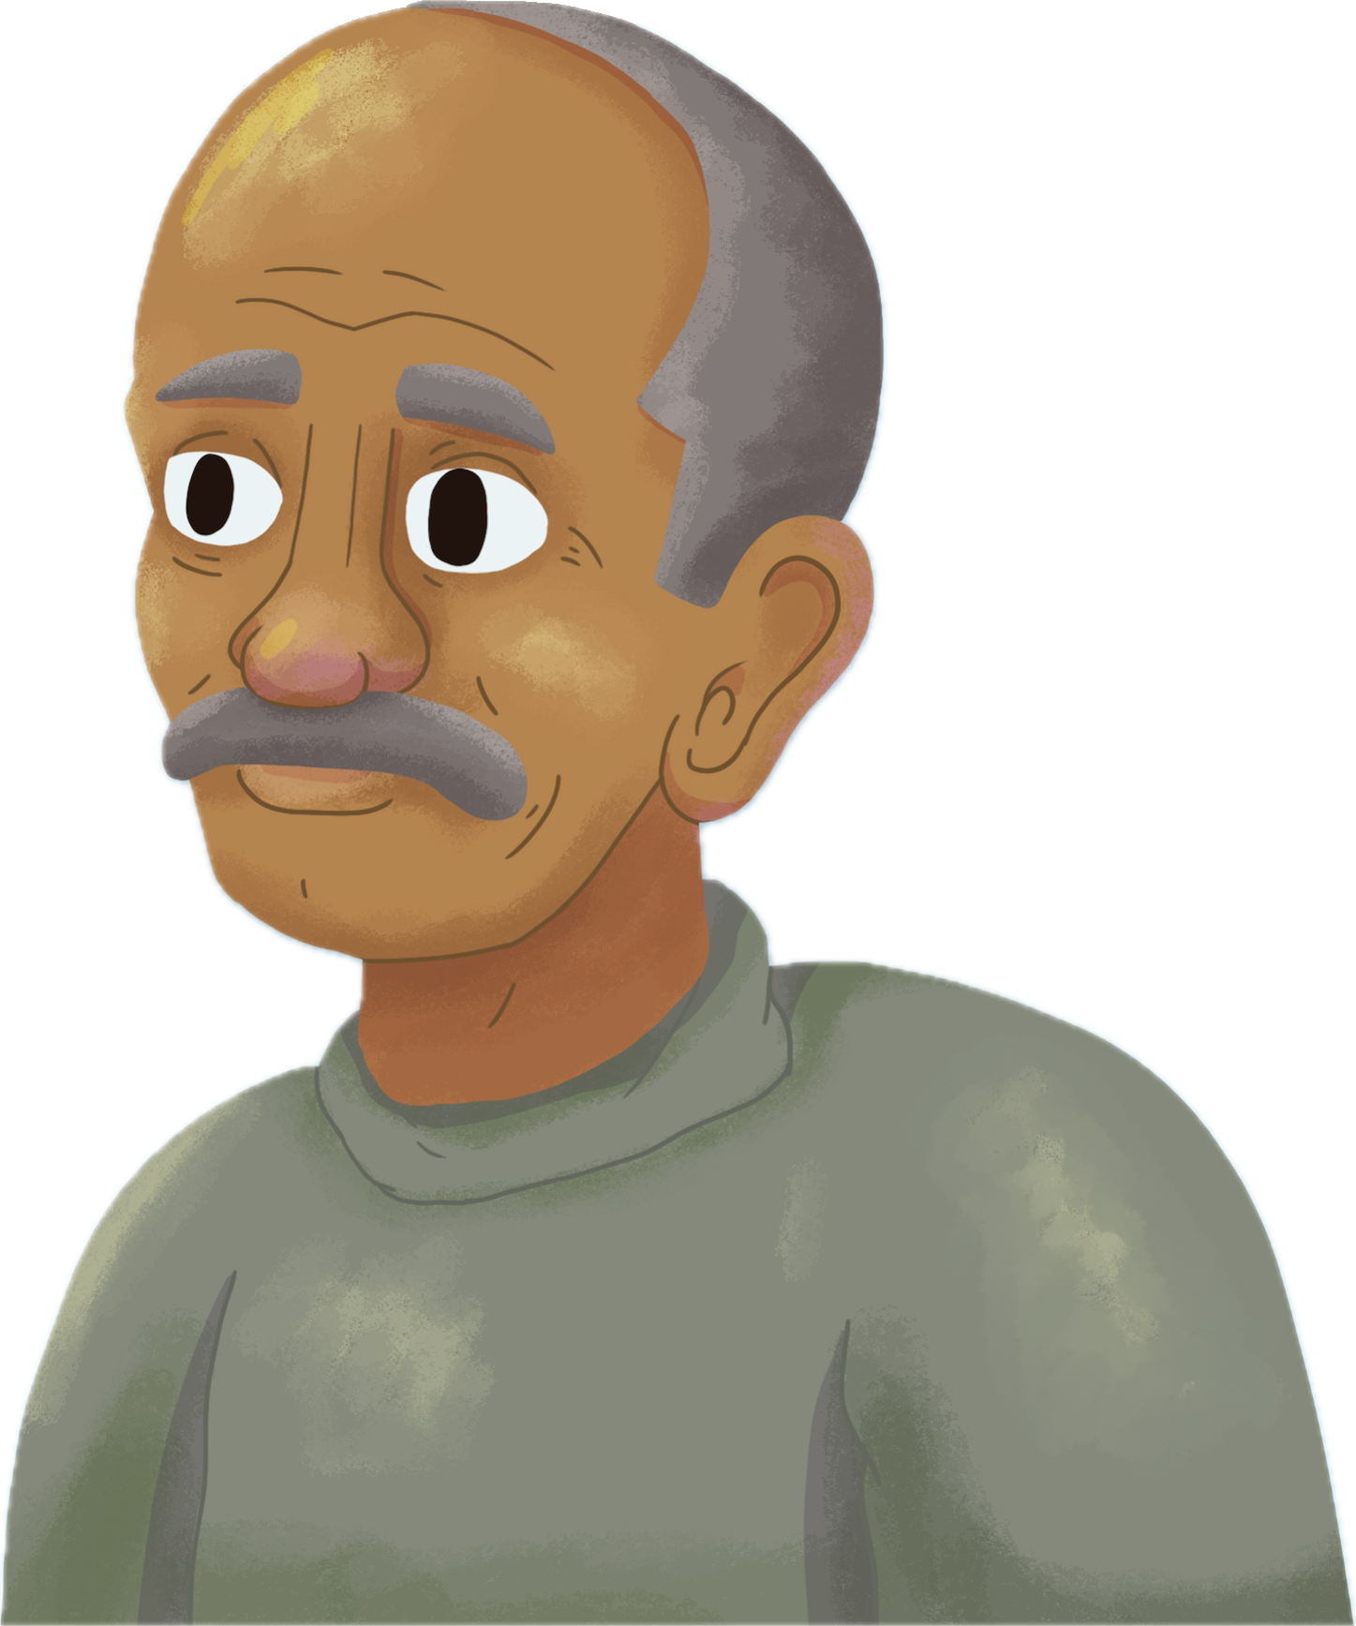
Jigsaw: Innovators of Digital Communication
In groups, read a one-page profile of
a digital communication innovator.
Discuss:
  What problem did they solve?
  How did their work improve communication?
  How did their work reduce errors or data loss?
Notes:
Explain: Today’s innovators solved problems like reliable long-distance transmission, data storage, and encoding information.

Slide 23
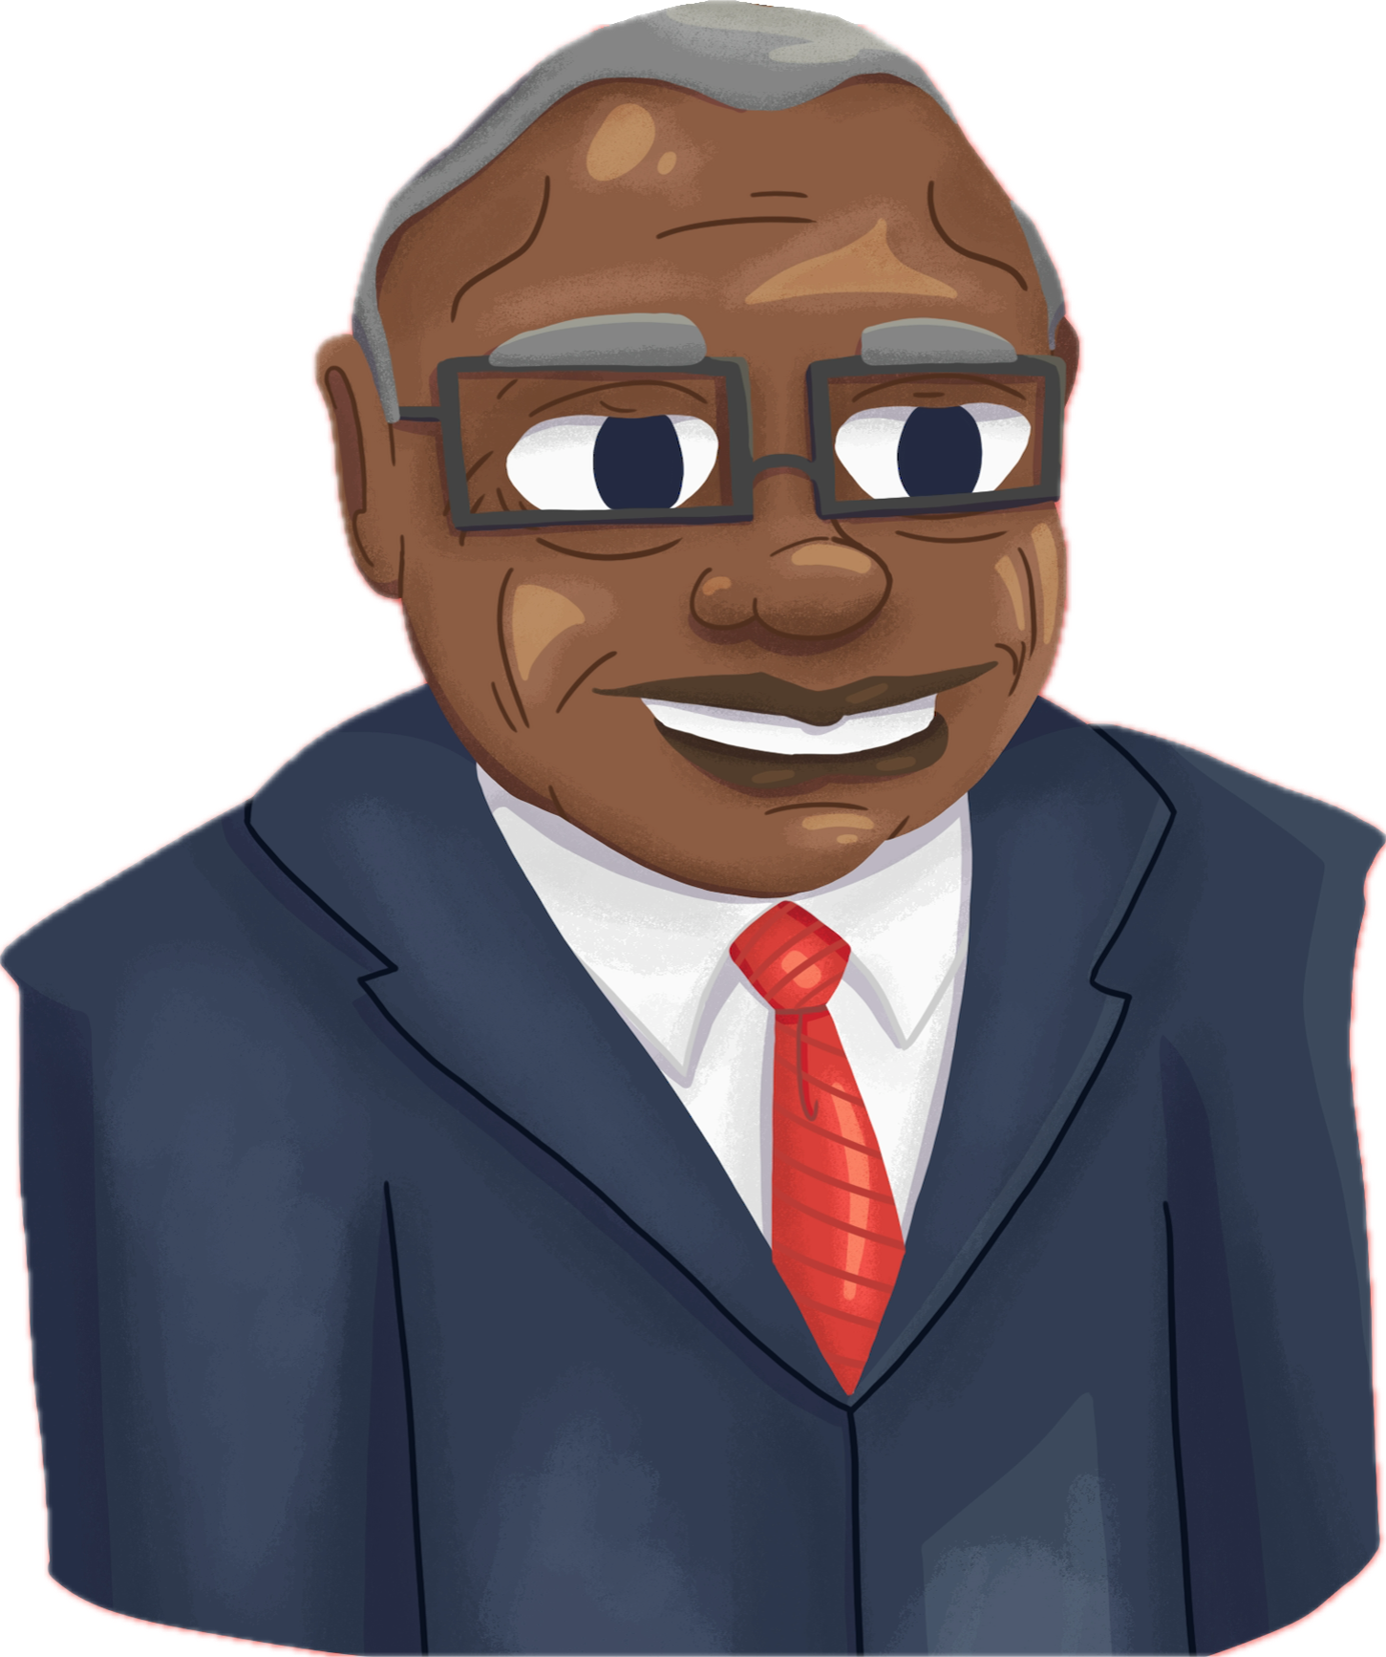



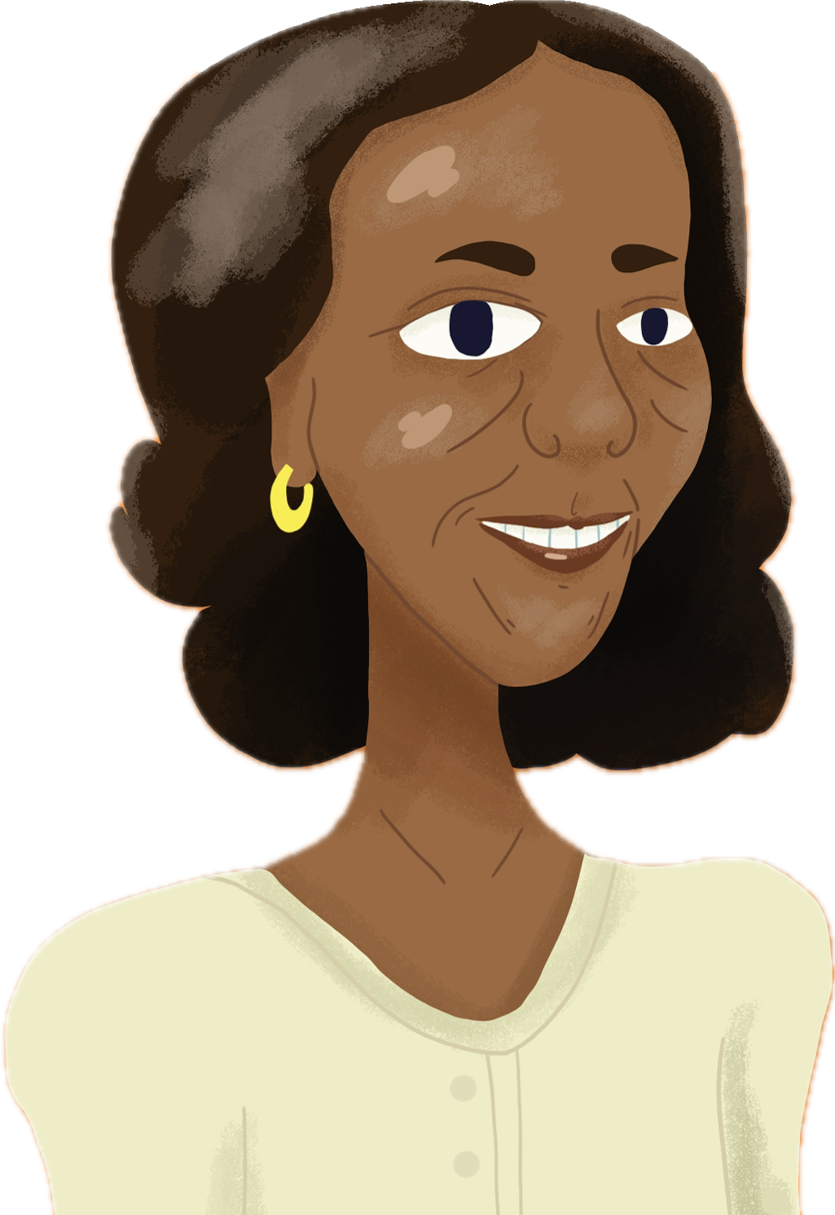
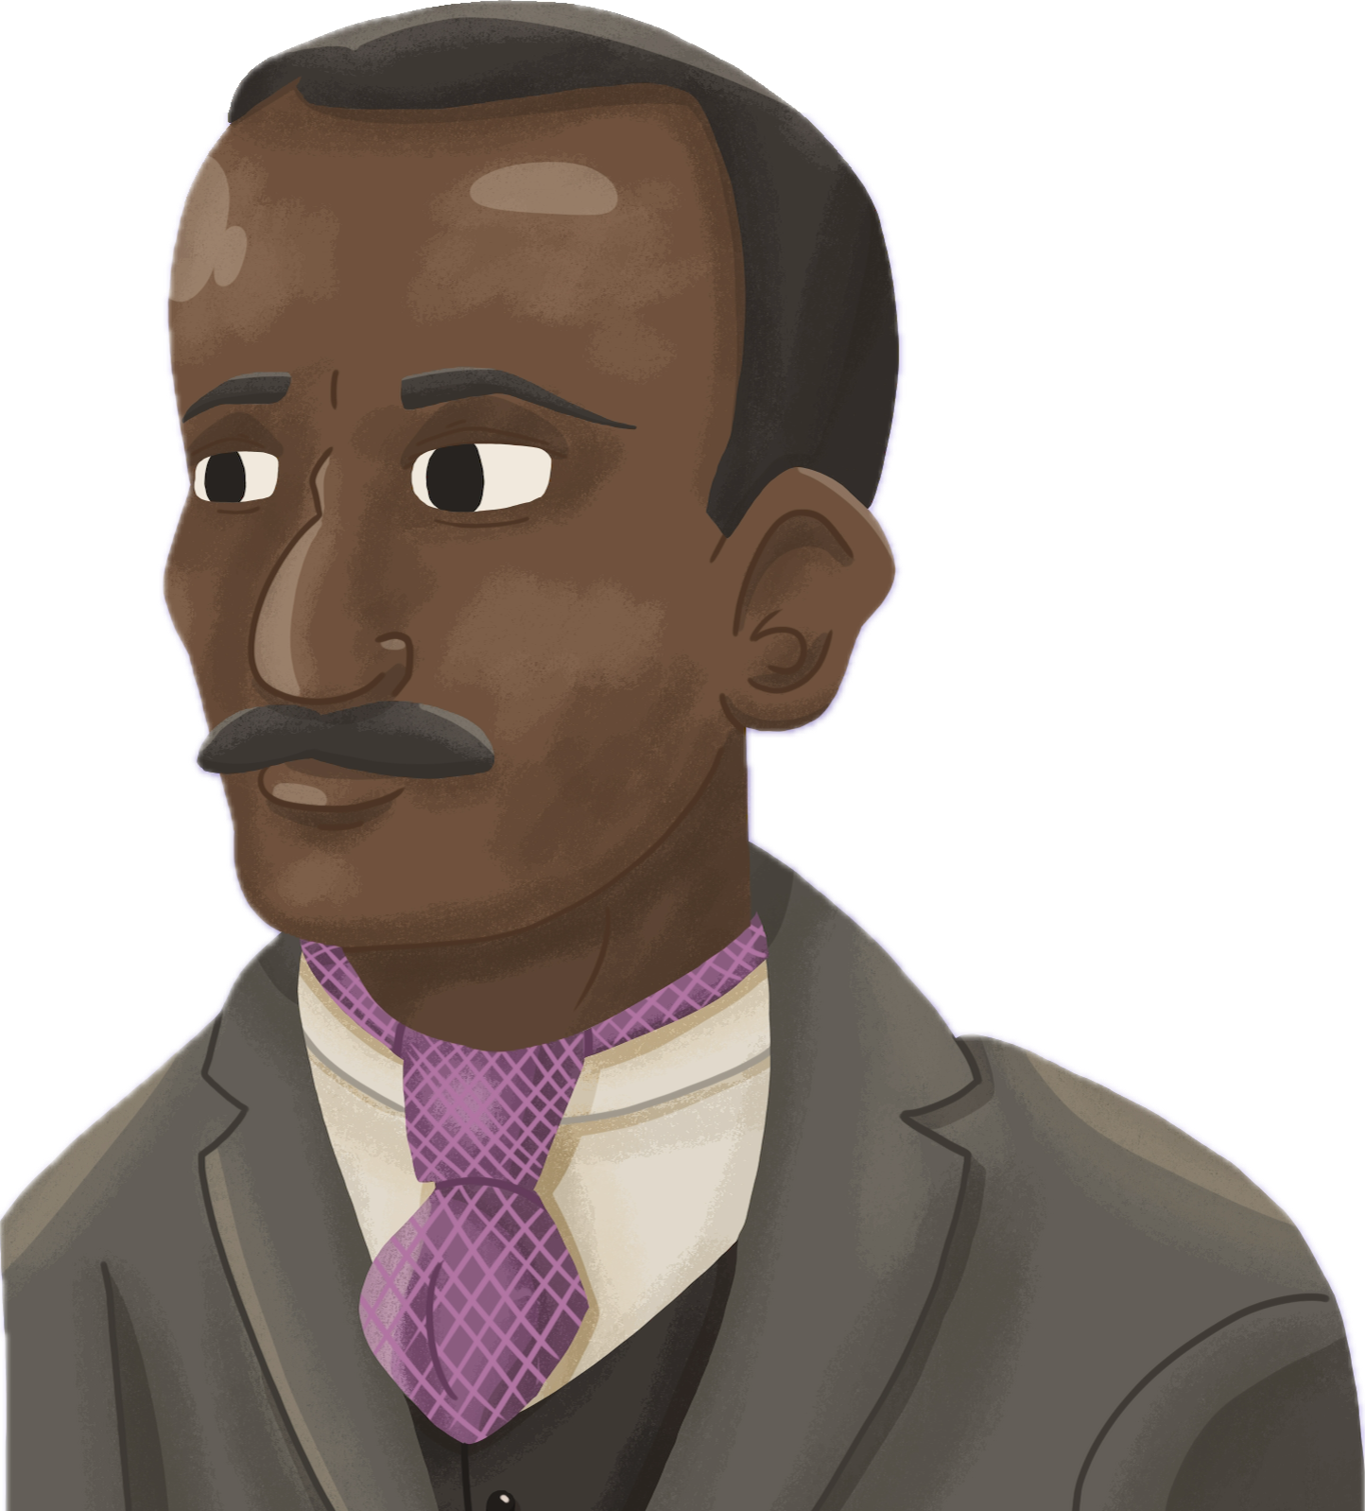
Jigsaw: Innovators of Digital Communication
Step 1: Read and discuss (10 minutes)
Step 2: Regroup and teach your innovator to others
(10 minutes)
Step 3: Share out and build a class chart together.
Notes:
Explain: Today’s innovators solved problems like reliable long-distance transmission, data storage, and encoding information.

Slide 24
Team Design Challenge: Digital Communication Tool
In teams, act as IT Applications Analysts.
Design a digital communication tool for a specific community (elders, multilingual families, after-school programs, etc.)

Slide 25
Team Design Challenge: Digital Communication Tool
Must Include:
A tool concept (app, SMS system, voice service, etc.)
Clear use of digital signals.
Where information is stored and the benefits and risks of digital storage.
At least one feature inspired by a jigsaw innovator.

Slide 26
Team Design Challenge: Digital Communication Tool
You have 15 minutes to design!
Each team will receive 2 minutes to pitch how it’s tool improves reliable communication.

Slide 27

Exit Ticket
Using the Exit Ticket questions provided on the handout, answer three of the six questions provided.
Notes:
https://learn.k20center.ou.edu/strategy/125

