Slide 2
Drought and the Dust Bowl
Climate, Ecosystems, and Human Impacts
Notes:
Engage:Students identify patterns in weather data over time in Oklahoma. They make predictions about what weather, biological, and human impacts contributed to the Dust Bowl.
Explore:Students view period art to understand the ecosystem and cultural effects of the Dust Bowl. They then investigate the interaction of wind, soil, and plants as ecological factors which contributed to the Dust Bowl in Oklahoma.
Explain:Students construct concept maps to explain how interactions among climate, human agriculture, and ecosystem features contributed to the Dust Bowl.
Extend:Students watch clips from "Interstellar" and create new concept maps to predict/explain what ecosystem interactions led to the movie's catastrophic dust storms.
Evaluate:Using evidence collected during the lesson, students evaluate the claim that soil conservation practices were exclusively responsible for preventing another Dust Bowl event during the drought of the 1950s.

Slide 3
Essential Question
What factors led to the Dust Bowl, and how was this event documented through the arts and science?

Slide 4
Notes:
Students identify patterns in weather data over time in Oklahoma. They make predictions about what weather, biological, and human impacts contributed to the Dust Bowl.

Slide 5
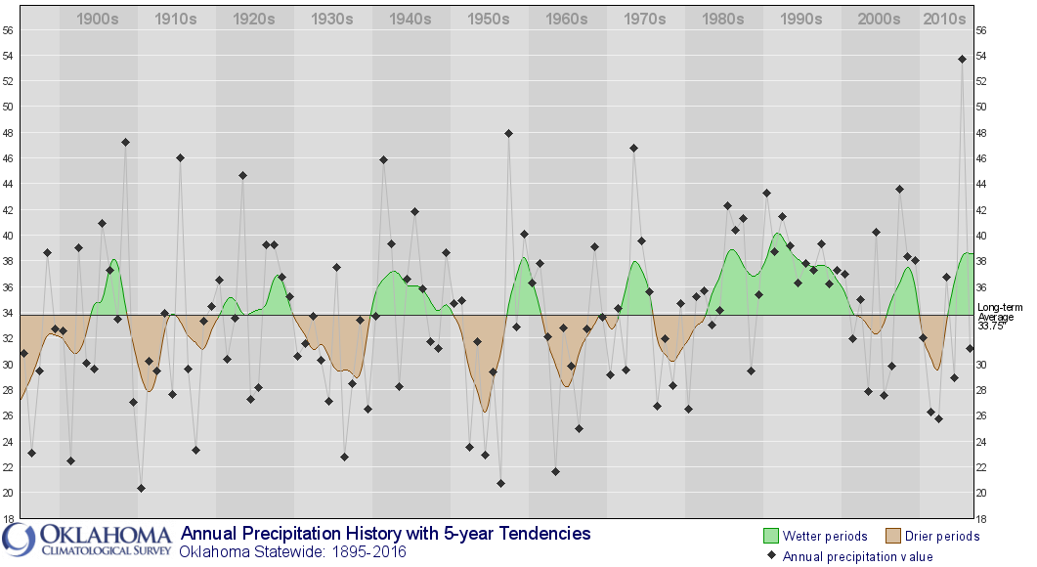
Notes:
https://www.mesonet.org/index.php/earthstorm/bellringer/oklahoma_rain
A few trends students might observe in the individual maps include,
"Record high" average temperature in 2012
Extremely dry periods are much drier (larger magnitude) than wetter periods are wet.
Since the 1980s Oklahoma has been, on average, wetter and wet for longer than in previous graph history.

Slide 6
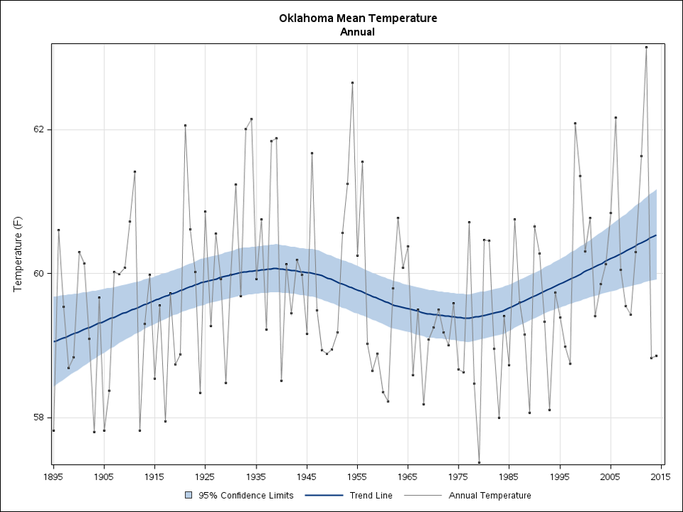
Notes:
https://www.ncdc.noaa.gov/temp-and-precip/state-temps/
A few trends students might observe in the individual maps include
Consistently increasing temperatures since mid-1990s.
Notable above average temperatures in the 1920s, 1950s, and mid-late 1990s.
"Record high" average temperature in 2012.
Some possible comparative data trends might include
The most severe dry periods tend to be the hottest periods.
The dry period in the 1950s was worse (more dry) than the period in the 1930s.
Precipitation amounts vary among data sources, but the temperature values are consistent among graphs.

Slide 7
Notes:
https://www.ars.usda.gov/ARSUserFiles/30700510/CliVarOK05.pdf
A few trends students might observe in the individual maps include,
Consistently increasing temperatures since mid-1990s.
Notable above average temperatures in the 1920s, 1950s, and mid-late 1990s.
"Record high" average temperature in 2012 (Students may recall this as a severely hot spring and summer.)
Extremely dry periods are much drier (larger magnitude) than wetter periods are wet.
Since the 1980s Oklahoma has been, on average, wetter and wet for longer than in previous graph history.
Some possible comparative data trends might include,
The most severe dry periods tend to be the hottest periods.
The dry period in the 1950s was worse (more dry) than the period in the 1930s.
Precipitation amounts vary among data sources, but the temperature values are consistent among graphs.

Slide 8
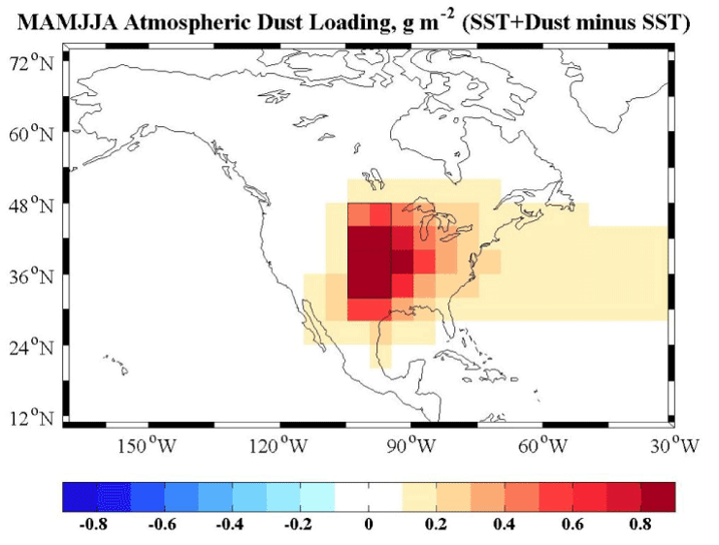
1932-1936
Notes:
http://www.giss.nasa.gov/research/briefs/cook_01/
At this point provide students with the NASA Atmospheric Dust Loading map (1932-1936).
Ask them how it connects to the temperature and precipitation data. When they have noticed that the extremely high dust concentration over the middle of the USA coincides with the extremely hot, dry period in the 1930s, explain/confirm their hunch that these are data from the Dust Bowl.

Slide 9
The Dust Bowl
For each prompt, make a claim and justify it.
What factors caused the Dust Bowl?
How was the Dust Bowl historically documented (e.g., how did people make a record of the event)?
Notes:
If student knowledge on the topic is limited, at this point they only need to know what the Dust Bowl was. If their prior knowledge extends to the causes of the Dust Bowl, simply accept their ideas without confirming or denying them. Wrap up by asking students to make and justify claims for each of the following prompts:
What factors caused the Dust Bowl?
How was the Dust Bowl historically documented (e.g., how did people make a record of the event)?

Slide 10
Notes:
Students view period art to understand the ecosystem and cultural effects of the Dust Bowl. They then investigate the interaction of wind, soil, and plants as ecological factors which contributed to the Dust Bowl in Oklahoma.

Slide 11
Exploring Art

Slide 12
The Dust Bowl in Art and Media
Explore the pictures, newspaper articles, literature, poems, and music about the Dust Bowl.
For each source, write down anything you observe or infer about the ecosystem, how people described the ecosystem, and the ways people interacted with the ecosystem.
Notes:
Students will explore various media to develop a) hypotheses about the ecosystem effects of the Dust Bowl, and b) an understanding of how the events of the Dust Bowl were documented in media arts. Be sure that students get to observe 3-4 art sources during your allotted time (about 10+ minutes per source). While students are engaging with the various media, they should record two different sets of observations: a) what they notice about the ecosystem described or shown in the media, and b) the ways people discussed or interacted with their environment.

Slide 13
Exploring Science

Slide 14
The Dust Bowl
What environmental factors contributed to the high dust content shown in the media you explored?
Notes:
Referring back to the NOAA Atmospheric Dust Loading data and media, guide students as a class or in small groups to develop a list of factors which contribute to the high dust content and environment they observed in the images. Help students emphasize the lack of plants in the images and the wind required to generate blowing dust. Using this as a jumping off point, students will investigate the effects of wind and plants on soil stability in groups.

Slide 15
Environmental Factors in the Dust Bowl
INSERT YOUR CLASS-SPECIFIC INVESTIGATION INSTRUCTIONS HERE
REMOVE/DUPLICATE THE SLIDE IF NECESSARY
Notes:
Referring back to the NOAA Atmospheric Dust Loading data and media, guide students as a class or in small groups to develop a list of factors contributing to the high dust content and environment they observed in the images. Help students emphasize the lack of plants in the images and the wind required to generate blowing dust. Using this as a jumping off point, students will investigate in groups the effects of wind and plants on soil stability.

Slide 16
Environmental Factors in the Dust Bowl
INSERT YOUR CLASS-SPECIFIC INVESTIGATION INSTRUCTIONS HERE
REMOVE/DUPLICATE THE SLIDE IF NECESSARY

Slide 17
Environmental Factors in the Dust Bowl
INSERT YOUR CLASS-SPECIFIC INVESTIGATION INSTRUCTIONS HERE
REMOVE/DUPLICATE THE SLIDE IF NECESSARY

Slide 18
Exploring Agriculture

Slide 19
Agricultural Factors in the Dust Bowl
INSERT YOUR CLASS-SPECIFIC AGRICULTURAL PRACTICE INFORMATION HERE
REMOVE/DUPLICATE THE SLIDE IF NECESSARY
Notes:
Emphasis at this point in the lesson is in making connections between the agriculture and its effects on the Southern Great Plains ecosystem. The clips noted above are highly descriptive without implicating agriculture as an explicit cause of the Dust Bowl. Students should add to their observation sheet, taking careful note of why some farmers and ranchers objected to The Great Plow Up, and how they described the native ecosystem and agricultural landscapes.

Slide 20
Agricultural Factors in the Dust Bowl
INSERT YOUR CLASS-SPECIFIC AGRICULTURAL PRACTICE INFORMATION HERE
REMOVE/DUPLICATE THE SLIDE IF NECESSARY

Slide 21
Agricultural Factors in the Dust Bowl
INSERT YOUR CLASS-SPECIFIC AGRICULTURAL PRACTICE INFORMATION HERE
REMOVE/DUPLICATE THE SLIDE IF NECESSARY

Slide 22
Notes:
Students construct concept maps to explain how interactions among climate, human agriculture, and ecosystem features contributed to the Dust Bowl.

Slide 23
What concepts have we addressed so far?
Notes:
Students will create Concept Card Maps to help synthesize their understanding around the ideas they've developed from the art, science, and agricultural explorations. To generate a collection of concepts, remind students what activities they have done to this point and ask them to detail what they learned or explored in each.

Slide 24
Concept Maps: The Story of the Dust Bowl
Create a concept map that “tells the story” of the Dust Bowl.
Use evidence from your explorations to decide what concepts are connected.
Draw lines between these concepts.
Label each line with a short description of the relationship
Notes:
Using the class set of concepts, have students create concept maps which, "Tell the story of the Dust Bowl." This activity can be successfully executed in student groups of 3-4, using sticky notes and chart paper. Regardless of the group size, have students explain how they constructed their concept maps to another student group. These discussions should include explanations of what art and science evidence students used and how they used it to put their concepts together. Use these discussions as an opportunity to correct misinformed student conceptions.

Slide 25
Concept Maps: The Story of the Dust Bowl
Pair up with another group
Share your Dust Bowl story by explaining your concept map to the other group
Be sure to describe how you used evidence to make your connections
Notes:
Regardless of the group size, have students explain how they constructed their concept maps to another student group. These discussions should include explanations of what art and science evidence students used and how they used it to put their concepts together. Use these discussions as an opportunity to correct misinformed student conceptions.
From here, students should also come to understand the changes in agricultural practices focused on soil conservation in response to the Dust Bowl. Ken Burns’ clips are suggested below to help provide information, but this would be an excellent opportunity to include the local community (e.g., farmers, 4-H resources) to teach students about sustainable farming practices.

Slide 26
A Simple Explanation
Create an “equation” for what you think caused the Dust Bowl.
You can use one of these formats or make your own:
_____ + _____ + _____ = Dust Bowl
_____ (x or +) _____ (x or +) _____ = Dust Bowl
_____ x (_____ + _____) + _____ = Dust Bowl
Notes:
This mathematical representation should include factors students observed in the data, investigations, and discussions, but does not have to include actual numbers.
For example, "Over-plowing + Drought + Wind = Dust Bowl" or "Wind x (High Temperature + Low Rain) + Agricultural Practices = Dust Bowl" would both be accurate equations.
The point is not complexity, but to have students intentionally synthesize their learning into a summary.

Slide 27
Notes:
Students watch clips from Interstellar and create new concept maps to predict/explain what ecosystem interactions led to the movie's catastrophic dust storms.

Slide 28
Interstellar Concept Map
Which concepts from our original list were not in the Interstellar clips we watched?
What concepts from Interstellar were not on our original list?
Notes:
In the movie Interstellar, Earth experiences events which parallel the Dust Bowl. Using clips of Interstellar as a point of comparison, students will create new concept maps to predict the reasons for the dust storms in the movie. Use the following three clips (listed as times) to develop modified concepts:
2:40-3:30 (death of wheat/crops)
17:10-19:40 (dust storm)
27:57-29:15 (scientific and social context)

Slide 29
Interstellar Concept Map
Create a new concept map using our revised concept list to explain why dust storms occur in Interstellar.
Use evidence from the movie clips and what you know about the causes of the Dust Bowl to develop the connections among your concepts.
Notes:
Have students review their Dust Bowl concept lists to remove factors that don't apply to Interstellar and add new factors which do. For example, "blight" would be a new concept for the movie which did not come up in their Dust Bowl list. Following the creation of the new concept maps, have student groups share with one another, or the entire class, as was done in the Explain portion.
“Based on what we are told/observe/infer about local environmental conditions in Interstellar, and based on what we know about the causes of the real-world Dust Bowl in the 1930s, why are there dust storms occurring in Interstellar?”

Slide 30
Notes:
Using evidence collected during the lesson, students evaluate the claim that soil conservation practices were exclusively responsible for preventing another Dust Bowl event during the drought of the 1950s.

Slide 31
Evaluating a Claim
Write a CER to explain why you agree or disagree with the following statement:
The use of soil conservation practices is the only reason the severe drought in the 1950s did not produce another Dust Bowl event.
You should use a variety of evidence from all the sources we’ve covered during this lesson.
Notes:
To conclude the lesson, students will circle back to their climate graphs from the Engage. If they did not make the connection before, help students identify the drought of the 1950s on the temperature and precipitation graphs. Students will evaluate the claim below, supporting their support or rejection of it using all the evidence they have collected over the course of the lesson. (See Attachments for scoring rubric.) Evidence sources include:
Observations from art
Observations and data from grass investigation
Observations from Ken Burns’ clips
Dust Bowl and Interstellar concept maps

