Slide 1
Does My Vote Count?
The Electoral College

Slide 2
Guiding Questions
Does my vote count in Presidential elections?
How does the Electoral College affect voting in the US?

Slide 3
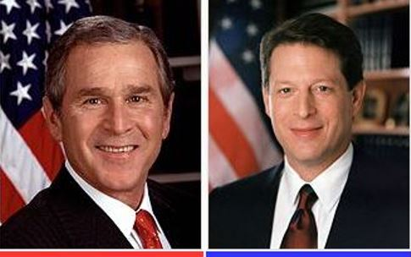
Who won the 2000 Presidential election?
George W. Bush Republican VP- Dick Cheney Popular Vote: 50,456,002 Percentage: 47.9% | Al Gore Democrat VP-Joe Lieberman Popular Vote: 50,999,897 Percentage: 48.4%

Slide 4
Who won the 2000 Presidential election?
Why did George Bush win and not Al Gore?
George W. Bush Republican VP- Dick Cheney Popular Vote: 50,456,002 Percentage: 47.9% | Al Gore Democrat VP-Joe Lieberman Popular Vote: 50,999,897 Percentage: 48.4%

Slide 5
Watch the following video
The Trouble with the Electoral College

Slide 6
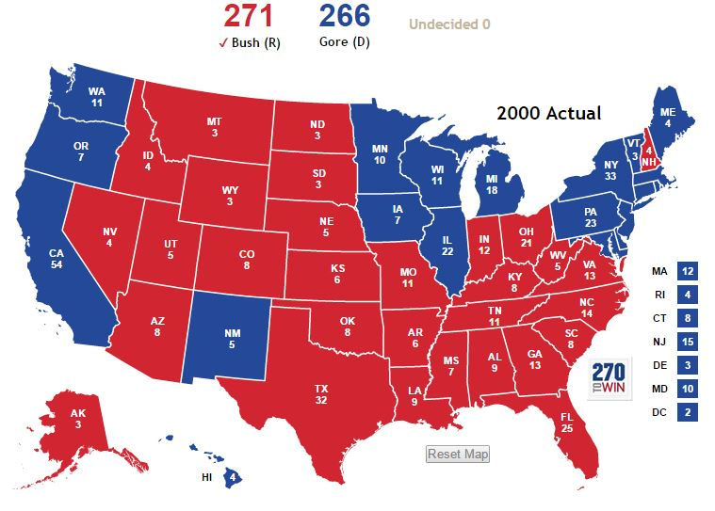
How did Gore win the popular vote but lose the presidency?
How did the Electoral College impact the 2000 election?

Slide 7
Understanding the Electoral College
Student Activity:
Place your name on the graphic organizer.
You will read one handout about the Electoral College.
Once you have completed your reading, write down 5 important facts that you think others should know from the reading.
You will write these facts under the heading on your graphic organizer that is the same as the handout you read.

Slide 8

Stop and Jot Reading Strategy
To help read your handout more easily:
Read only one or two paragraphs at a time.
Write down main ideas or phrases in the margin of what you just read.

Slide 9

Creating Group Notes
Share the 5 facts that you found in the reading with your group.
Choose which 8 facts you will share with the class from your group. You will have to decide which facts are the best.
Write down the 8 facts on Chart paper to share.
4. Decide who will each share 1 or 2 of the facts. All group members should participate.

Slide 10

Individual Writing Assignment
You are a campaign manager for your party’s presidential candidate. It is two months before the November election. Look at the electoral college map provided. You are to:
Identify how many electoral votes your candidate currently has and how many more are needed to win.
Identify states that are leaning toward your candidate and swing states that are a toss up.
Write an email to your candidate. Describe a campaigning strategy in the key states that will lead to his victory.

