Slide 2
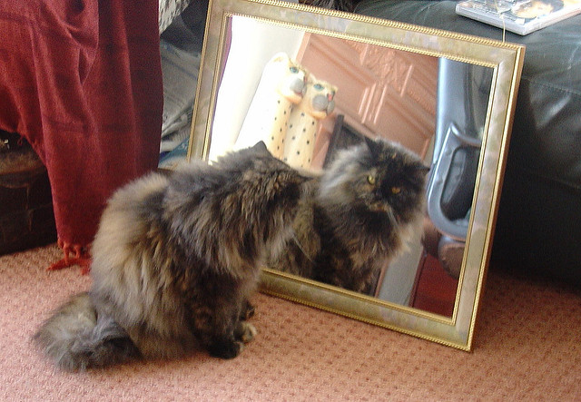

Slide 3
Imagine you are the cat looking in the mirror. Complete this sentence:
“The best part of me is ___________ because ____________.”

Slide 4
“The best part of me is ________ because ________ ... ”
it/they let me…
it/they take me…
it/they remind me…
it/they look like…
it/they help me…

Slide 5
What is the best part of me?

Slide 6
“The best part of me is ________ because ________ . . . ”
it/they let me
it/they take me
it/they remind me
it/they look like
it/they help me

Slide 8
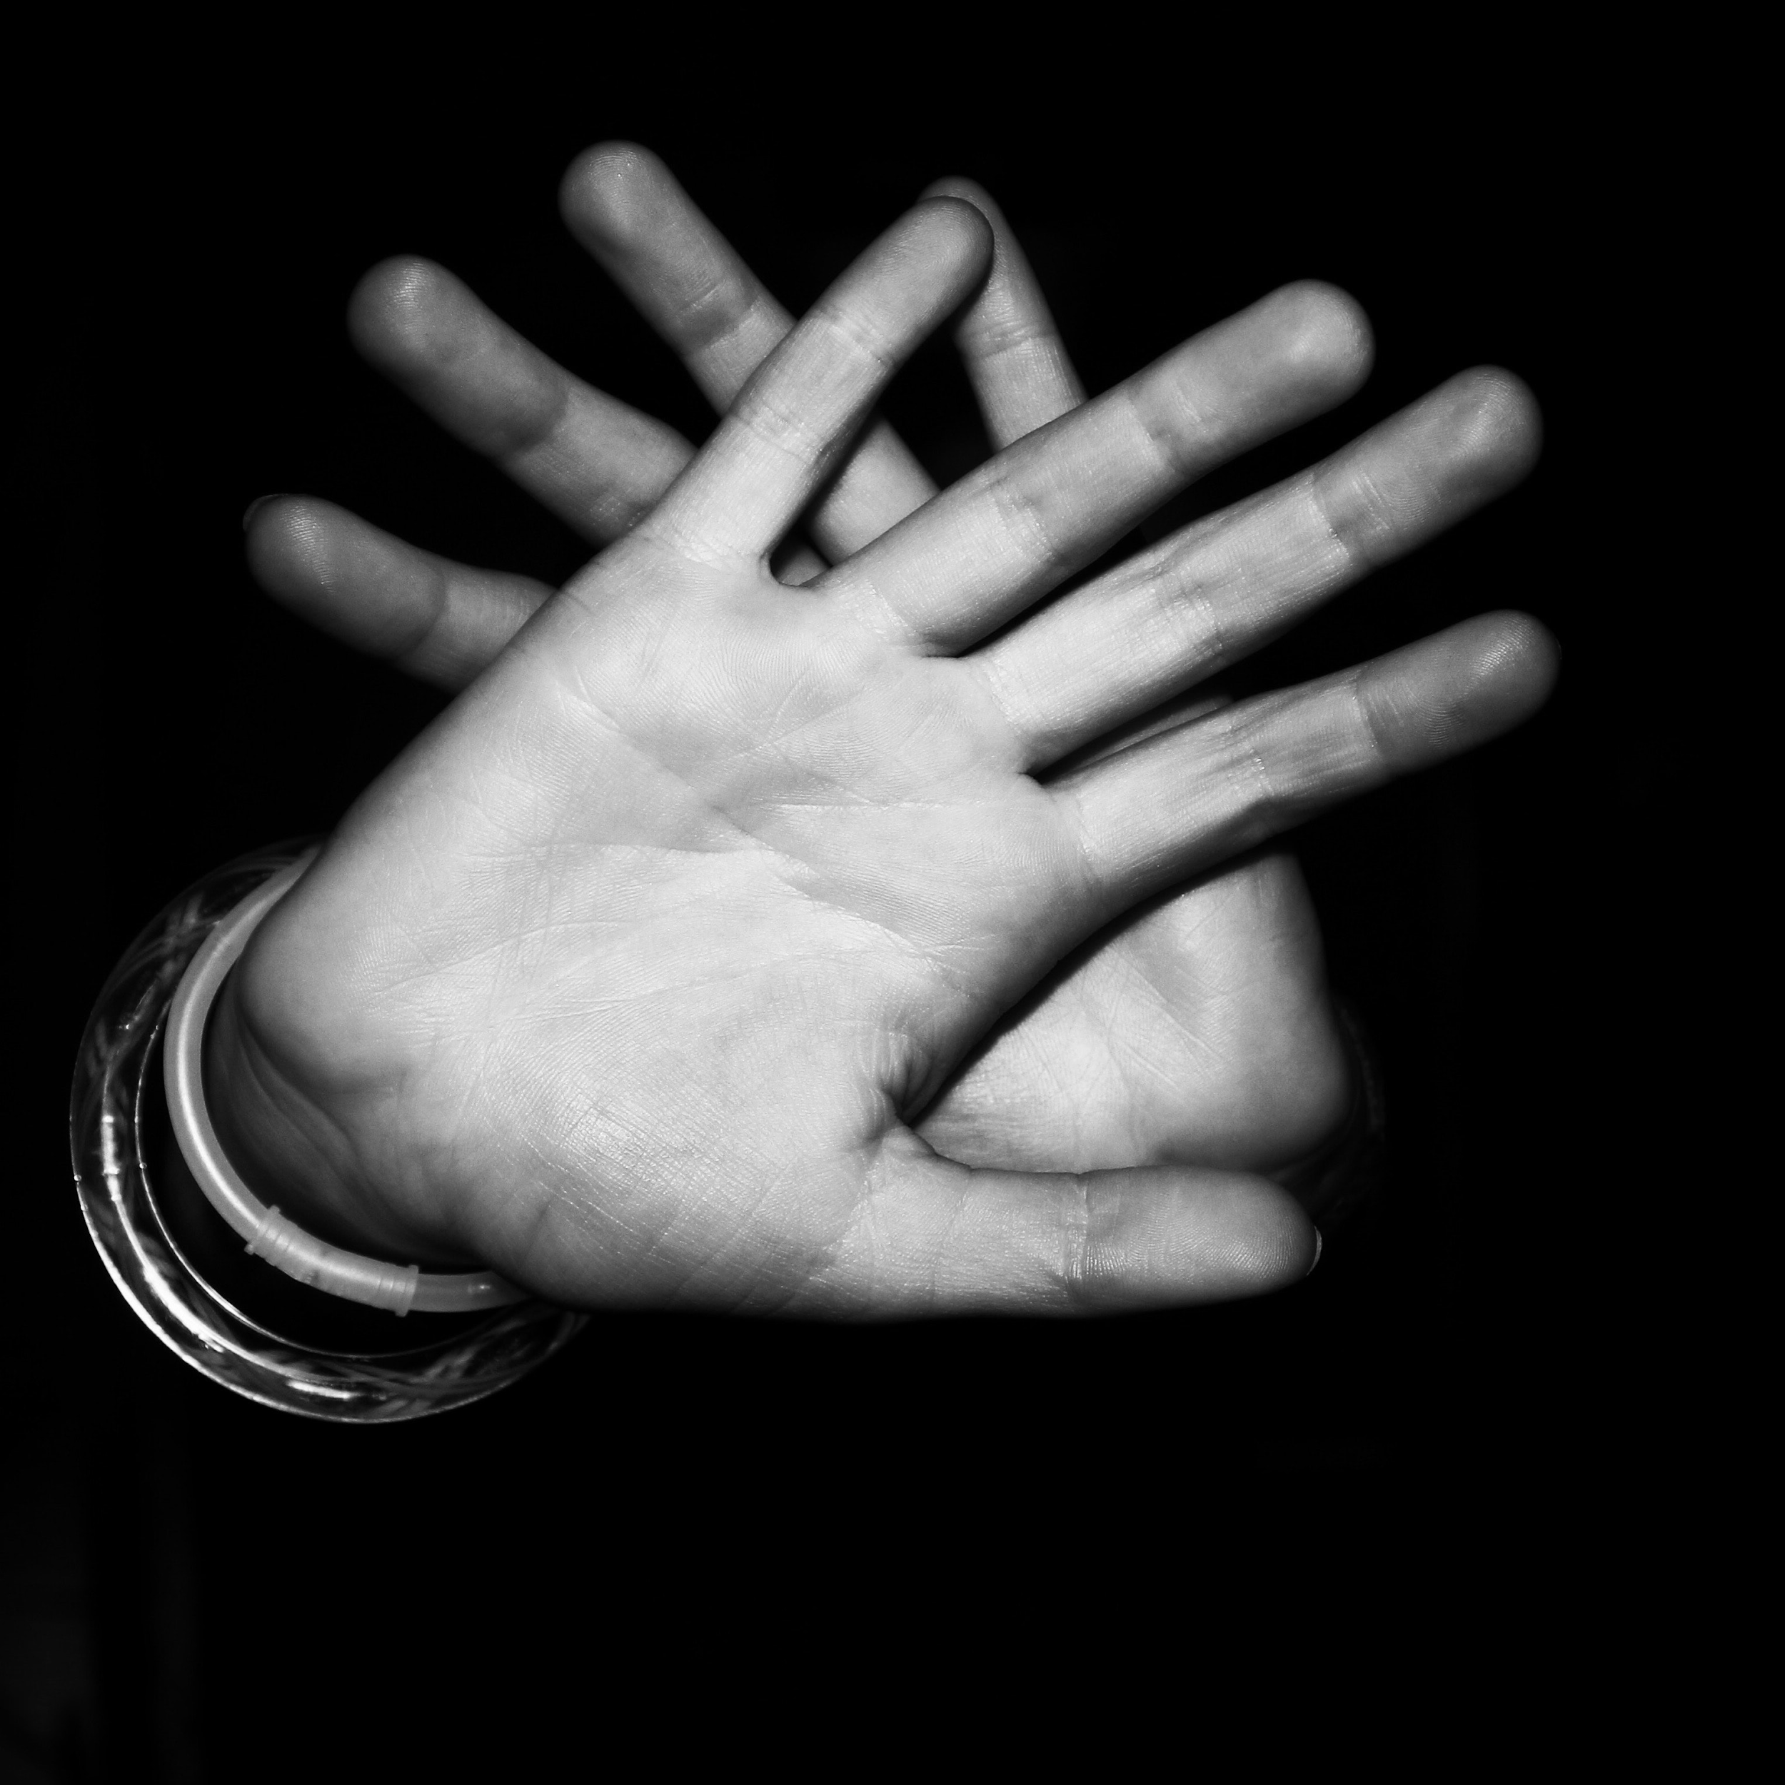
Area of Pho-cus
Crop your photo
Mount it on paper (top or bottom)

Slide 9
Area of Pho-cus Poem
What are the physical characteristics of ______________?
Use precise words and comparisons to help others visualize details:
Size, shape, form, close-up details, colors, reflectivity, textures, etc.
How does ______________ resemble an inanimate object (a plant, toy, etc.)?
In what ways does _____________ help you have fun?
In what ways does _____________ help you accomplish important things?
When you think about your ______________ what emotions do you feel?
If you want to mention one thing about ____________ that you don’t like, what is it?
In what ways does your ____________ trigger POSITIVE associations (pleasantly reminding you of people, animals, objects, places, or events)?

