Slide 2
Area of Pho-cus
Photography and Descriptive Poetry

Slide 3
Essential Question
What is the best part of me?

Slide 4
Lesson Objectives
Write a descriptive poem based on a photograph you take of your favorite personal feature.

Slide 5
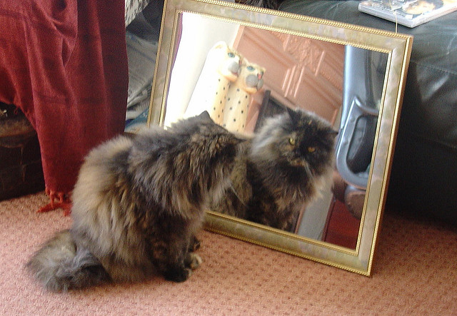

Slide 6
Imagine you are the cat looking in the mirror.
Complete this sentence:
“The best part of me is
____________because
______________.”

Slide 7
The best part of me is ________ because ________ ... ”
it/they let me…
it/they take me…
it/they remind me…
it/they look like…
it/they help me…

Slide 8
What is the best part of me?

Slide 9
Notes:
Barron, M. Best part of me read aloud. https://www.youtube.com/watch?v=Q0Sk1EAD8JY

Slide 10
Area of Pho-cus
Crop your photo
Mount it on paper (top or bottom)

Slide 11
Area of Pho-cus Poem
What are the physical characteristics of ______________?
Use precise words and comparisons to help others visualize details:
Size, shape, form, close-up details, colors, reflectivity, textures, etc.
How does ______________ resemble an inanimate object (a plant, toy, etc.)?
In what ways does _____________ help you have fun?
In what ways does _____________ help you accomplish important things?
When you think about your ______________ what emotions do you feel?
If you want to mention one thing about ____________ that you don’t like, what is it?
In what ways does your ____________ trigger POSITIVE associations (pleasantly reminding you of people, animals, objects, places, or events)?

