Slide 2
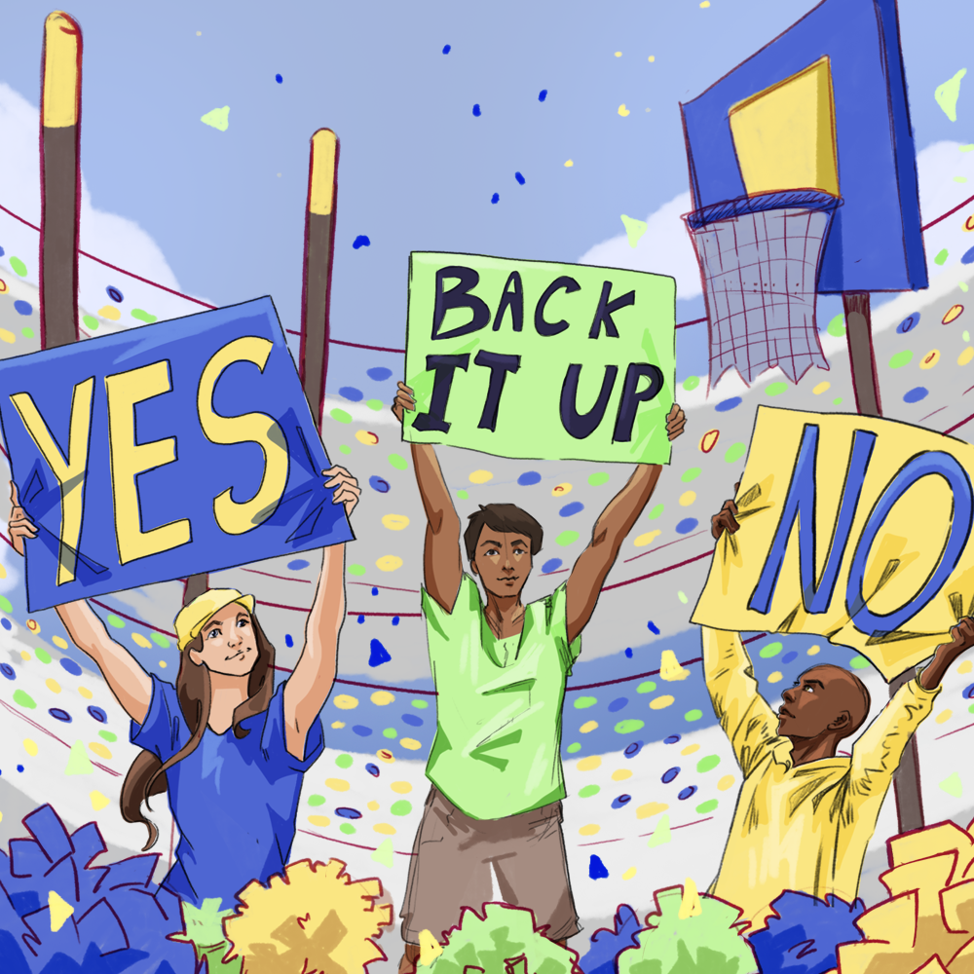
Game-Changing Writing
Persuasive Paragraphs

Slide 3
Essential Question
How can we use evidence and reasoning to convince others to agree with our ideas?

Slide 4
Learning Objectives
Identify the parts of a strong argumentative paragraph.
Write a strong argumentative paragraph.

Slide 5
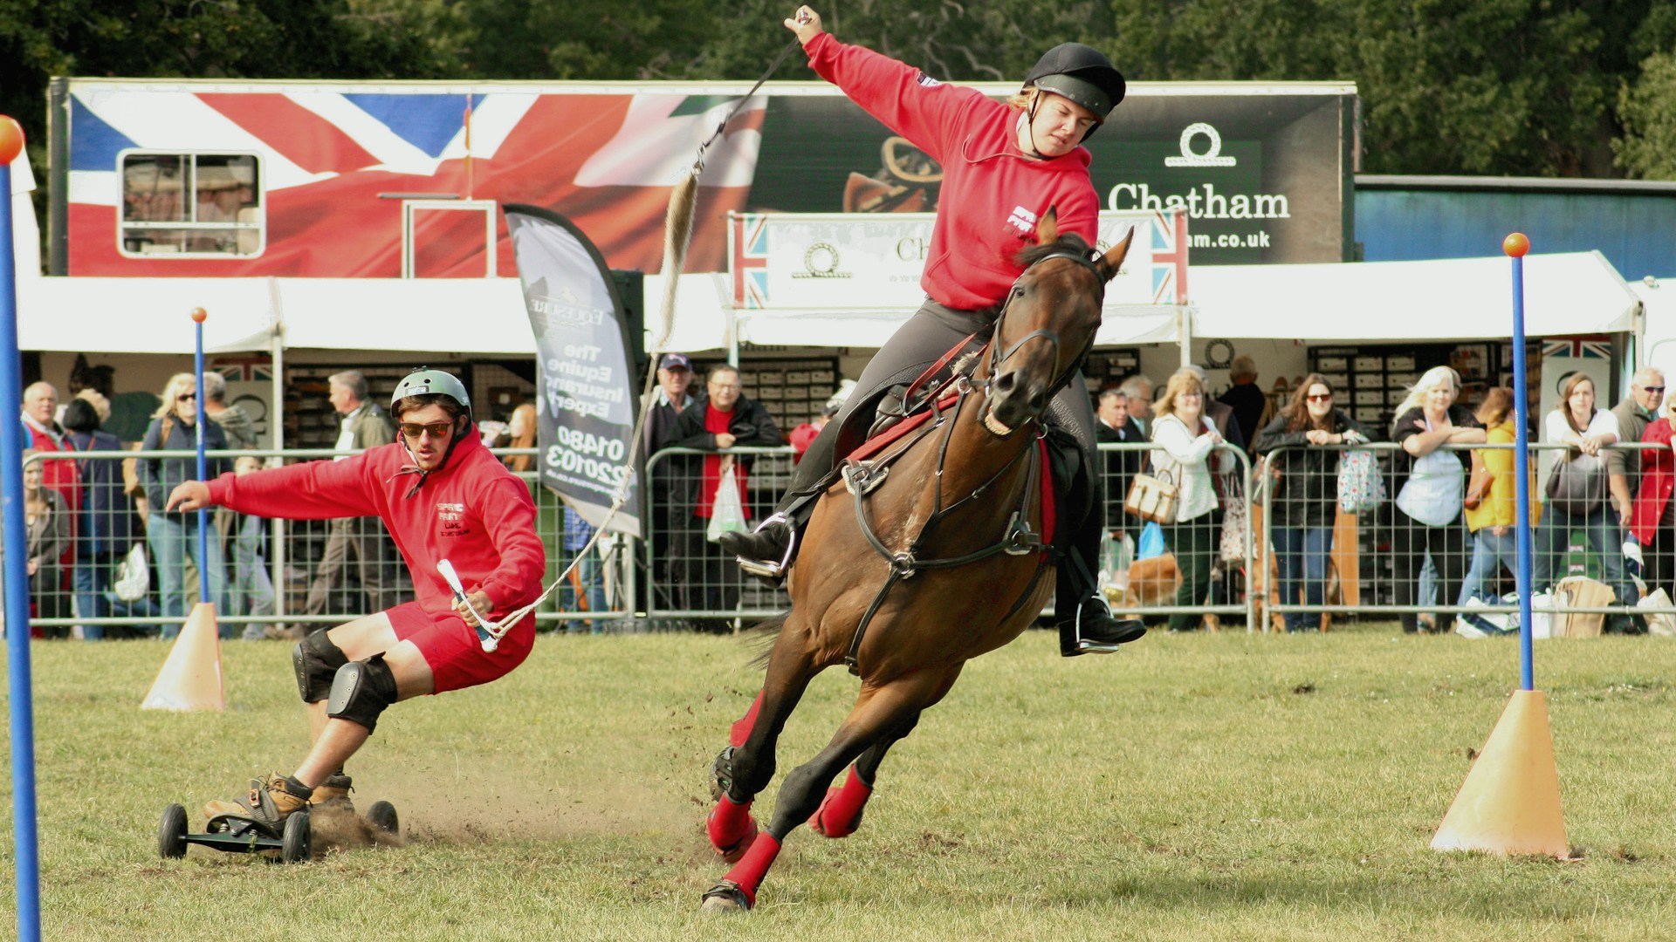
Caption It!
Part 1
Write one complete
sentence to describe the given image.
Notes:
White, D. [davidwhite50]. (2019, September 7). Horseboarding [Photograph]. Unsplash. https://unsplash.com/photos/man-wearing-red-pullover-riding-on-brown-horse-5xqYGosigVs

Slide 6
Caption It!
Part 2
Look at the image carefully.
Write a list of
adjectives describing the given image.
Notes:
White, D. [davidwhite50]. (2019, September 7). Horseboarding [Photograph]. Unsplash. https://unsplash.com/photos/man-wearing-red-pullover-riding-on-brown-horse-5xqYGosigVs

Slide 7
Caption It!
Part 3
Rewrite your original sentence using at least three adjectives from your list.
Then trade with a classmate.
Notes:
White, D. [davidwhite50]. (2019, September 7). Horseboarding [Photograph]. Unsplash. https://unsplash.com/photos/man-wearing-red-pullover-riding-on-brown-horse-5xqYGosigVs

Slide 8
Caption It!
Part 4
Compare their new sentence with the original.
What difference(s)
do you notice?
Notes:
White, D. [davidwhite50]. (2019, September 7). Horseboarding [Photograph]. Unsplash. https://unsplash.com/photos/man-wearing-red-pullover-riding-on-brown-horse-5xqYGosigVs

Slide 9

Think-Pair-Share
Think:
Read Paragraph A.
Identify at least three errors and correct them.
Read Paragraph B.
Answer the questions that follow it.
Notes:
K20 Center. (n.d.). Think-pair-share. Strategies. https://learn.k20center.ou.edu/strategy/139

Slide 10
Think-Pair-Share
Pair:
Discuss your edits with a partner.
  Did you make the same corrections?
Discuss the differences between Paragraphs A and B.
Share:
Share one of your edits with the class.
Notes:
K20 Center. (n.d.). Think-pair-share. Strategies. https://learn.k20center.ou.edu/strategy/139

Slide 11
Deconstructed Paragraph
In your group, arrange the sentences in what you believe to be the best order for a good paragraph.
Be ready to explain your reasoning.

Slide 12
Deconstructed Paragraph (Sample Response)
Basketball is a great sport.
It helps improve physical fitness and coordination.
Playing basketball also teaches teamwork and communication.
These could be in either order.
Players can also develop discipline by attending regular practices and working to improve their skills.
Because of these benefits, basketball is an excellent sport.

Slide 13

Writing a Strong Paragraph
A good paragraph is a group of sentences that focus on one main idea.
A persuasive/argumentative paragraph contains:
  Claim
  Evidence
  Reasoning
Notes:
K20 Center. (n.d.). Claim, evidence, reasoning (CER). Strategies. https://learn.k20center.ou.edu/strategy/156

Slide 14
Writing a Strong Paragraph
Use C-E-R to remember what to include:
Claim: the point or argument that the author
will try to prove
Evidence: facts, data, research, etc. to support the claim
Reasoning: explanation of why the evidence supports the claim
Notes:
K20 Center. (n.d.). Claim, evidence, reasoning (CER). Strategies. https://learn.k20center.ou.edu/strategy/156

Slide 15

Claim, Evidence, Reasoning
Notes:
K20 Center. (2021, August 19). Claim, evidence, and reasoning [Video]. YouTube. https://www.youtube.com/watch?v=JGOxVIgmGWE

Slide 16
Claim
States the main idea of the paragraph
Introduces what the paragraph is about
Is usually the first sentence
Presents a debatable position
Example: Dogs make excellent pets for many families.

Slide 17
Evidence
Details that support or prove claim
Can include facts, examples, quotes,
observations, data, etc.
Examples:
Studies show that petting a dog can reduce stress.
Dogs can help protect a home.
Dogs encourage people to exercise by going for walks.

Slide 18
Reasoning
Makes connections between the evidence
and the claim
Explains your thought process to the reader
  Why does your evidence prove your claim?
  Why is your evidence good evidence?
Example: The repetitive motion of petting a dog is a grounding exercise, which helps reduce stress. This ability to reduce stress is an important reason why dogs make great pets.

Slide 19
May I Be of Some Persuasion?
Write a CER paragraph using one of the following:
What activity should be taken as seriously as a professional sport?
What activity should be made an official school sport?
Which sport is the best?
What activity should people follow instead of sports?

Slide 20

A Way With Words
Notes:
K20 Center. (20210, February 24). A way with words [Video]. YouTube. https://www.youtube.com/watch?v=QAn9e5s8AMM

Slide 21
May I Make Some Suggestions?
Like Mr. Walters, you are now going to take on the role of a professional writer.
Use the Expert Editing Guide to edit your partner’s CER paragraph before it’s published.
Return the CER paragraph to the original author.
Use your peer’s feedback to rewrite your CER paragraph. Get it ready for publication.

