Slide 2
Thinking Outside of the Box
Surface Area and Volume of Rectangular Prisms

Slide 3
Essential Questions
What is the relationship between surface area and volume?
How are surface area and volume used in the real world?

Slide 4
Lesson Objectives
Apply the understanding of perimeter and area to surface area and volume.
Describe the relationship between surface area and volume.
Solve real-world problems involving surface area
and volume.

Slide 5

Think-Pair-Share
Think:
How big is your paper?
In what ways can you measure it?
Individually, answer the questions above. Write your thinking on your square piece of paper.
Notes:
K20 Center. (n.d.). Think-Pair-Share. Strategies. https://learn.k20center.ou.edu/strategy/139

Slide 6
Think-Pair-Share
Pair:
What is the perimeter of your paper?
What is the area of your paper?
In pairs, discuss how you found the area and perimeter of your paper.
Notes:
K20 Center. (n.d.). Think-Pair-Share. Strategies. https://learn.k20center.ou.edu/strategy/139

Slide 7
Think-Pair-Share
Share:
What is the perimeter of your paper?
What is the area of your paper?
Notes:
K20 Center. (n.d.). Think-Pair-Share. Strategies. https://learn.k20center.ou.edu/strategy/139

Slide 8
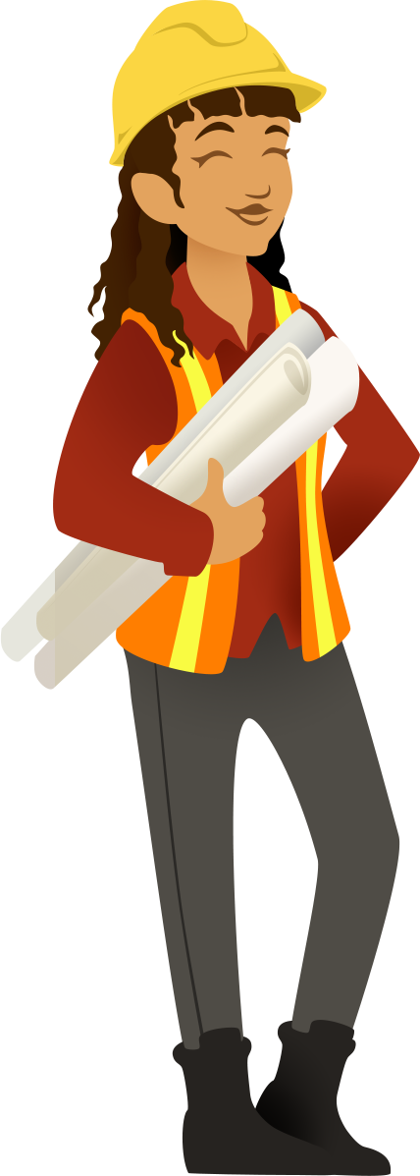
Put on Your Engineering Hat
How much can the paper hold?

Slide 9
Constructing Origami Boxes
In traditional origami, artists use single pieces of paper to create artistic animals, flowers, and even mathematical objects like cubes and pyramids.
In our explorations, we will be making functional boxes out of single sheets of paper.
For this exploration, you will need a piece of square paper, cubes, a ruler, and a pencil.

Slide 10
Exploring Origami Boxes
How much volume do you think your box can hold?
How much surface area do you think your box has?
  Remember, there is not a lid to the box.

Slide 11
Making Connections
What relationships do you see between the answers you put in your table?

Slide 12
Critical Thinking Cube
Describe: Describe how you found the volume of your box.
Apply: Write a formula to find the volume of any box.
Compare: Compare volume to surface area.
Analyze: What are the dimensions of volume?
Of surface area?
Synthesize: Write a formula to find the surface area of any box (with a lid).
Argue: Is there a relationship between area, perimeter,
surface area, and volume? Justify your answer.
Notes:
K20 Center. (n.d.). Critical Thinking Cube. Strategies. https://learn.k20center.ou.edu/strategy/1583

Slide 13
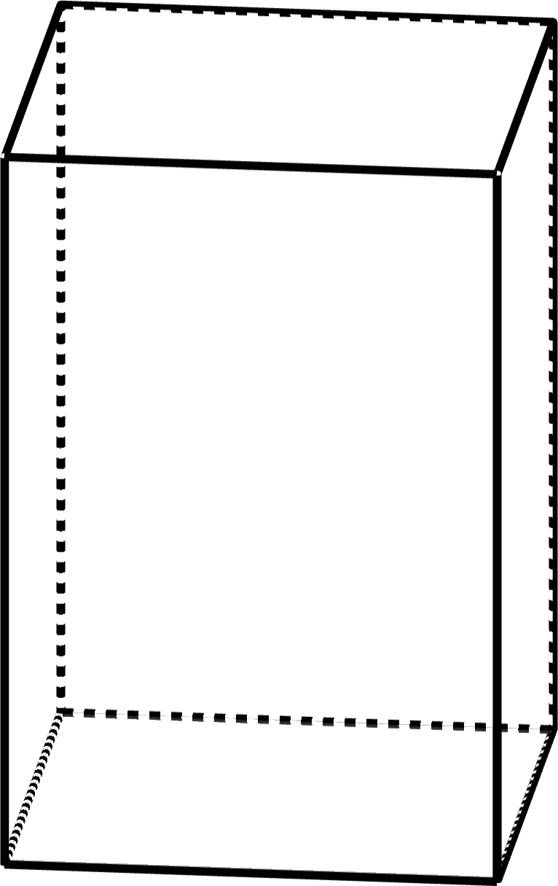
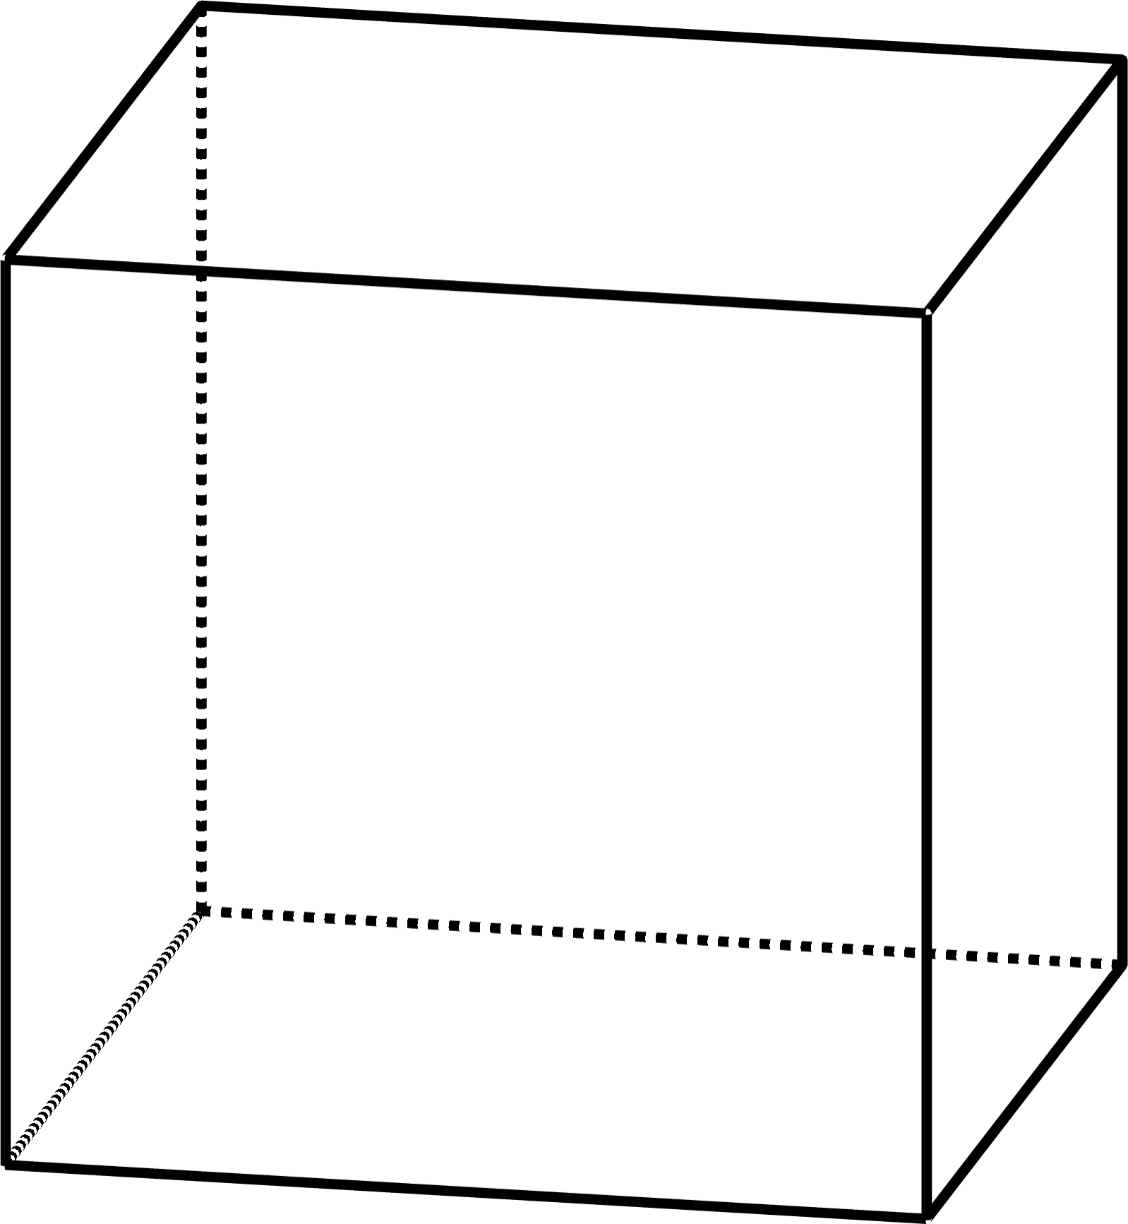
Volume of Rectangular Prisms
Notes:
K20 Center. (n.d.). Elbow Partners. Retrieved from https://learn.k20center.ou.edu/strategy/116

Slide 14
Volume of Rectangular Prisms
How are the two formulas for volume related?
  V = B·h
  V = l·w·h
How do they relate to area of a rectangle?

Slide 15
Volume of Rectangular Prisms
The area of the base of a rectangular prism is length times width: A = l·w.
  Area is a two-dimensional (2D) measurement.
  The units we use for area are units², square feet, cm², etc.

Slide 16
Volume of Rectangular Prisms
Volume is the 3D measurement that accumulates all of those areas “h times,” where h is the height of the prism.
  Think about the area of your paper. If you stacked a lot of them together, in order to create a ream of paper, you would take your area times the number of pages (or the height) to find the volume, or amount of space, that stack of paper takes up.
  The units we use for volume are units³, cubic feet, m³, etc.
We use B for the area of the base, instead of A, to be more specific about which area we are referring to.

Slide 17
Surface Area of Rectangular Prisms
Notice that Ph represents the area of the lateral faces.
Notes:
K20 Center. (n.d.). Elbow Partners. Retrieved from https://learn.k20center.ou.edu/strategy/116

Slide 18
Surface Area of Rectangular Prisms
How is surface area related to area?
How is it related to perimeter?

Slide 19
Surface Area of Rectangular Prisms
A rectangular prism has a top and bottom, both have the same area, B.
The area of the lateral faces (the faces/sides between the top and bottom) is the sum of 4 lengths times the 4 widths.
  The lengths are all the same; they are the height of the prism.
  The widths are actually the perimeter of the base.

Slide 20
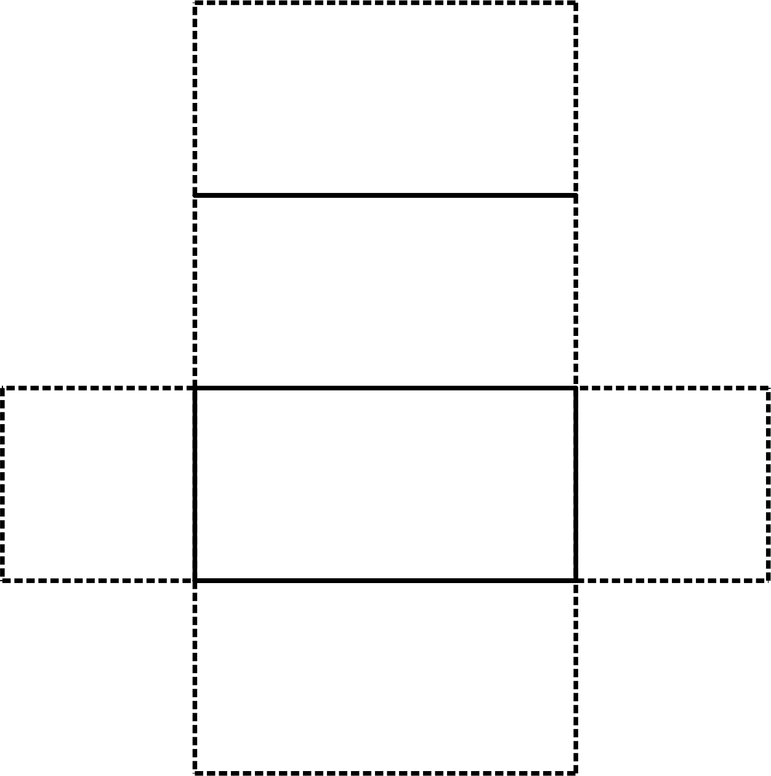
Surface Area of Rectangular Prisms
Base
height
width₁
height
width₄
Base
width₂
height
width₃
height

Slide 21
Surface Area of Rectangular Prisms
The units we use for surface area are units², square feet, cm², etc. because surface area is the sum of the areas of each surface.

Slide 22
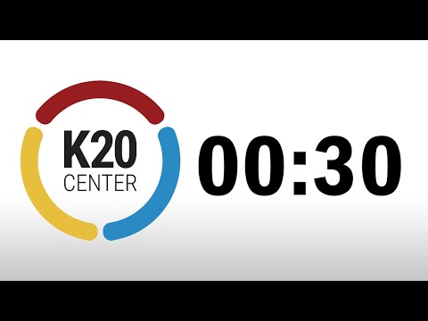
Careers Using Geometry
In what careers do you think surface area and/or volume is used?
30 Second Timer

Slide 23

Civil Engineers Use Volume & Surface Area
Civil Engineer and Rectangular Prisms

Slide 24
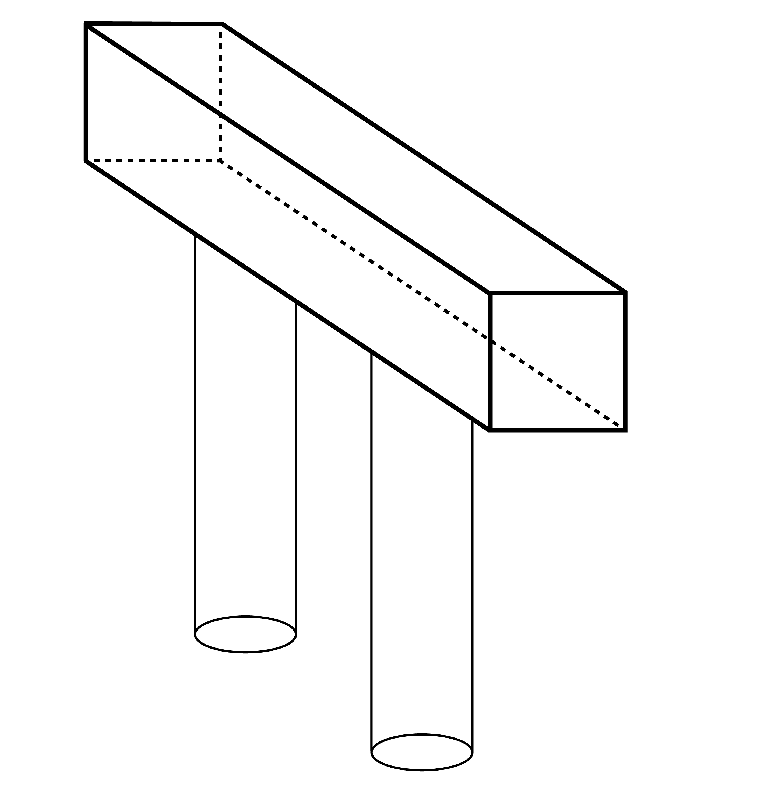
Engineering the Bridge Cap
bridge pier cap
Does the bridge pier cap need to be redesigned?
face of bridge pier cap
columns

Slide 25
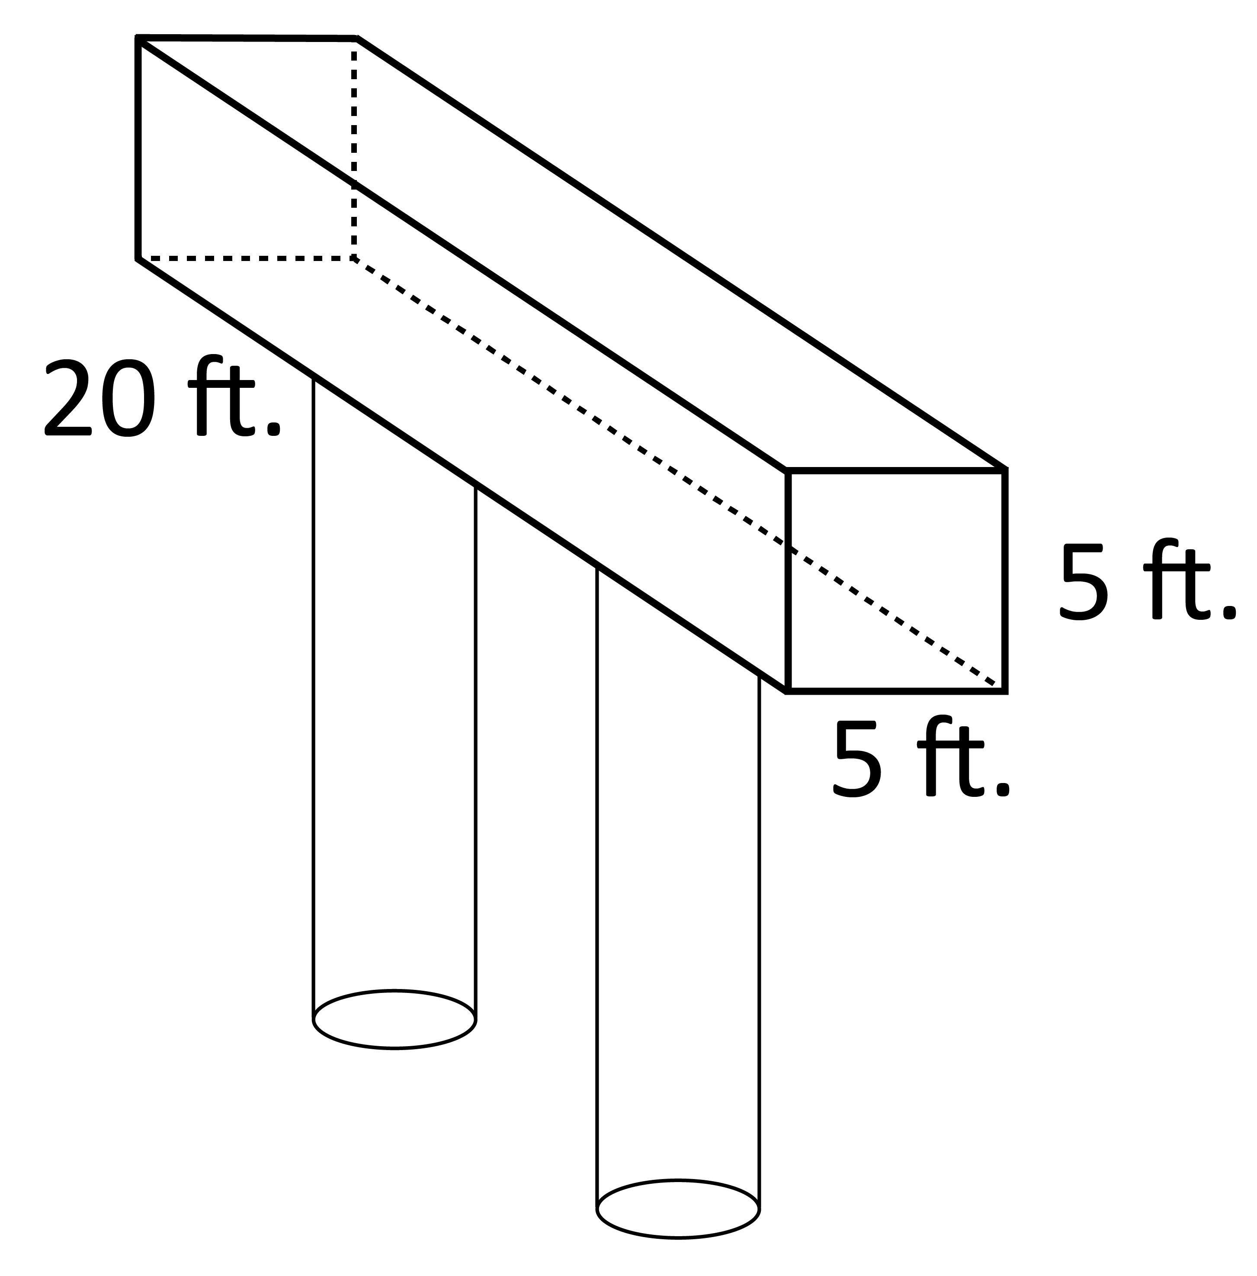
Engineering the Bridge Cap (Solution)
Label the image with the given information.

Slide 26
Engineering the Bridge Cap (Part A)

Slide 27
Engineering the Bridge Cap (Part A)
The maximum allowable weight for the bridge pier cap is 82,500 pounds.

Slide 28
Engineering the Bridge Cap (Part B)
The face of bridge pier can be up to 5.244 ft. x 5.244 ft. without a redesign.

Slide 29

Engineering the Bridge Cap
If the emblem mold has a diameter of 5.2 feet, do we need a redesign?

Slide 30

Muddiest Point
When finding volume…
Crystal Clear: What do you think is the easiest part?
Muddiest Point: What do you think is the most confusing?
When finding surface area…
Crystal Clear: What do you think is the easiest part?
Muddiest Point: What do you think is the most confusing?
Notes:
K20 Center. (n.d.). Muddiest Point. Strategies. https://learn.k20center.ou.edu/strategy/109

