Slide 2
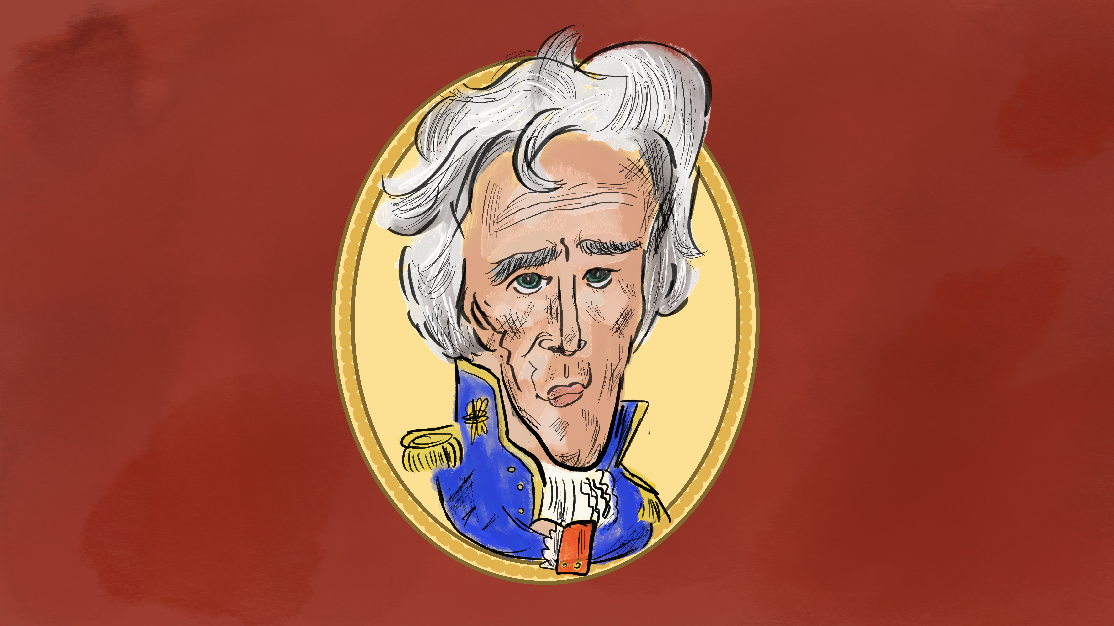
As Long as Grass Grows
Andrew Jackson’s Native American Policies

Slide 3
Essential Questions
How did Andrew Jackson address issues related to Native Americans during his presidency?
How did Native Americans respond to Andrew Jackson’s actions?

Slide 4
Learning Objectives
Develop an understanding of the policies of Andrew Jackson related to Native Americans.
Examine the responses of Native leaders to Jackson’s policies.

Slide 5

I Notice, I Wonder
On the back of your handout, you will:
Write down true statements that you find – things you noticed.
Write down things that you have questions about – things you wonder about.
Select one of each to share.
Notes:
K20 Center. (n.d.). I notice, I wonder. Strategies. https://learn.k20center.ou.edu/strategy/180

Slide 6
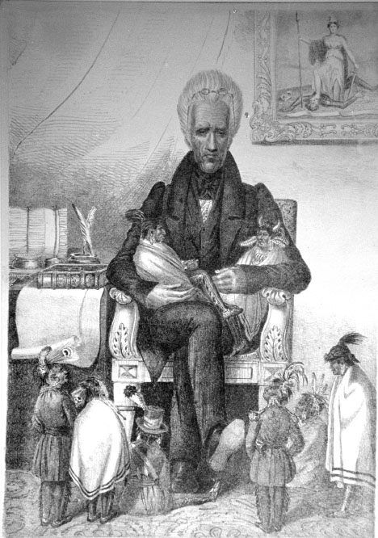
Andrew Jackson
Political Cartoon
Notes:
University of Michigan, Clements Library. (n.d.). Indians of the Midwest: Andrew Jackson, the great father, ca. 1830. Newberry Dis. https://digcoll.newberry.org/indians-midwest/media/andrew-jackson-the-great-father-ca-1830

Slide 7

Frayer Model
Write the term “paternalism” in the center of the oval.
In the upper left corner, create a definition for the term.
In the upper right corner, list the characteristics of paternalism.
  Think about adjectives that could be used to describe paternalism.
In the lower right corner, write at least two examples of paternalism.
In the lower left corner, create a visual that illustrates paternalism.
Notes:
K20 Center. (n.d.). Frayer model. Strategies. https://learn.k20center.ou.edu/strategy/126

Slide 8
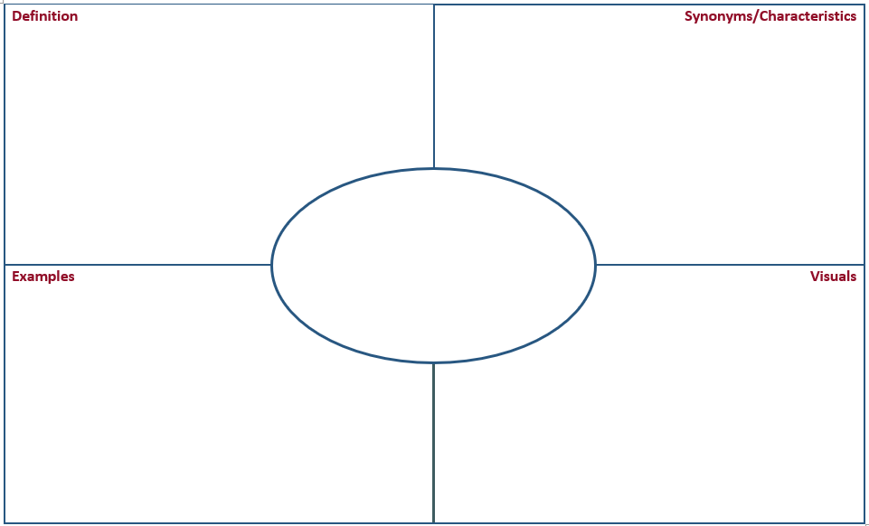
Frayer Model
Notes:
K20 Center. (n.d.). Frayer model. Strategies. https://learn.k20center.ou.edu/strategy/126

Slide 9
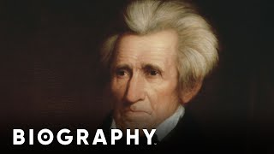
Andrew Jackson: 7th President of the United States | Biography
Notes:
Biography. (2018, May 7). Andrew Jackson: 7th President of the United States | Biography. YouTube. https://youtu.be/X2AHvAJktAg

Slide 10

Stop and Jot
Read the text you are assigned, stopping at the end of each paragraph to write the main ideas of that paragraph in the margin.
Keep in mind your list of “I Notice, I Wonder” statements as you read.
When finished, review your notes with your partner.
Add to your notes as needed, based on your discussion.
Be ready to share.
Notes:
K20 Center. (n.d.). Stop and jot. Strategies. https://learn.k20center.ou.edu/strategy/168

Slide 11

Paired Texts H-Chart
Write the name of your text on the left side of your Paired Texts H-Chart.
Add your combined notes to this side.
Move into your new groups. You are now the “expert” on your document/text.
Write the name of the other group’s text on the right side of the chart.
Notes:
K20 Center. (n.d.). Paired texts H-chart. Strategies. https://learn.k20center.ou.edu/strategy/132

Slide 12
Paired Texts H-Chart
Share information from your document/text with your group.
  Who is the author or speaker?
  What is the main topic?
  What notes did your group make?
Listen to your new group members and record their ideas on your chart.
  What ideas are discussed?
  What can you learn about the ideas of each author or speaker?
Add notes to the right side of your chart.
Notes:
K20 Center. (n.d.). Paired texts h-chart. Strategies. https://learn.k20center.ou.edu/strategy/132

Slide 13
Paired Texts H-Chart
After everyone in your group has shared, synthesize information from both sources and record it in the middle section of the chart.
  What language is being used?
  Are there terms being used by both, and if so, are they being used in the same way?
  What is Jackson expecting to happen?
  How are the Native Americans responding?
What have you learned from reading these two texts together?
Notes:
K20 Center. (n.d.). Paired texts h-chart. Strategies. https://learn.k20center.ou.edu/strategy/132

Slide 14

POMS
Consider all of the primary sources from this lesson and respond to the following question:
“What connections might there be between the idea of paternalism and the policies of Andrew Jackson?”
Write your answer on a sticky note. Think carefully about significant/important points made throughout the lesson.
Notes:
K20 Center. (n.d.). Poms: point of most significance. Strategies. https://learn.k20center.ou.edu/strategy/101​​​​​​​

Slide 15

Cognitive Comics
Respond to the Andrew Jackson comic by creating your own from the Native American perspective.
Notes:
K20 Center. (n.d.). Cognitive comics. Strategies. https://learn.k20center.ou.edu/strategy/198

