Slide 2
DOWNSTREAM
How humans interact with watersheds

Slide 3
Think-Pair-Share
Observe a model of a watershed.
Predict what would happen if there was a bunch of rain at one time.

Slide 4
Build a Watershed
Arrange the items on your base to create different heights.
Cover the items with a plastic bag. This will create areas that water will roll off and down.
Draw a picture of your model. Use arrows to show where you predict the water will flow. Circle spots where you predict water will collect or pool.

Slide 5
Make it Rain
Use a spray bottle of water to imitate rain over the plastic bag.
Look at your picture. Were your predictions correct?
Use a different color to revise your picture to show how the water actually flowed and pooled.

Slide 6
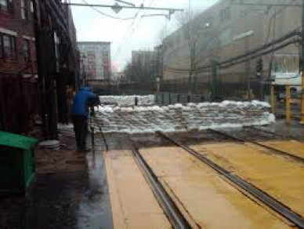
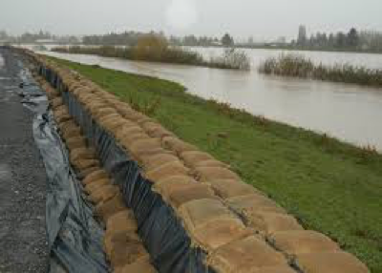
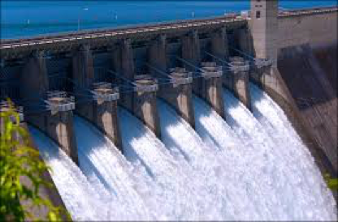
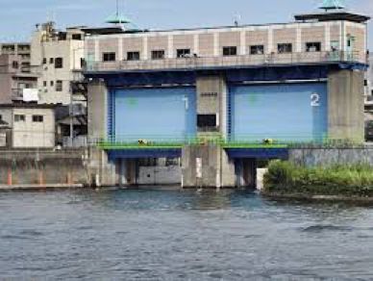
Stop the Flood
Look at the pictures of sandbags and flood gates.
Use the sandbags and blocks to prevent flooding in the areas where the water pools.

Slide 7
Explain your Thinking
What is the best way to prevent damage from flooding?
Claim:
Evidence:
Reason:

Slide 8
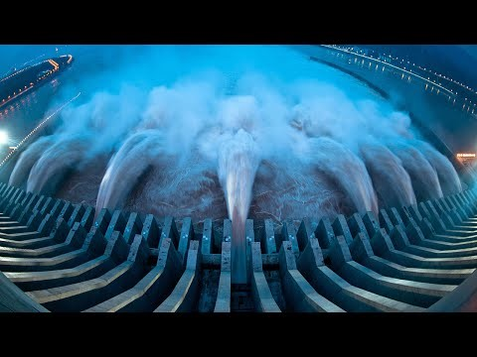
I Notice, I Wonder
Watch the Emergency Water Discharge video. While watching, write down some things you notice and wonder.

Slide 9
I Notice, I Wonder
I Notice
I Wonder

Slide 10

How am I Feeling? What am I Thinking?
Draw a picture of how you feel about what you have learned.
What do you think about what you have learned?

