Slide 2
(Not Quite) Breaking All the Rules
Grammar and Poetry

Slide 3
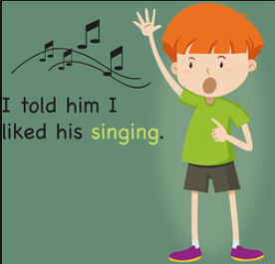
GERUNDS
To find gerunds in sentences, look for a verb + ing that is used as a noun.
Examples:
Bowling
Fishing
Dancing
Surfing
Listening
Writing

Slide 4
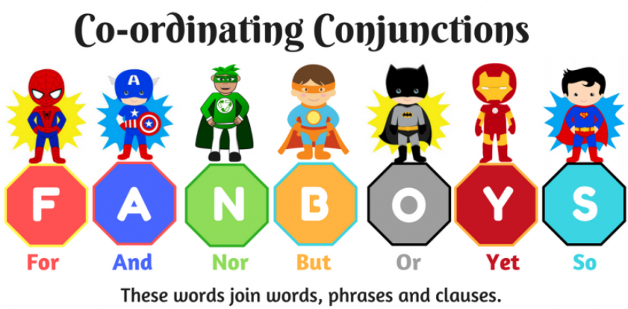
COORDINATING CONJUNCTIONS
Coordinating conjunctions join two or more sentences, main clauses, words, or other parts of speech.
Example: FANBOYS
For
And
Nor
But
Or
Yet
So

Slide 5
PREDICATES
The part of a sentence or clause containing a verb and stating something about the subject. It’s what the subject does.
Example:
John went home.

Slide 6
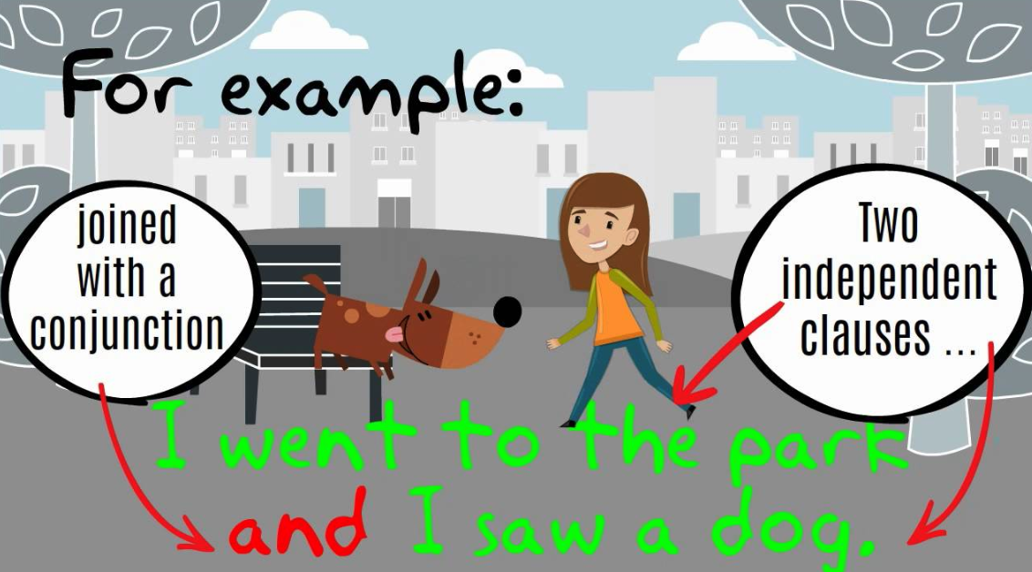
COMPOUND SENTENCE
Joins two or more sentences that have related ideas, usually with a coordinating conjunction preceded by a comma.
Example:
I want to buy a salad,
but I’ll get a sandwich.

Slide 7
COMPOUND-COMPLEX SENTENCES
Made up of more than one sentence joined by a conjunction, and at least one of those sentences is compound. It is a compound sentence with a dependent (or subordinate) clause.
Example:
I finished making dinner, but I forgot to turn off the oven because I got an important phone call.

Slide 8
ESSENTIAL QUESTION
How can grammatical rules add structure and variety to poetry?

Slide 9
“Messy Room” by Shel Silverstein

Slide 10
Anchor Charts: What to Include
Grammatical element name
Gerund, predicate, coordinating conjunction, compound sentence, compound-complex sentence
How would you define or explain your grammatical element to someone else?
A full sentence example from one of Silverstein’s poems
An image that demonstrates the grammatical element

Slide 11
Adding structure and variety to poetry
Choose ONE Silverstein poem.
Modify your poem by adding extra lines that integrate:
Gerunds.
Predicates.
Coordinating conjunctions.
Compound sentences.
Compound-complex sentences.
3. Will you change the tone of the poem or keep it the same?

Slide 12
ESSENTIAL QUESTION
How can grammatical rules add structure and variety to poetry?

