Slide 2
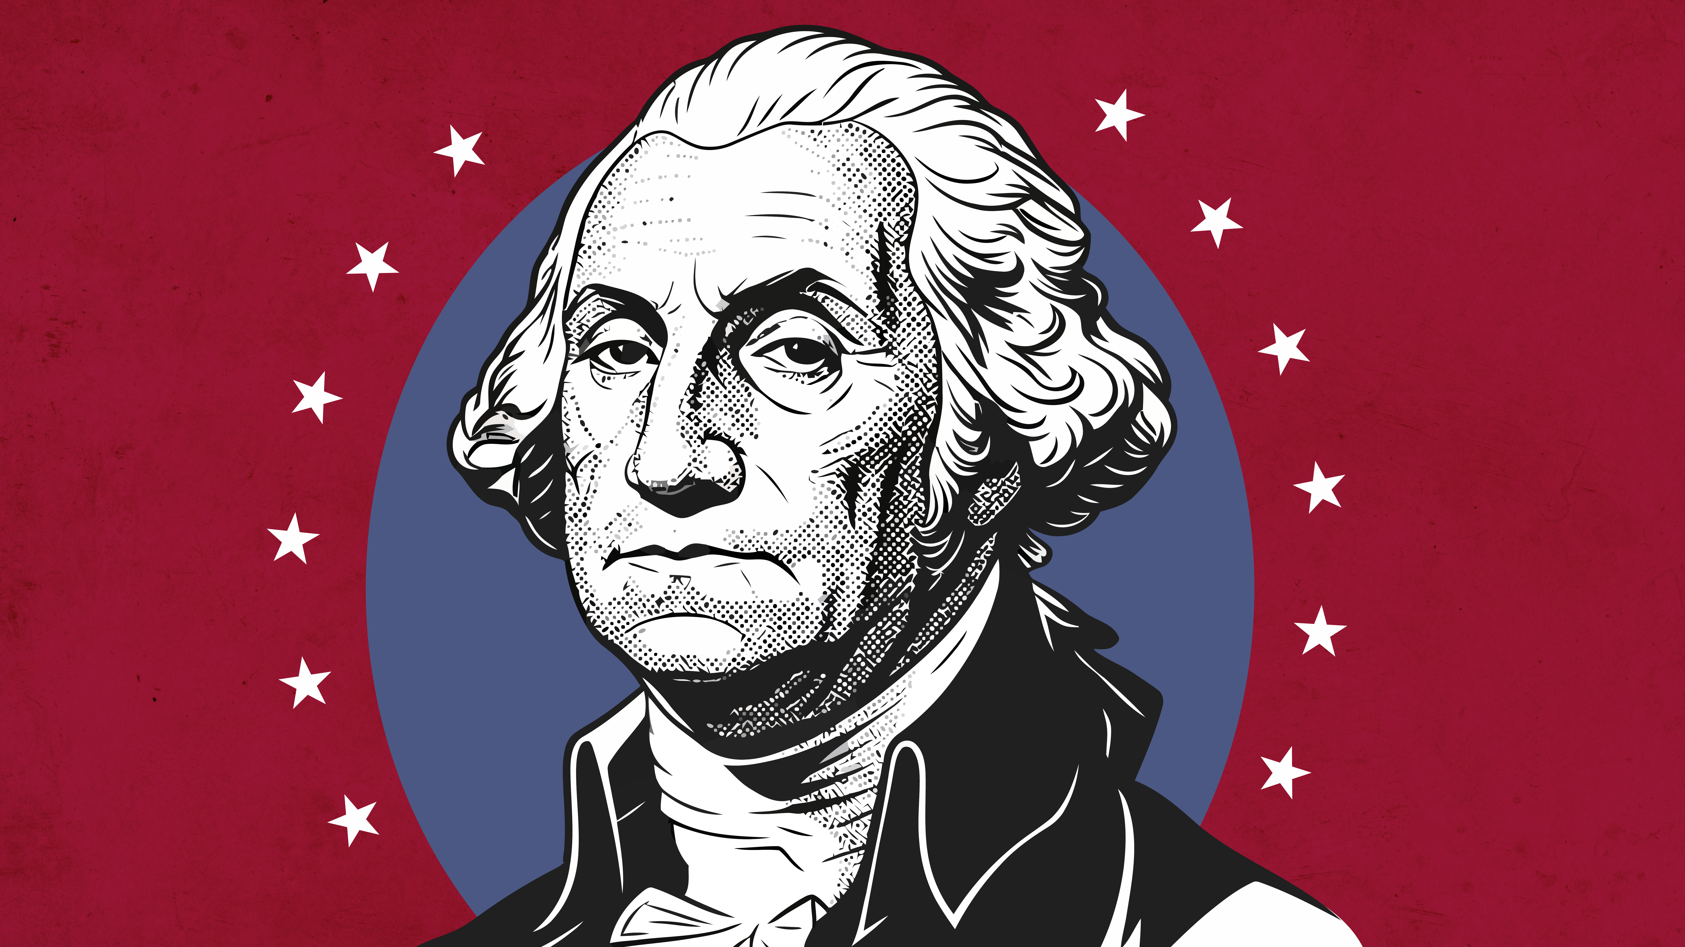
One Last Time
George Washington’s Precedent-Setting Presidency

Slide 3
Essential Questions
Where should power and authority lie?
How do decisions of the past impact the present?

Slide 4
Learning Objectives
Identify the major characteristics of George Washington’s presidency.
Examine the importance of the precedents set by George Washington’s presidency

Slide 5
Video
Think about these questions…
  Who is the main character singing this song?
  What task does he want help with?
  Who is going to learn to say goodbye?
  What does the singer say he wants to tell people?
  Why do you think saying goodbye might have been important?

Slide 6
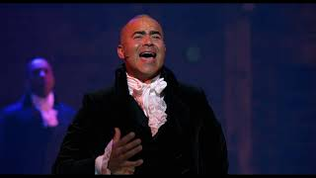
One Last Time from Hamilton https://youtu.be/mgoFrstrYNk?si=LaOjfSi_ZuMPKeUf

Slide 7

Frayer Model
Write the term “precedent” in the center oval.
In the upper left corner, create a definition for the term.
In the upper right corner, list the characteristics of precedent – think about adjectives that could describe precedent.
In the lower right corner, write at least two examples of precedent.
In the lower left corner, create a visual that illustrates precedent.

Slide 8

Why-Lighting
As you read George Washington’s Precedent-Setting Presidency:
  Highlight the sentences or passages that seem important.
  Then, write in the margins why you highlighted those passages.

Slide 9
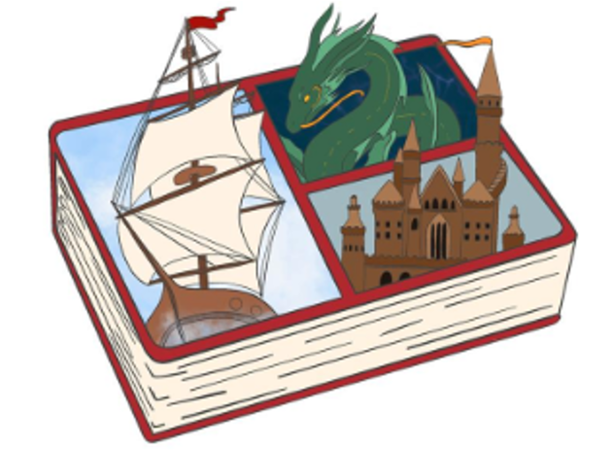
Bento Box
You will be translating the information that you gathered into 4 - 6 images related to the precedents that George Washington’s presidency set.
Include a very brief summary of your images on your project.

Slide 10
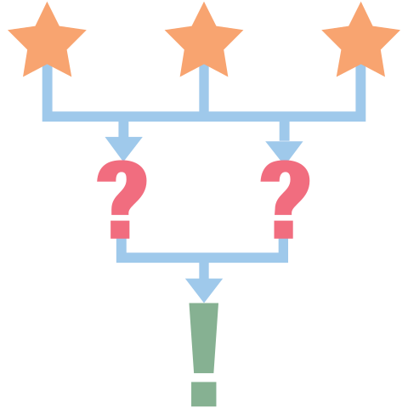
3-2-1
Respond to the following:
  What are three things you learned about precedent?
  What are two questions you still have?
  What is the one thing you found interesting?

