Slide 2
Southern Colonists
5th Grade Social Studies

Slide 3
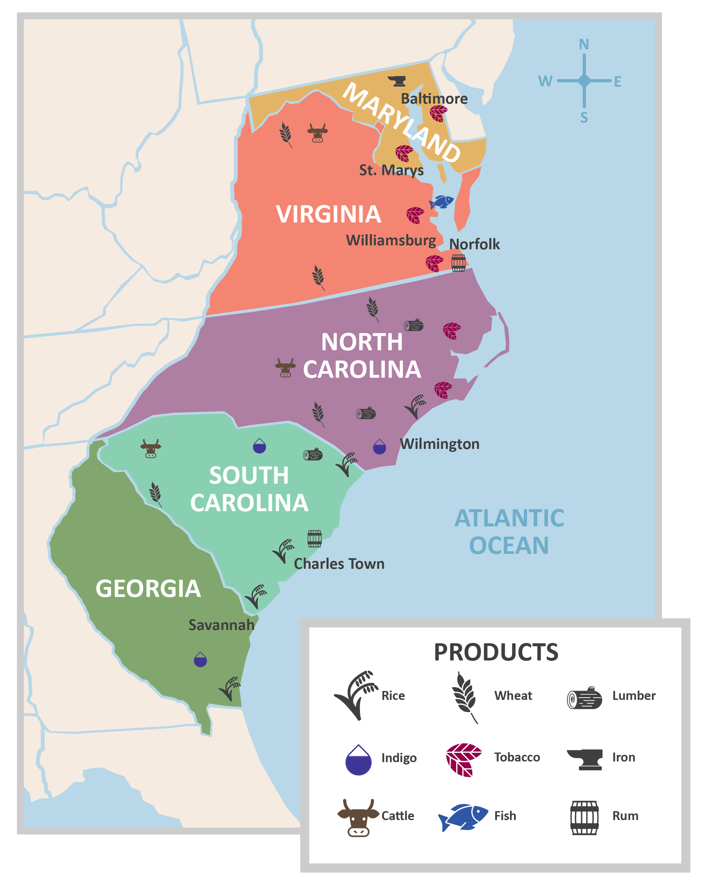
I Notice, I Wonder

Slide 4
Colonist Card Sort (Journal Quotes)
These cards feature quotes from various
Southern Colonists’ Journals
As a group, sort the cards in any way
that you think makes sense.
What role do you think the different colonists played?

Slide 5
Colonist Card Sort (Biographies)
Now, check out the biography cards.
Which biographies do you think
match the different journal quotes?

Slide 6
Pick 2 to Compare
OR Compare All 3

Slide 7
More About the Life of Slaves

Slide 8
RAFT Writing
Choose One of the Prompts
Role | Indentured Servant | Slave | Colonists
Audience | Contract Holder | Other Slaves | Self
Format | Letter | Poem or Song | Journal Entry
Topic | Terms of Service | What Life Is Like as a Slave in the Southern Colonies | A Day in the Life

