Slide 2
WHY ARE TAXES IMPORTANT?
Second Grade Social Studies

Slide 3
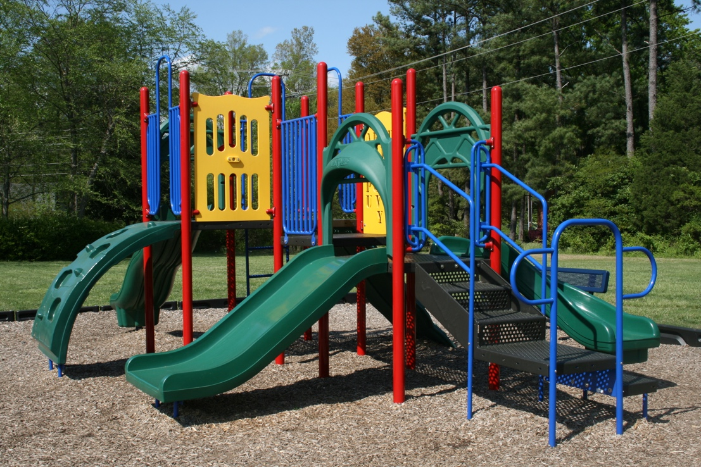
Playground Comparison
2009-04-21 Hampton forest apartment homes playground.jpg. (n.d.). [Digital image]. Retrieved from https://commons.wikimedia.org/wiki/File:2009-04-21_Hampton_Forest_Apartment_Homes_playground.jpg
Radar on playground slide - Huntsville, Alabama.jpg. (n.d.). [Digital Image]. Retrieved from https://commons.wikimedia.org/wiki/File:Radar_on_playground_slide_-_Huntsville,_Alabama.jpg

Slide 4
Why are taxes needed for community services?

Slide 5
Welcome To Our Town!
What services should we provide to our residents next year?
Library
Police Department
Fire Department
Department of Transportation/Roads
Water and Sanitation
Schools
Garden in the center of town in Brodhead, Wisconsin. (n.d.). [Digital Image]. Retrieved from https://www.goodfreephotos.com/united-states/wisconsin/sugar-river-state-trail/garden-in-the-center-of-town-brodhead-wisconsin.jpg.php

