Slide 2
DNA Fingerprinting

Slide 3
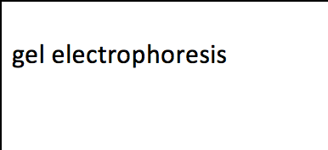
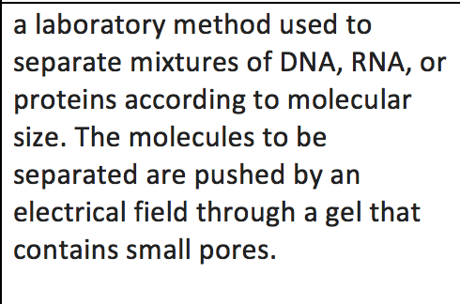
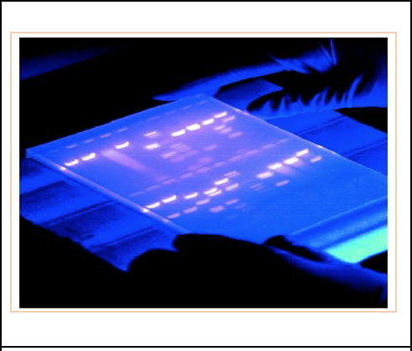
Gel Electrophoresis
First, DNA strands are broken apart using enzymes
The shorter the DNA strand, the farther it will travel

Slide 4
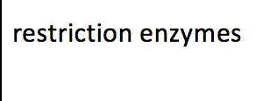
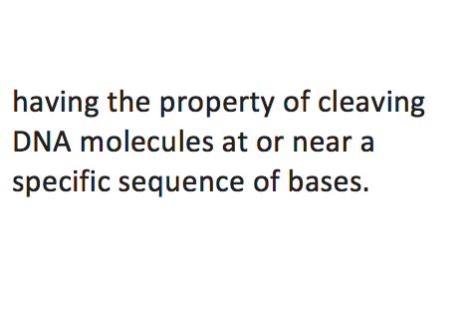
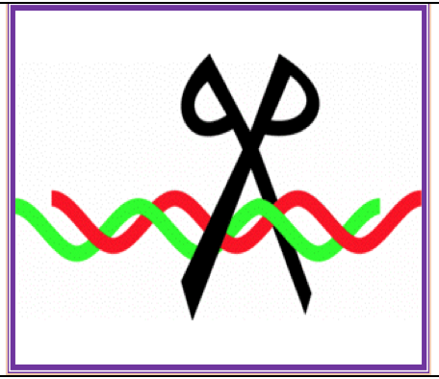
Restriction Enzymes
Cuts DNA strands at certain places

Slide 5
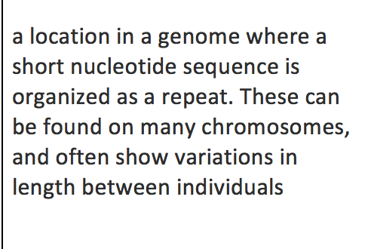
Variable Number of Tandem Repeats (VNTRs)
The number of consecutive repeats can have dramatic effects, like the difference between a severe disease or not getting sick at all

Slide 6
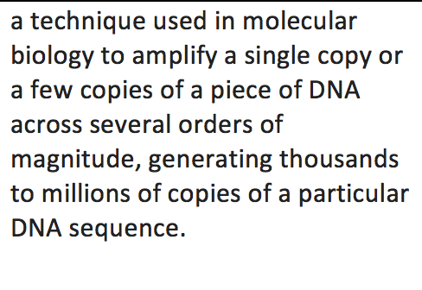
Polymerase Chain Reaction
This technique was made famous because a scientist thought he had a viable dinosaur DNA sample using PCR
…turns out it was his own DNA and he had accidentally contaminated the sample

Slide 7
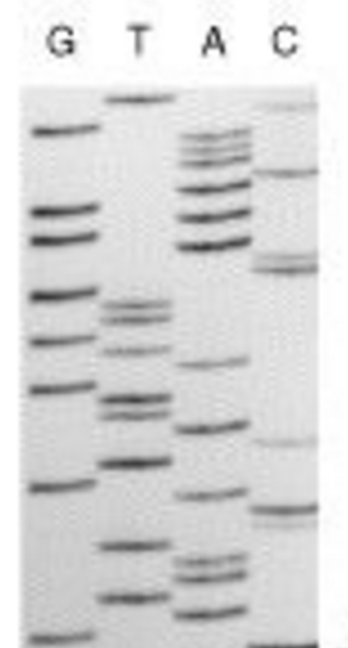
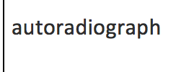
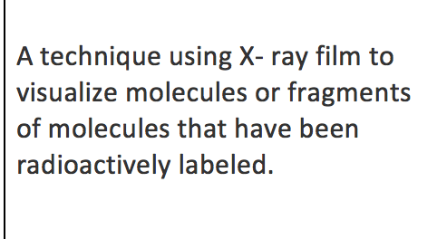
Autoradiograph
The DNA is what is radioactively labeled, specifically a certain DNA code.
If the organism has the code, the X-ray would catch it.

Slide 8
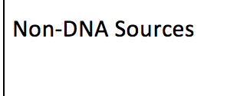
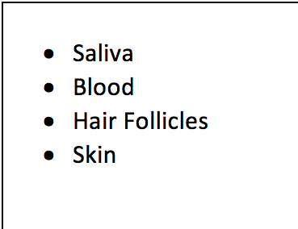
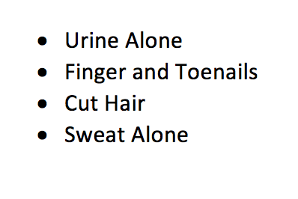
DNA sources and non-DNA sources

