Slide 1
Crime Investigation Tools

Slide 2
DNA Tools

Slide 3
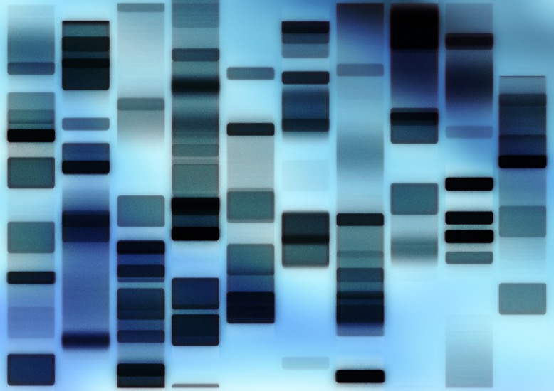
Gel Electrophoresis
First, DNA strands are broken apart using enzymes
The shorter the DNA strand, the farther it will travel

Slide 4
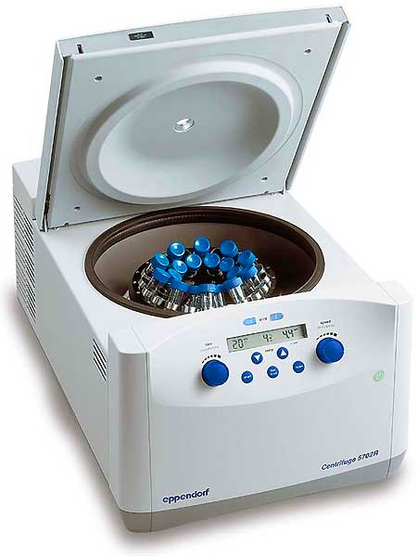
Centrifuge
Spins quickly to separate the different particles in blood

Slide 5
DNA Sources

Slide 6
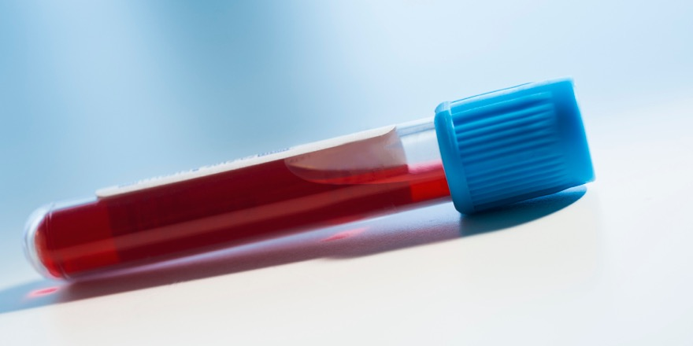
Blood
Red blood cells actually don’t have a nucleus, so no DNA
However, white blood cells do, so when blood is used for DNA testing it’s the white blood cells

Slide 7
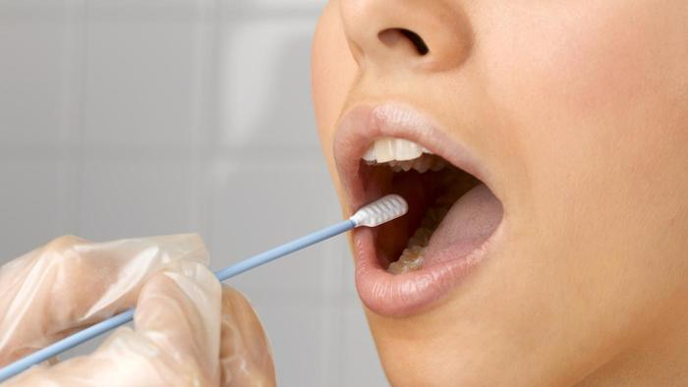
Mouth Swabs
Despite many people thinking mouth swabs are for spit, it’s actually for the cheek skin cells
The saliva keeps the skin cells from drying out

Slide 8
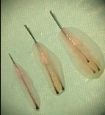
Hair Follicle
Hair itself doesn’t have any nuclei
However, the hair follicle (the part that attaches to the head) does have a nucleus
This picture includes both the follicle and surrounding skin, but not all of that is needed (the follicle is the white end when you pull a hair out)

Slide 9
Not DNA Sources

Slide 10
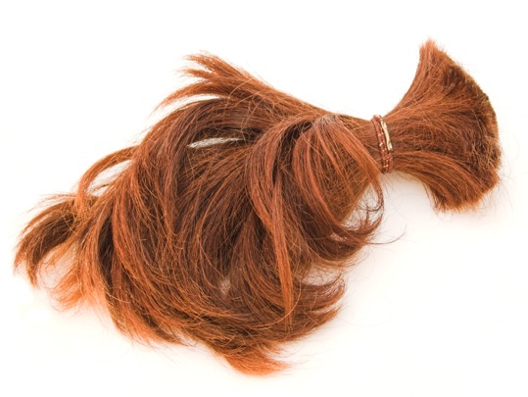
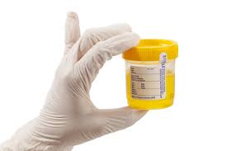
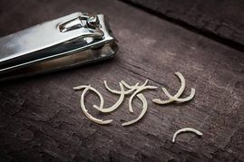
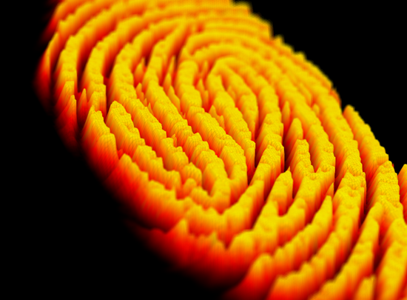
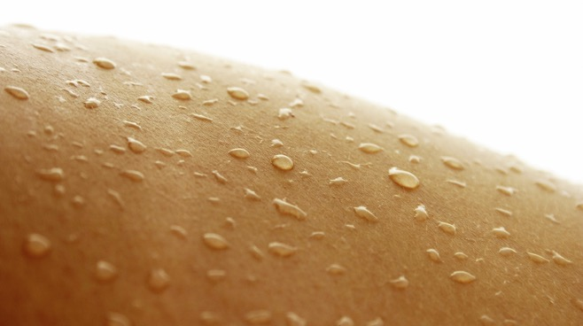
What’s missing from all of these?

Slide 11
What’s missing from all of these?
A nucleus!
On there own, sweat, urine, nails, hair, and oils that help create fingerprints do not have any DNA connection to you
Think about it: all of those are byproducts (or waste) from various bodily processes
However, all of these can be used for DNA if skin cells are attached to it (just like the saliva mouth swab) because the skin does have DNA

Slide 12
Non-DNA Investigation Tools

Slide 13

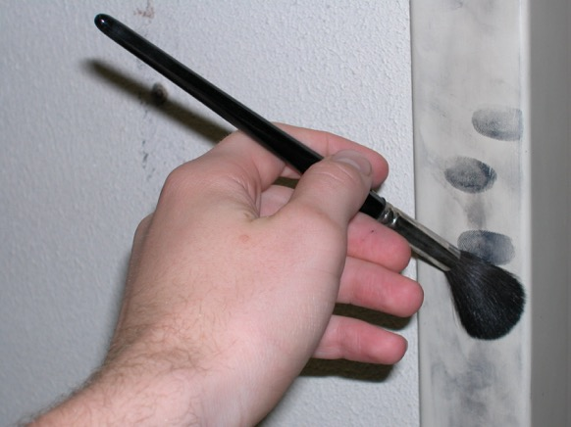
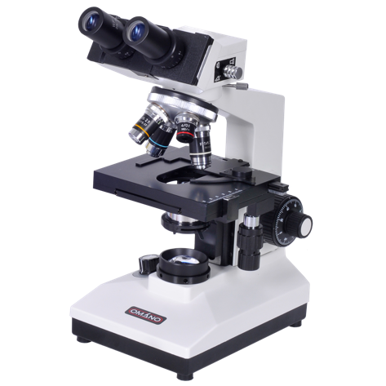
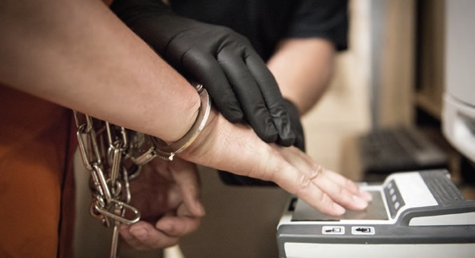
All of these don’t use DNA

