Slide 1
Crime Investigation Tools
K20 Center

Slide 2
DNA Tools

Slide 3
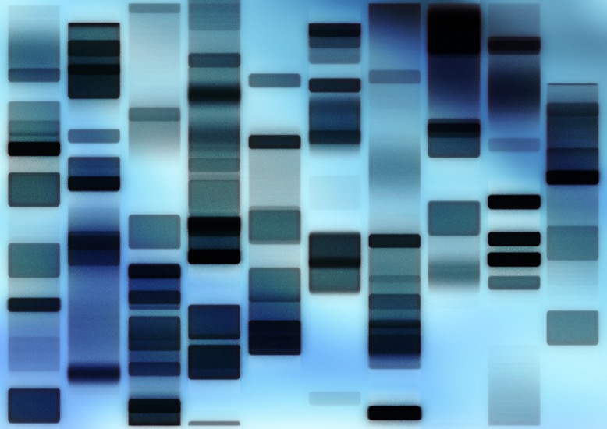
Gel Electrophoresis
First, DNA strands are broken apart using enzymes.
The shorter the DNA strand, the farther it will travel.

Slide 4
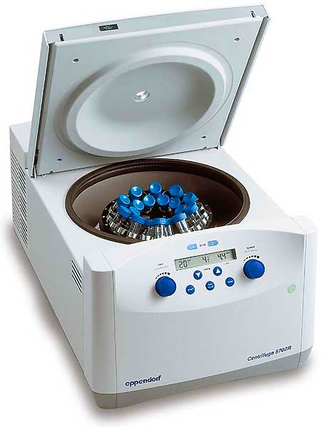
Centrifuge
Spins quickly to separate the different particles in blood.

Slide 5
DNA Sources

Slide 6
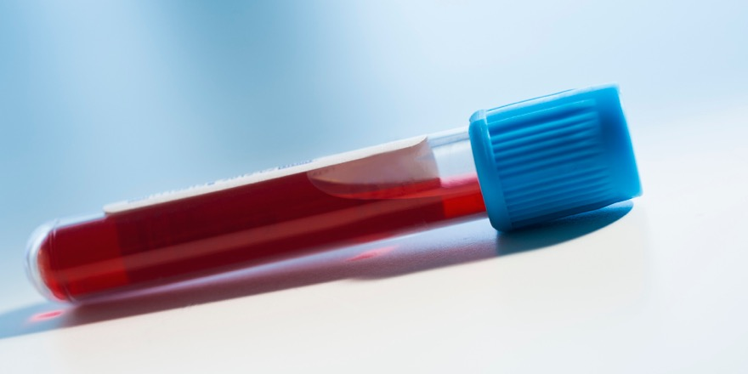
Blood
Red blood cells actually don’t have a nucleus, so no DNA.
However, white blood cells do, so when blood is used for DNA testing it’s the white blood cells.

Slide 7
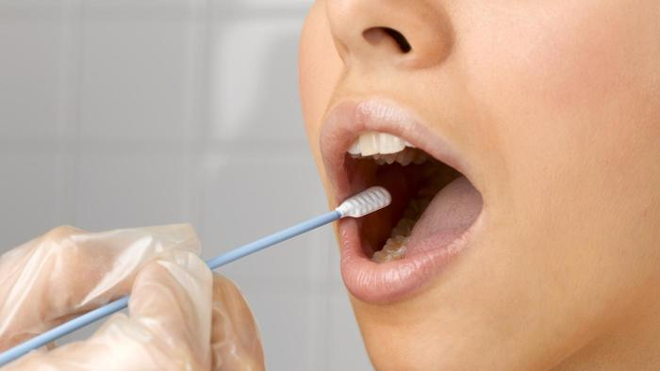
Mouth Swabs
Despite many people thinking mouth swabs are for spit, it’s actually for the cheek skin cells.
The saliva keeps the skin cells from drying out.

Slide 8
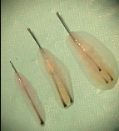
Hair Follicle
Hair itself doesn’t have any nuclei.
However, the hair follicle (the part that attaches to the head) does have a nucleus.
This picture includes both the follicle and surrounding skin, but not all of that is need (the follicle is the white end when you pull a hair out).

Slide 9
Not DNA Sources

Slide 10
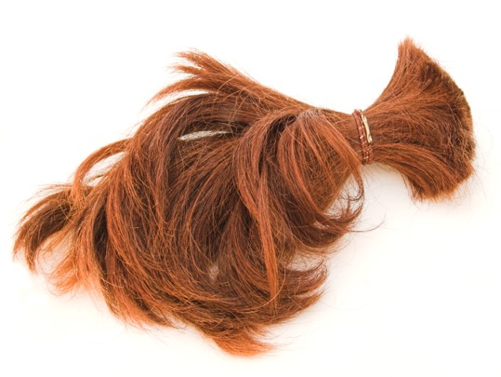
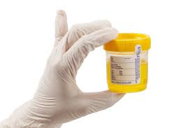
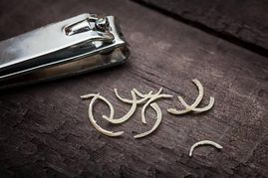
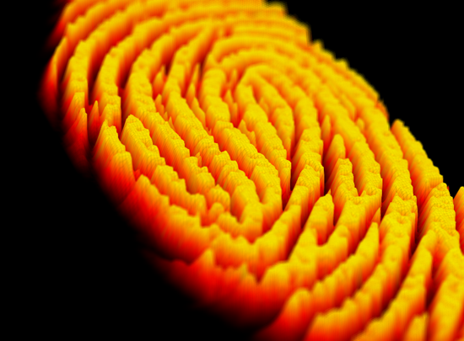
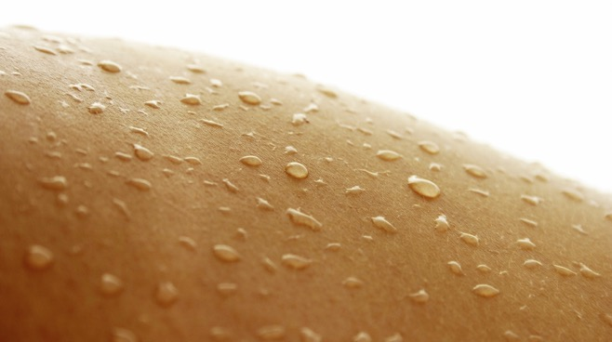
What’s missing from all of these?

Slide 11
What’s missing from all of these?
A nucleus!
On their own, sweat, urine, nails, hair, and oils that create fingerprints do not have any DNA connection to you.
Think about it: all of these byproducts (or waste) from various bodily processes.
However, all of these can be used for DNA if skin cells are attached to it (just like the saliva mouth swab) because the skin does have DNA.

Slide 12
Non-DNA Investigation Tools

Slide 13

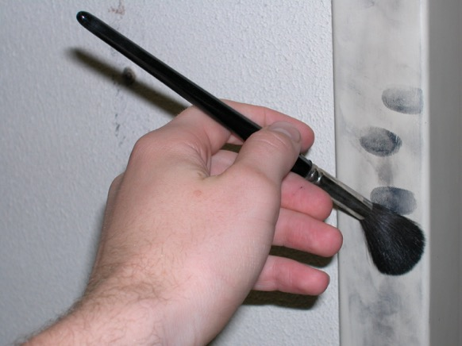
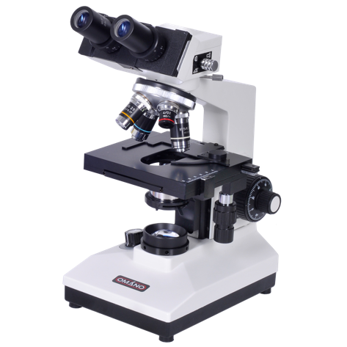
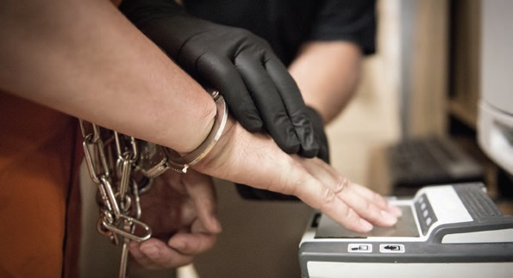
All of these don’t use DNA

