Slide 1
Memes > GIFs
Seventh-Grade Math

Slide 3
Essential Question:
How can one-variable inequalities be used to represent relationships?

Slide 4
Card Sort
In pairs, sort the cards to match the scenario to the inequality.
When finished, find another pair. Discuss how you and your partner determined the matches

Slide 6
What Numbers Work?
In your pairs, complete the “What Numbers Work?” handout:
Determine what numbers will work and what numbers won’t work with the inequality.
Show the numbers that work on the number line.
Think about why certain numbers don’t work.

Slide 8
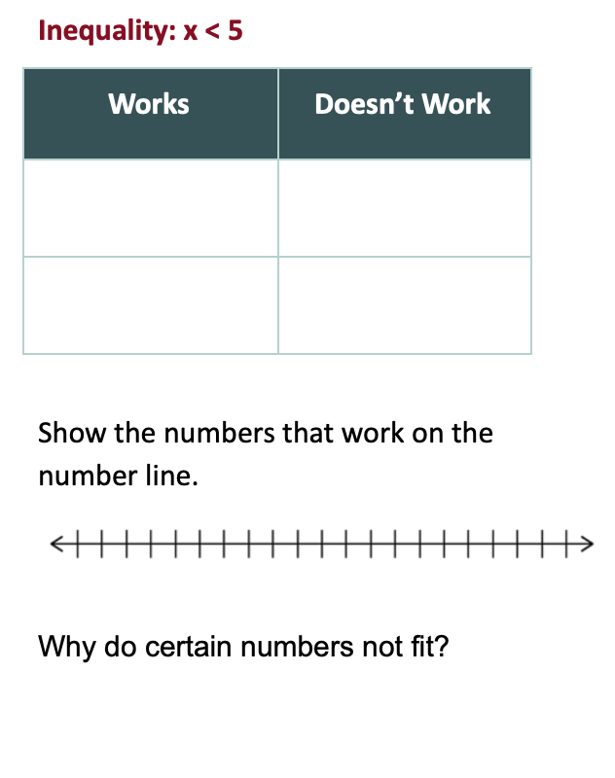
Reflection
With a different pair, discuss your findings.

Slide 9
Discussion
How can you solve the following problem without creating a table?
X - 3 < 15

Slide 10
Try on your own!
Solve and graph the following inequality on a number line:
X + 2 > 11

Slide 11
Challenge Question
Solve and graph the following inequality on a number line:
X + 6 > 19

Slide 12
Notes:
Brittany and Amber

Slide 13
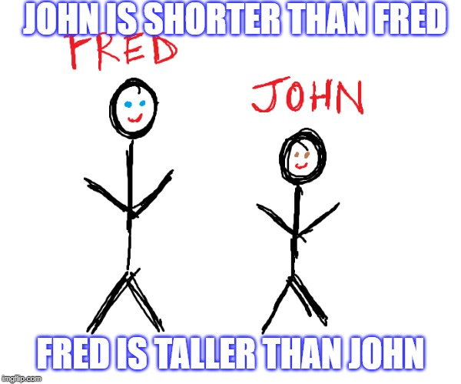
Meme Maker
Create a meme from either: a) one of the scenarios from the Card Sort activity, or b) one of your own (teacher approved).
You will be displaying your meme around the classroom.

Slide 15
Exit Ticket
Which student solved the inequality incorrectly? What should they have done?
Tommy | Talon
3 + X > 2 | X - 5 < 6
X > 5 | X < 11

