Slide 2
Popcorn > Raisinets
Inequalities with Two Variables

Slide 3
Essential Question
How can two-variable inequalities be used to represent relationships?

Slide 4
Learning Objectives
Graph linear inequalities.
Interpret the solutions of a linear inequality.

Slide 5
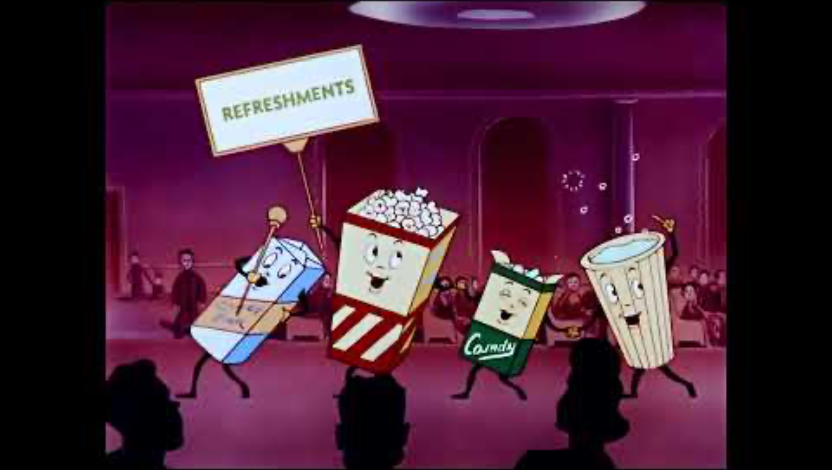
It’s Showtime!
Let’s All Go to the Lobby!
Notes:
Burrns Luciano. (2021, May 15). Let’s all go to the lobby! Intermission bumper 4K update [Video]. YouTube. https://www.youtube.com/watch?v=lm6IU6V-dE8

Slide 6
It’s Showtime!
Would you rather…
have two boxes of candy and no drink, or a small popcorn and unlimited drinks?
invite two more friends to watch a movie with you and have no snacks, or go with one friend and have money to buy snacks?
Does it depend on the circumstances?

Slide 7

Movie Snacks
Scenario 1: Your family goes to the movies. The snack
bar is all out of large popcorn containers and large cups. The only size they have left is small. Your family has $30 to spend. How many orders of popcorn and drinks can your family buy if a small popcorn costs $6 and a small drink costs $5? Your family does not want any change.
With a partner, determine the different solutions to the scenario.
Record the solutions on your handout, graph the points, and then answer the questions.
Notes:
Clker-Free-Vector-Images. (2014, August 3). Popcorn [Illustration]. Pixabay. https://pixabay.com/vectors/pop-corn-popcorn-corn-food-snack-312386/

Slide 8
Movie Snacks
Scenario 2: Your family decided that it was too difficult to determine how many orders of popcorn and drinks to buy so that they wouldn’t get any change back. They decided that they do not mind if they get change back. How many different combinations of popcorn orders and drinks can your family buy?
With the same partner, find solutions to the new problem.
Record the solutions on your handout, graph the points, and then answer the questions.
Notes:
Clker-Free-Vector-Images. (2014, August 3). Popcorn [Illustration]. Pixabay. https://pixabay.com/vectors/pop-corn-popcorn-corn-food-snack-312386/

Slide 9
Graphing Linear Inequalities
Step 1: Start the same way you would when graphing a linear equation.
Rewrite the equation in slope-intercept form.
Create a table.
Find the intercepts, etc.
Plot some points.

Slide 10
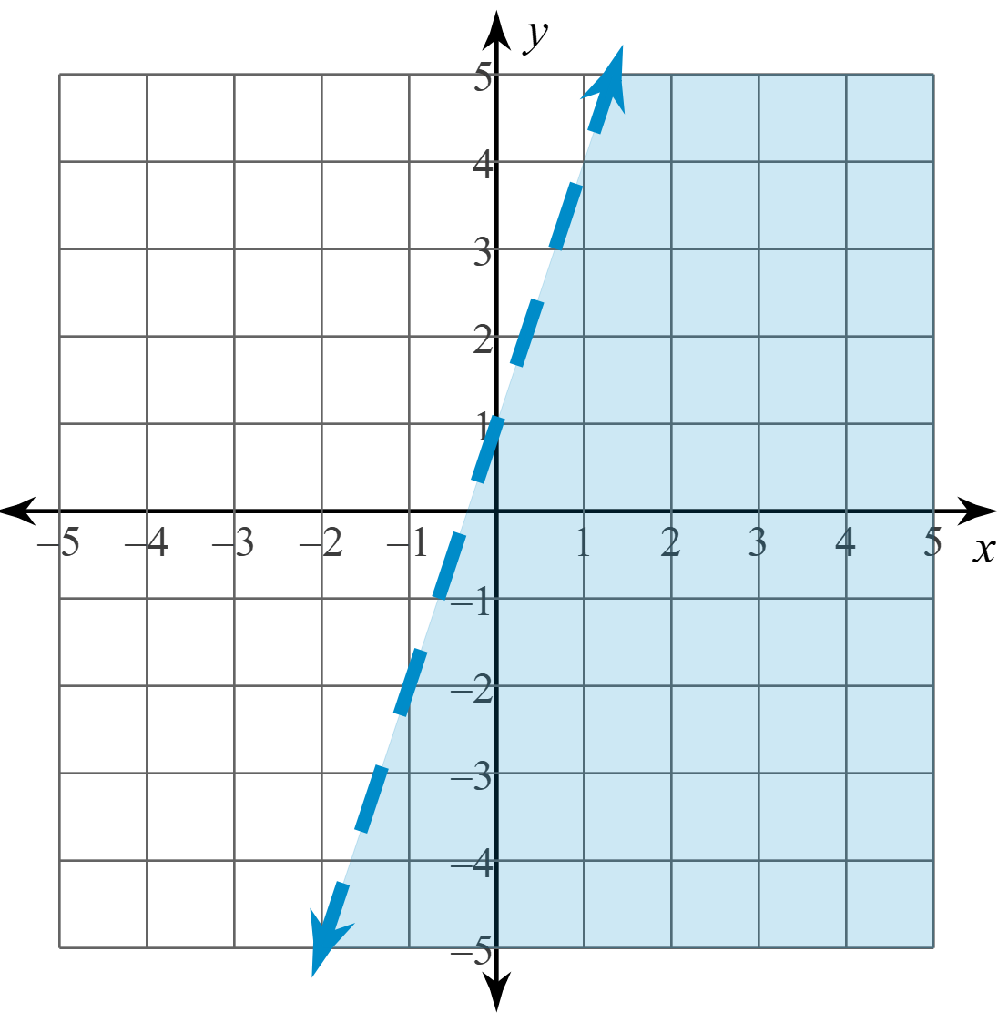
Graphing Linear Inequalities
The difference between graphing linear equations and linear inequalities is the consideration of the following two details:
Solid or dashed lines
Shading

Slide 11
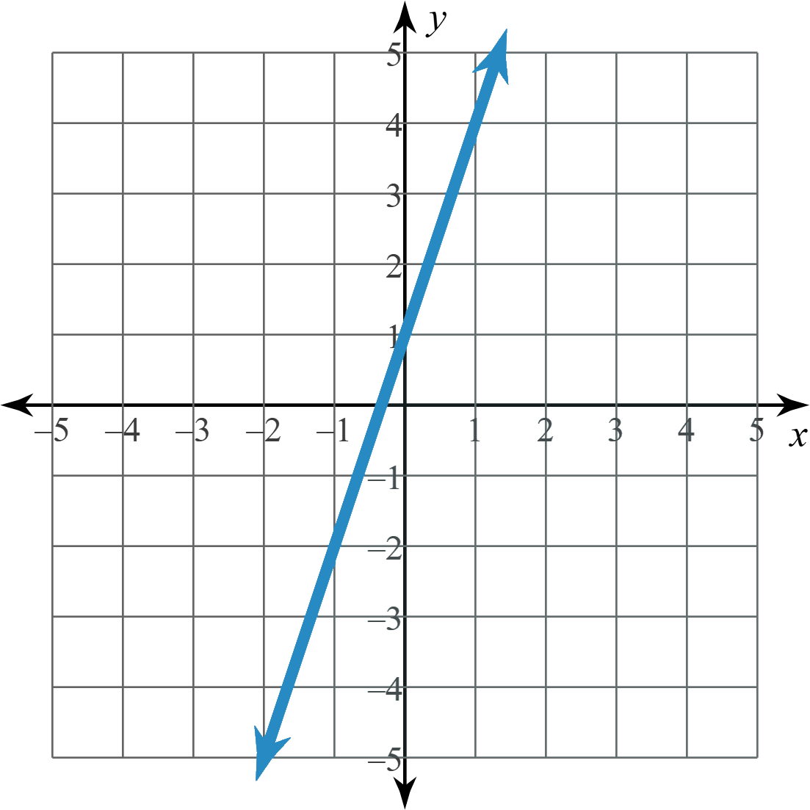
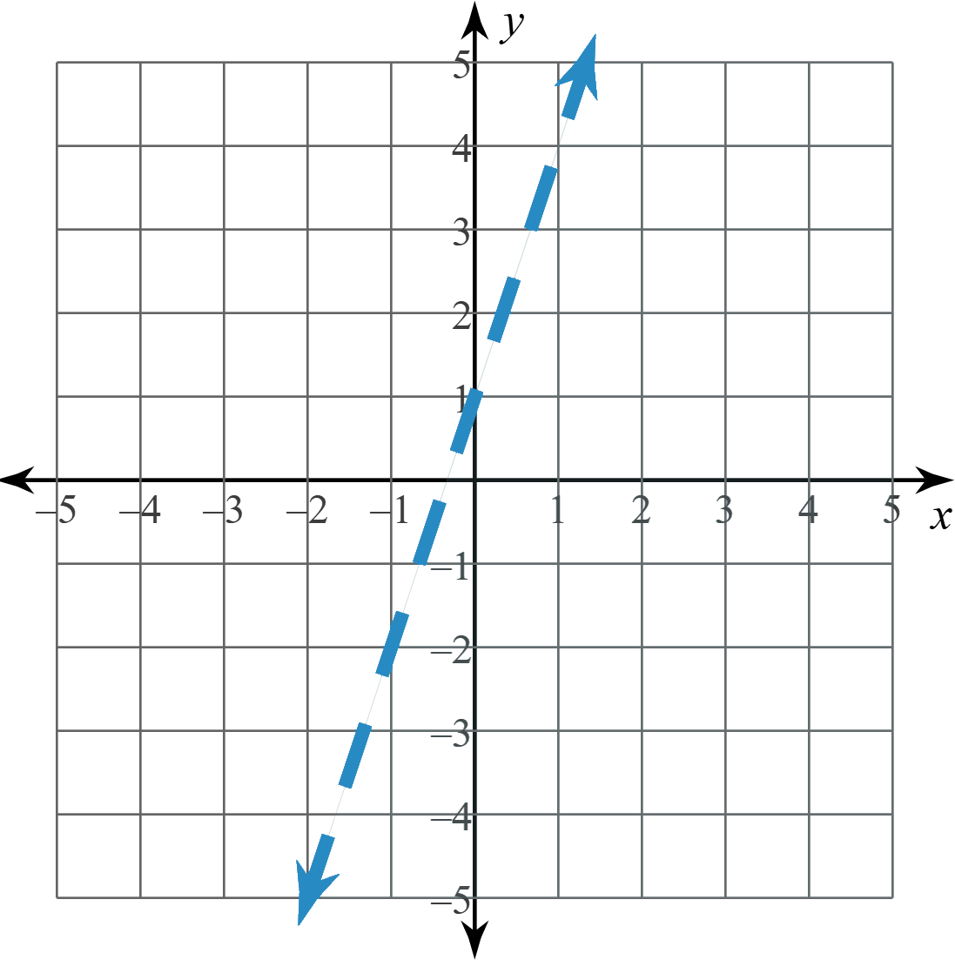
Graphing: Solid or Dashed Line?
Step 2: After plotting some points, add the following:
Sketch a solid line
if the inequality is ≤ or ≥
Sketch a dashed line
if the inequality is < or >

Slide 12
Graphing: Shading
Step 3: Pick a test point.
This can be any point that is not on the line.
(0, 0) is often the easiest point to pick.
Substitute the values from the point into the inequality
(for x and y) to see if it makes the inequality true or false.

Slide 13
Graphing: Shading
Step 4: Shade the graph to include or exclude the test point.
If the inequality is TRUE, shade toward the test point.
If the inequality is FALSE, shade away from the test point.
Should we shade toward or away from the origin?

Slide 14
Graphing: Shading
test point
Since the test point makes the inequality TRUE,
we shade toward the test point.

Slide 15
Graphing: Shading
What if you choose a test point
other than the origin?
Try the point (–2, 1).
test point

Slide 16
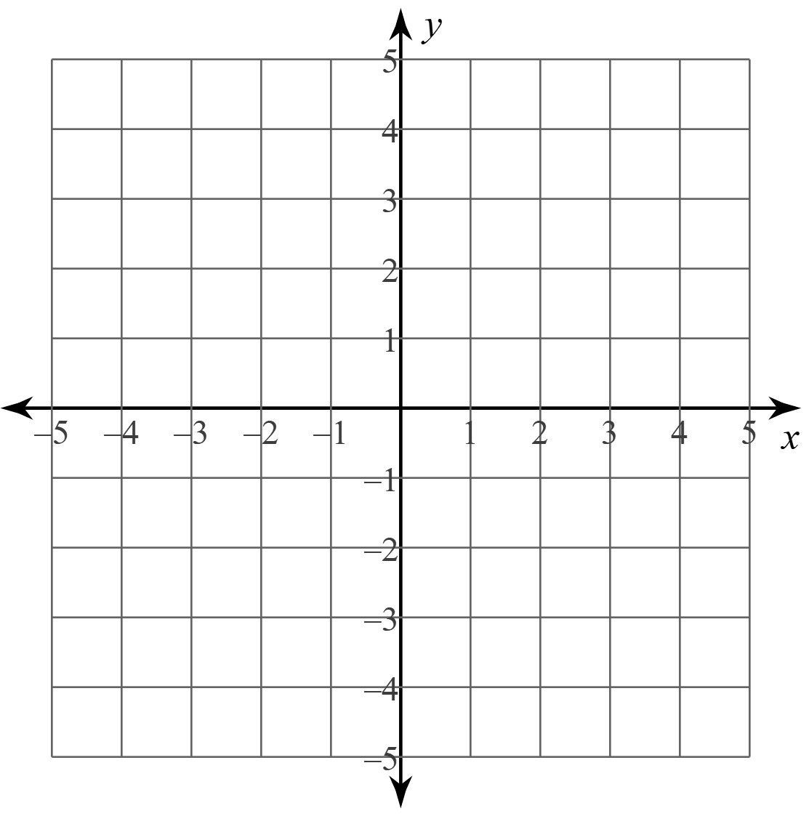
Graphing Linear Inequalities: Example 1
Graph: 2y < 3x – 2
Will this be a solid or dashed line?
What test point will you use?

Slide 17
Graphing Linear Inequalities: Example 2
Graph: 2y – 4x ≥ 6

Slide 18
Reflection: Movie Snacks
Review Scenario 2 on the Movie Snacks handout.
Where are all the points located on the graph you created?
Could you shade a region that would contain all your points?
Notes:
Clker-Free-Vector-Images. (2014, August 3). Popcorn [Illustration]. Pixabay. https://pixabay.com/vectors/pop-corn-popcorn-corn-food-snack-312386/

Slide 19
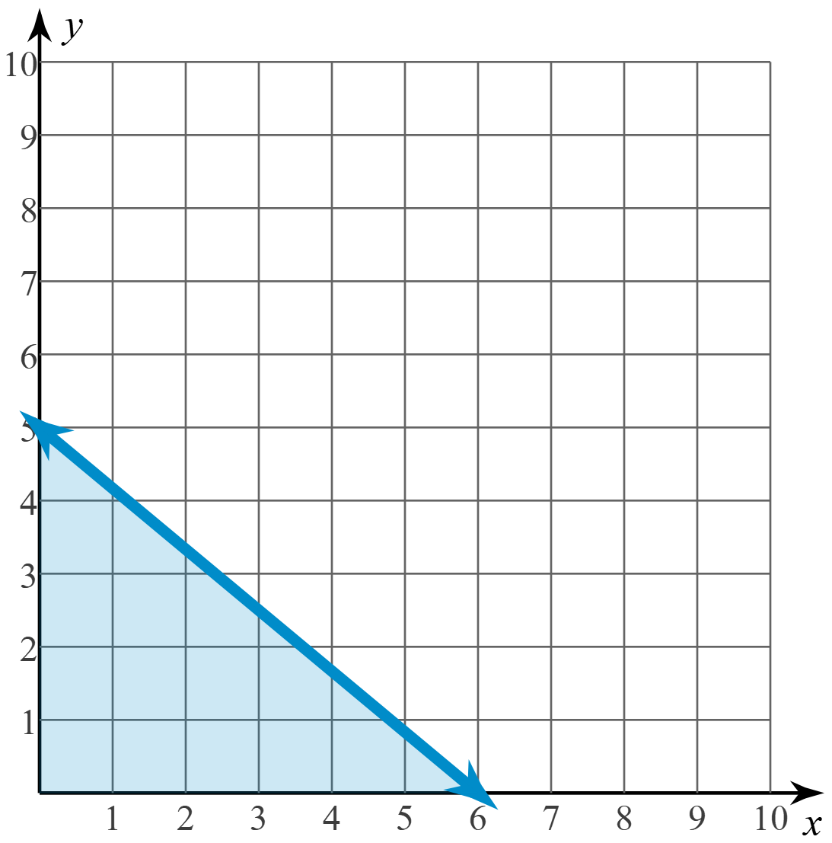
Reflection: Movie Snacks
Graph: 5x + 6y ≤ 30
Does the graph look familiar to you?
Why or why not?

Slide 20
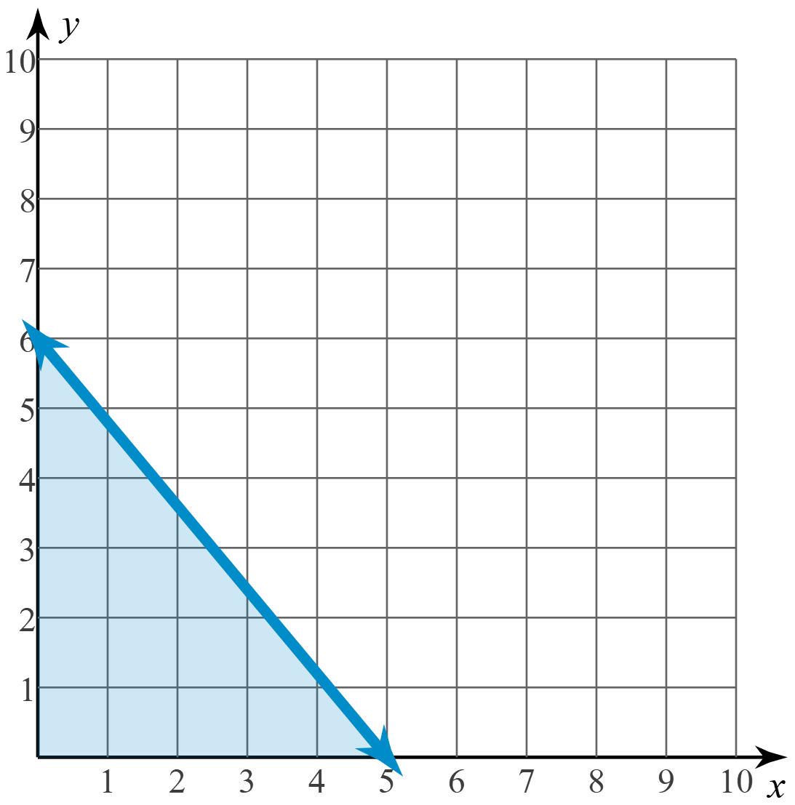
Reflection: Movie Snacks
Graph: 6x + 5y ≤ 30
Does the graph look familiar to you?
Why or why not?

Slide 21

Amplify: Polygraph
Go to student.amplify.com/join
Enter the code: <INSERT SESSION CODE>
This is like a game of Guess Who? or 20 Questions.
Picker: You should pick a graph and respond to questions with “yes” or “no.”
Guesser: You should ask yes or no question to determine which graph the Picker selected.
Notes:
Teacher’s Note: Add the session code to this slide in place of the highlighted text.

Slide 22
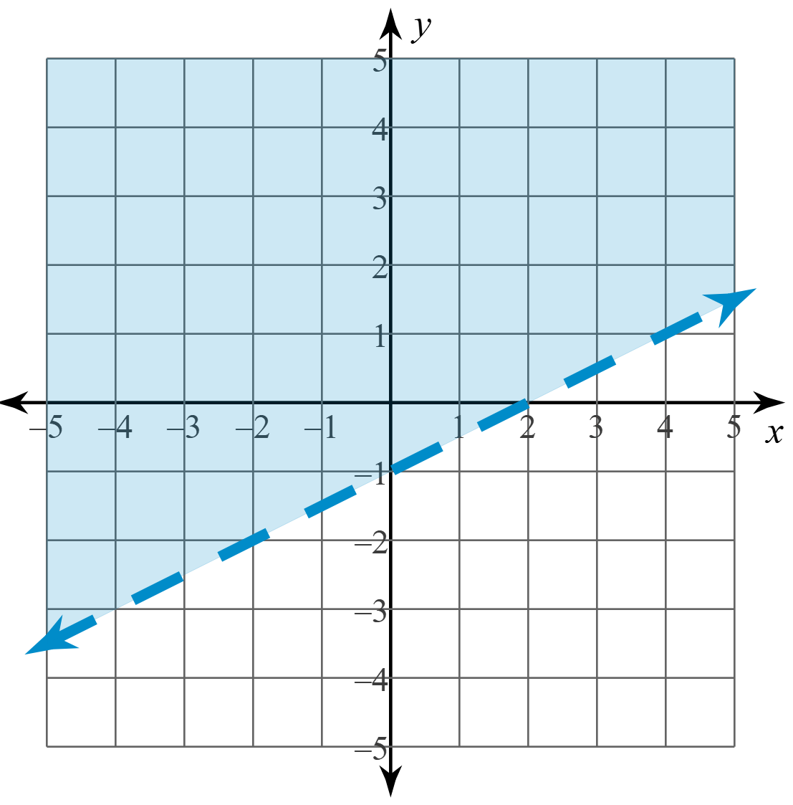
Exit Ticket
Write the inequality represented by this graph.
Notes:
K20 Center. (n.d.). Bell ringers and exit tickets. https://learn.k20center.ou.edu/strategy/125

