Slide 2
Popcorn > Raisinets
Inequalities with Two Variables

Slide 3
Essential Question
How can two-variable inequalities be used to represent relationships?

Slide 4
Lesson Objectives
Graph linear inequalities.
Interpret the solutions of a linear inequality.

Slide 5
It’s Showtime!
Would you rather…
Have two boxes of candy and no drink, or a small popcorn and unlimited drinks?
Invite two more friends to watch a movie with you and have no snacks, or go with one friend and have the money to buy snacks?
Does it depend on the circumstances?
Let’s All Go to the Lobby!
Notes:
Burrns Luciano. (2021, May 15). Let's All go to the Lobby! Intermission Bumper 4K Update [Video]. YouTube. https://youtu.be/lm6IU6V-dE8

Slide 6
Movie Snacks
Scenario 1: Your family goes to the movies. The snack bar is all out of large popcorn containers and large cups. The only size they have left is small. Your family has $30 to spend. How many orders of popcorn and drinks can they buy if a popcorn costs $6 and a drink costs $5? Your family does not want any change.
In pairs, determine the different solutions to the scenario.
Record the solutions on your handout, graph them, and answer the questions.

Slide 7
Movie Snacks
Scenario 2: Your family decided it was way too difficult to determine the number of orders of popcorn and drinks they need to buy to get back no change. Now they do not mind if they get change back. How many different combinations of popcorn orders and drinks can your family buy?
With the same partner, find solutions to the new problem.
Record the solutions on your handout, plot them, and answer the questions.

Slide 8
Graphing Linear Inequalities
Step 1: Start the same way you would when graphing a linear equation.
Rewrite the equation in slope-intercept form.
Create a table.
Find the intercepts, etc.
Plot some points.

Slide 9
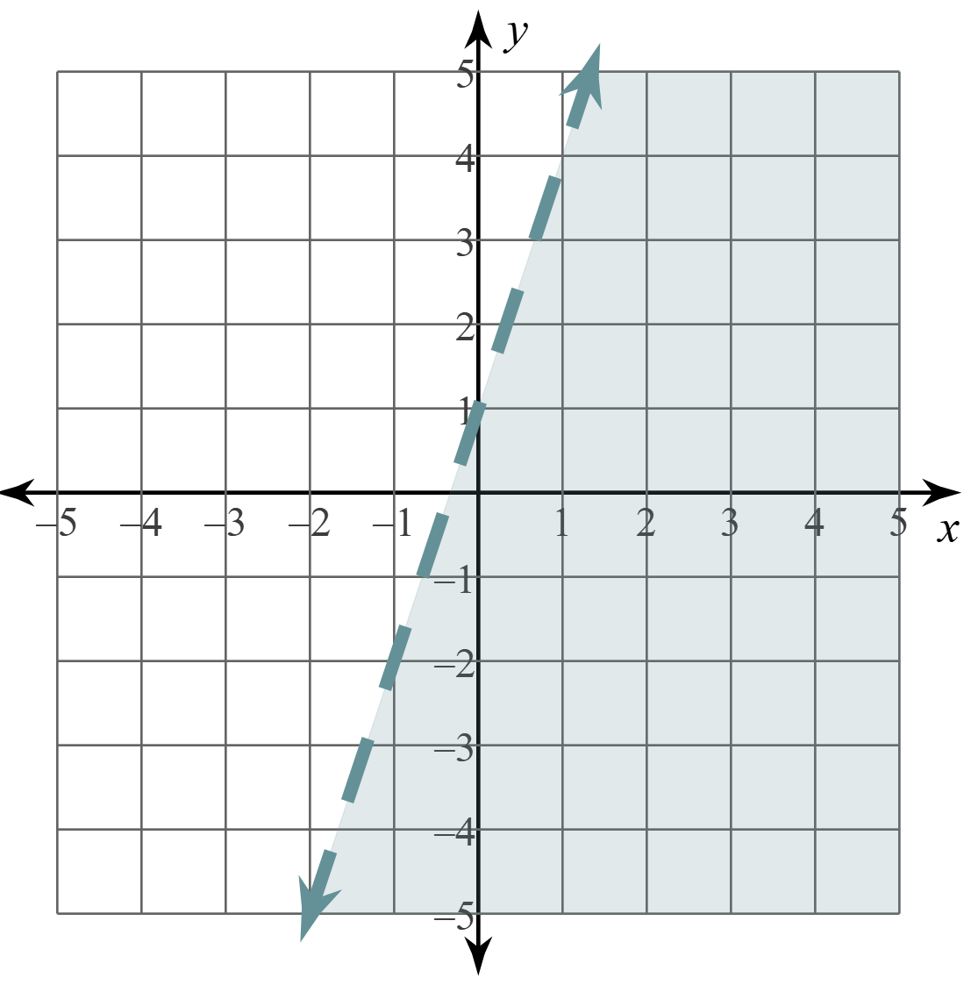
Graphing Linear Inequalities
The difference between graphing linear equations and linear inequalities is that we also need to consider the following two details:
Solid or dashed lines
Shading

Slide 10
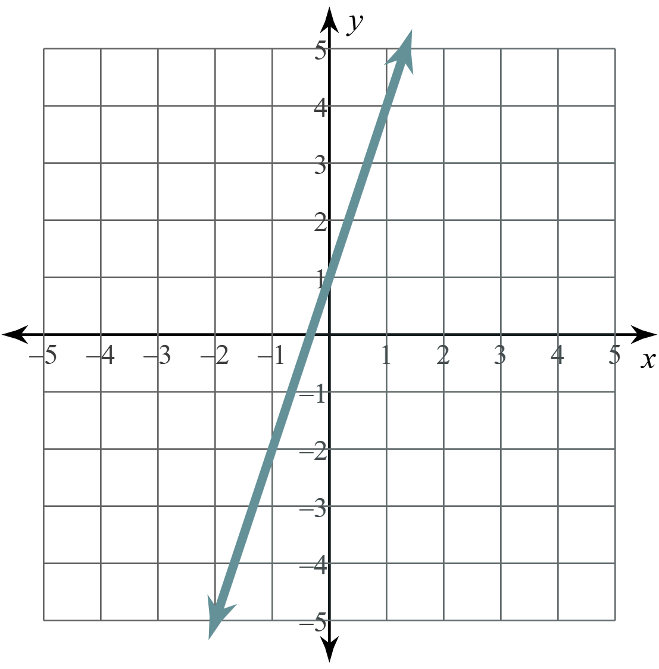
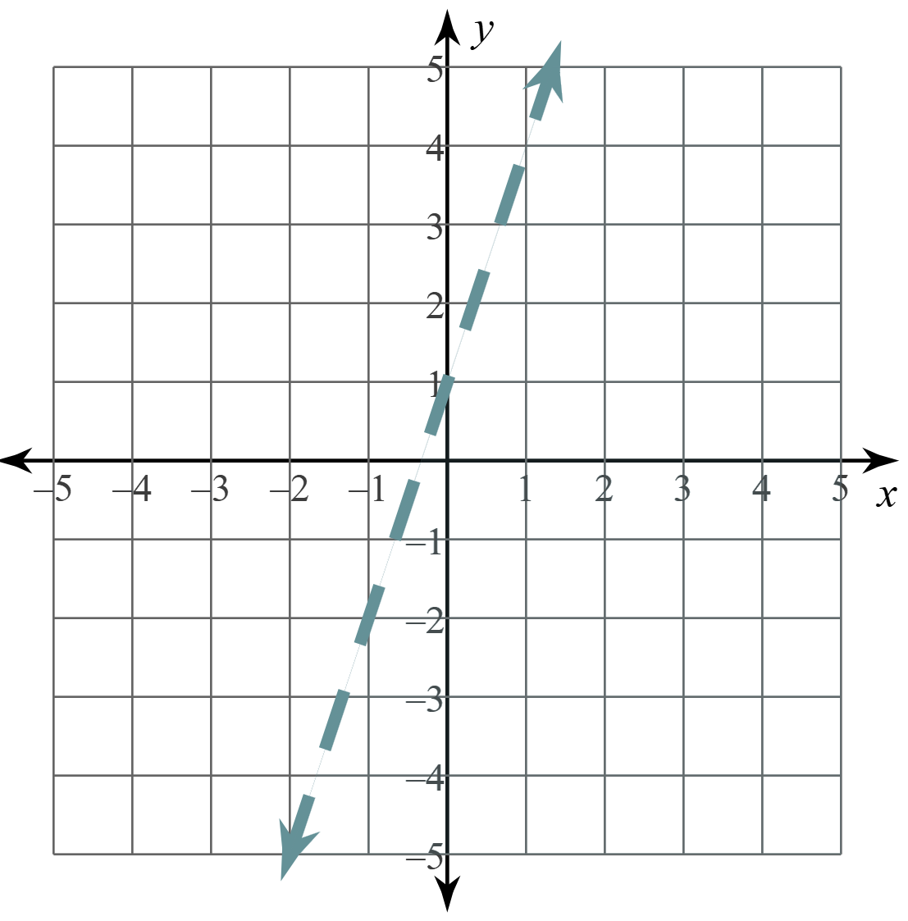
Graphing: Solid or Dashed Line?
Step 2: After plotting some points,
sketch a solid line if the inequality is ≤ or ≥.
sketch a dashed line if the inequality is < or >.

Slide 11
Graphing: Shading
Step 3: Pick a “test point.” This can be any point that is not on the line.
(0, 0) is often the easiest point to pick.
Substitute the values from the point into the inequality (for x and y) to see if it makes the inequality true or false.

Slide 12
Graphing: Shading
Step 4: Shade to include or exclude the test point.
If the inequality is TRUE, shade toward the test point.
If the inequality is FALSE, shade away from the test point.
Should we shade toward or away from the origin?

Slide 13
Graphing: Shading
Since the test point makes the inequality TRUE, we shade toward the test point.
test point

Slide 14
Graphing: Shading
What if I don’t test with the origin?
Let’s see what happens.
Try the point: (–2, 1).
test point

Slide 15
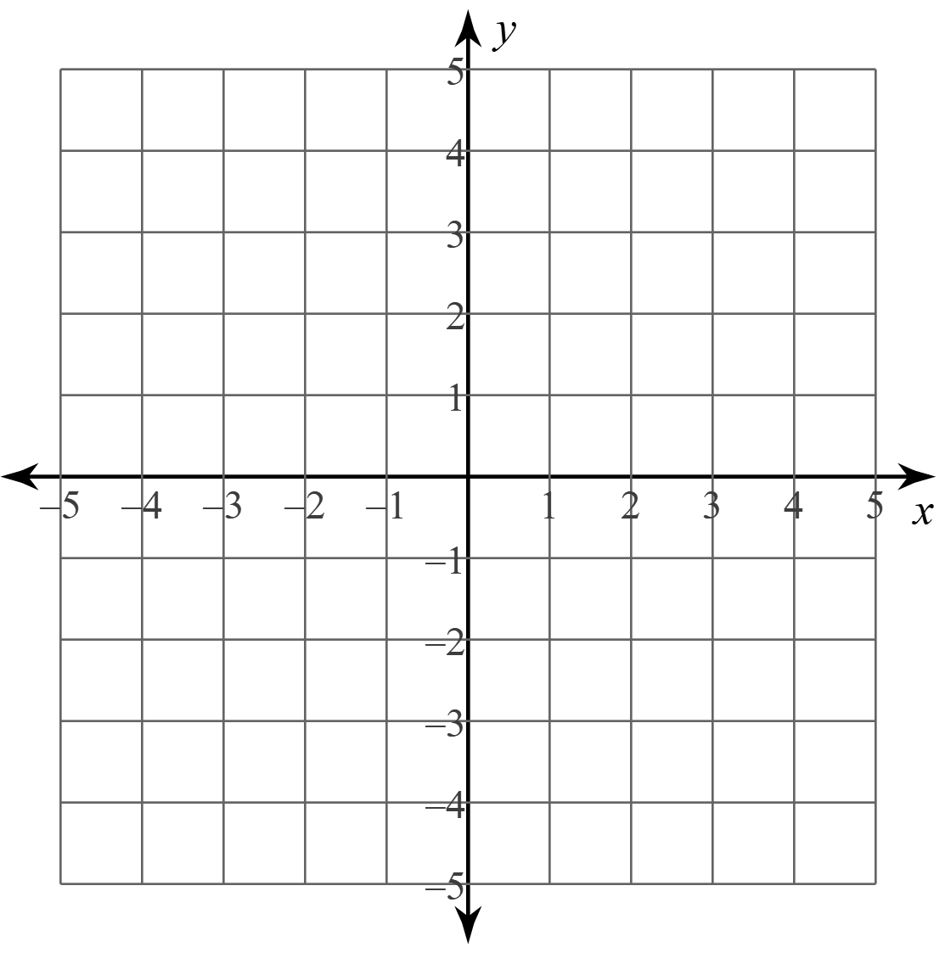
Graphing Linear Inequalities: Example 1
Graph: 2y < 3x – 2
Will this be a solid or dashed line?
What point are you going to use to test?

Slide 16
Graphing Linear Inequalities: Example 2
Graph: 2y – 4x ≥ 6

Slide 17
Reflection: Movie Snacks
Look at Scenario 2 from the Movie Snacks handout.
Where are all the points located on the graph you created?
Could you shade a region that would contain all your points?

Slide 18
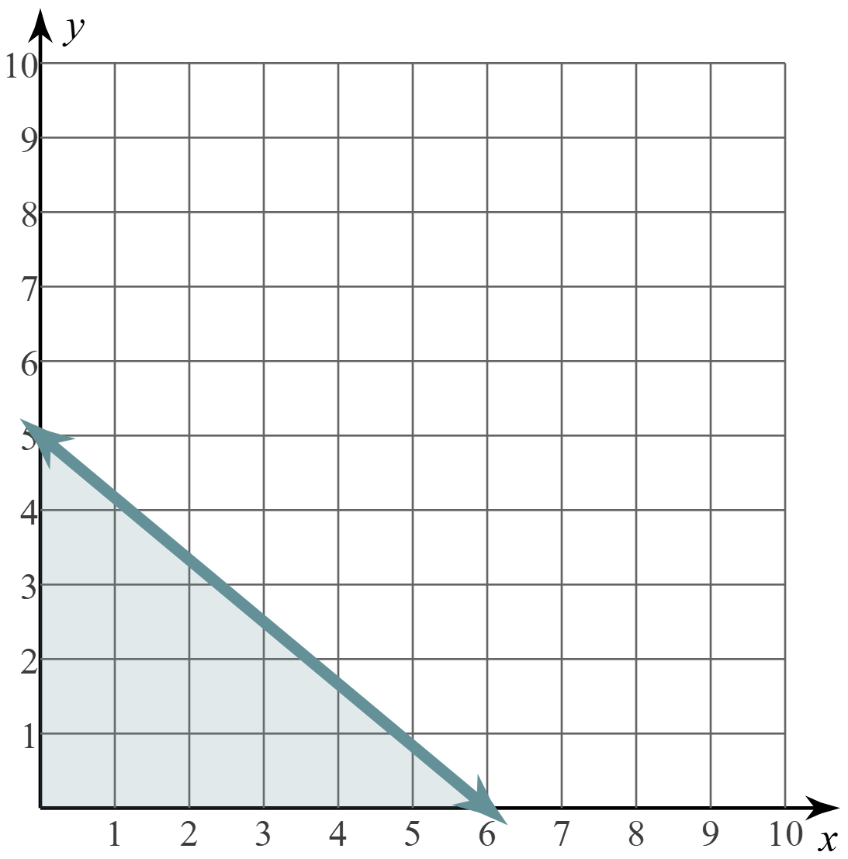
Reflection: Movie Snacks
Graph:
Does the graph look familiar to you?
Why or why not?

Slide 19
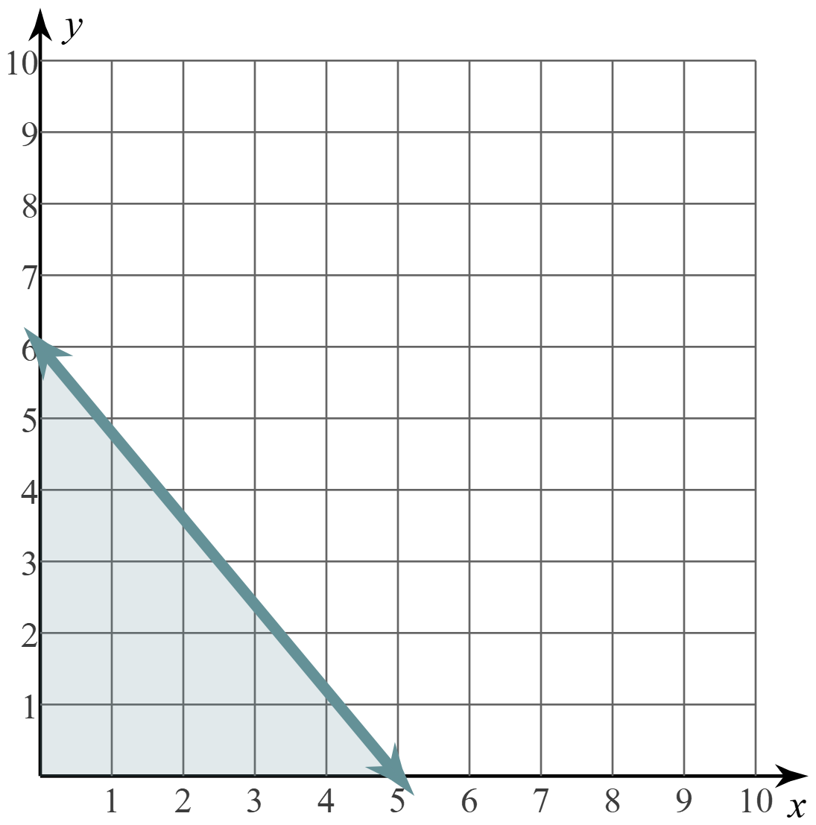
Reflection: Movie Snacks
Graph:
Does the graph look familiar to you?
Why or why not?

Slide 20
Desmos: Polygraph
Go to student.desmos.com.
Enter code.
This is like a game of Guess Who? Or 20 Questions.
Picker: You’ll pick a graph and respond with “yes” or “no.”
Guesser: You’ll need to ask yes or no question to determine which graph the Picker selected.

Slide 21
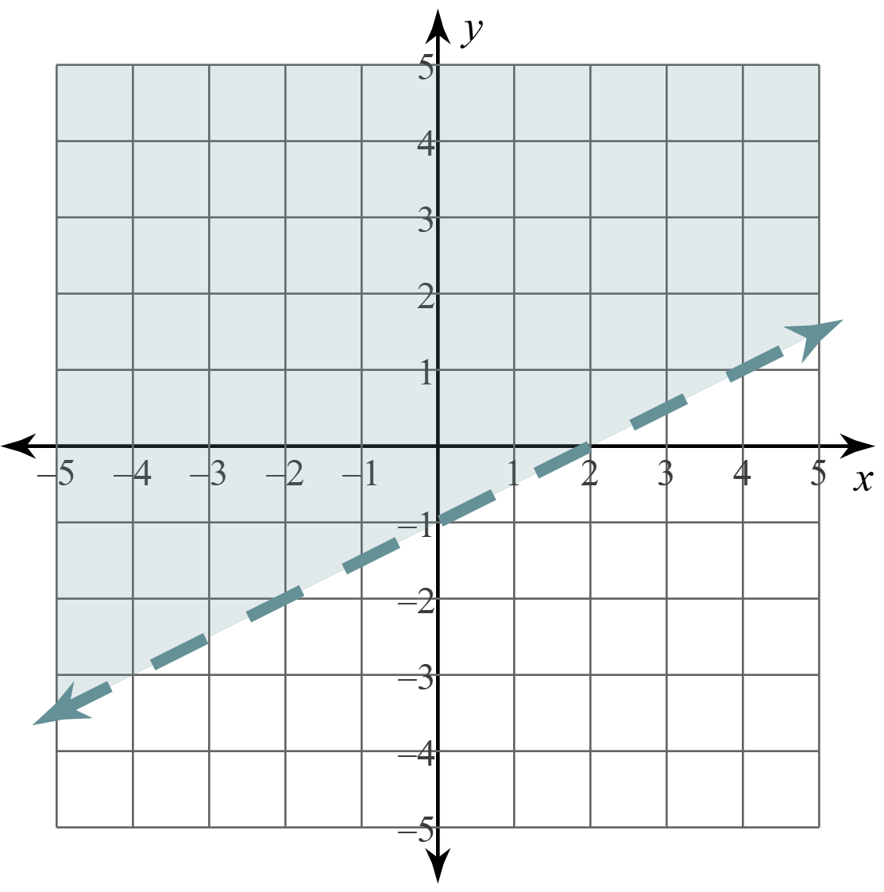
Exit Ticket
Write the inequality represented by this graph.

