Slide 2
Analyzing Literary Figures

Slide 3
Essential Question
Does literature make the author, or does the author make literature?

Slide 4
Objectives
Analyze and summarize the impact of key literary figures.
Make connections between literary figures.

Slide 5
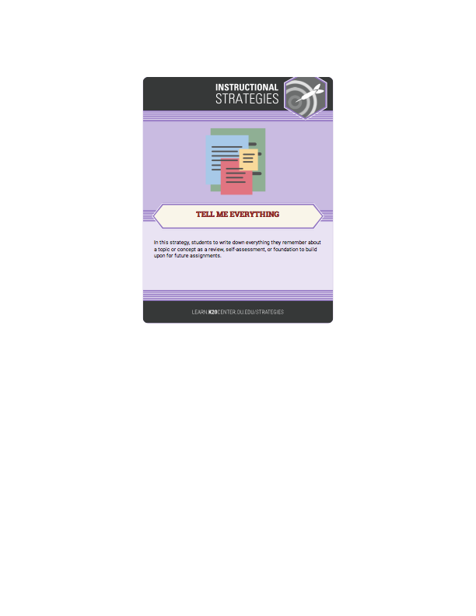
Tell Me Everything
On a blank sheet of paper, tell me…
  Every author that you can think of!
You will have one minute!

Slide 6
Tell Me More
Using your list, tell me everything you know about the people on it.
You have one minute!

Slide 7
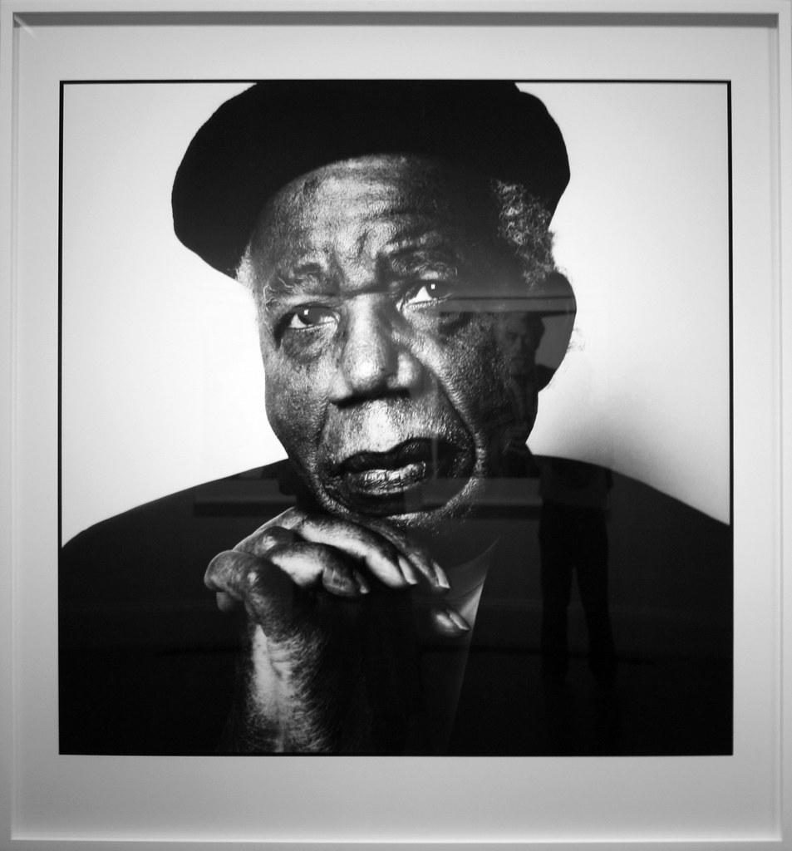
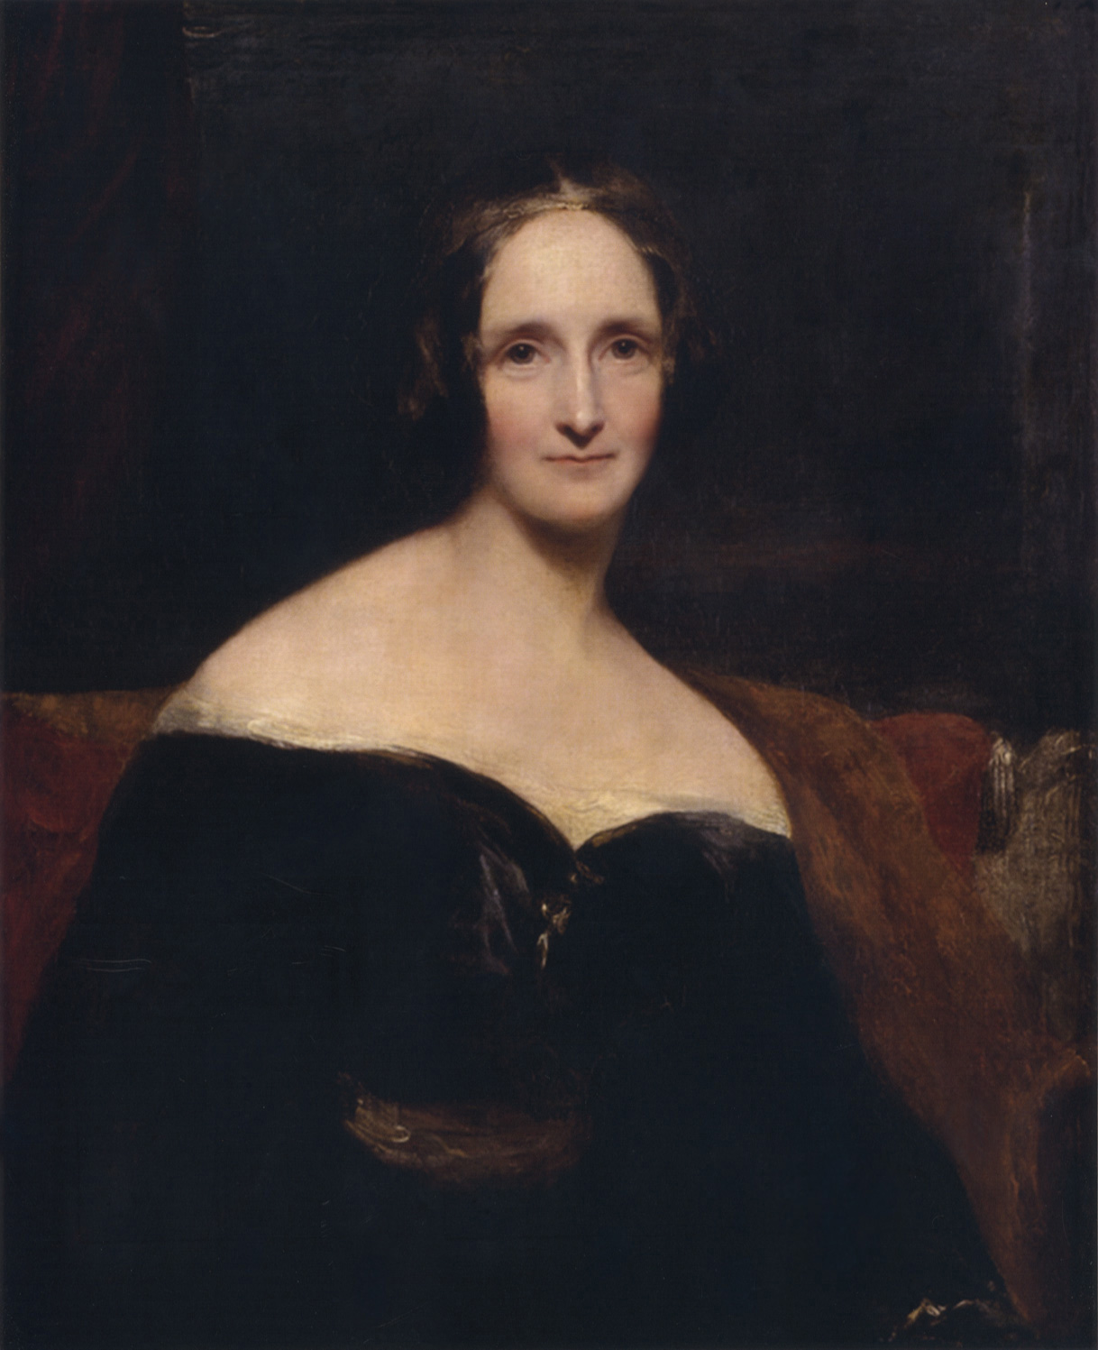
Literary Figures
Who are these literary figures?
Were they included in your lists?
Why or why not?
Notes:
Chinua Achebe
Cliff. (2009, April 18). Chinua Achebe, by Steve Pyke, gelatin silver print, 2008, published in The New Yorker, May 26, 2008. Flickr. https://www.flickr.com/photos/nostri-imago/3457997382
Mary Shelley
Rothwell, R. (1840). Portrait of Mary Shelley. Wikimedia Commons. https://commons.wikimedia.org/wiki/File:RothwellMaryShelley.jpg

Slide 8
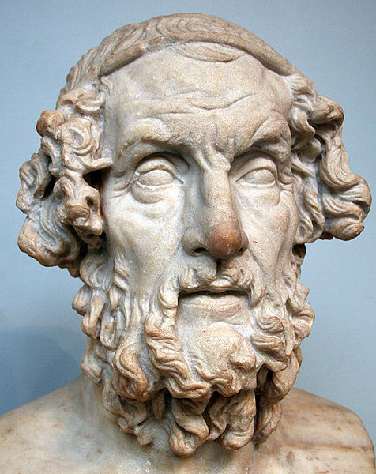
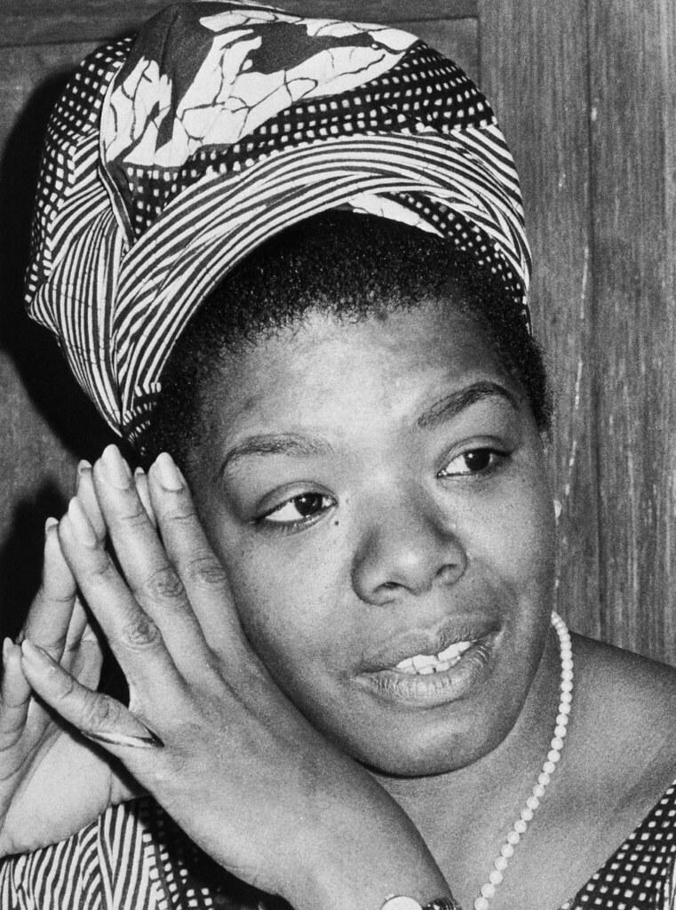
Literary Figures
Who are these literary figures?
Were they included in your lists?
Why or why not?
Notes:
Homer
Yonidebest. (2005, February 23). Photograph taken of the bust of Homer in the British Museum, London… Wikimedia Commons. https://commons.wikimedia.org/wiki/File:Homer_British_Museum.jpg
Maya Angelou
Saba, T. (2003, March 11). San Francisco: Poet Maya Angelou shown in photo from files dated 1970. Flickr. https://www.flickr.com/photos/97453745@N02/9046265165

Slide 9
Your Task
Draw a slip of paper.
The name on the paper will be the name of the person you will research for the project.

Slide 10
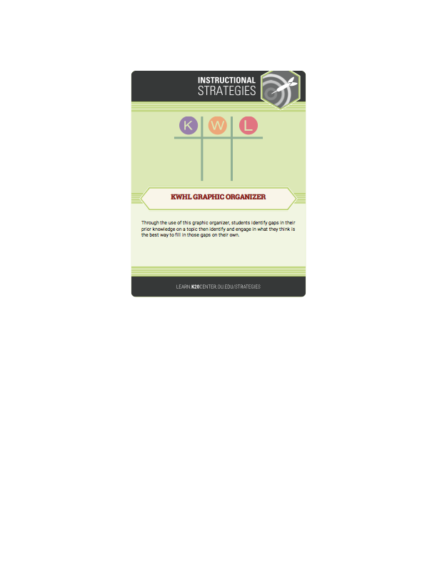
KWHL Chart
At the top of your KWHL Chart, write the name of your literary figure.
In the “K” column, fill in everything you know about your figure.

Slide 11
KWHL Chart
In the “W” column, write down everything you want to know about your figure.
Need help? Think about…
  What do I want to know?
  What would others want to know?
  For what is this person famous?

Slide 12
KWHL Chart
In the “H” column, write down how you could go about finding the information you listed in the “W” column.
What does that mean?
  A focused Internet search
  Reading encyclopedia articles
  Which resources could you use to learn more about your figure?

Slide 13
Research
Using the “H” portion of your chart to guide you, research your assigned figure.
Some things to consider as you research…
  Notable accomplishments
  Common themes in their writing
  Connections to other literary figures
  Interests or hobbies
  Contributions to their field
  Interesting facts

Slide 14
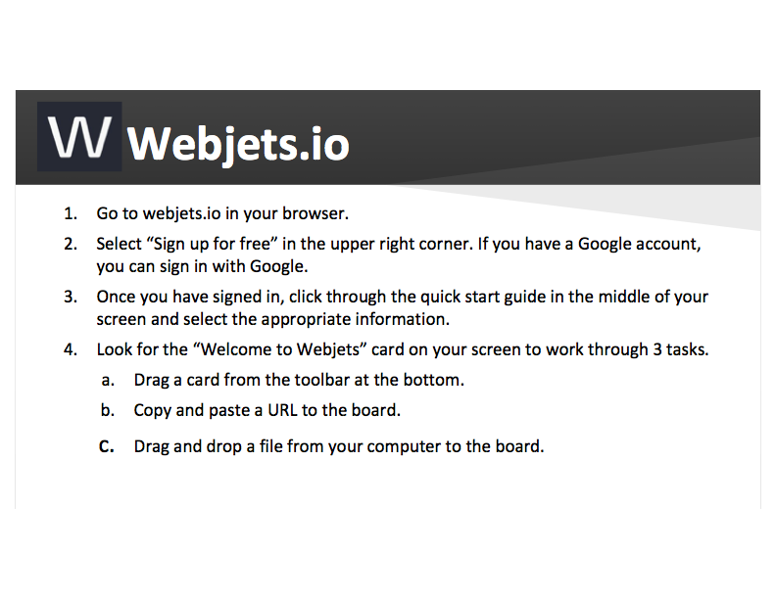

Slide 15
Literary Figures Project
Using the template, create a project about your figure that includes the following…
  Most Famous Work
  Three Minute Bio
  Genre(s)
  Most Used Literary Devices
  Similar Author
  Dissimilar Author
  Common Themes or Topics
  Image

Slide 16
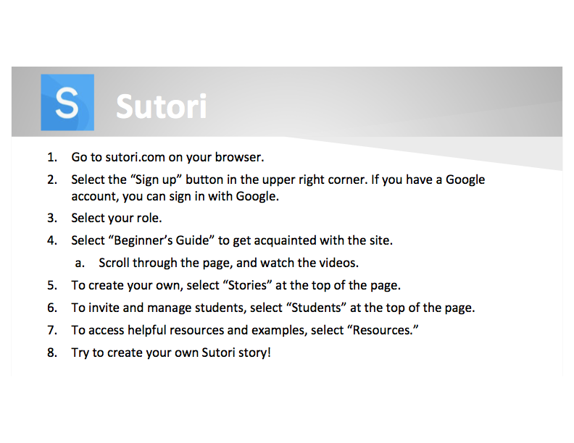

Slide 17
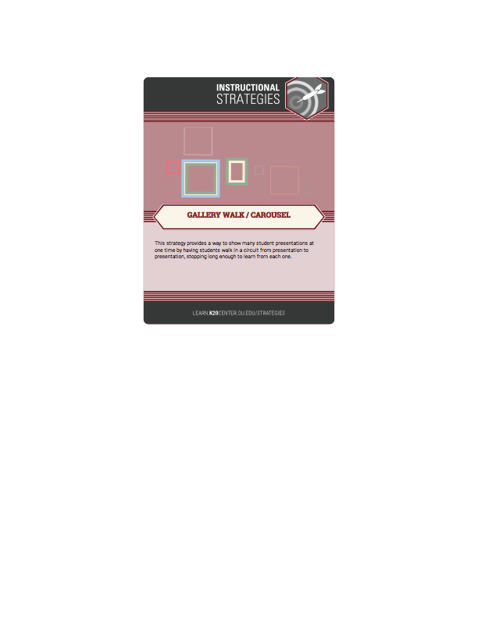
Gallery Walk
You will be viewing the projects of your peers.
Using sticky notes, write down any praise you have or any helpful tips.
  Did you like their image or symbols? Tell them!
  Did they use the wrong your/you’re? Tell them politely!
We will be rotating clockwise around the room, and only ONE person should be viewing the project at a time.

Slide 18
Gallery Walk with Sutori
Have students share the links to the projects in Google Classroom (or collaborative workspace).
Assign 3-5 links to each student.
Review and read through each peer’s project.
Comment on aspects you love, or politely offer advice if you notice any issues.

Slide 19
KWHL Revisited
You should have the “L” column of your chart empty.
Now, fill in the “L” column with the information you have learned about your historical figure.

