Slide 1
Analyzing Oklahoma Historical Figures
Oklahoma History

Slide 2
Essential Question
Do people make history, or does history make people?

Slide 3
Objectives
Analyze and summarize the impact of key historical figures in Oklahoma history.
Make connections between historical figures.

Slide 4
Tell Me Everything!
On a blank sheet of paper, tell me …
Every Oklahoma historical figure you can think of.
You have 1 minute.

Slide 5
Tell Me More!
Using your list, tell me …
Everything that you know about the people on the list.
You have 1 minute.

Slide 6
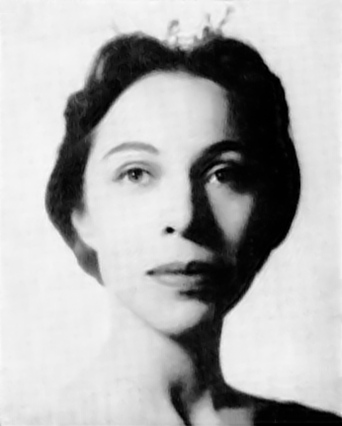
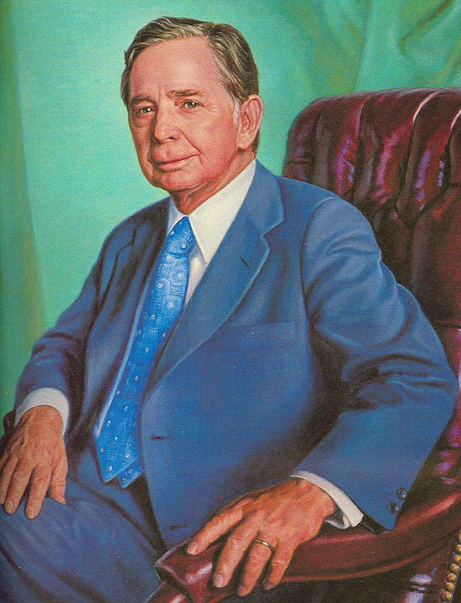
Oklahoma Historical Figures
Who are these Oklahoma historical figures?
Were they included in your list? Why or why not?
Notes:
Maria Tallchief Image Source: Unknown author. (1961). Headshot of Maria Tallchief from the April 1961 issue of Dance Magazine, commemorating the magazine’s annual award winners. Wikimedia Commons. https://commons.wikimedia.org/wiki/File:Maria_Tallchief_1961.png
Carl Albert Image Source: Unknown author. (ca. 1971-1977). Cropped portrait of Carl Albert, speaker of the U.S. House of Representatives. Wikipedia. https://en.m.wikipedia.org/wiki/File:Speaker_Albert_-_portrait_(cropped).jpg

Slide 7
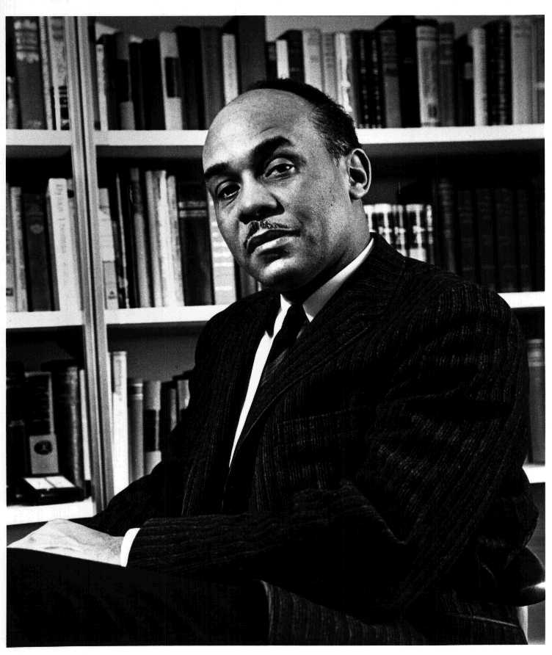
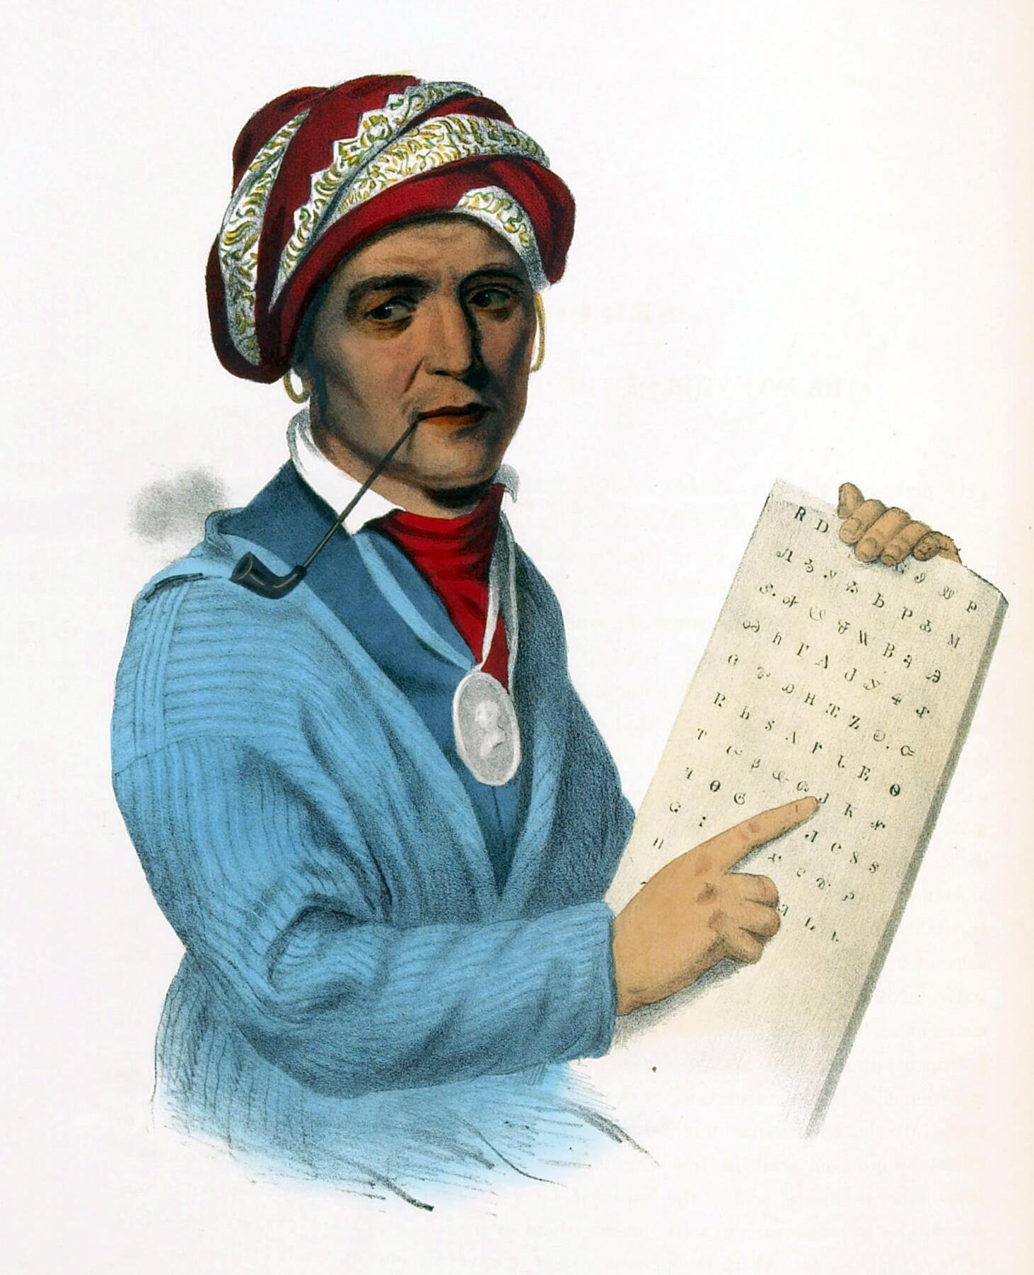
Oklahoma Historical Figures
Who are these Oklahoma historical figures?
Were they included in your list? Why or why not?
Notes:
Ralph Ellison Image Source: USIA staff photographer. (1961). Ralph Ellison, noted author and professor. Wikimedia Commons. https://commons.wikimedia.org/wiki/File:Ralph_Ellison_photo_portrait_seated.jpg
Sequoyah Image Source: Lehman, G., Duval, P. S., & Inman, H. (ca. 1833-1846). Sequoyah with a tablet depicting his writing system for the Cherokee language. 19th-century print of a painting. Wikimedia Commons. https://commons.wikimedia.org/wiki/File:Sequoyah.jpg

Slide 8
Your Task
Draw a slip of paper.
The name on the paper will be the name of the person you will research for the project.

Slide 9
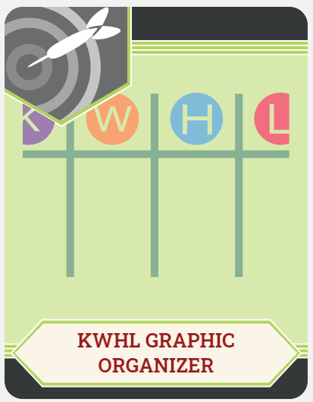
KWHL Chart
Write the name of your historical figure at the top of your KWHL Chart.
In the “K” column, fill in everything that you know about your figure.

Slide 10
KWHL Chart
In the “W” column, write down everything you want to know about your figure.
Need help? Think about:
What do I want to know?
What would others want to know?
For what is this person famous?

Slide 11
KWHL Chart
In the “H” column, write down ways you can find the information you listed in the “W” column.
For example:
A focused Internet search
Reading encyclopedia articles
What other resources could you use to learn more about your figure?

Slide 12
Research
Using the “H” portion of your chart as a guide, research your assigned figure.
Some things to consider as you research:
Notable accomplishments
Education
Connections to other historical figures
Interests or hobbies
Contributions to their field
Interesting facts

Slide 13
Notes:
Source: Wilson, C. (2020). Interactive classrooms for all contents. Activities. https://learn.k20center.ou.edu/pd/816ff8a793dedf6ff5046224f801b713

Slide 14
Historical Figures Project
Using the template, create a project about your figure that includes each of the following:
Quote
Five fast facts
Historical importance
Six-word memoir
BFF
Worst enemy
Four symbols
Image

Slide 15
Notes:
Source: Wilson, C. (2020). Interactive classrooms for all contents. Activities. https://learn.k20center.ou.edu/pd/816ff8a793dedf6ff5046224f801b713

Slide 16
Gallery Walk
Find a peer project to review.
Only ONE person should view each project at a time.
Using sticky notes, write down any praise you have or any helpful tips.
Did you like their image or symbols? Tell them!
Did they use the wrong your/you’re? Tell them politely!
Rotate clockwise around the room to the next project.

Slide 17
Sutori Gallery Walk
Share the link to your project in Google Classroom (or another collaborative workspace your teacher specifies).
Review and read through each peer project that you are assigned.
Comment on aspects that you love, and politely offer advice if you notice any issues.

Slide 18
KWHL Chart Revisited
Fill in the “L” column on your chart with the information that you have learned about your historical figure.

