Slide 2

Analyzing World Historical Figures
Analyzing History

Slide 3
Essential Question
Do people make history, or does history make people?

Slide 4
Learning Objectives
Analyze and summarize the impact of key historical figures in world history.
Make connections between historical figures.

Slide 5

Tell Me Everything!
On a blank sheet of paper, tell me…
  Every world historical figure you can think of.
You have 1 minute.
Notes:
K20 Center. (n.d.). Tell me everything. Strategies. https://learn.k20center.ou.edu/strategy/107

Slide 6
Tell Me More!
Using your list, tell me…
  Everything that you know about the people on your list.
You have 1 minute.
Notes:
K20 Center. (n.d.). Tell me everything. Strategies. https://learn.k20center.ou.edu/strategy/107

Slide 7
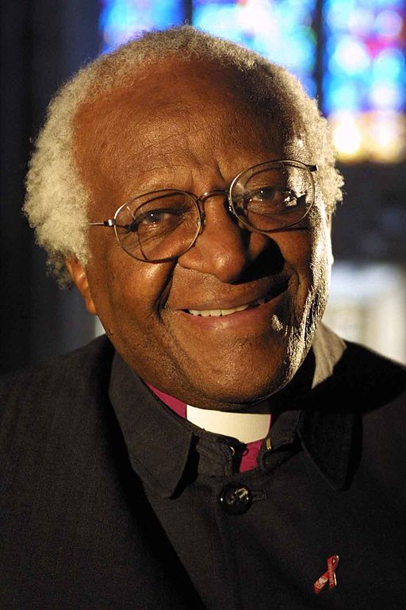
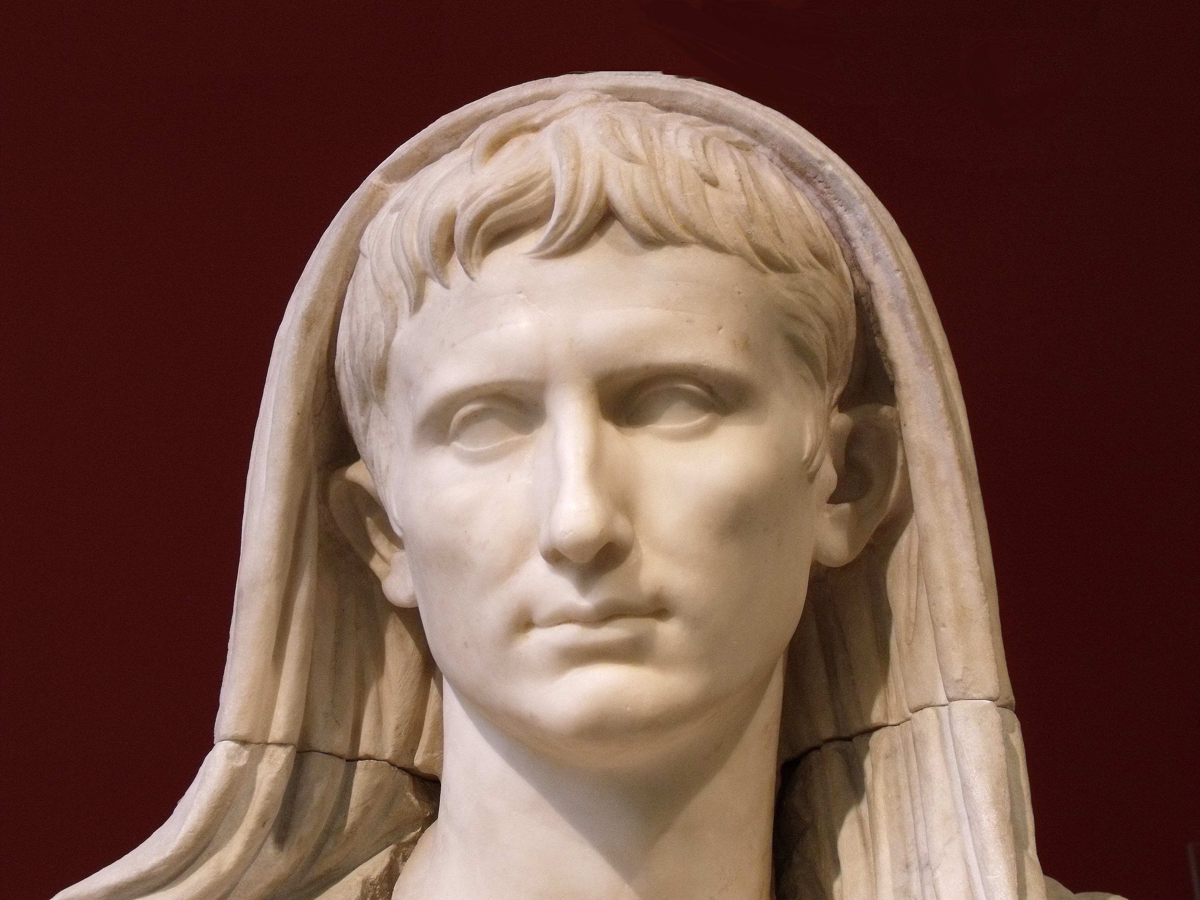
World Historical Figures
Who are these figures?
Were they included on your list?
Why or why not?
Notes:
Desmond Tutu Image Source: Gool, B. (2005, January 25). Archbishop Desmond Tutu [Photograph]. Wikimedia Commons. https://commons.wikimedia.org/wiki/File:Archbishop-Tutu-medium.jpg
Augustus Image Source: Alphanidon. (2010, February 19). Head of Augustus as Pontifex Maximus, Roman artwork of the late Augustan period, last decade of the 1st century BC [Photograph]. Wikipedia. https://en.wikipedia.org/wiki/Augustus#/media/File:August_Labicana_Massimo_Inv56230_n2.jpg

Slide 8
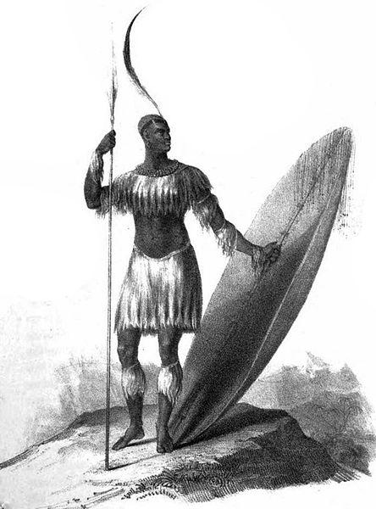
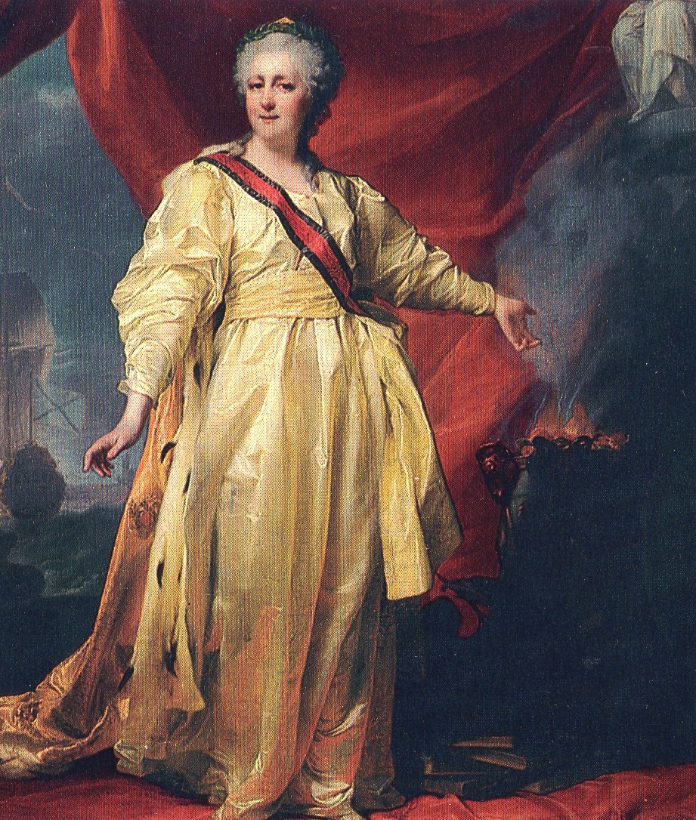
World Historical Figures
Who are these figures?
Were they included on your lists? Why or why not?
Notes:
Catherine the Great Image Source: Levitzky, D. (ca. 1770). Portrait of Catherine II the legislatress in the temple devoted to the goddess of justice [Image]. Wikimedia Commons. https://commons.wikimedia.org/wiki/File:Empress_Catherine_The_Great_circa_1770_(D.G._Levitsky).JPG
Shaka Zulu Image Source: King, J. (1824). Only known drawing of King Shaka Zulu holding an assegai and heavy shield, 1824 [Image]. Wikimedia Commons. https://commons.wikimedia.org/wiki/File:KingShaka.jpg

Slide 9
Your Task
Draw a slip of paper.
The name on your slip of paper is the name of the person you will research for the project.

Slide 10

KWHL Chart
Write the name of your historical figure at the top of your KWHL Chart.
In the “K” column, fill in everything you know about your figure.
Notes:
K20 Center. (n.d.). KWHL graphic organizer. Strategies. https://learn.k20center.ou.edu/strategy/127

Slide 11
KWHL Chart
In the “W” column, write down everything you want to know about your figure.
Need help? Think about:
What do I want to know?
What would others want to know?
Why is this person famous?
Notes:
K20 Center. (n.d.). KWHL graphic organizer. Strategies. https://learn.k20center.ou.edu/strategy/127

Slide 12
KWHL Chart
In the “H” column, write down how you can find the information you listed in the “W” column. What other resources could you use to learn more about your figure?
For example:
A focused internet search
Reading encyclopedia articles
Notes:
K20 Center. (n.d.). KWHL graphic organizer. Strategies. https://learn.k20center.ou.edu/strategy/127

Slide 13
Research
Research your assigned figure using the “H” portion of your chart as a guide.
Some things to consider as you research:
  Notable accomplishments
  Education
  Connections to other historical figures
  Interests or hobbies
  Contributions to their field
  Interesting facts

Slide 14
Historical Figures Project
Using the template, create a project about your figure that includes each of the following:
Quote
Five fast facts
Historical importance
Six-word memoir
BFF
Worst enemy
Four symbols
Image

Slide 15
Gallery Walk
Find a peer project to review.
  Only one person should review each project at a time.
Using sticky notes, write down praise of their project and any helpful tips.
  Did you like their image or symbols?
  Did you notice any errors, like the wrong “your” or “you’re”?
Rotate clockwise to the next project when you’re done.
Notes:
K20 Center. (n.d.). Gallery walk / carousel. Strategies. https://learn.k20center.ou.edu/strategy/118

Slide 16
KWHL Chart Revisited
In the “L” column, record information that you learned about your historical figure during this lesson.
Notes:
K20 Center. (n.d.). KWHL graphic organizer. Strategies. https://learn.k20center.ou.edu/strategy/127

