Slide 1
The Consequences of Time Travel
English Language Arts (ELA)

Slide 2
Essential Question
How can the actions of one person affect others?

Slide 3
Learning Objectives
Analyze a text for elements of cause and effect and foreshadowing.
Create a presentation using textual evidence.

Slide 4
Always, Sometimes, or Never True
Label each statement with one of the following:
Always True
Sometimes True
Never True
Include your reasons for selecting each label.

Slide 5
Have you ever read a book or seen a movie that included time travel?
Did the characters have any time-related issues during their adventures?

Slide 6
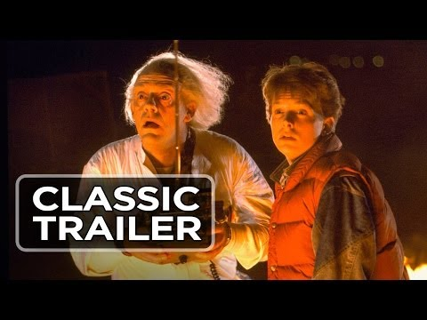
Notes:
Video Source: Movieclips Classic Trailers. (2013, November 15). Back to the Future (1985) theatrical trailer – Michael J. Fox movie HD [Video]. YouTube. https://www.youtube.com/watch?v=qvsgGtivCgs

Slide 7
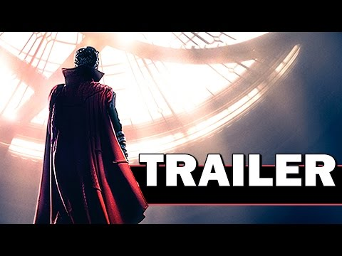
Notes:
Video Source: FRESH Movie Trailers. (2016, April 13). Doctor Strange official trailer (Marvel – movie HD) [Video]. YouTube. https://www.youtube.com/watch?v=MWRUNTLisPo

Slide 8
I Think/We Think
Brainstorm your own definitions for each of these terms:
Cause
Effect
Foreshadowing
Record your definitions in the “I Think” column.

Slide 9
I Think/We Think
Discuss your definitions within your group.
Together, brainstorm a new definition for each term. Be sure you agree on these definitions.
Record your definitions in the “We Think” column.

Slide 10
I Think/We Think
Discuss examples of each term with your group.
Record these in the “Examples” column.

Slide 11
“A Sound of Thunder”
While you’re reading, highlight examples of the following:
Foreshadowing
Cause
Effect

Slide 12
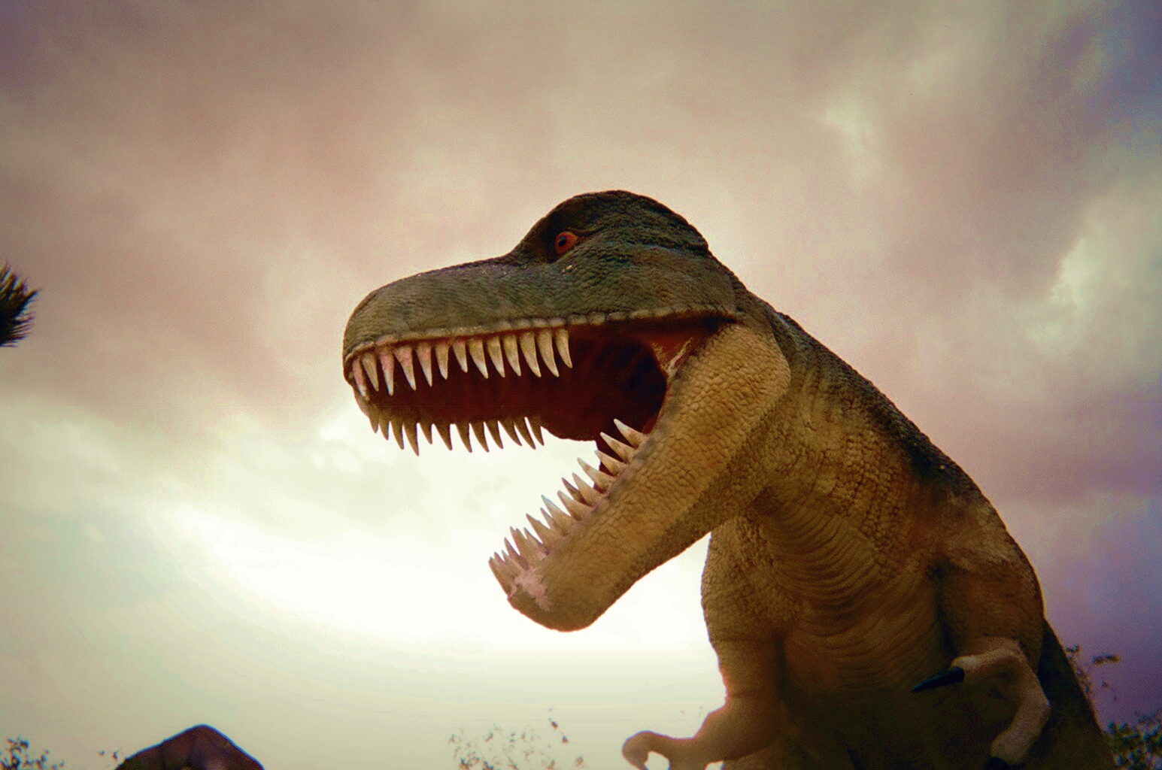
A Sound of Thunder
By Ray Bradbury
In your Why-Lighting Chart, include the following:
Your Why-Lighted excerpts
Whether the excerpt is a cause, an effect, or foreshadowing
Your reasoning
Outlaw wolf. (2010). Untitled. Flickr. https://www.flickr.com/photos/hellooutlaw/4660441215/
Notes:
Image Source: Outlaw wolf. (2010). Untitled. Flickr. https://www.flickr.com/photos/hellooutlaw/4660441215/

Slide 13
Time Travel, Inc. Travel Brochure
In your brochure, include:
The company’s title
Summary of the services
Three or more rules
Rationale for each rule
Consequences for breaking the rules
Artwork to market your company
Outlaw wolf. (2010). Untitled. Flickr. https://www.flickr.com/photos/hellooutlaw/4660441215/
Notes:
Image Source: Outlaw wolf. (2010). Untitled. Flickr. https://www.flickr.com/photos/hellooutlaw/4660441215/

Slide 14
Always, Sometimes, or Never True
Re-evaluate your responses from the beginning of the lesson.
Make any changes that you think would be appropriate now that you’ve read “A Sound of Thunder.”

