Slide 2
The Spiro Mounds Builders
Oklahoma History

Slide 3
Essential Questions
What are the significant symbols and icons of civilizations and cultures?
How can we know about the past if we weren’t there?

Slide 4
Learning Objectives
Summarize the accomplishments of the Spiro Mounds builders.
Analyze the importance of preserving history.

Slide 5

Always, Sometimes, Never True Activity
On the Always, Sometimes, Never True handout, for each statement, choose the answer that best describes how often the statement is true: always, sometimes, or never.
Then, in the right column, justify or explain your answer.
With your partner, discuss your responses.

Slide 6
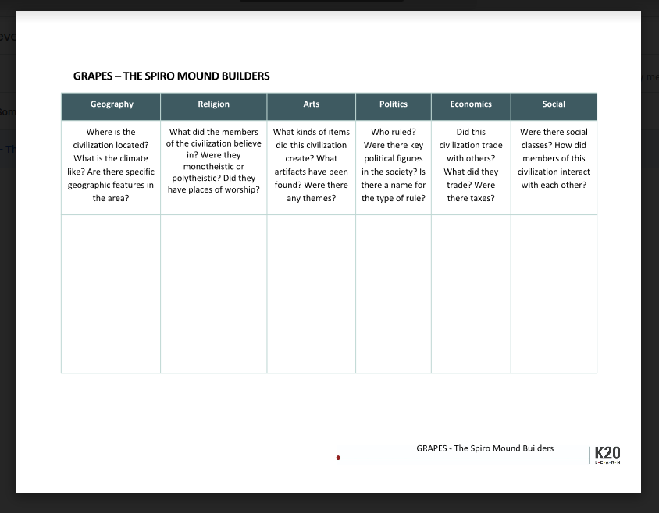
GRAPES Graphic Organizer
As you watch the video, fill in your GRAPES graphic organizer, answering the questions in each column to the best of your ability.
When the video is over, share out any interesting information you found and how and why you categorized information on the GRAPES chart.
Keep this chart for later!

Slide 7
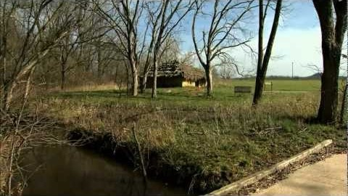
Spiro Mounds Video
Source: OETA.tv [oklahomanews]. (2013, Jan. 8). OETA story on Highway 9: Spiro Mounds aired 12-14-12 [Video].
YouTube. https://www.youtube.com/watch?v=HP1h8bVhs7s

Slide 8
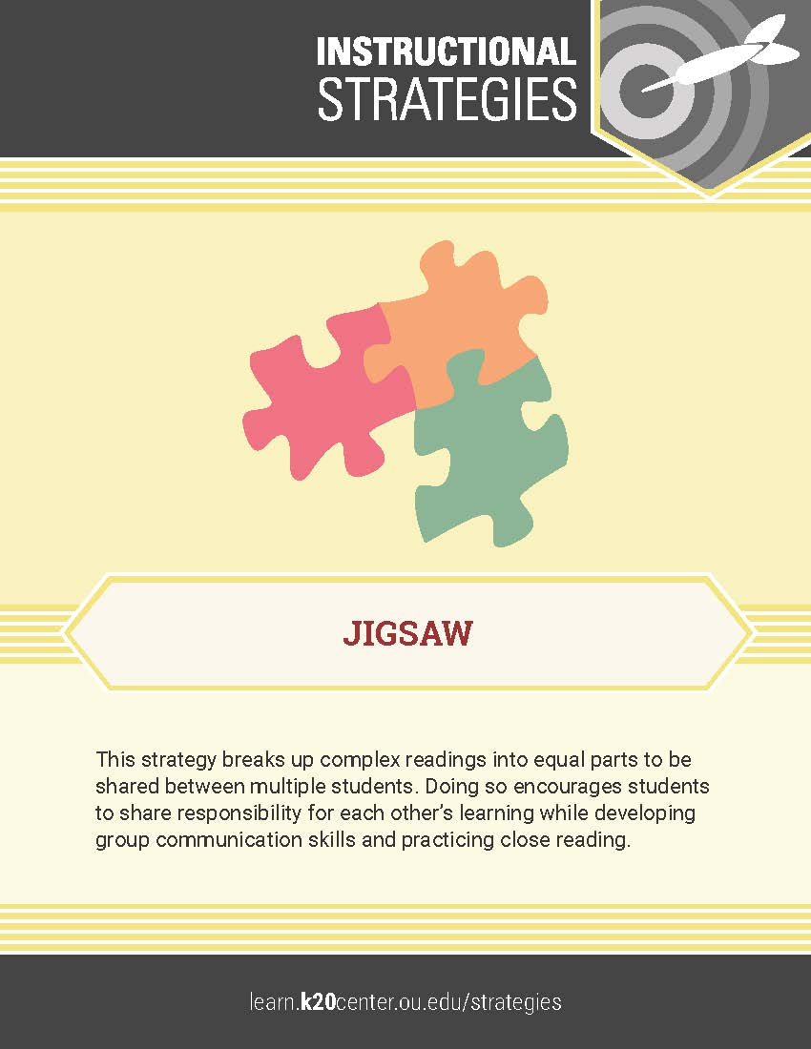
Jigsaw Activity
You will receive a number that determines your group.
Read the document that corresponds to the group number you received.
As you read, write down information that fits in the six GRAPES categories.
Then, on the back of your GRAPES handout, write down a brief summary of your article.

Slide 9
Jigsaw Activity – cont.
Now, summarize your document and highlight any important information to your group.
As one group member shares out, the rest of the members should be writing down that information in their handouts.
Share out the important information your group recorded with the whole class.

Slide 10

Two-Minute Paper
On a sheet of paper, respond to the prompt below.
  Why is it important to preserve historical sites, such as the Spiro Mounds?
You will have two minutes to write your response.

Slide 11
Always, Sometimes, Never True - Revisited
Return to the Always, Sometimes, Never True handout from earlier in the lesson.
Review your original labels and make any changes you deem necessary to your labels or your reasoning.
Share out any substantial changes with the whole class.

