Slide 2
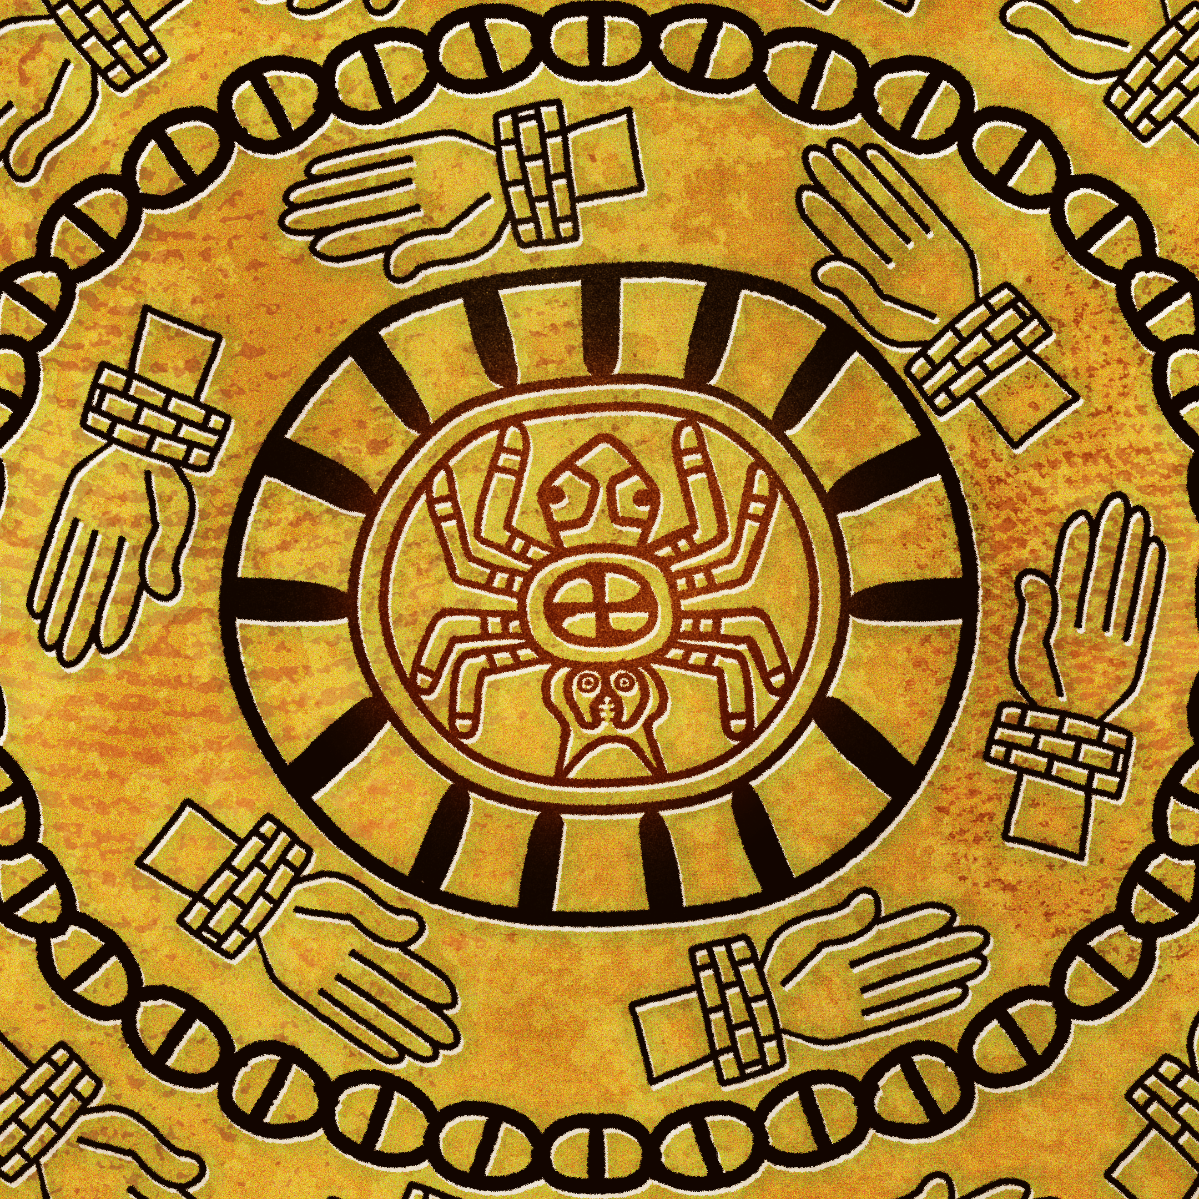
The Spiro Mounds Builders
Oklahoma History

Slide 3
Learning Objectives
Identify who the Spiro Mound Builders were and explain their significance to Oklahoma history.
Describe key aspects about the culture or lifestyle of the Spiro Mound Builders.

Slide 4
Essential Question
How did the accomplishments of the Spiro Mound Builders and other pre-contact cultures shape life in North America prior to European arrival?

Slide 5

Always, Sometimes, or Never True
On the Always, Sometimes, Never True handout, for each statement, choose the answer that best describes how often the statement is true: always, sometimes, or never.
Then, justify or explain your answer in the right column.
  With your partner, discuss your responses.
Notes:
K20 Center. (n.d.). Always, sometimes, or never true. Strategies. https://learn.k20center.ou.edu/strategy/145

Slide 6
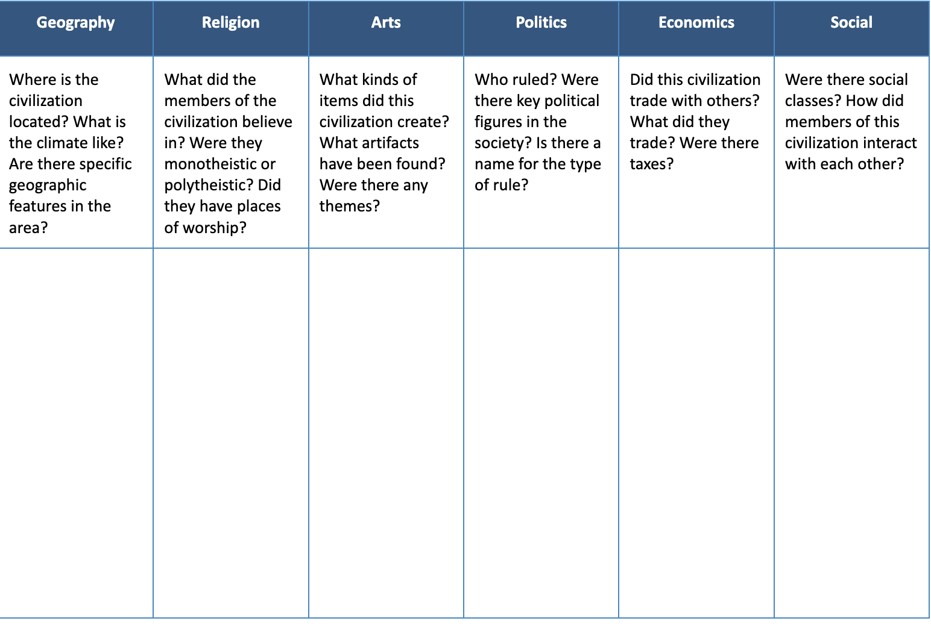
GRAPES Graphic Organizer
As you watch the video, fill in your GRAPES graphic organizer, answering the questions in each column to the best of your ability.

Slide 7
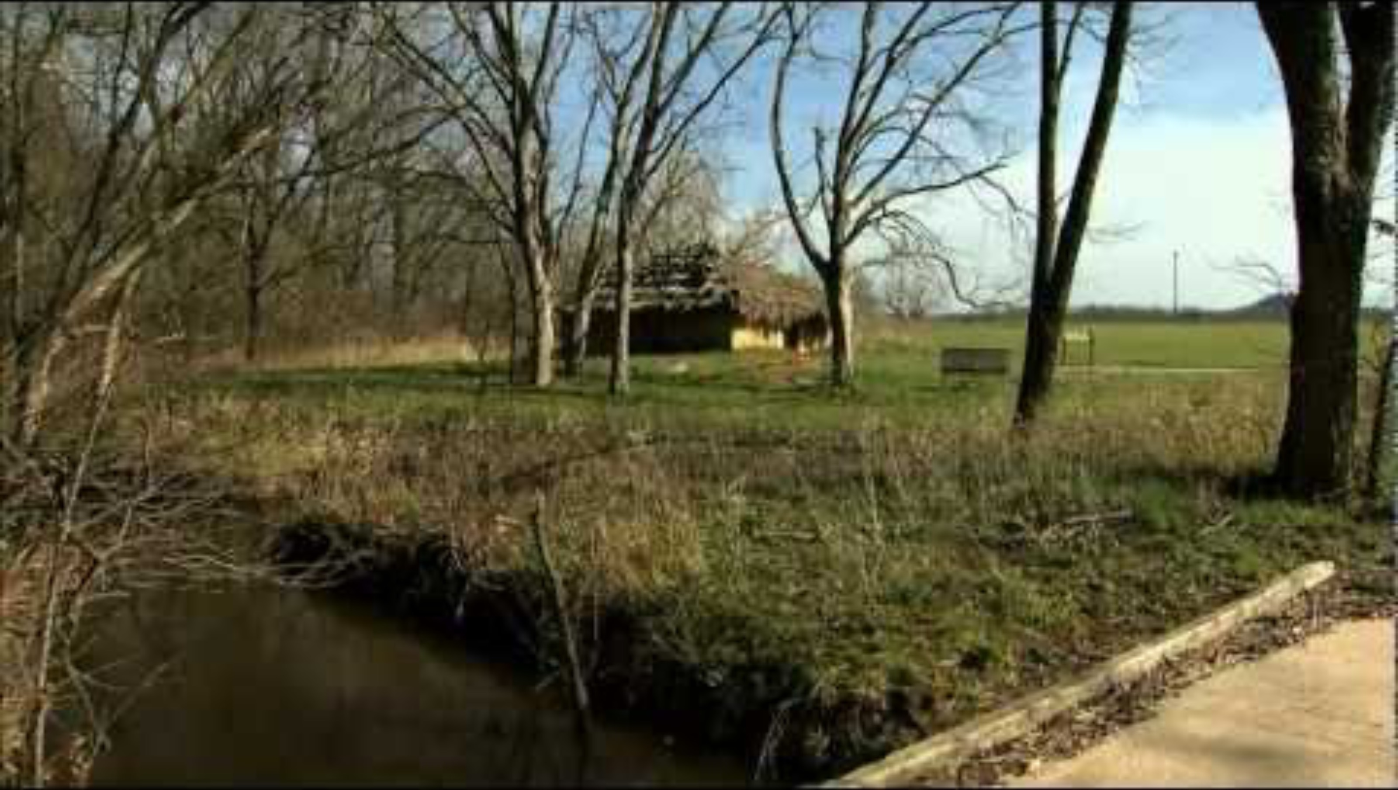
OETA Story on Highway 9: Spiro Mounds
Notes:
The Oklahoma News Report. (2013, January 8). OETA story on Highway 9: Spiro Mounds aired 12-14-12 [Video]. YouTube. https://www.youtube.com/watch?v=HP1h8bVhs7s

Slide 8
GRAPES Graphic Organizer
Share out any interesting information you found and how and why you categorized information on the GRAPES chart.
Keep this chart for later!

Slide 9

Jigsaw
You will receive a number that determines your group.
Read the document that corresponds to the group number you received.
Write down information that fits the GRAPES categories.
On the back of your GRAPES handout, write down a brief summary of your article.
Notes:
K20 Center. (n.d.). Jigsaw. Strategies. https://learn.k20center.ou.edu/strategy/179

Slide 10
Jigsaw
Summarize your document and highlight any important information to your group.
As one group member shares out, the rest of the members should be writing down that information in their handouts.
Share the information your group recorded.
Notes:
K20 Center. (n.d.). Jigsaw. Strategies. https://learn.k20center.ou.edu/strategy/179

Slide 11

Two-Minute Paper
On a sheet of paper, respond to the prompt below.
  Why is it important to preserve historical sites, such as the Spiro Mounds?
You will have 2 minutes to write your response.
Notes:
K20 Center. (n.d.). Two-minute paper. Strategies. https://learn.k20center.ou.edu/strategy/152

Slide 12
Always, Sometimes, or Never True Revisited
Return to the Always, Sometimes, Never True handout from earlier in the lesson.
Review your original labels and make any changes you deem necessary to your labels or your reasoning.
Share out any substantial changes with the class.
Notes:
K20 Center. (n.d.). Always, sometimes, or never true. Strategies. https://learn.k20center.ou.edu/strategy/145

Slide 13

S-I-T
Identify the following about the Spiro Mound Builders:
  A surprising fact or idea
  An interesting fact or idea
  A troubling fact or idea
Notes:
K20 Center. (n.d.). S-I-T. Strategies. https://learn.k20center.ou.edu/strategy/926

