Slide 2

Brainstorm
How many churches do you see in your community?
What types of churches do you see in your community?
Which churches might you have seen in European communities 500 years ago?
Notes:
K20 Center. (n.d.). Collective brain dump. Strategies. https://learn.k20center.ou.edu/strategy/111

Slide 3

We Want a Reformation!
Global Age

Slide 4
Essential Question
How do theological movements influence history?

Slide 5
Learning Objectives
Summarize the cause of the Protestant Reformation.
Identify the key events of the Protestant Reformation.
Analyze how the Protestant Reformation influenced society.

Slide 6
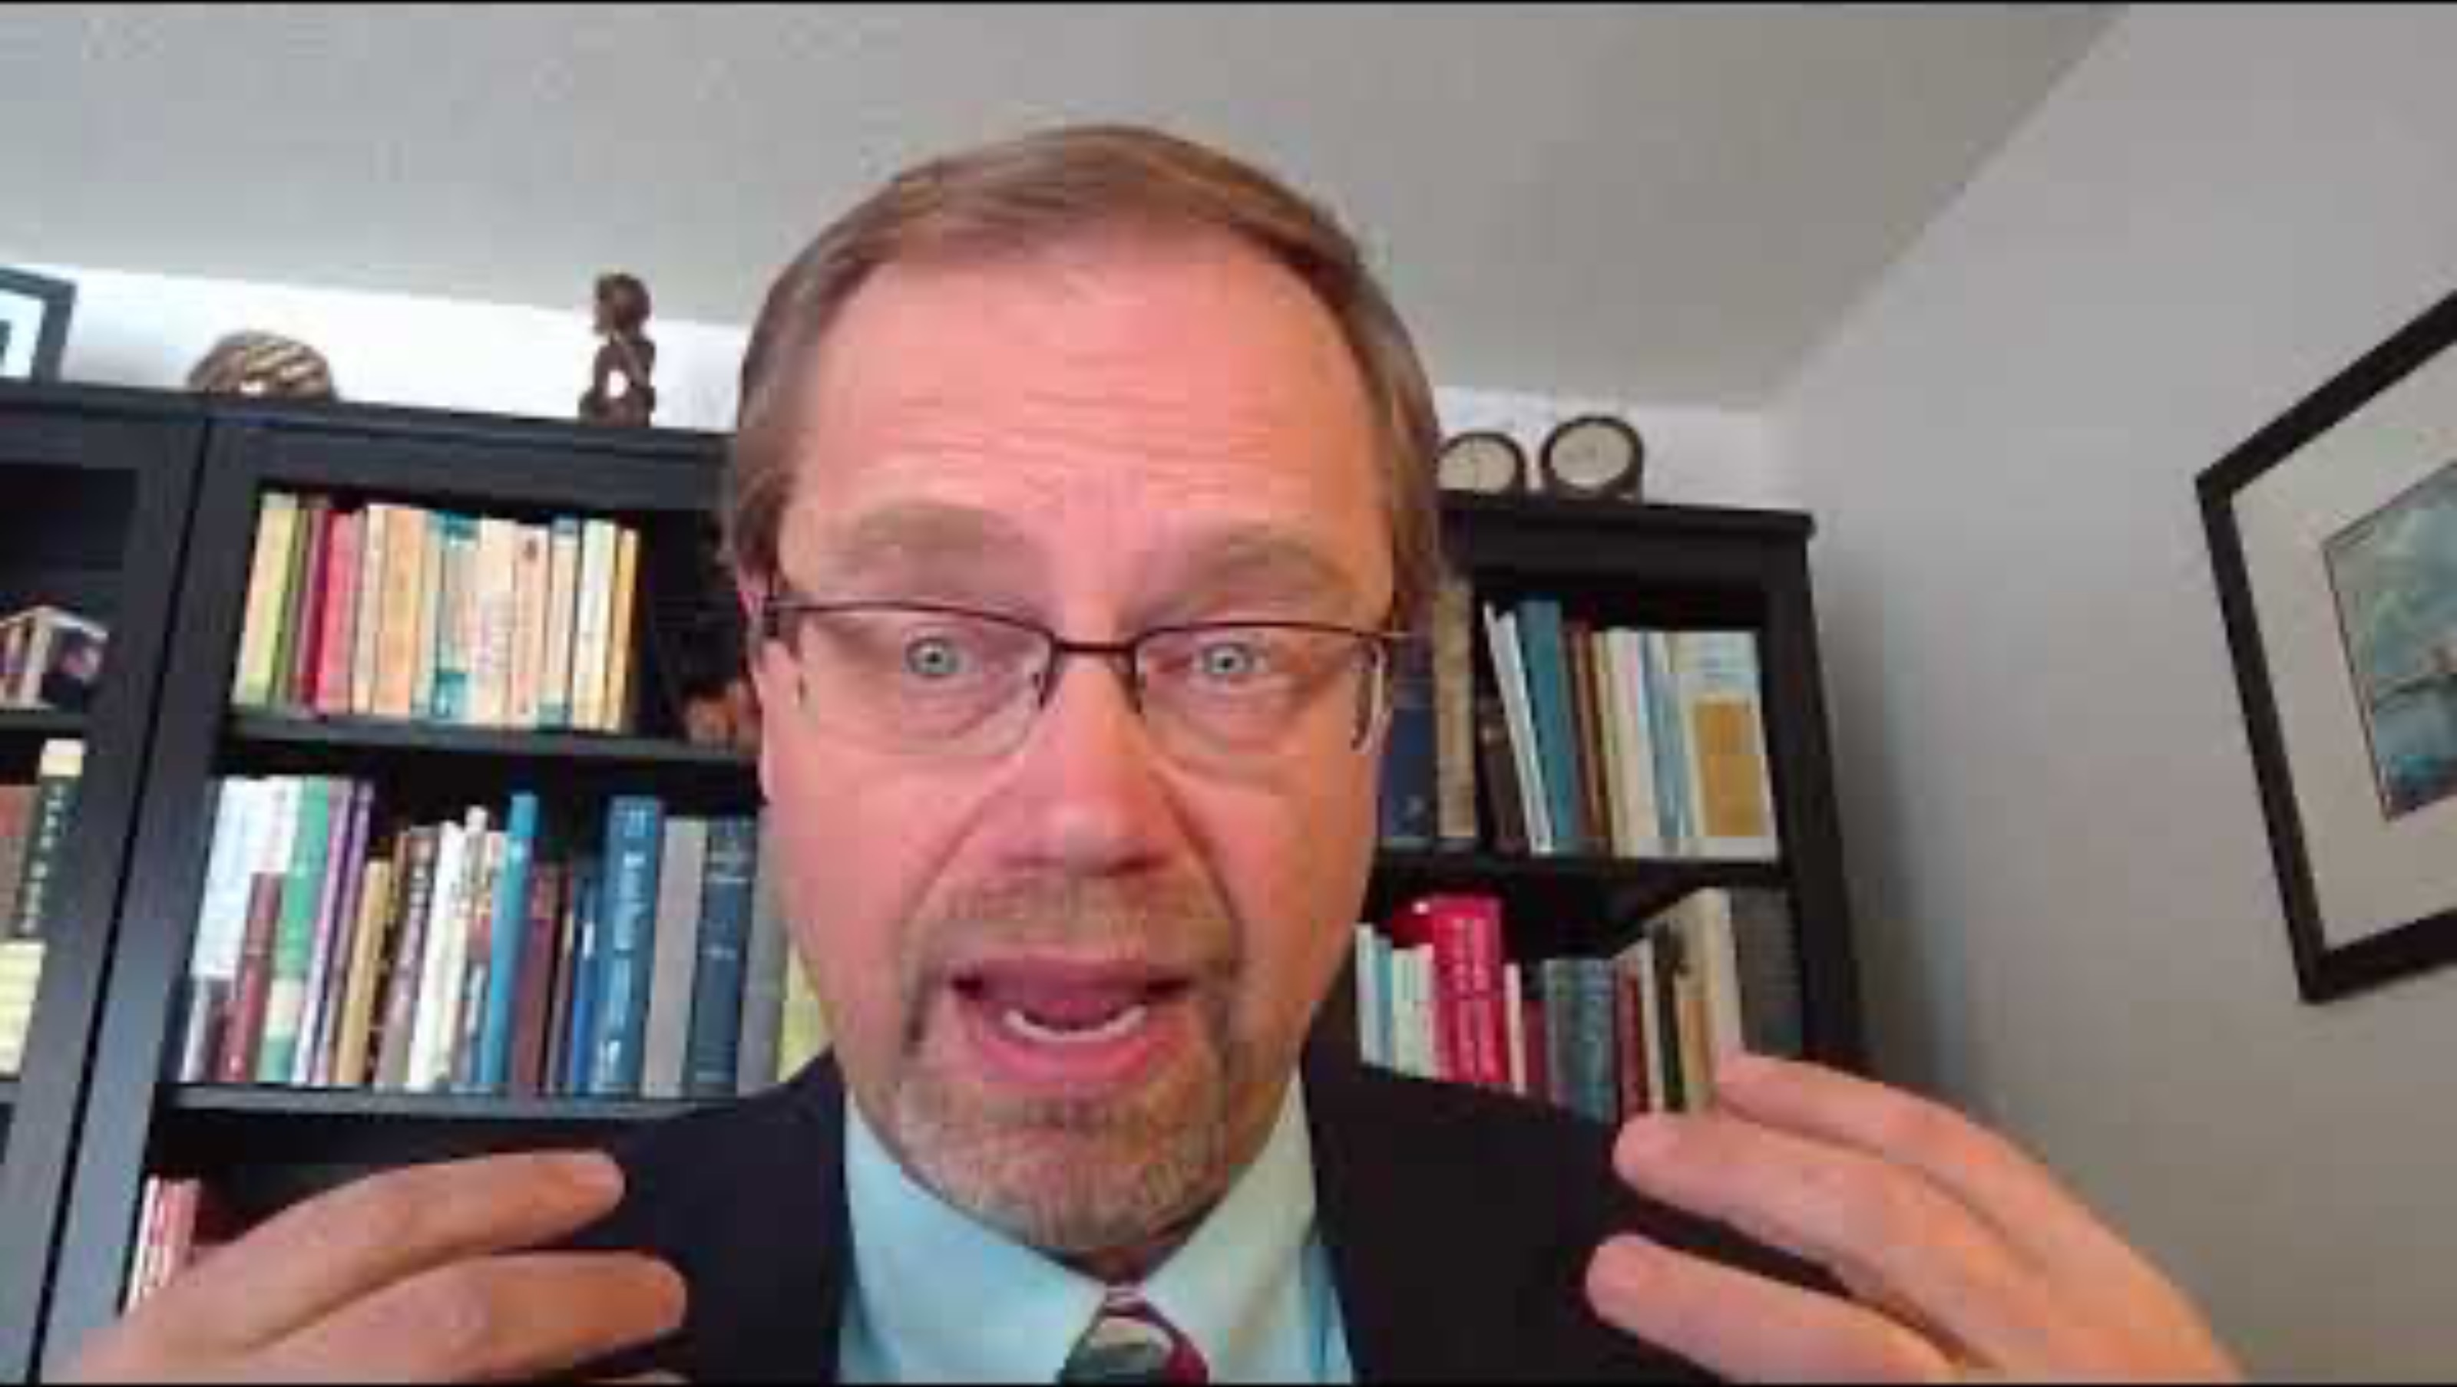
K20 ICAP - Professor of History - We Want a Reformation
Notes:
K20 Center. (2021, March 21). K20 ICAP - Professor of history - We want a reformation [Video]. YouTube. https://youtu.be/6dutuZj765A?si=mvRLHDXAeGN4aPSN

Slide 7

Why-Lighting
Become an expert on your assigned passage.
As you read, do the following:
  Highlight information you believe is important.
  Next to information you highlight, write why you believe that information is important.
Notes:
K20 Center. (n.d.). Why-lighting. Strategies. https://learn.k20center.ou.edu/strategy/128

Slide 8

Jigsaw
Share your notes from your assigned passage with your group members.
Listen to your group members share information about their readings.
As you listen to the other “experts,” take notes in your graphic organizer.
Notes:
K20 Center. (n.d.). Jigsaw. Strategies. https://learn.k20center.ou.edu/strategy/179

Slide 9
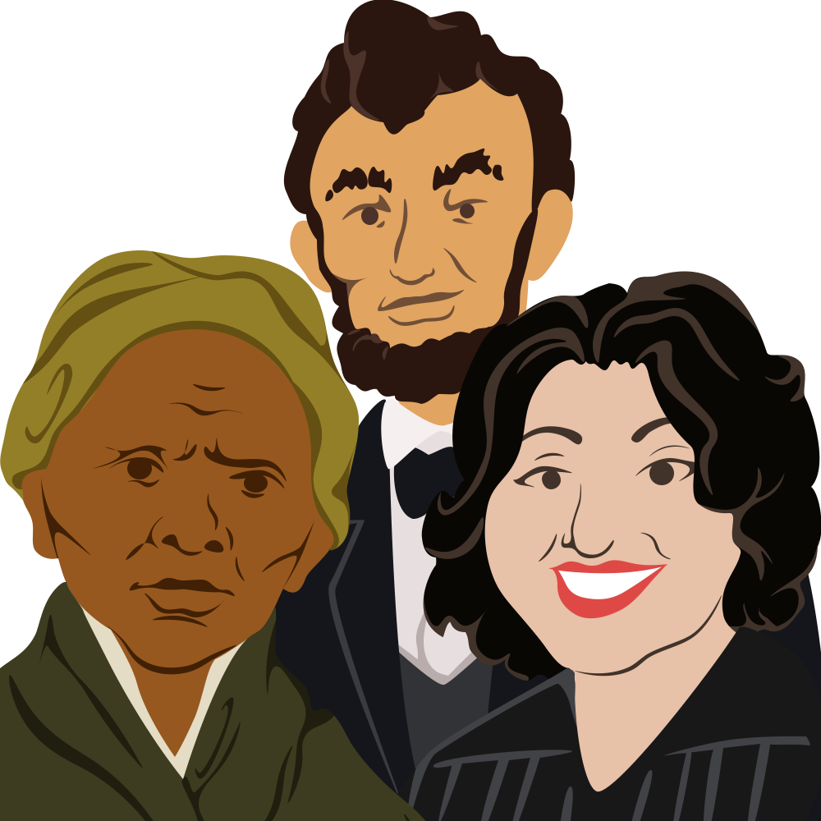

Historical Mingle
Read the name and information on the historical figure card you receive.
Consider how you will assume the role of this historical figure.
Consider what information about this person you will share with your classmates.
Use the information from the earlier reading to help you prepare!
Notes:
K20 Center. (n.d.). Historical mingle. Strategies. https://learn.k20center.ou.edu/strategy/184
K20 Center. (2021, September 21). K20 Center 3 minute timer [Video]. YouTube. https://youtu.be/iISP02KPau0?si=wznvGKHPcfYcdu_v

Slide 10
Historical Mingle
Walk around the room, “mingle” with other characters, and find a partner.
Introduce yourself as your historical figure.
Share information about yourself with your partner.
Ask your partner questions.
3 Minute Timer
Notes:
K20 Center. (2021, September 21). K20 Center 3 minute timer [Video]. YouTube. https://youtu.be/iISP02KPau0?si=wznvGKHPcfYcdu_v

Slide 11
Historical Mingle
Walk around the room, “mingle” with other characters, and find a partner.
Introduce yourself as your historical figure.
Share information about yourself with your partner.
Ask your partner questions.
3 Minute Timer
Notes:
K20 Center. (2021, September 21). K20 Center 3 minute timer [Video]. YouTube. https://youtu.be/iISP02KPau0?si=wznvGKHPcfYcdu_v

Slide 12

Historical Mingle
Walk around the room, “mingle” with other characters, and find a partner.
Introduce yourself as your historical figure.
Share information about yourself with your partner.
Ask your partner questions.
2 Minute Timer
Notes:
K20 Center. (2021, September 21). K20 Center 2 minute timer [Video]. YouTube. https://youtu.be/HcEEAnwOt2c?si=fAprml7tjhzWfPtu

Slide 13
Historical Mingle
Walk around the room, “mingle” with other characters, and find a partner.
Introduce yourself as your historical figure.
Share information about yourself with your partner.
Ask your partner questions.
2 Minute Timer
Notes:
K20 Center. (2021, September 21). K20 Center 2 minute timer [Video]. YouTube. https://youtu.be/HcEEAnwOt2c?si=fAprml7tjhzWfPtu

Slide 14
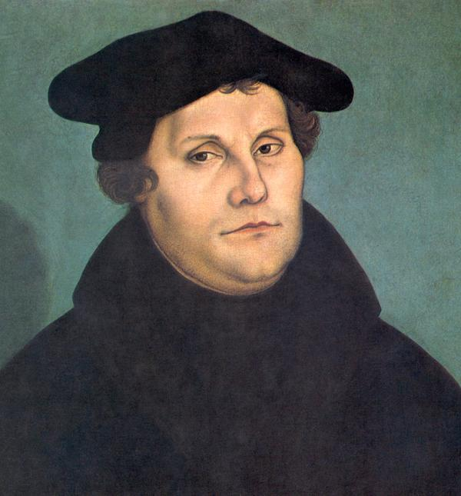
Martin Luther
What did I support?
Why did I support it?
Notes:
Lucas Cranach the Elder. (1529). Portrait of Martin Luther [Oil on wood]. Wikimedia Commons. https://commons.wikimedia.org/wiki/File:Martin_Luther_by_Cranach-restoration.jpg

Slide 15
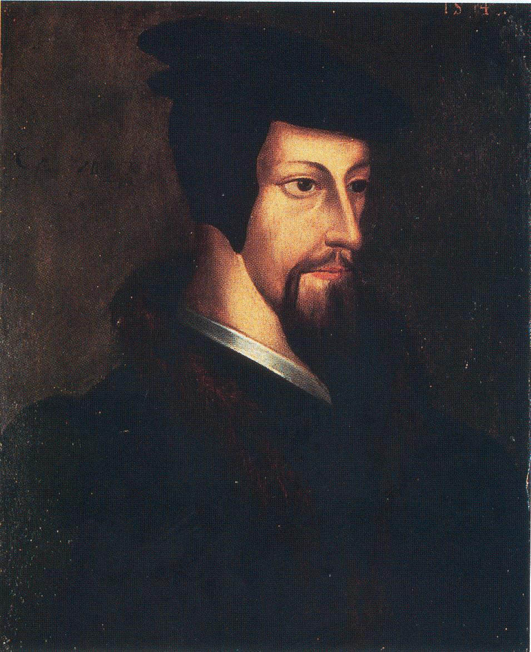
John Calvin
What did I support?
Why did I support it?
Notes:
John Calvin as a young man [Oil on wood]. (n.d.). Wikimedia Commons. https://commons.wikimedia.org/wiki/File:John_Calvin_-_Young.jpg

Slide 16
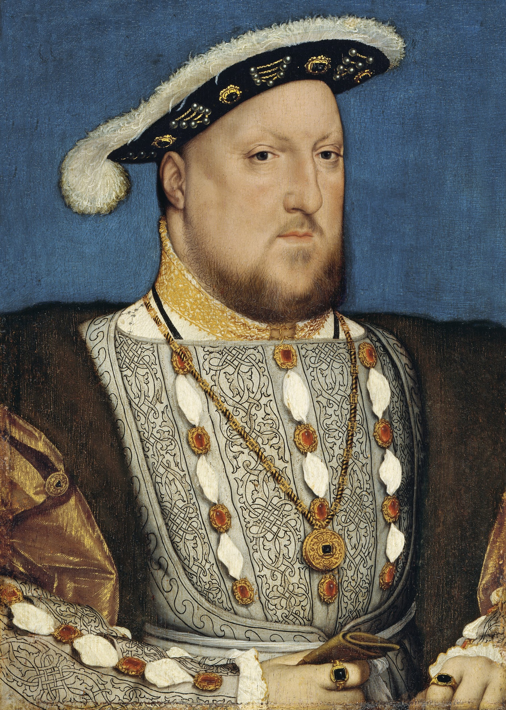
King Henry VII of England
What did I support?
Why did I support it?
Notes:
Hans Holbein the Younger. (ca. 1537). Portrait of Henry VIII [Oil on panel]. Wikimedia Commons. https://en.wikipedia.org/wiki/File:Hans_Holbein,_the_Younger,_Around_1497-1543_-_Portrait_of_Henry_VIII_of_England_-_Google_Art_Project.jpg

Slide 17
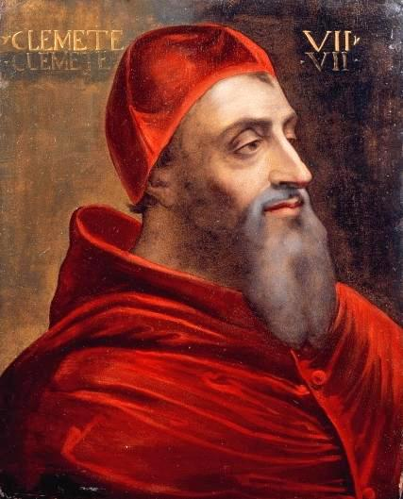
Pope Clement VII
What did I support?
Why did I support it?
Notes:
Del Piombo, S. (ca. 1530). Portrait of Giulio de’ Medici, Pope Clement VII [Painting]. Wikimedia Commons. https://commons.wikimedia.org/wiki/File:Portrait_of_Giulio_de_Medici_(1478_-_1534)_Pope_Clement_VII.jpg

Slide 18
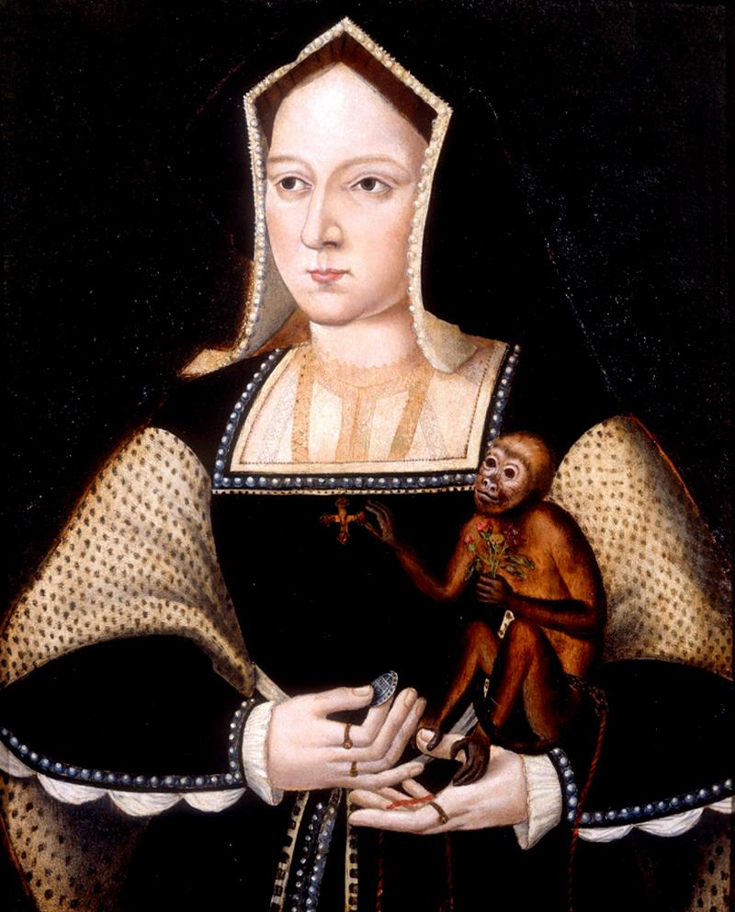
Catherine of Aragon
What did I support?
Why did I support it?
Notes:
Horenbout, L. (1525). Portrait of Catherine of Aragon with a monkey [Painting]. Wikimedia Commons. https://commons.wikimedia.org/wiki/File:Katharine_of_Aragon_with_a_monkey.jpg

Slide 19
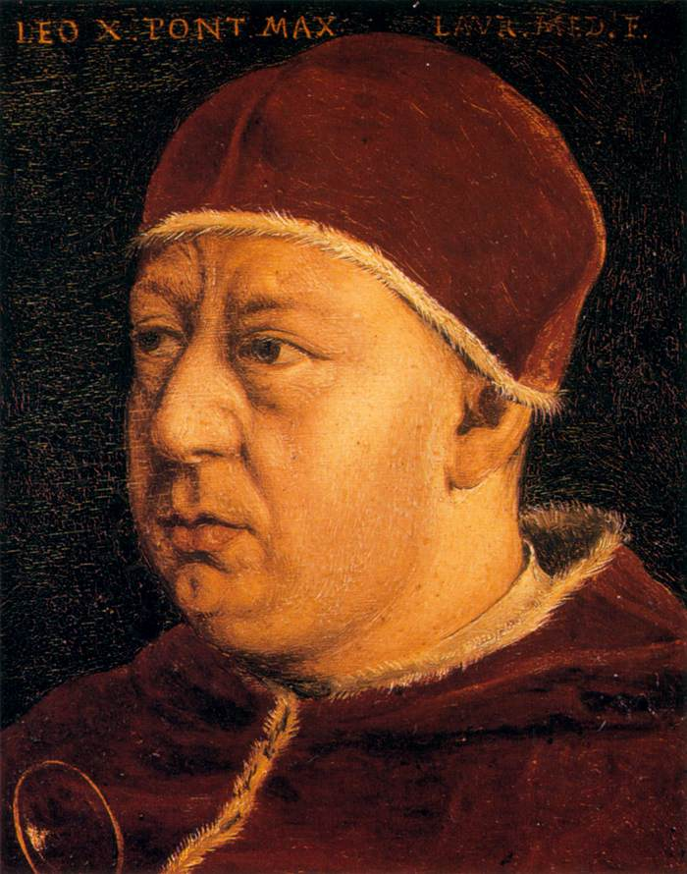
Pope Leo X
What did I support?
Why did I support it?
Notes:
Bronzino. (ca. 1565). Portrait of Pope Leo X [Oil on tin]. Wikimedia Commons. https://commons.wikimedia.org/wiki/File:Angelo_Bronzino_-_Pope_Leo_X_-_WGA3273.jpg

Slide 20
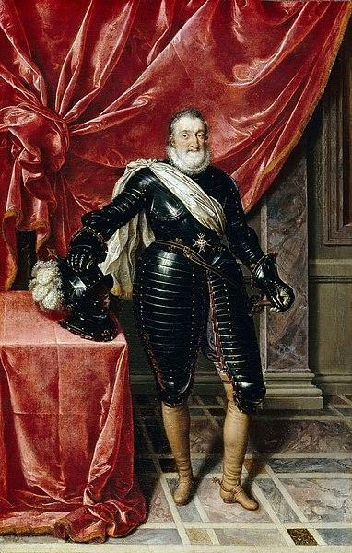
King Henry IV of France
What did I support?
Why did I support it?
Notes:
Frans Pourbus the Younger. (ca. 1610). Henry IV, King of France in armour [Oil on canvas]. Wikimedia Commons. https://commons.wikimedia.org/wiki/File:Henry_IV_of_france_by_pourbous_younger.jpg

Slide 21

Six-Word Memoir
Create a “memoir” that is exactly six words long and covers one of the following topics:
An event you read about during the Jigsaw activity
Your assigned historical figure
Notes:
K20 Center. (n.d.). Six-word memoirs. Strategies. https://learn.k20center.ou.edu/strategy/75

