Slide 2
Brainstorm
How many churches do you see in our community?
What types of churches do you see in our community?
Which churches might we have seen 500 years ago in communities in Europe?

Slide 3
We Want a Reformation!
Global Age

Slide 4
Essential Question
How do theological movements influence history?

Slide 5
Lesson Objectives
Summarize the cause of the Protestant Reformation;
Identify the key events of the Protestant Reformation;
Analyze how the Protestant Reformation influenced society.

Slide 6
We Want a Reformation: Professor Paul Koelpin
Notes:
Professor Paul Koelpin of Martin Luther College in New Ulm, MN. Professor of History; Professor of Theology; Head Coach, Men’s Soccer.

Slide 7
Why-Lighting
As you read the passage that you are to become an “expert” on, do the following:
Highlight any information that you believe is important;
In the margins, write why you believe that passage is important.
Notes:
K20 Center. (n.d.). Why-lighting. Strategies. https://learn.k20center.ou.edu/strategy/128

Slide 8
Jigsaw
In your group of 5 you will:
Share your “expert” information from the reading;
Take notes in your graphic organizer as other “experts” share information from their reading.
Notes:
K20 Center. (n.d.). Jigsaw. Strategies. https://learn.k20center.ou.edu/strategy/179

Slide 9
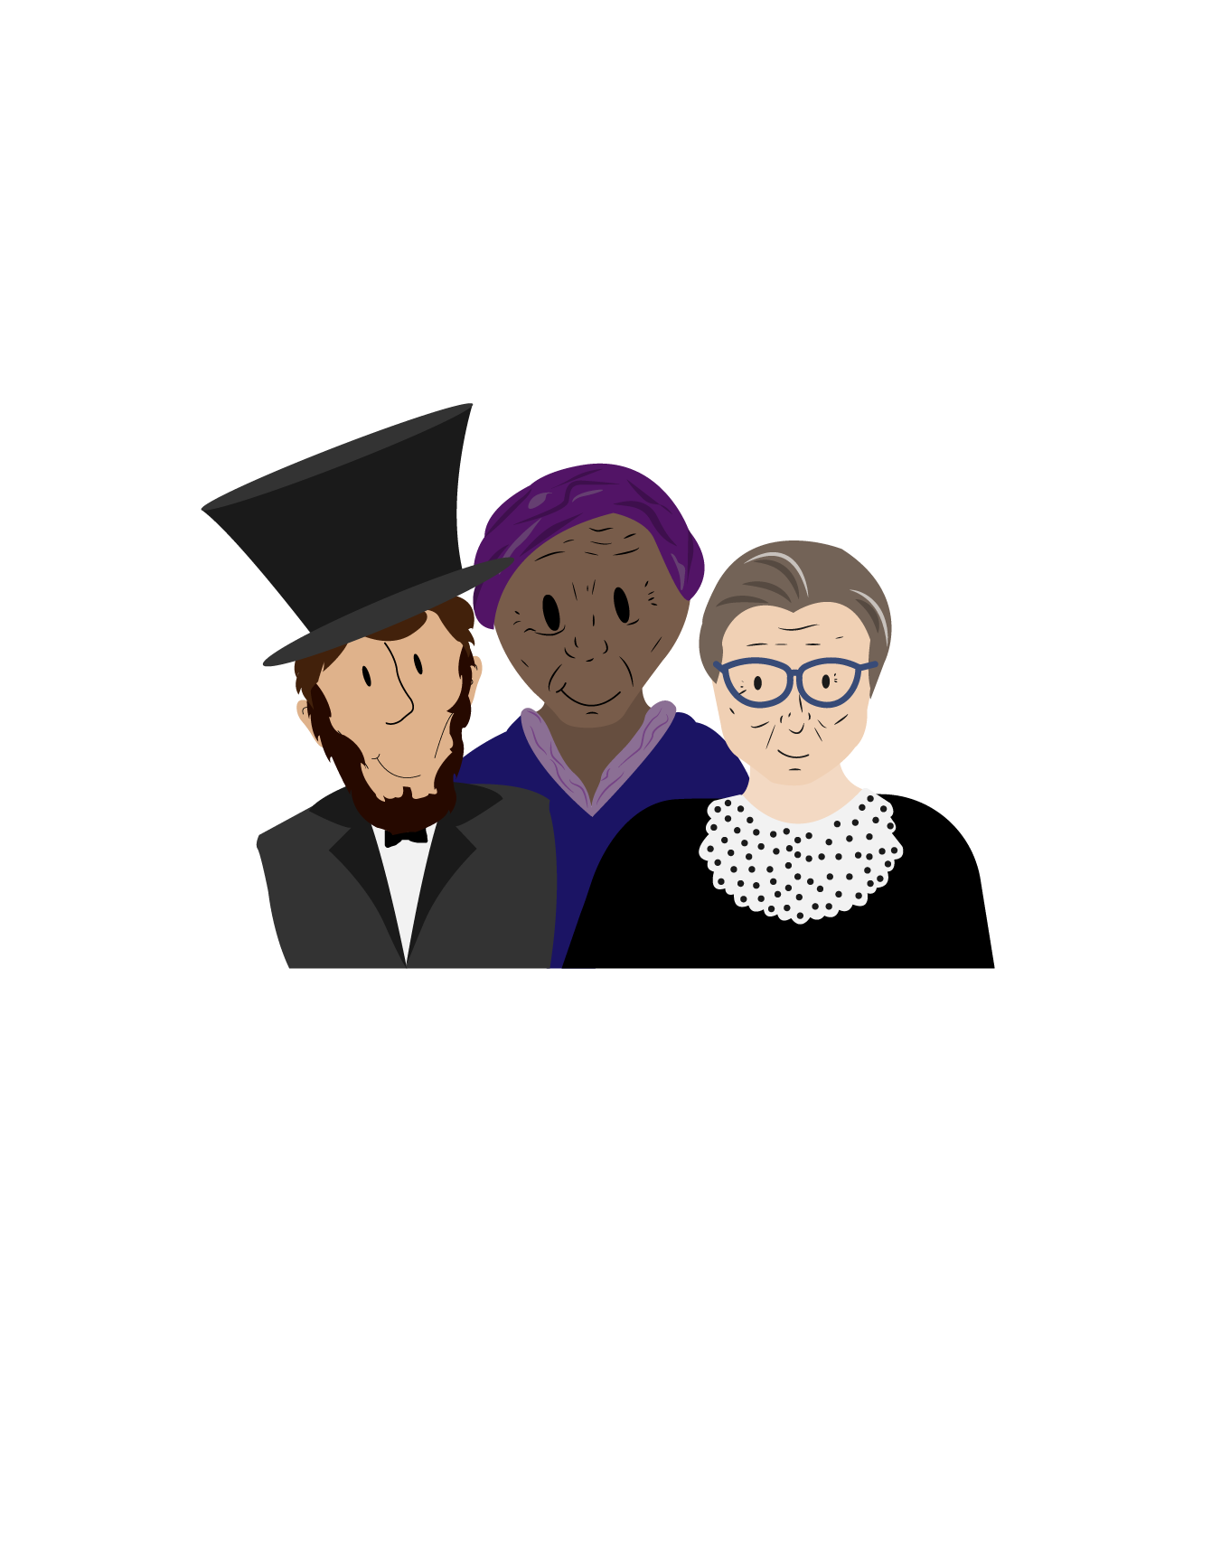
Historical Mingle
Each of you will:
Receive the name, photo, and a short description of the life of a historical figure;
Carefully prepare to assume the role of the character;
Determine how you will present yourself to your classmates.
Notes:
K20 Center. (n.d.). Historical Mingle. Strategies. https://learn.k20center.ou.edu/strategy/184

Slide 10
Historical Mingle
Read through your assigned role;
Prepare to introduce yourself as the person you have been assigned.
*Hint: You can always use the information from the reading earlier in the lesson to help you prepare!
Notes:
3-minute timer

Slide 11
Historical Mingle
Read through your assigned role;
Prepare to introduce yourself as the person you have been assigned.
*Hint: You can always use the information from the reading earlier in the lesson to help you prepare!
Notes:
2-minute timer

Slide 12
Historical Mingle
“Mingle” with the other historical figures in your classroom.
Find one person that you would like to get to know better.
Notes:
3-minute timer

Slide 13
Historical Mingle
“Mingle” with the other historical figures in your classroom.
Find one person that you would like to get to know better.
Notes:
2-minute timer

Slide 14
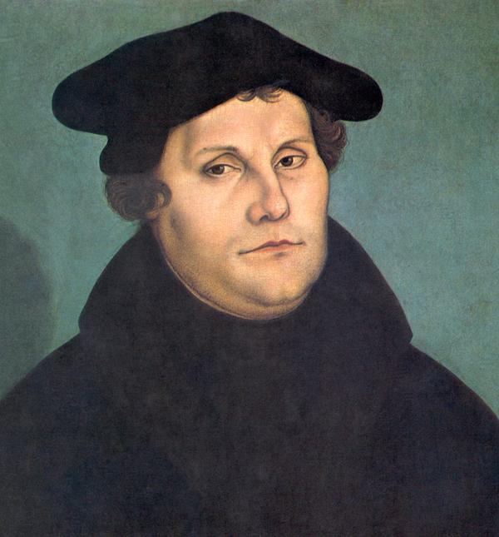
Martin Luther
What did I support?
Why did I support it?
Wikimedia. (n.d.). Portrait of Martin Luther by Cranach the Elder. [Digital image]. https://commons.wikimedia.org/wiki/File:Martin_Luther_by_Cranach-restoration.jpg
Notes:
Cranach the Elder, L. (2018, October 31). Martin Luther [Digital image]. Retrieved January 20, 2021, from https://commons.wikimedia.org/wiki/File:Martin_Luther_by_Cranach-restoration.jpg

Slide 15
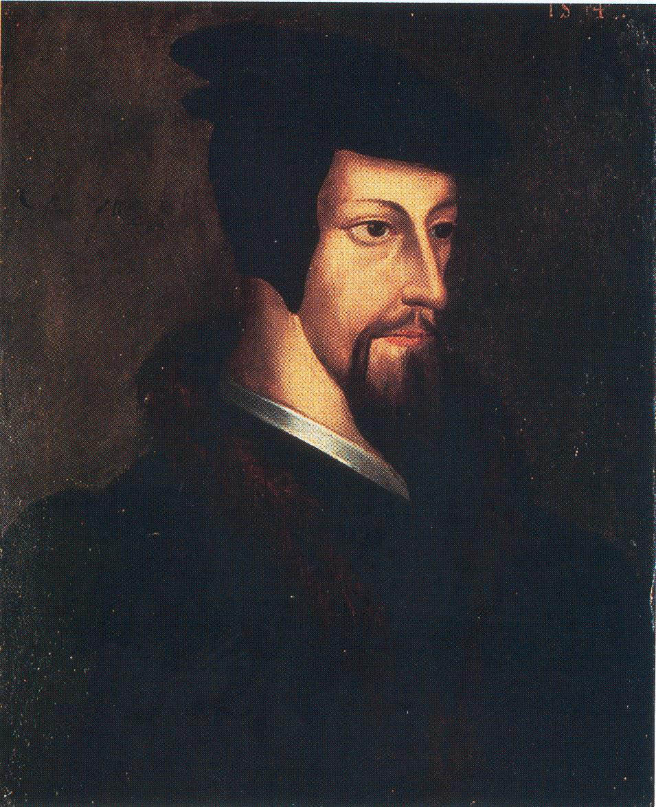
John Calvin
What did I support?
Why did I support it?
Wikimedia. (n.d.) Portrait of Young John Calvin from the collection of the Library of Geneva. [Digital image]. https://commons.wikimedia.org/wiki/File:John_Calvin_-_Young.jpg
Notes:
Flemish School. (2010, November 11). [Portrait of Young John Calvin from the collection of the Library of Geneva]. Retrieved January 20, 2021, from https://commons.wikimedia.org/wiki/File:John_Calvin_-_Young.jpg

Slide 16
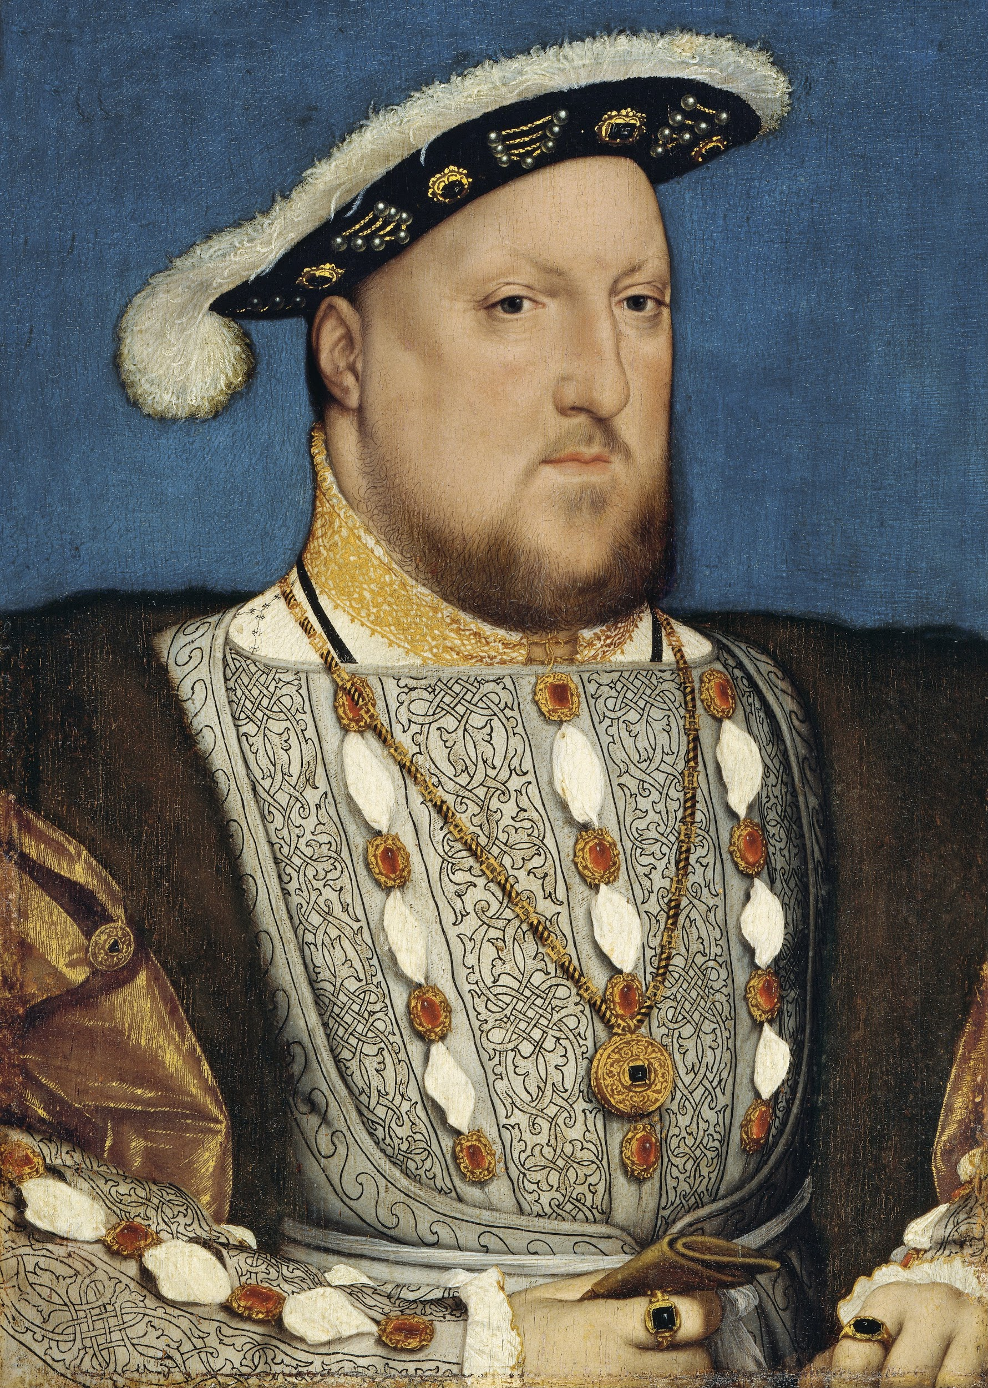
King Henry VIII of England
What did I support?
Why did I support it?
Wikimedia. (n.d.) Portrait of Henry VIII by Hobein. [Digital image]. https://en.wikipedia.org/wiki/File:Hans_Holbein,_the_Younger,_Around_1497-1543_-_Portrait_of_Henry_VIII_of_England_-_Google_Art_Project.jpg
Notes:
Holbein, H. (2011, February 18). Portrait of Henry VIII [Digital image]. Retrieved January 20, 2021, from https://en.wikipedia.org/wiki/File:Hans_Holbein,_the_Younger,_Around_1497-1543_-_Portrait_of_Henry_VIII_of_England_-_Google_Art_Project.jpg

Slide 17
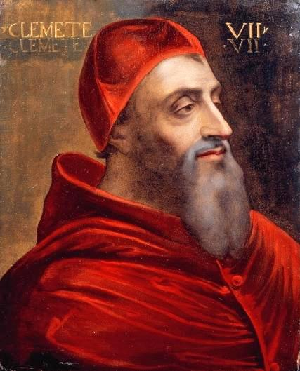
Pope Clement VII
What did I support?
Why did I support it?
Wikimedia. (n.d.). Portrait of Giulio de' Medici (1478-1534) Pope Clement VII. [Digital image]. https://commons.wikimedia.org/wiki/File:Portrait_of_Giulio_de_Medici_(1478_-_1534)_Pope_Clement_VII.jpg
Notes:
Del Piombo, S. (2016, March 29). [Portrait of Giulio de' Medici (1478 - 1534) Pope Clement VII]. Retrieved January 20, 2021, from https://commons.wikimedia.org/wiki/File:Portrait_of_Giulio_de_Medici_(1478_-_1534)_Pope_Clement_VII.jpg

Slide 18
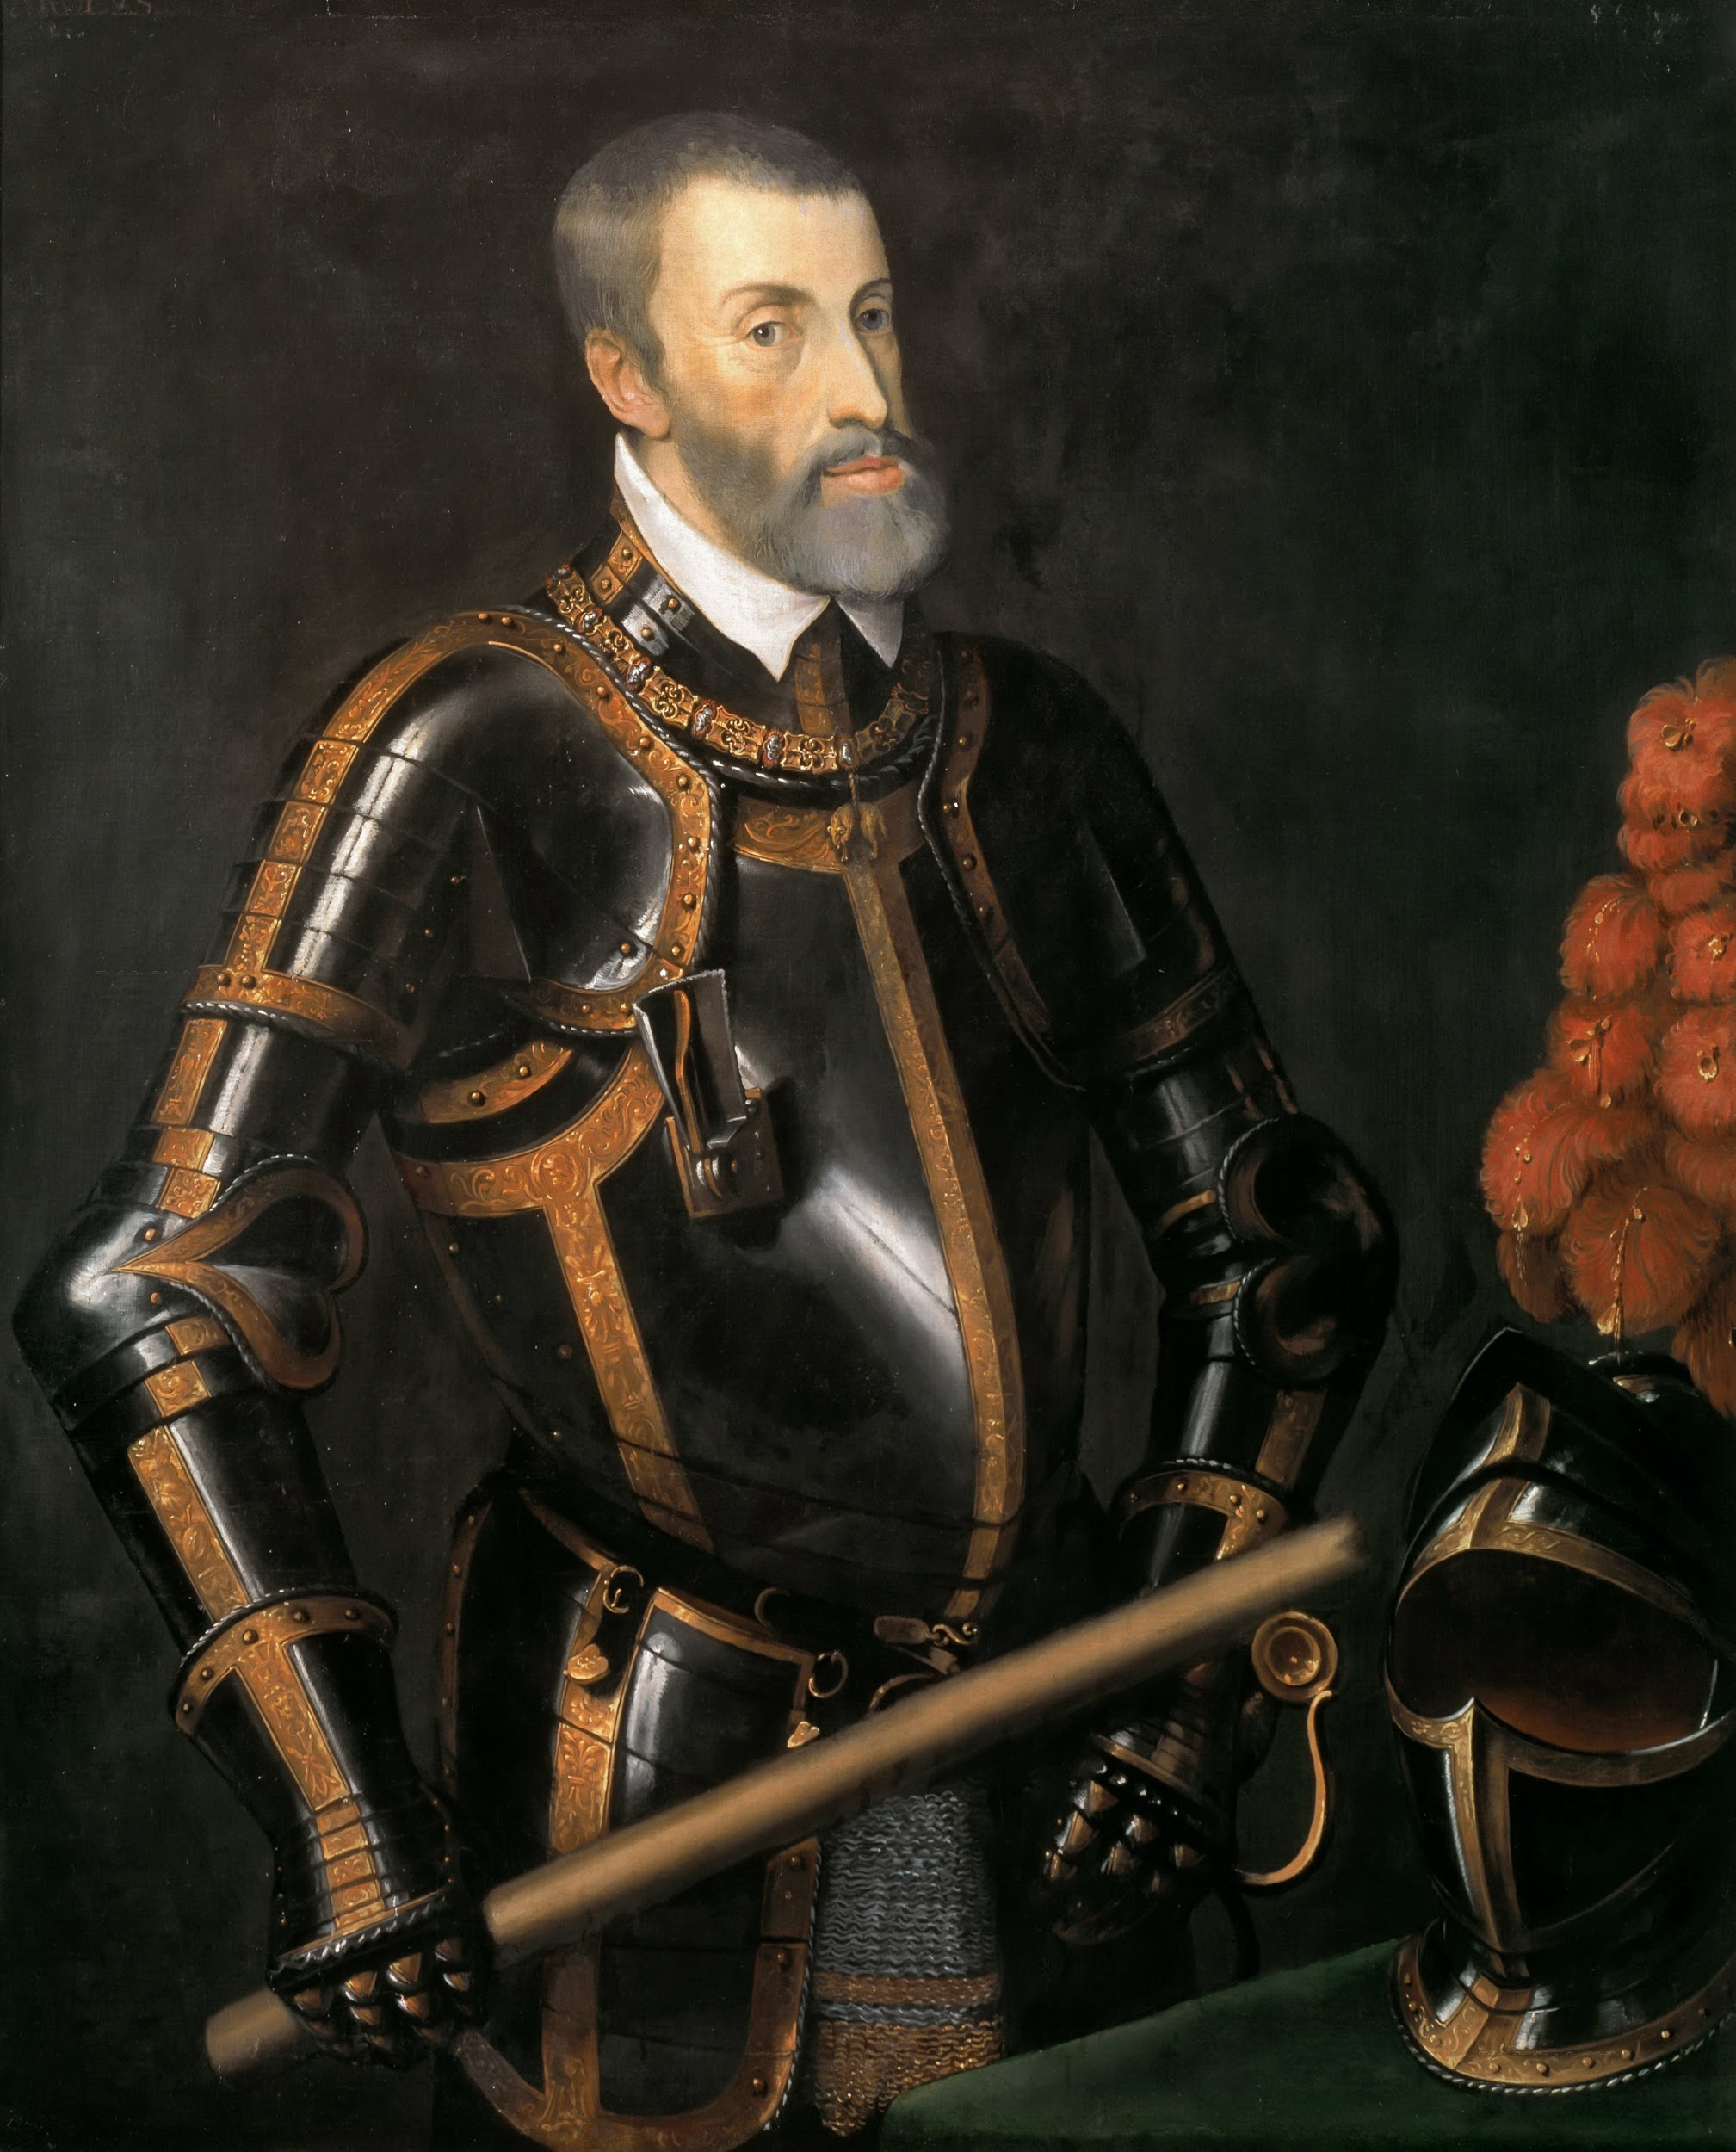
Holy Roman Emperor Charles V
What did I support?
Why did I support it?
Wikimedia. (n.d.). Emperor Charles V in armor by T.Vecelli. [Digital image]. https://en.m.wikipedia.org/wiki/File:Elderly_Karl_V.jpg
Notes:
Vecelli, T. (2020, July 2). Emperor Charles V in armor [Digital image]. Retrieved January 20, 2021, from https://en.m.wikipedia.org/wiki/File:Elderly_Karl_V.jpg

Slide 19
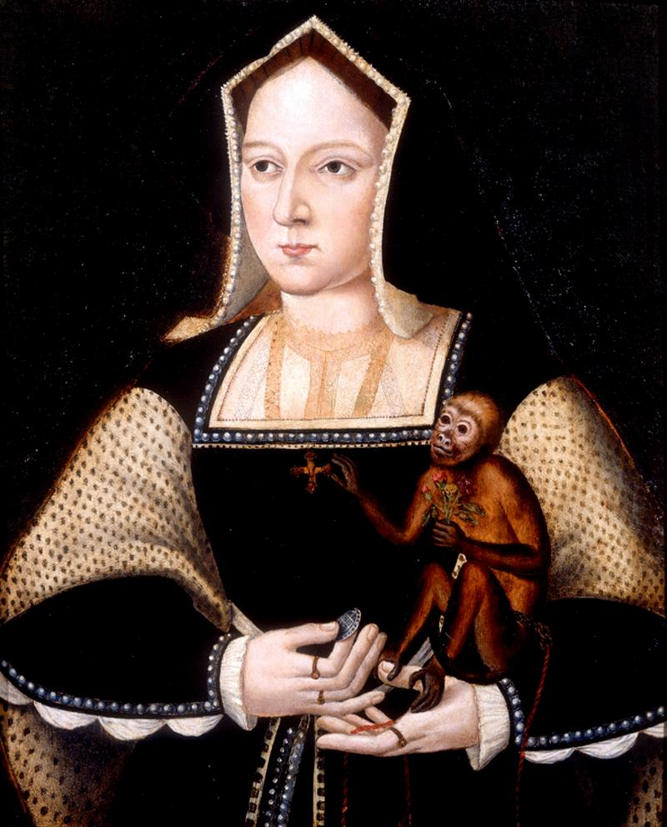
Catherine of Aragon
What did I support?
Why did I support it?
Wikimedia. (n.d.) Catherine of Aragon by Horenbout. [Digital image]. https://commons.wikimedia.org/wiki/File:Katharine_of_Aragon_with_a_monkey.jpg
Notes:
Horenbout, L. (2012, July 3). [This is the largest miniature of Henry VIII's first wife. Three other miniatures exist, but two are circular copies of this original; the third is believed to be a companion piece to a miniature of the king. A unique feature of this work is that it includes Katharine's hands. All of Horenbout's other miniatures focused on the head and shoulders. All of his portraits have plain blue backgrounds and are traced with a gold line. Later artists such as Nicholas Hilliard inherited this style and continued it into the 17th century.]. Retrieved January 20, 2021, from https://commons.wikimedia.org/wiki/File:Katharine_of_Aragon_with_a_monkey.jpg

Slide 20
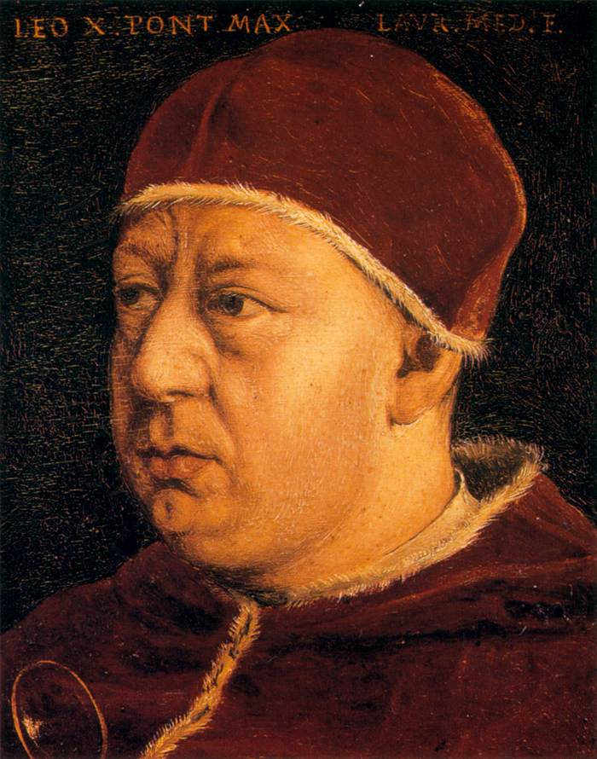
Pope Leo X
What did I support?
Why did I support it?
Wikimedia. (n.d.) Pope Leo X by Bronzino. [Digital image]. https://commons.wikimedia.org/wiki/File:Angelo_Bronzino_-_Pope_Leo_X_-_WGA3273.jpg
Notes:
Bronzino. (2011, June 3). Pope Leo X [Digital image]. Retrieved January 20, 2021, from https://commons.wikimedia.org/wiki/File:Angelo_Bronzino_-_Pope_Leo_X_-_WGA3273.jpg

Slide 21
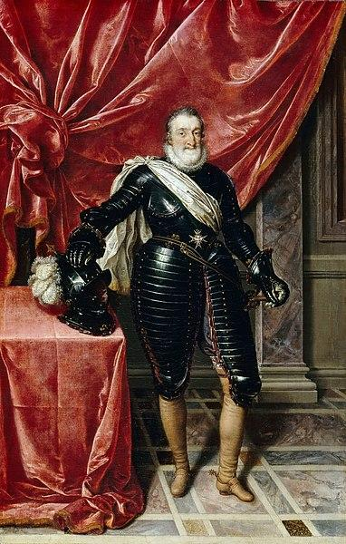
King Henry IV of France
What did I support?
Why did I support it?
Wikimedia. (n.d.) Henry IV, King of France in Armour by Pourbus the Younger. [Digital image]. https://commons.wikimedia.org/wiki/File:Henry_IV_of_france_by_pourbous_younger.jpg
Notes:
Pourbus the Younger, F. (2017, October 29). Henry IV, King of France in Armour [Digital image]. Retrieved January 20, 2021, from https://commons.wikimedia.org/wiki/File:Henry_IV_of_france_by_pourbous_younger.jpg

Slide 22
Six-Word Memoir
Create a “memoir” that is exactly six (6) words and covers one (1) of the following:
One of the events you read about in the Jigsaw activity;
Your assigned historical figure.
Notes:
K20 Center. (n.d.). Six-word Memoir. Strategies. https://learn.k20center.ou.edu/strategy/75

