Slide 1
My Love is Like Figurative Language
Grade 9 English Language Arts

Slide 2
Essential Question
How might being able to recognize literary features help us in appreciating literature?

Slide 3
Learning Objectives
Identify four types of figurative language:
  Hyperbole
  Metaphor
  Personification
  Simile
Analyze how figurative Language affects writing

Slide 4
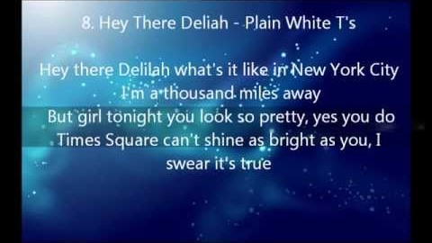
Figurative Language Review

Slide 5

Pick a Card!
♥ Personification
♠ Simile
♣ Metaphor
♦ Hyperbole

Slide 6
Window Notes
As a group:
Identify an example from the video.
Define your term.
Come up with your own examples.
Decide who in your group will share out with the class.

Slide 7
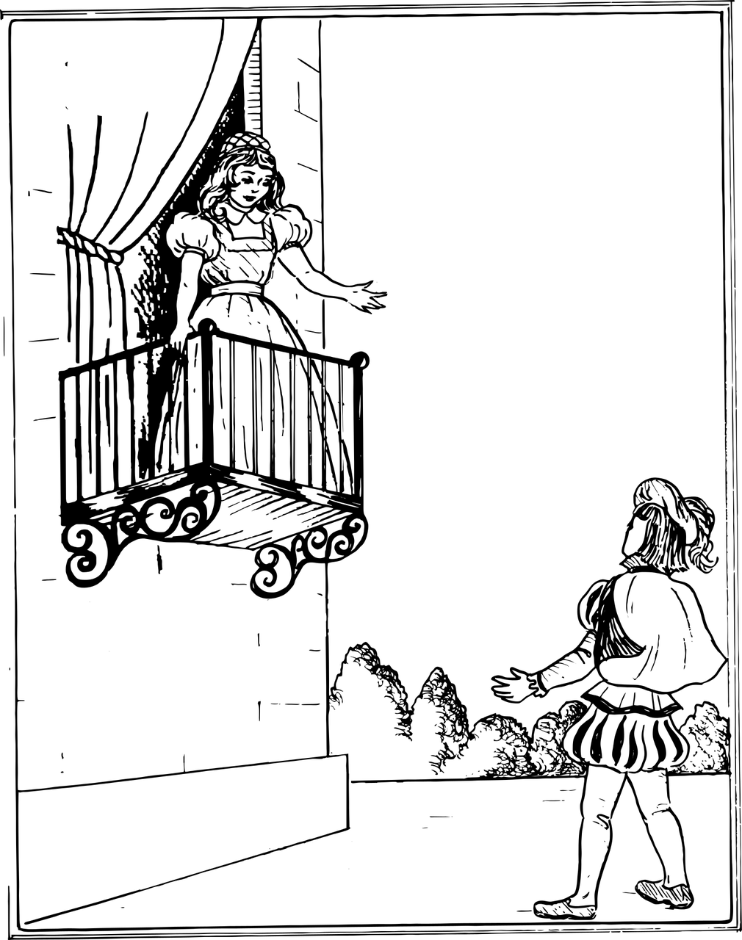
Romeo and Juliet
William Shakespeare
Notes:
Image source: b0red. (2017, July 12). Romeo and Juliet. Pixabay. https://pixabay.com/vectors/romeo-juliet-play-theater-2498582/

Slide 8

Categorical Highlighting
As you read excerpts from the play identify and highlight the different examples of figurative language.
Simile- color
Metaphor- color
Hyperbole- color
Personification- color
Notes:
Teacher’s Note: Determine which color of highlighter you will assign for each type of figurative language add update the colors on this slide accordingly.

Slide 9

Anchor Chart
Include all of the following:
A definition of your assigned figurative language type.
An example from Romeo and Juliet.
An illustration of your example.
Answers to these questions:
  Why was figurative language used in this example?
  What does figurative language add to literature?

Slide 10

Gallery Walk
Use sticky notes to provide comments on your classmates Anchor Charts.
Comments can include:
Constructive feedback.
What stood out.
What you liked.
Questions you still have.

Slide 11
Anchor Chart - Revisited
Review the feedback left for your Anchor Chart.
Make adjustments as needed.

Slide 12
Figurative Language Review

