Slide 2
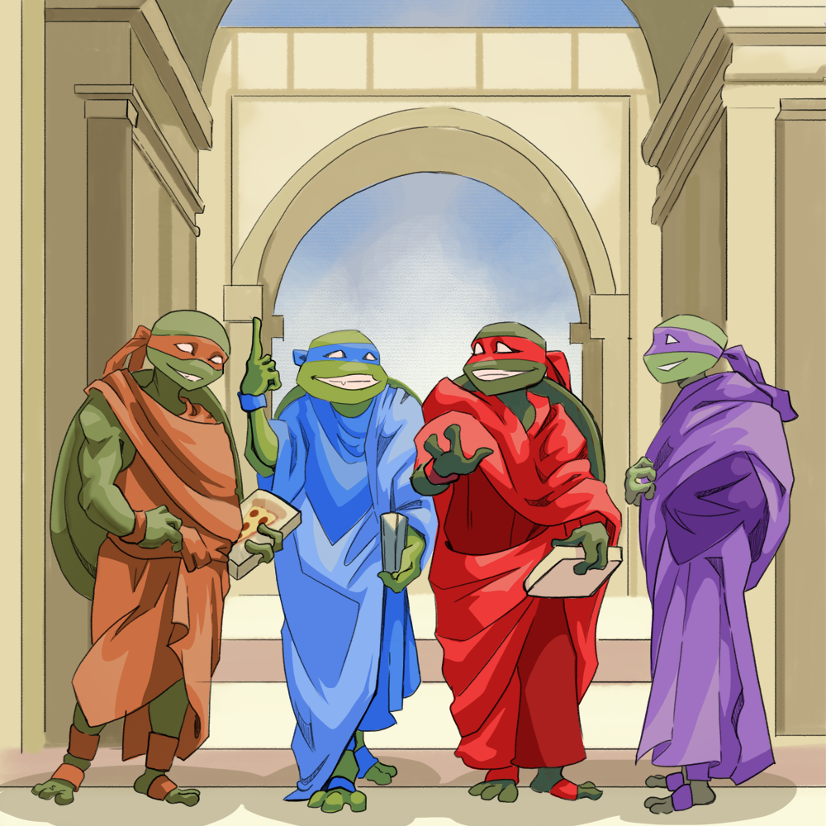
Not Just Ninja Turtles
World History and the Renaissance

Slide 3
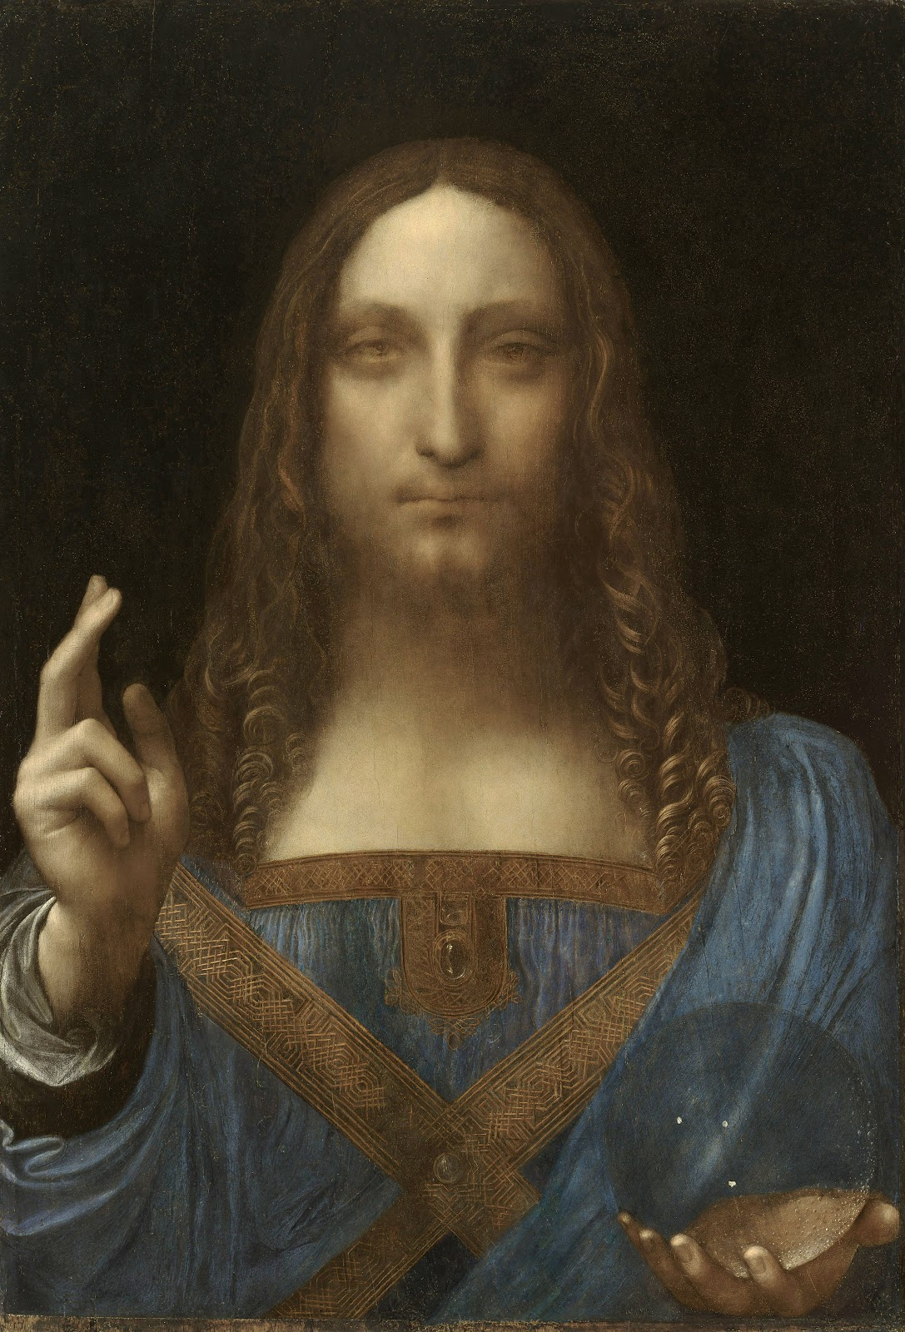
Artwork 1
Notes:
Teacher’s Note: Don’t reveal the title or artist yet. Simply give students time to view the image.
da Vinci, L. (ca. 1500). Salvator Mundi [Painting: Oil on walnut wood]. Wikimedia Commons. https://commons.wikimedia.org/wiki/File:Leonardo_da_Vinci,_Salvator_Mundi,_c.1500,_oil_on_walnut,_45.4_%C3%97_65.6_cm.jpg

Slide 4
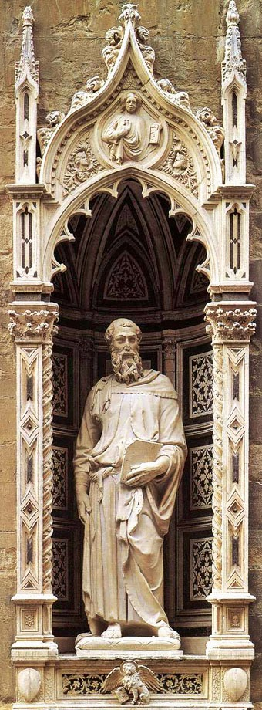
Artwork 2
Notes:
Teacher’s Note: Don’t reveal the title or artist yet. Simply give students time to view the image.
Donatello. (1411–1413). Saint Mark [Marble statue]. Wikimedia Commons. https://commons.wikimedia.org/wiki/File:Stmark.jpg

Slide 5
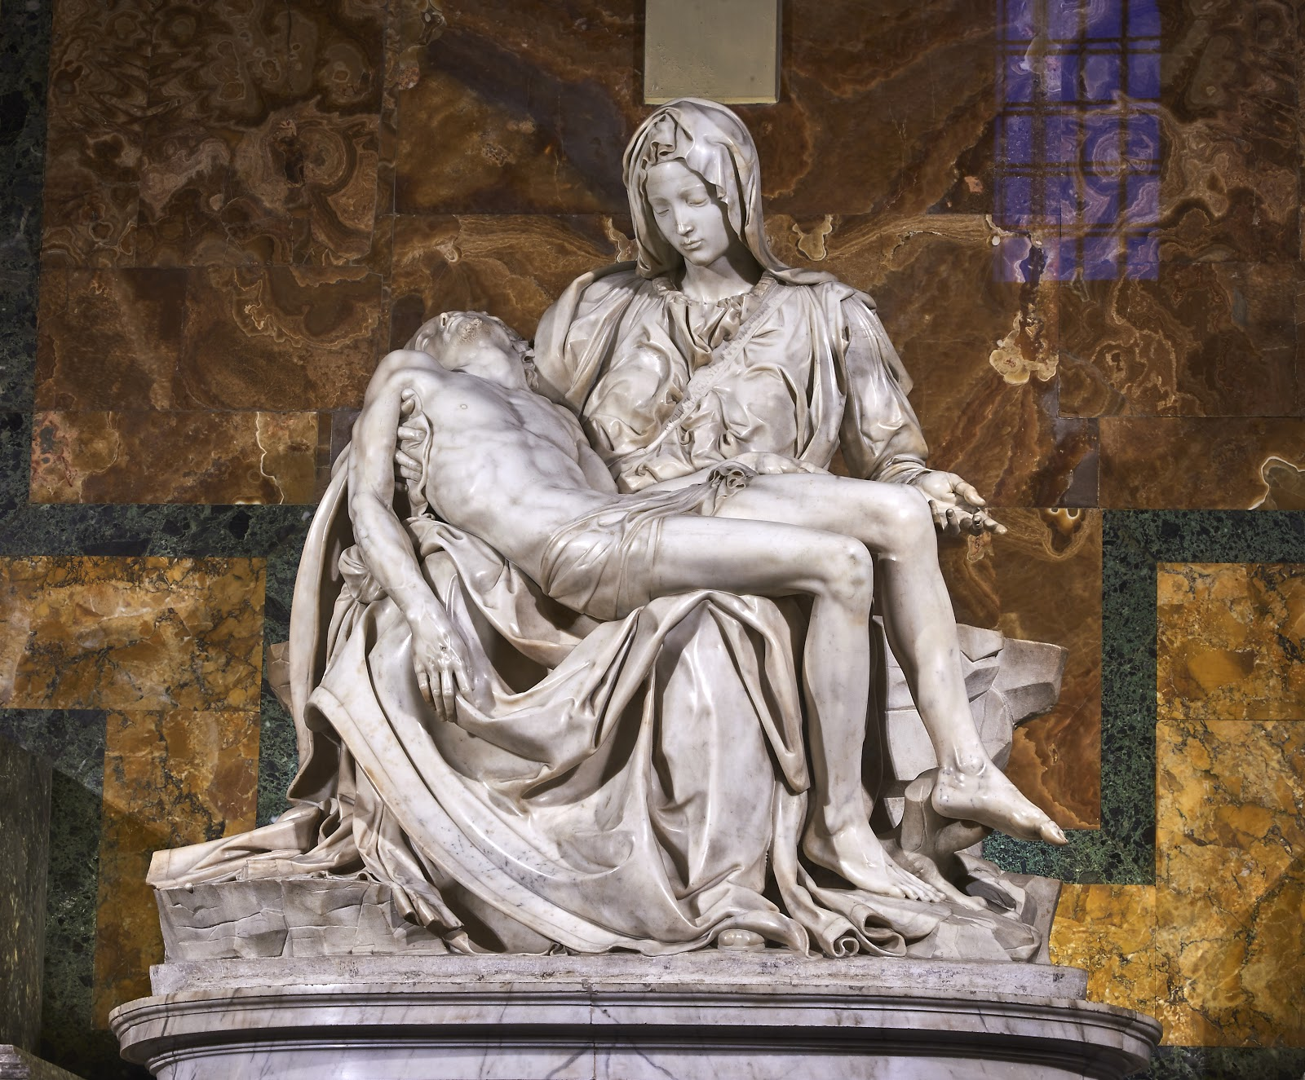
Artwork 3
Notes:
Teacher’s Note: Don’t reveal the title or artist yet. Simply give students time to view the image.
Michelangelo. (1498–1499). Pietà [Statue]. Wikimedia Commons. https://commons.wikimedia.org/wiki/File:Michelangelo%27s_Piet%C3%A0,_St_Peter%27s_Basilica_(1498%E2%80%9399).jpg

Slide 6
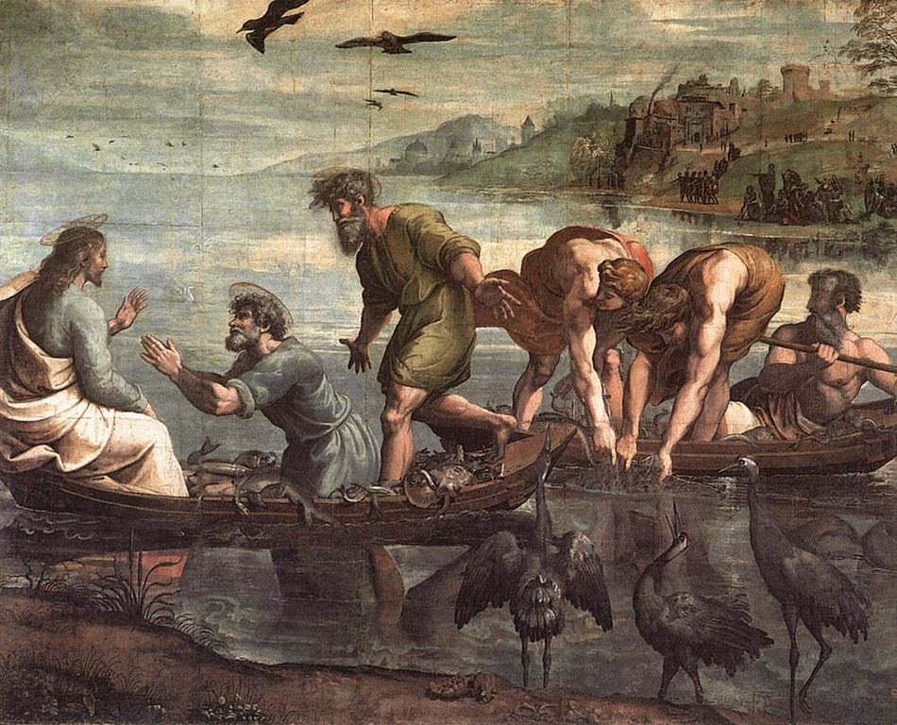
Artwork 4
Notes:
Teacher’s Note: Don’t reveal the title or artist yet. Simply give students time to view the image.
Raphael. (1515). The miraculous draught of fishes [Painting]. Wikimedia Commons. https://commons.wikimedia.org/wiki/File:V%26A_-_Raphael,_The_Miraculous_Draught_of_Fishes_(1515).jpg

Slide 7

Four Corners
Find the four images hanging in different locations around the room.
Move to the area near the image that you like best.
Notes:
K20 Center. (n.d.). Four corners. Strategies. https://learn.k20center.ou.edu/strategy/138

Slide 8
Four Corners
Say hello to your group members!
As a group, discuss why you chose this piece of art.
Notes:
K20 Center. (n.d.). Four corners. Strategies. https://learn.k20center.ou.edu/strategy/138

Slide 9
Four Corners
Elect a group spokesperson to tell the class why you selected the artwork.
Notes:
K20 Center. (n.d.). Four corners. Strategies. https://learn.k20center.ou.edu/strategy/138

Slide 10
Essential Questions
What can art tell us about history?
How does art reflect history?

Slide 11
Learning Objectives
Identify the characteristics of Renaissance art.
Analyze the impact of culture on Renaissance art

Slide 12
Artwork 1
Salvator Mundi
Leonardo da Vinci
Notes:
da Vinci, L. (ca. 1500). Salvator Mundi [Painting: Oil on walnut wood]. Wikimedia Commons. https://commons.wikimedia.org/wiki/File:Leonardo_da_Vinci,_Salvator_Mundi,_c.1500,_oil_on_walnut,_45.4_%C3%97_65.6_cm.jpg

Slide 13
Artwork 2
Saint Mark
Donatello
Notes:
Donatello. (1411–1413). Saint Mark [Marble statue]. Wikimedia Commons. https://commons.wikimedia.org/wiki/File:Stmark.jpg

Slide 14
Artwork 3
Pietà
Michelangelo
Notes:
Michelangelo. (1498–1499). Pietà [Statue]. Wikimedia Commons. https://commons.wikimedia.org/wiki/File:Michelangelo%27s_Piet%C3%A0,_St_Peter%27s_Basilica_(1498%E2%80%9399).jpg

Slide 15
Artwork 4
The Miraculous Draught of Fishes
Raphael
Notes:
Raphael. (1515). The miraculous draught of fishes [Painting]. Wikimedia Commons. https://commons.wikimedia.org/wiki/File:V%26A_-_Raphael,_The_Miraculous_Draught_of_Fishes_(1515).jpg

Slide 16

It’s OPTIC-al!
As a group, analyze the image you selected.
Answer the following questions on your handout:
  Observations: What do you notice or observe?
  Parts: What are the parts or details?
  Title: What does the title tell you?
  Interrelationships: How do the parts convey the artist’s message?
  Conclusion: What can you tell from the artwork? What does it convey?
Notes:
K20 Center. (n.d.). It’s OPTIC-al. Strategies. https://learn.k20center.ou.edu/strategy/99

Slide 17
The Renaissance Crash Course
As you watch the video:
Annotate your “It’s OPTIC-al Graphic Organizer.” Add any new information that you think is helpful to understanding Renaissance art.
Consider this question:
  How do you think the Renaissance is reflected in the art you have viewed today?

Slide 18
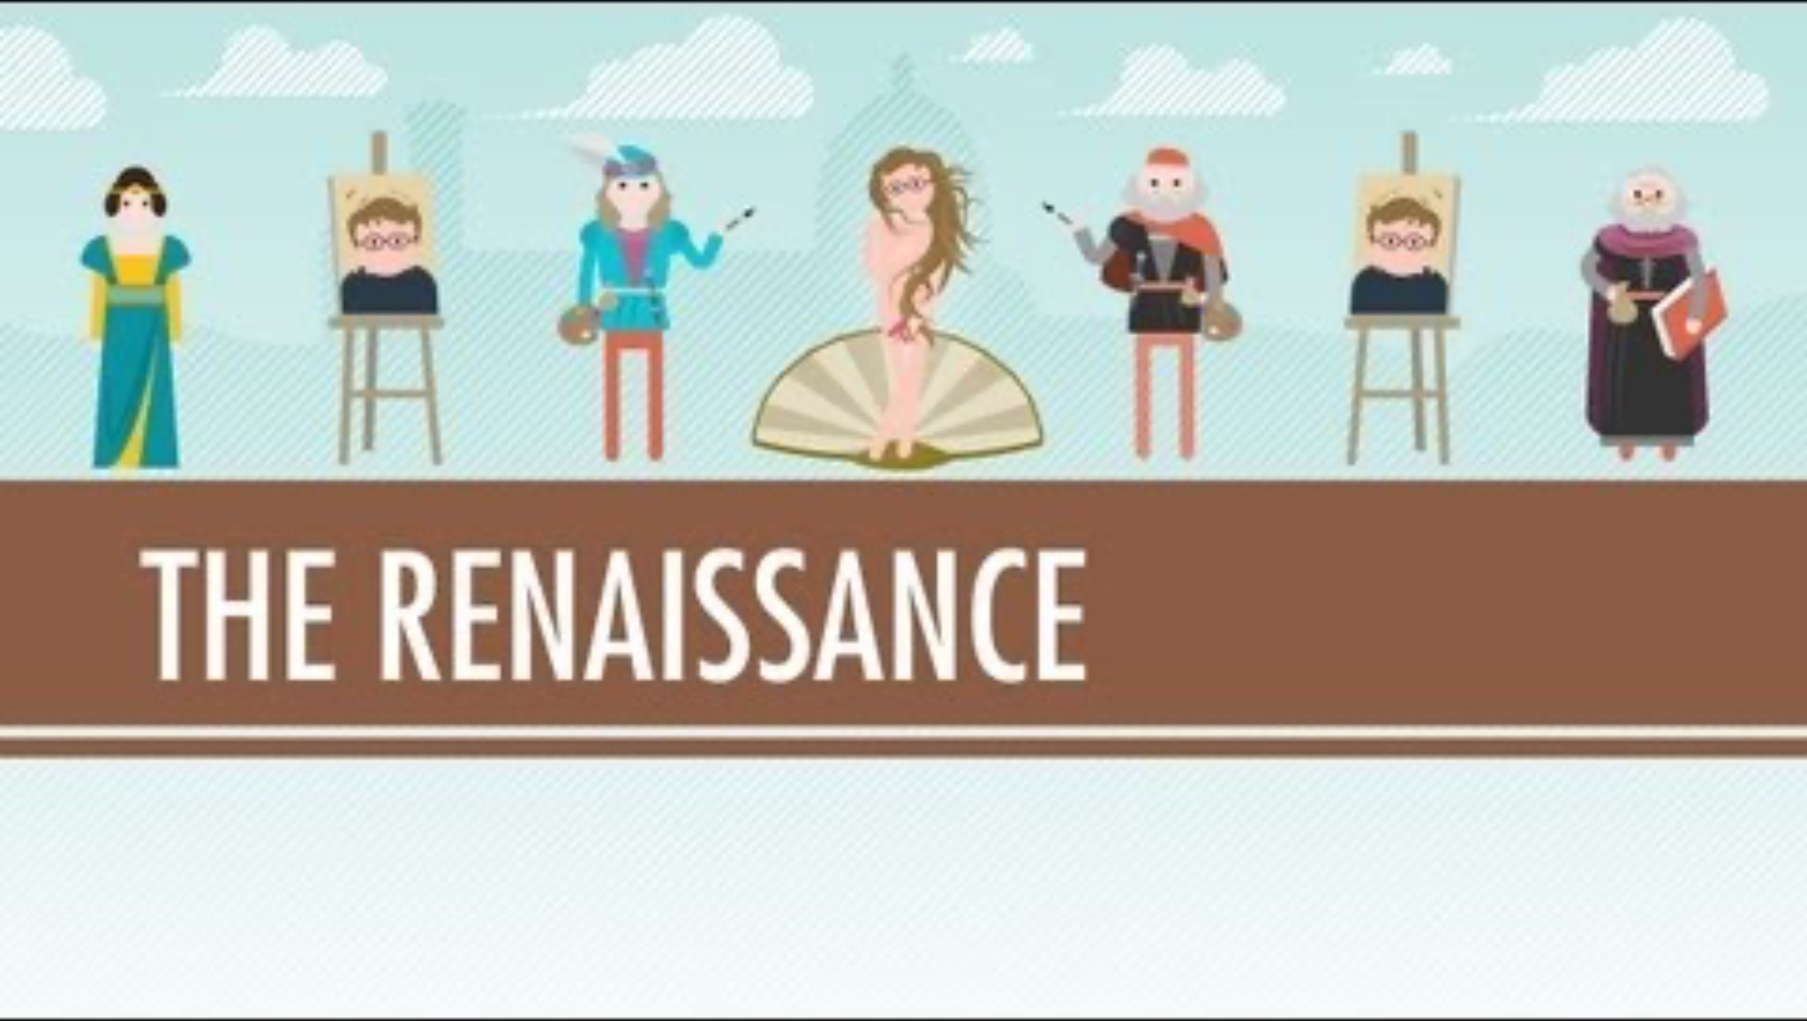
The Renaissance: Was it a thing?
Notes:
CrashCourse. (2012, June 21). The Renaissance: Was it a thing? – Crash course world history #22 [Video]. YouTube. https://www.youtube.com/watch?v=Vufba_ZcoR0

Slide 19

Anchor Chart
Work with your small group to create a poster for your Renaissance artist.
Make sure to include:
  The artist’s name
  Graphics (pictures of the artist or their most famous works)
  Common themes of the artist’s works
  Description of how this artist’s work reflects the Renaissance period
Notes:
K20 Center. (n.d.). Anchor charts. Strategies. https://learn.k20center.ou.edu/strategy/58

Slide 20

Gallery Walk
Post your presentations around the room.
Elect a spokesperson to stay at your presentation and explain it to visitors.
The rest of your group should move clockwise around the room to view other presentations and leave feedback:
  What did the group do well?
  Did you find a typo or have some constructive feedback?
Notes:
K20 Center. (n.d.). Gallery walk / carousel. Strategies. https://learn.k20center.ou.edu/strategy/118

