Slide 2
The Literary Work of
Ralph Ellison
Oklahoma History + American Literature

Slide 3
Magnetic Statements
Review the five statements on the handout.
Choose the statement that you are most drawn to, find most compelling and/or that speaks or resonates with you the most.
Go stand by that statement and prepare to share your reasoning.

Slide 4
Essential Questions
How does literature help us understand the human experience?
How have the messages of Ellison’s literary work contributed to our understanding of American society both historically and currently?

Slide 5
Learning Objectives
Describe the literary contributions of Ralph Ellison and the influence of his writing on society historically and currently.

Slide 6
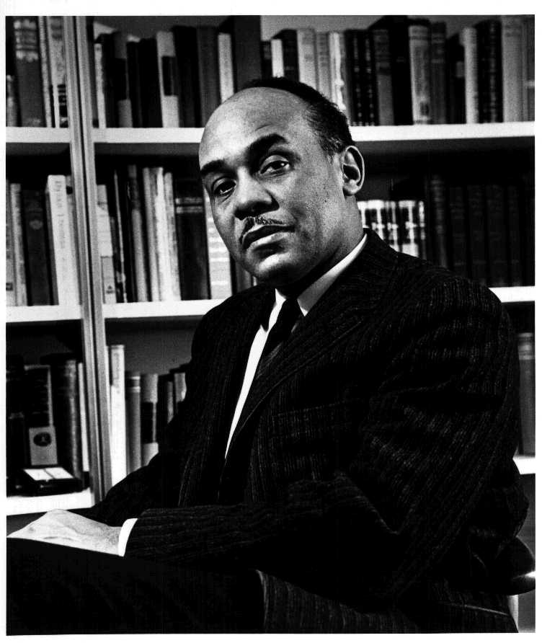
Ralph Ellison Video - POMS
Please follow the link to view the Ralph Ellison Video.
As you watch the video record at least one POMS to share with the class after the video is over.
Notes:
United States Information Agency staff photographer - Stephen Winick (June 2, 2017). Ralph Ellison, Invisible Folklorist. Folklife Today. Library of Congress. https://blogs.loc.gov/folklife/files/2017/05/Ralph_Ellison_photo_portrait_seated.jpg The image is originally from NARA (reference number 306-PSA-61-8989).

Slide 7
Invisible Man - Prologue Analysis
Read the section of the prologue you have been assigned.
Working with your group and using your own words, create a 1-3 sentence summary of your section of the prologue.
Notes:
First-edition dust jacket cover of Invisible Man (1952) by the American author Ralph Ellison. https://en.wikipedia.org/wiki/Invisible_Man#/media/File:Invisible_Man_(1952_1st_ed_jacket_cover).jpg

Slide 8
Chat Stations
You will have 3 minutes to discuss the question at each station and record your thoughts in the Chat Station Note Catcher.
When time is called, rotate to the next station.
When you have gone to all three stations returned to your seats and prepare to share your thoughts with the class.

Slide 9
Exit Ticket - Poster Evaluation
Based on what you have learned, explain why the artist who created this poster highlights Ralph Ellison as both a “Oklahoma and American Legend.”
Notes:
http://ralphellisonfoundation.org/school-posters/

