Slide 2
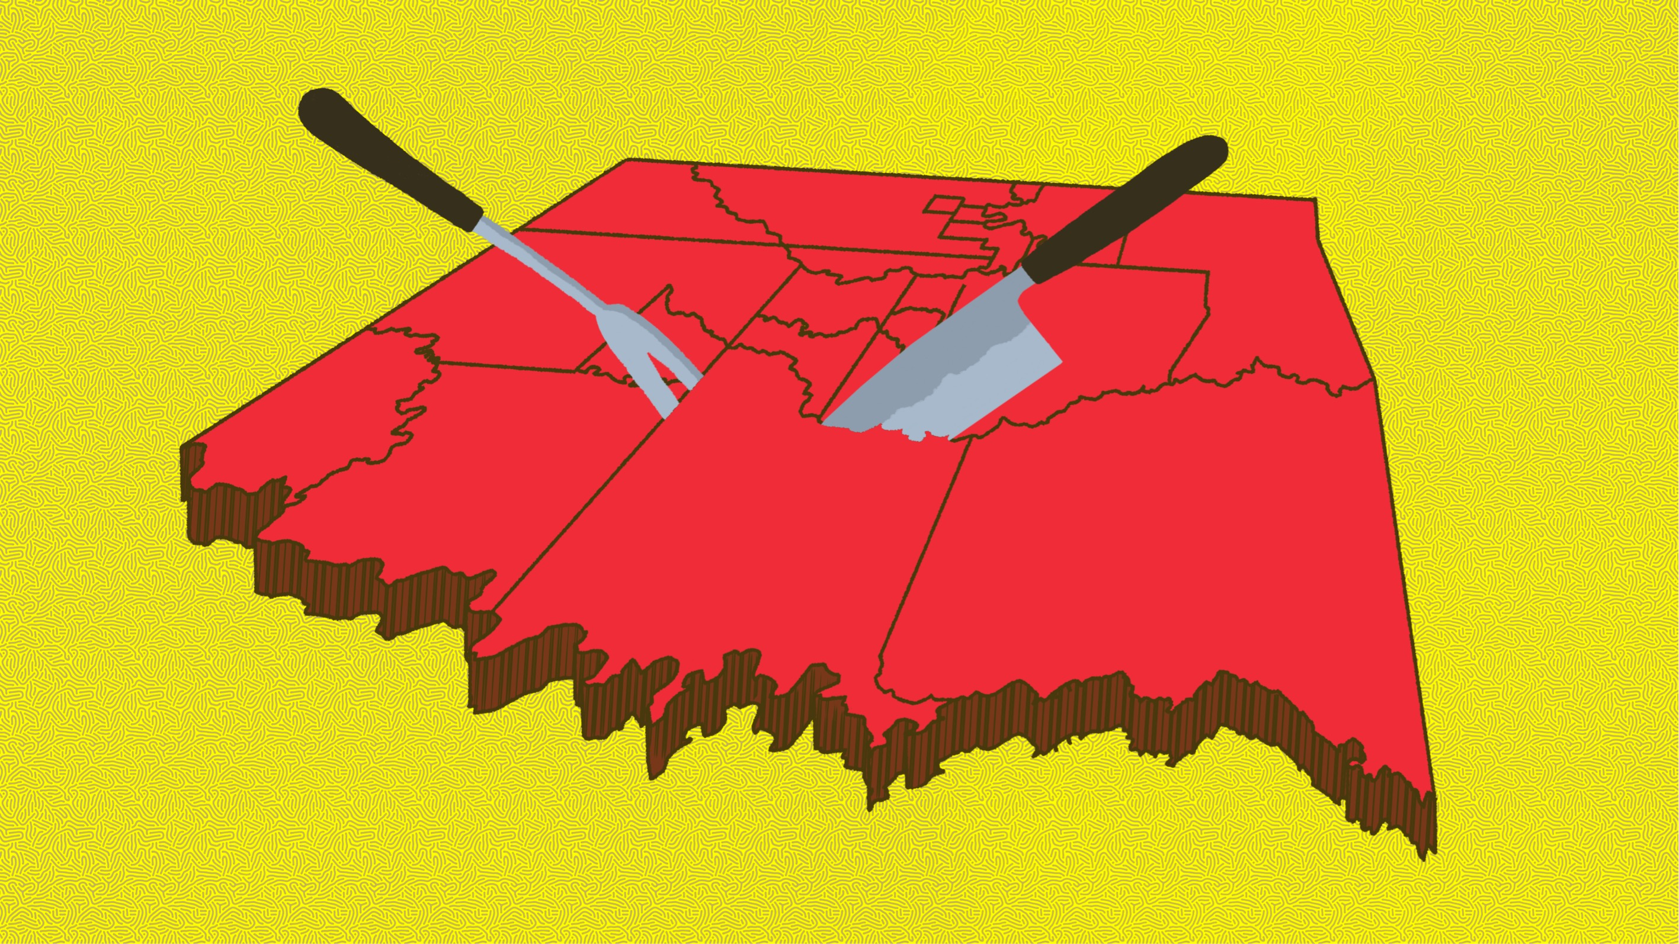
Allotment in Indian Territory
Oklahoma History

Slide 3
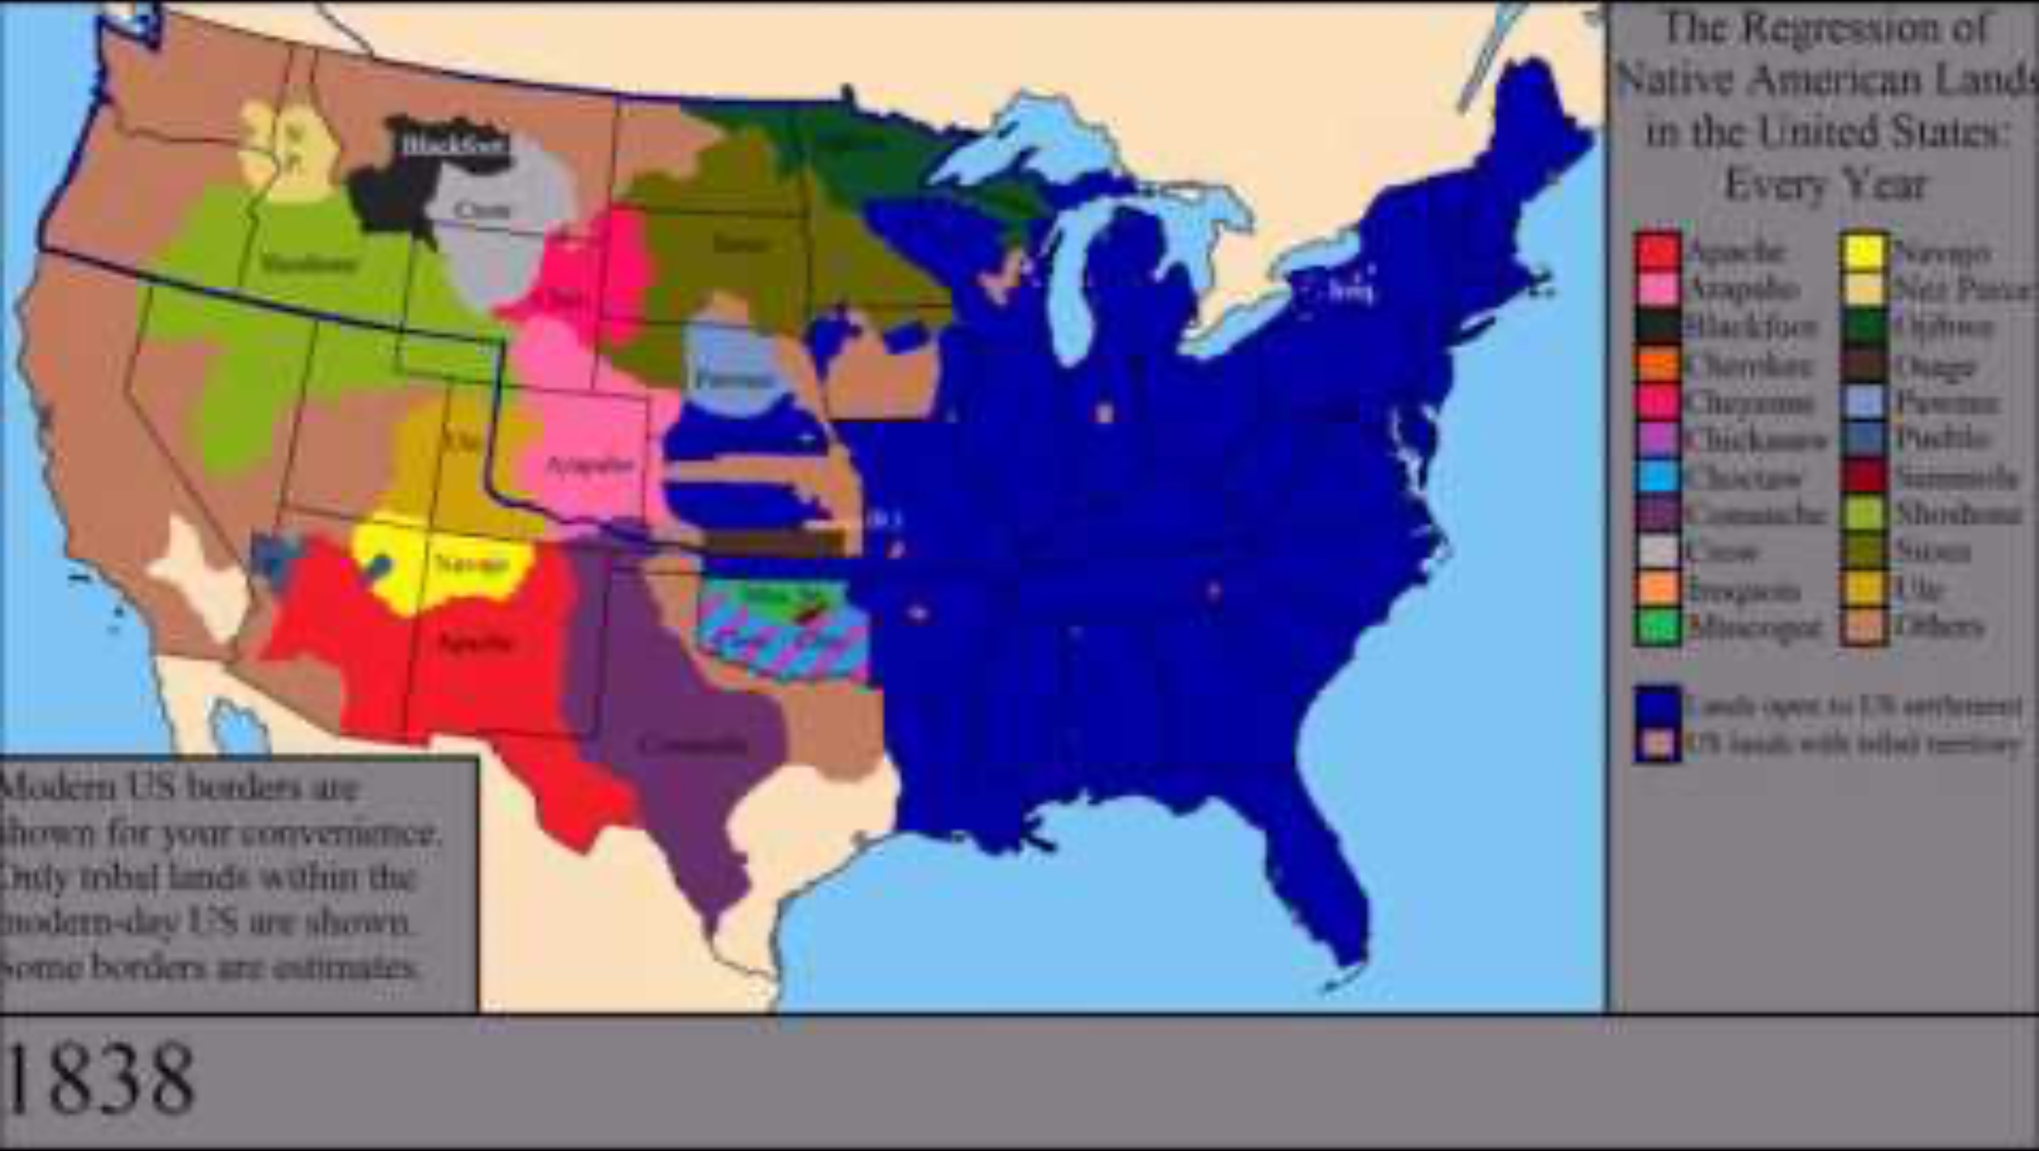
The Loss of Native American Lands Within the US: Every Year
Notes:
EmperorTigerstar. (2016, November 25). The loss of Native American lands within the US: Every year [Video]. YouTube. https://www.youtube.com/watch?v=Zadq5dl2G8Q

Slide 4
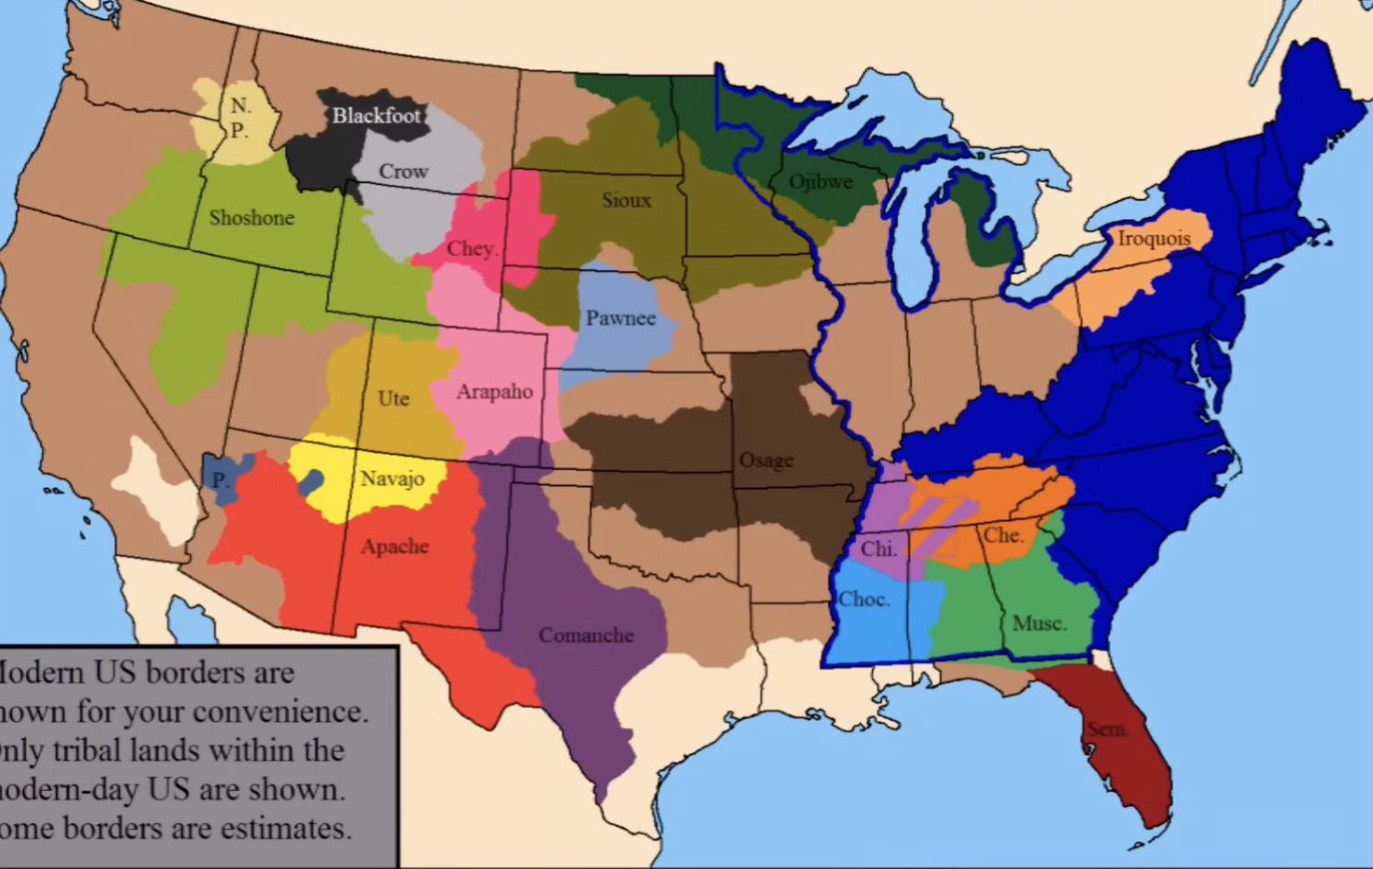
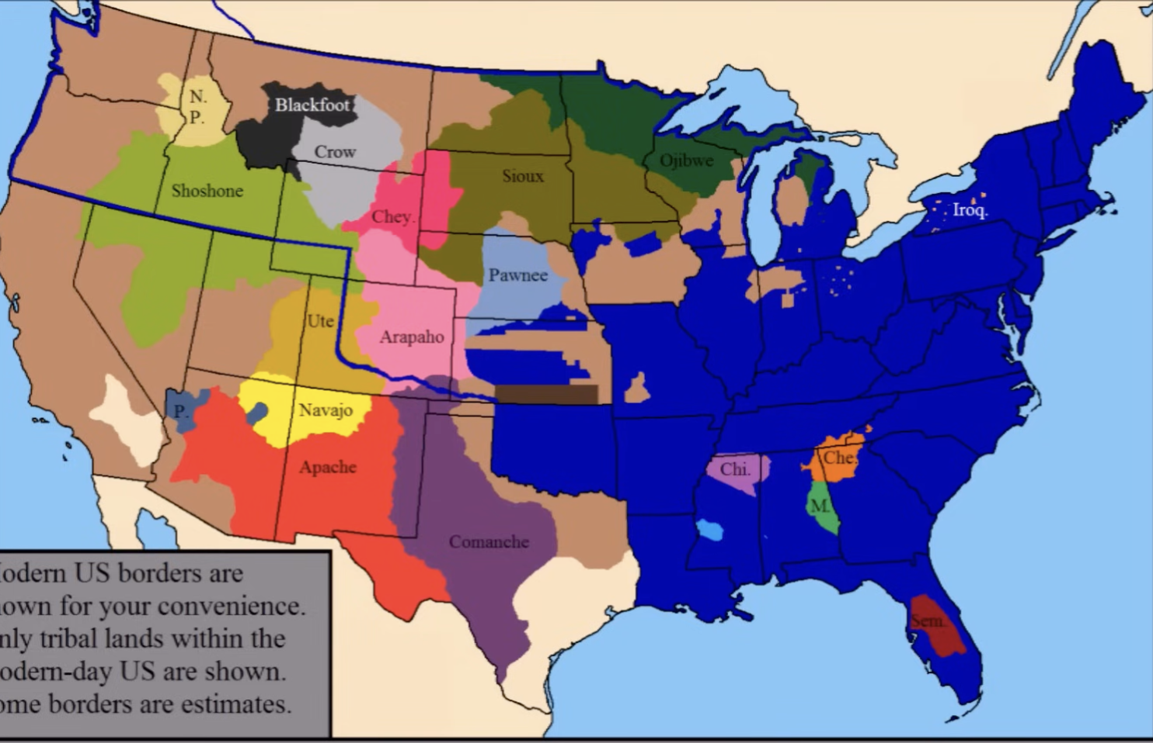
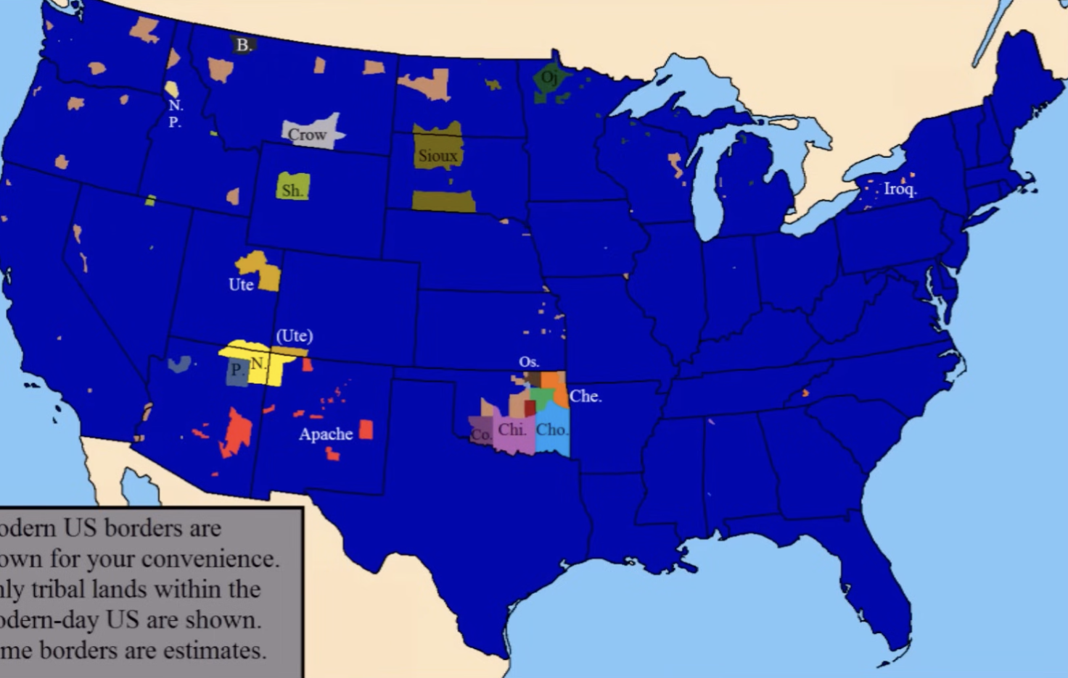
Tribal Nations and Land Loss
What types of U.S. government policies made the land loss shown in the video a reality?
Notes:
EmperorTigerstar. (2016, November 25). The loss of Native American lands within the US: Every year [Video]. YouTube. https://www.youtube.com/watch?v=Zadq5dl2G8Q

Slide 5
Policies that Resulted in Tribal Land Loss
The Doctrine of Discovery
Treaties
Land Cessions
Violent Engagements/Military Campaigns
Removal
Reservations

Slide 6
Essential Questions
How have the policies and decisions of the U.S. government affected tribal sovereignty?
How did the policy of allotment affect tribes in Indian Territory?

Slide 7
Learning Objectives
Explore the major pieces of allotment legislation, such as the Dawes Act of 1887 and the Curtis Act of 1898, and evaluate how allotment affected Indian Territory.
Describe the differing perspectives on allotment in Indian Territory.

Slide 8
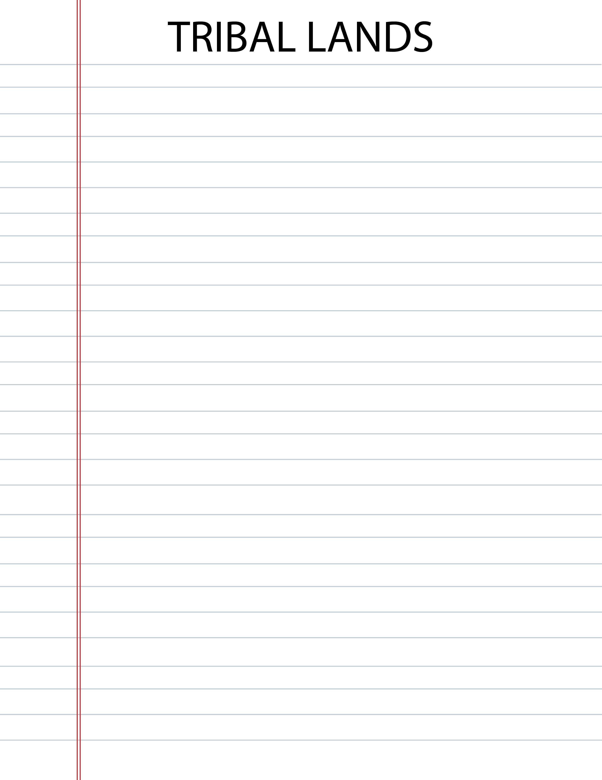
Allotment Simulation Image 1

Slide 9
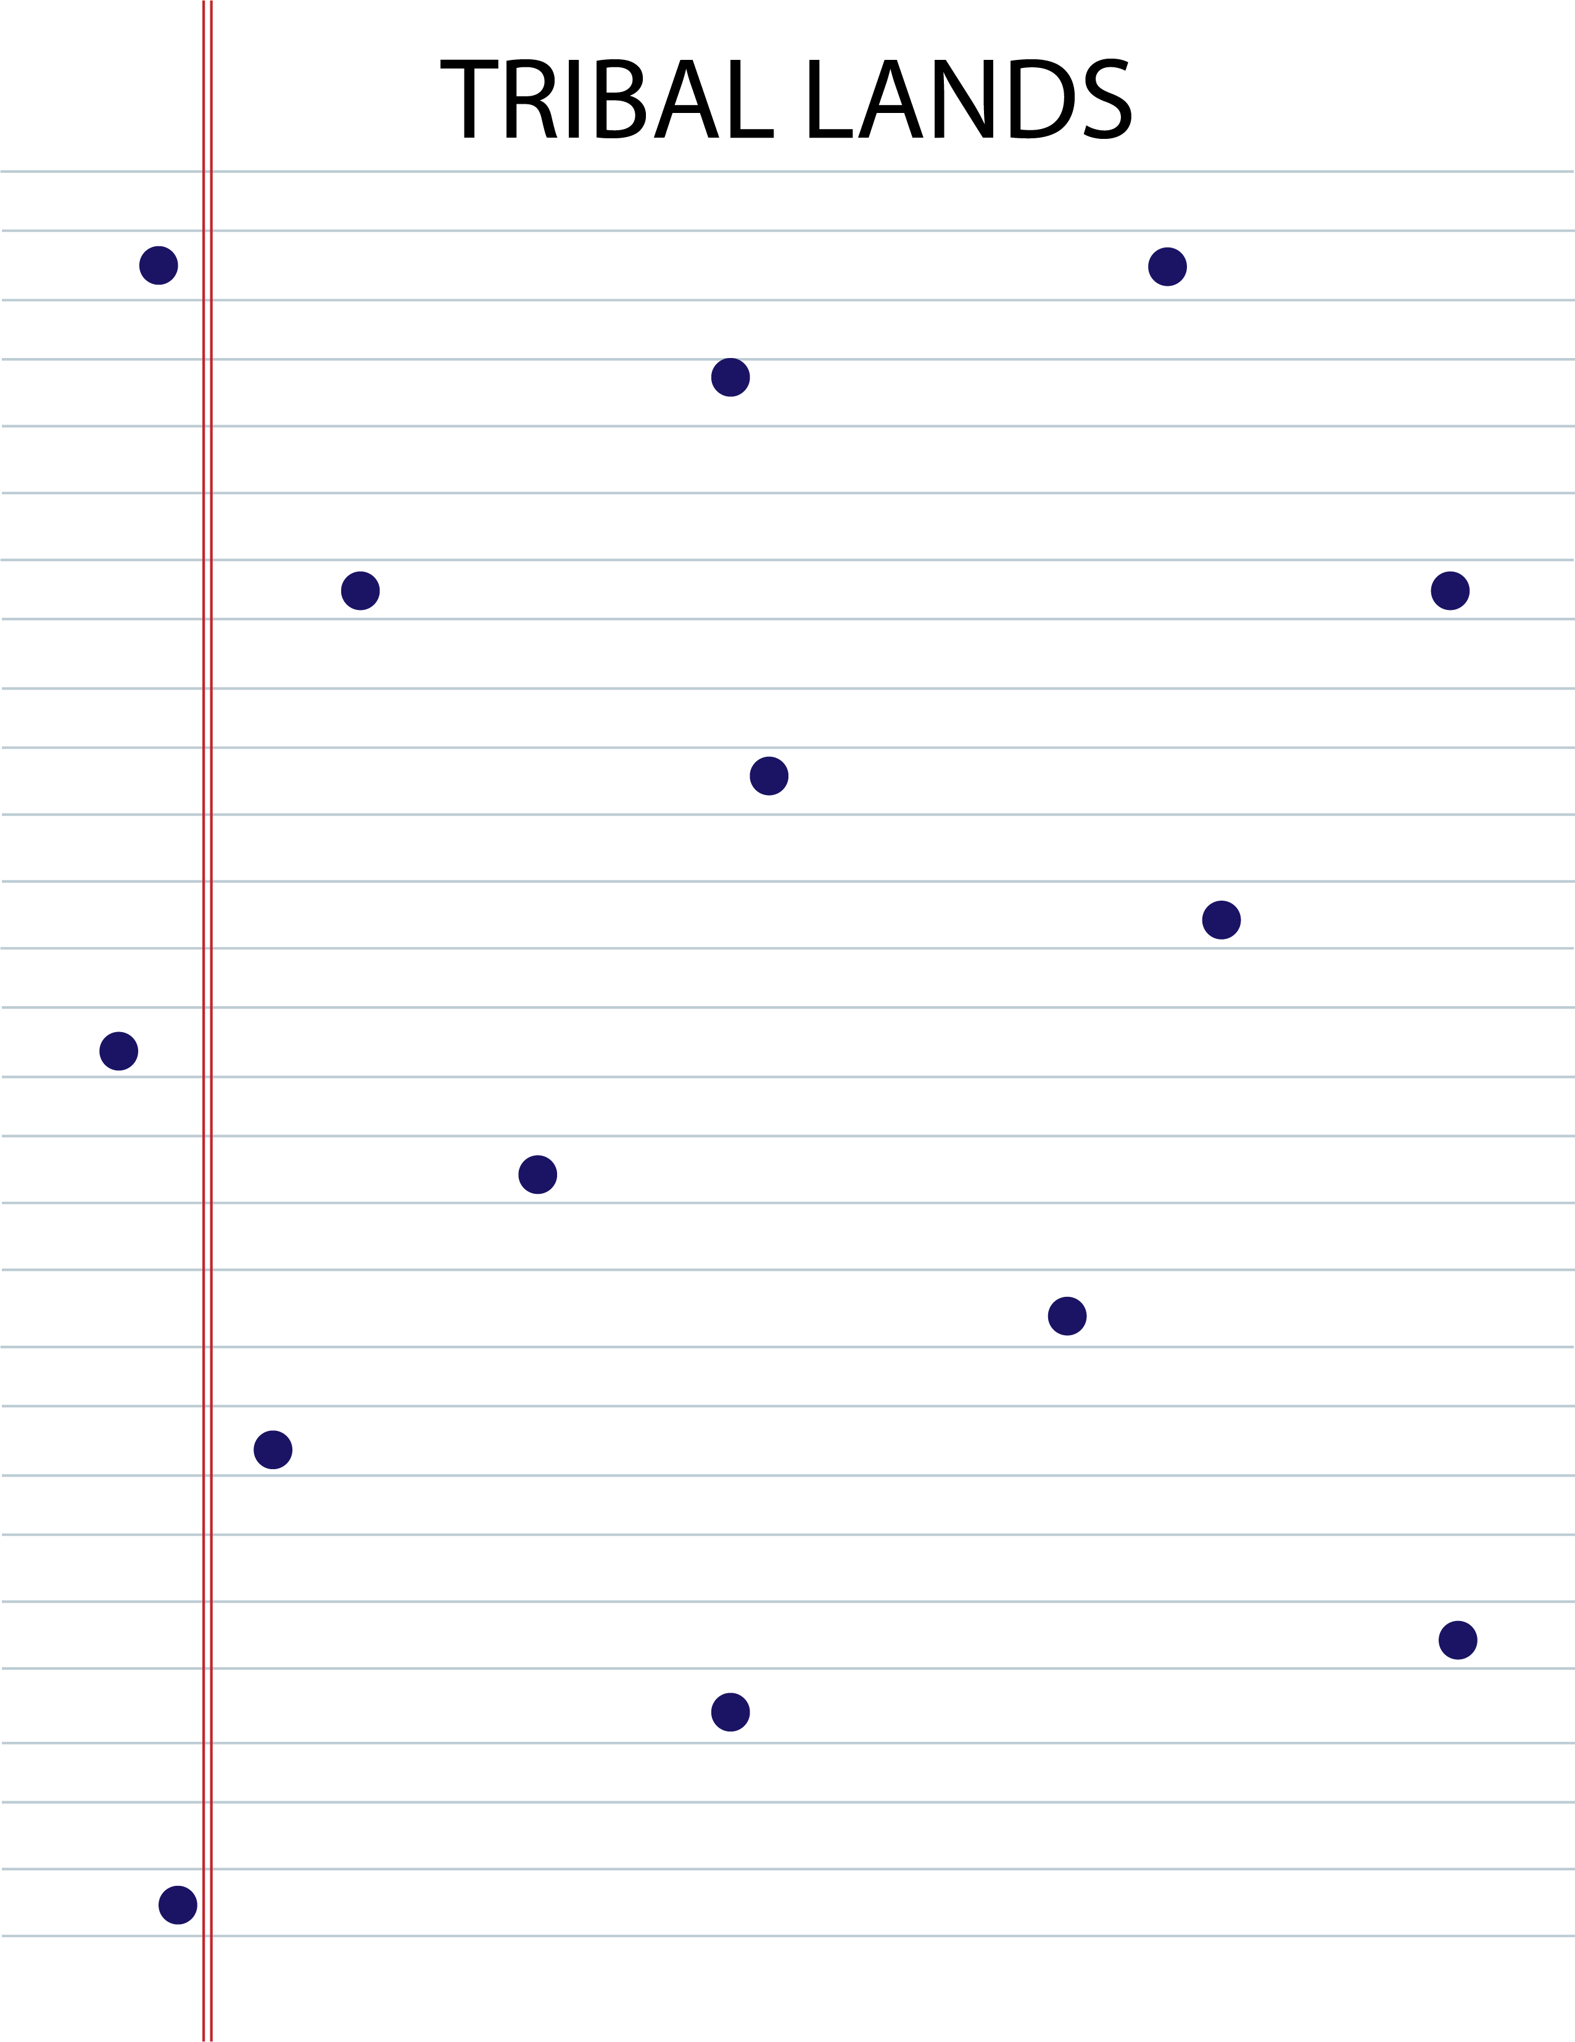
Allotment Simulation Image 2

Slide 10
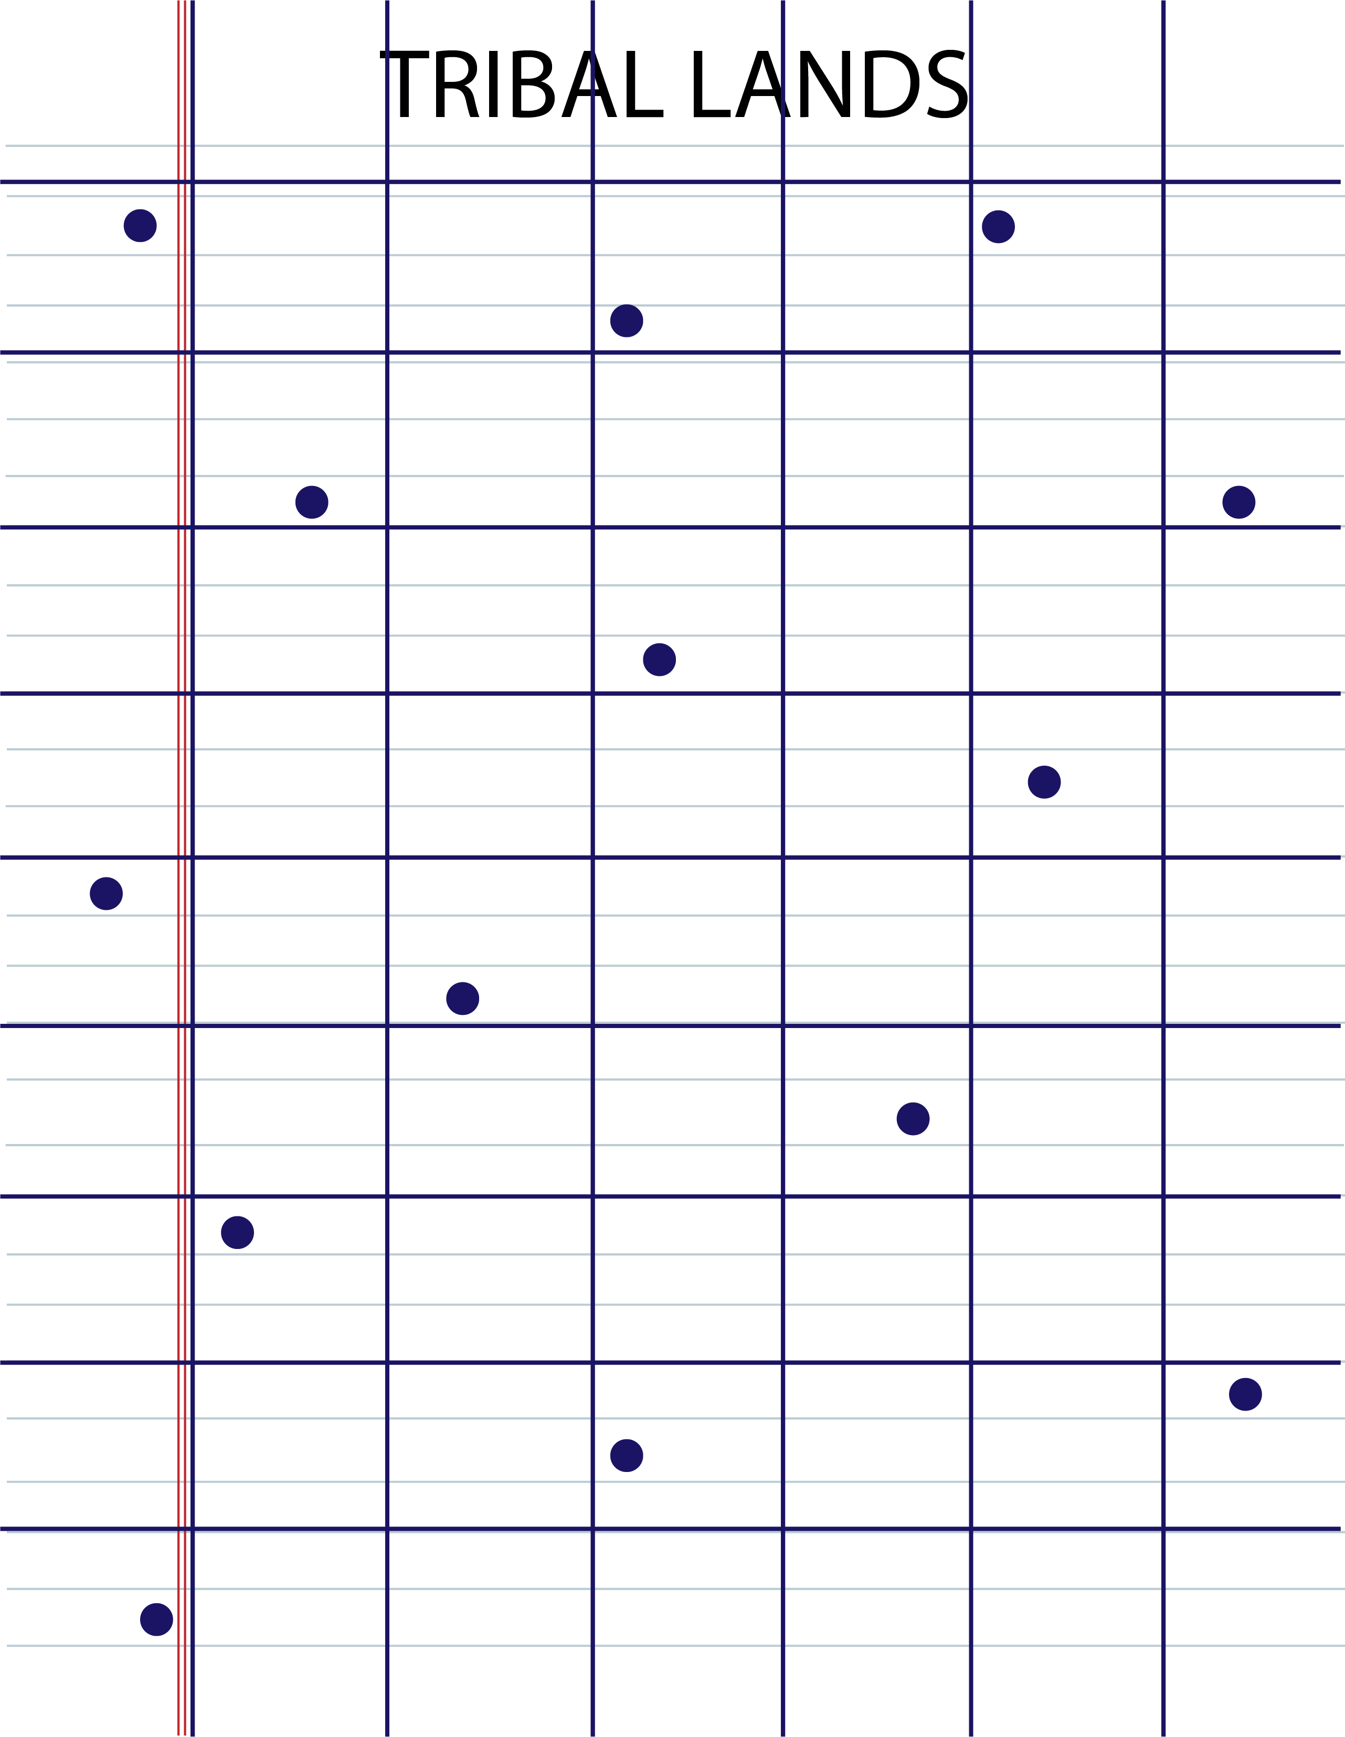
Allotment Simulation Image 3

Slide 11
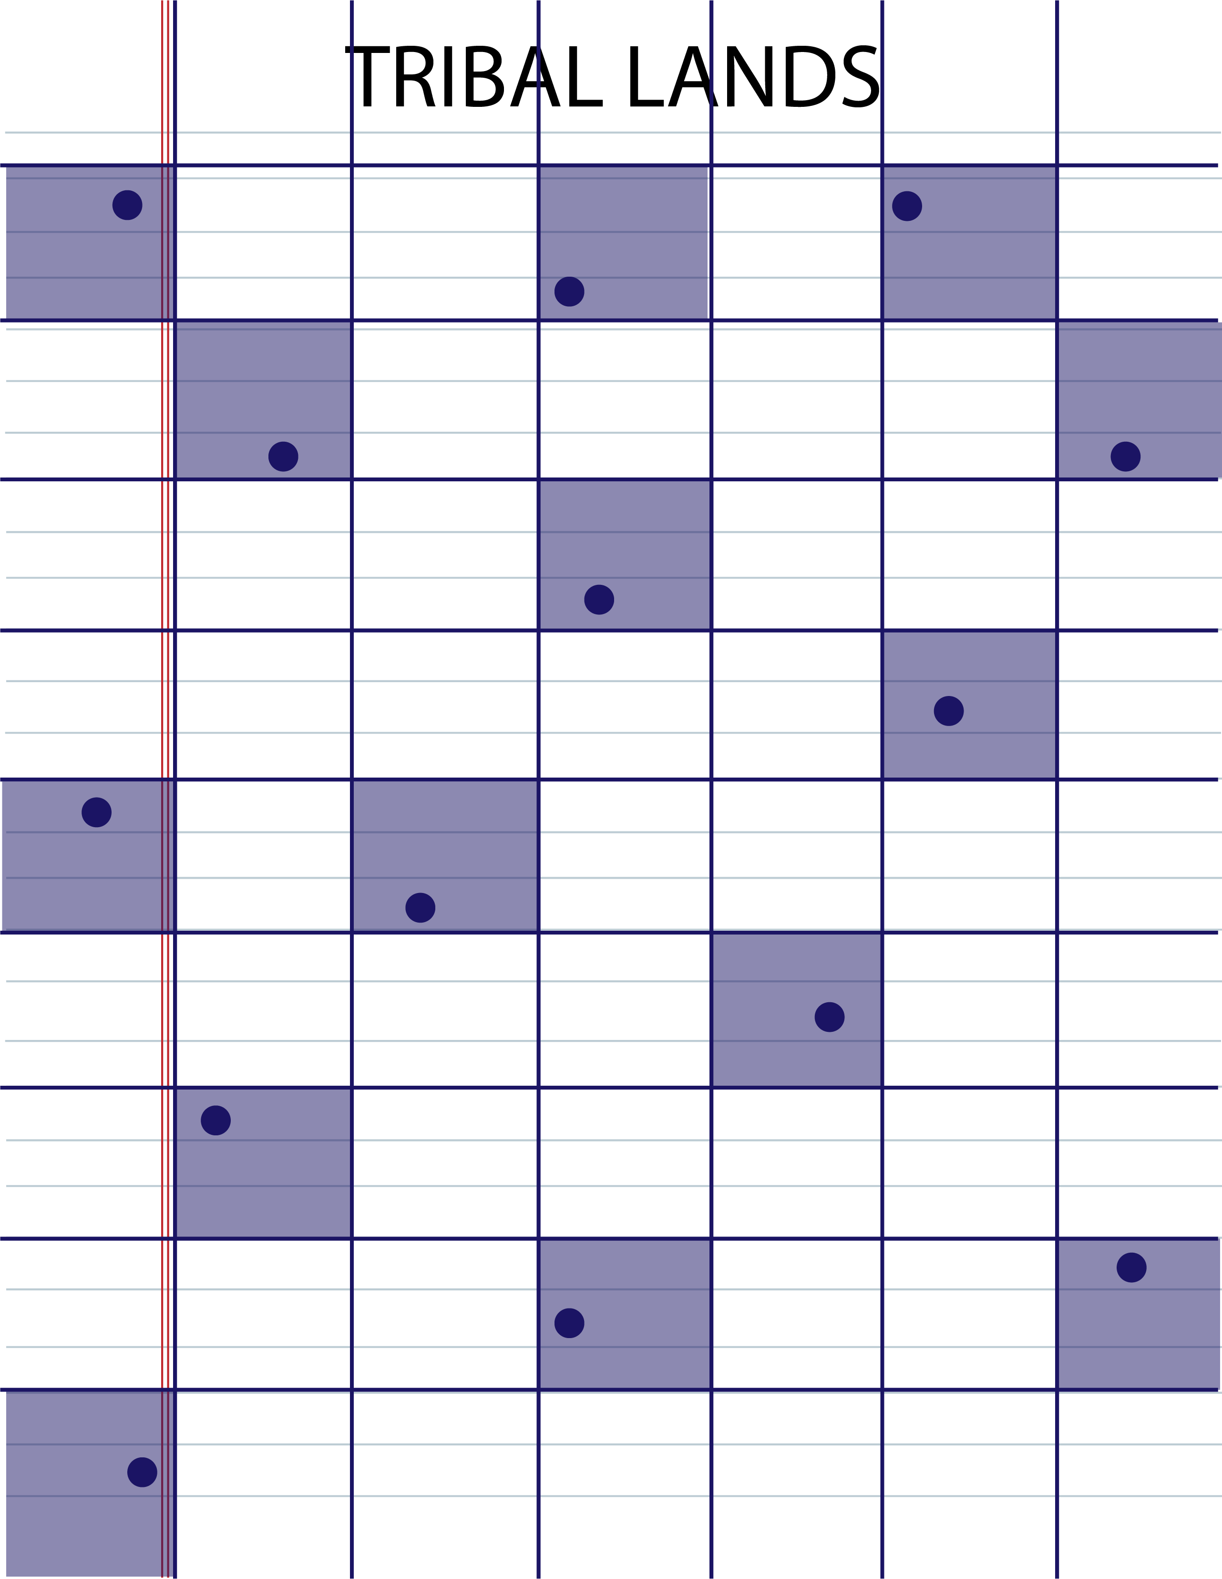
Allotment Simulation Image 4

Slide 12
Allotment Simulation Reflection
Based on what you observed from the allotment simulation, complete the following sentence:
As a result of allotment…

Slide 13
Allotment in Indian Territory Article
As you read the article with your group, consider the following:
What was the Dawes Act of 1887?
What was the Curtis Act of 1898?
Why did the U.S. government favor policies like the Dawes and Curtis Acts that required Native lands to be allotted to individual owners?
How did most Native American groups feel about those allotment policies?

Slide 14
Honeycomb Harvest
Tribal Nations
Allotment
Arrange the hexagons to show how the key concepts from the Allotment in Indian Territory article relate to one another.
U.S. Government
Dawes Act
Curtis Act

Slide 15
Allotment and the Supreme Court
How does the history of allotment relate to the ruling in the case of McGirt v. Oklahoma?

Slide 16
Allotment and the Supreme Court
Prepare a response to this question with your group and find at least one piece of text evidence from the Supreme Court opinion to support your response.
  How does the history of allotment relate to the ruling in the case of McGirt v. Oklahoma?

Slide 17

Emoji Reflection
Choose three emojis that you think best represent:
  The U.S. government’s perspective toward allotment.
  The Tribal Nations’ perspectives toward allotment.
Write a response to justify each set of choices.

