Slide 2
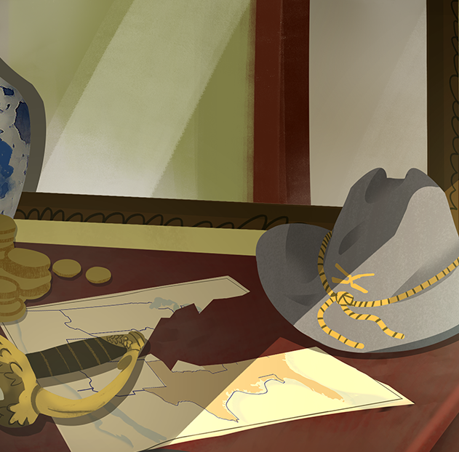
Why Did the Southern States Secede?
The U.S. Civil War

Slide 3
List-Group-Label
Create a label that describes what the items have in common.
  The compromise of 1850
  Publication of Uncle Tom’s Cabin
  Kansas-Nebraska Act
  Dred Scott v. Sandford
  John Brown’s Raid on Harpers Ferry
  The election of 1860

Slide 4
Essential Questions
What was the principal cause of the Civil War?
Why did the Southern states secede from the Union to form the Confederate States of America?

Slide 5
Learning Objectives
Evaluate the central cause of the U.S. Civil War.
Explain, using textual evidence, why the Southern states seceded to form the Confederate States of America.

Slide 6
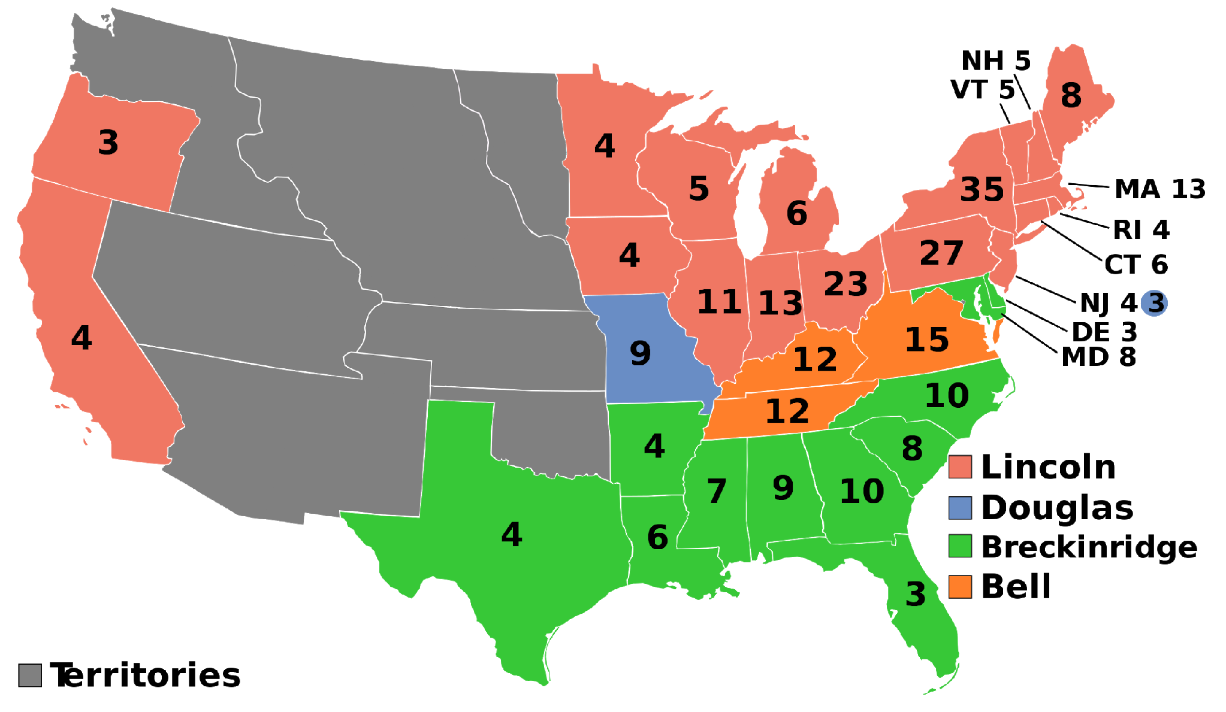
Election of 1860 and Secession
After the election of 1860, seven slaveholding states seceded from the Union.
Secede:
to formally break away
Notes:
AndyHogan14. (2011, November 8). 1860 Electoral College [Map]. Wikimedia Commons. https://commons.wikimedia.org/wiki/United_States_presidential_election_maps#/media/File:ElectoralCollege1860.svg

Slide 7
Ordinances of Secession
States that seceded made formal declarations of secession, which explained their decisions to break away from the United States.
Read and analyze one ordinance of secession from South Carolina, Mississippi, or Texas.

Slide 8

Why-Lighting
Read the ordinance of secession with your group.
Highlight pieces of the text that explain why that state seceded from the Union.
Add a note explaining why you highlighted each passage.

Slide 9
Text Evidence of Secession
Circle the state whose ordinance your group analyzed.
Summarize why the state left the Union.
Include relevant textual evidence from the document.

Slide 10
Why-Lighting
Read the excerpt from either the Constitution of the Confederate States of America (CSA) or the “Cornerstone Speech.”
Highlight pieces of the text that explain why the Southern states seceded from the Union.
Add a note explaining why you highlighted each passage.

Slide 11
Why Did the Southern States Secede?
As a class, create a claim responding to this question.
Use textual evidence from the documents you analyzed to support your claim.
State your reasoning by explaining how your evidence supports the claim.

Slide 12
Do you think the U.S. Civil War is…
 | Estimated Percentages | Actual Percentages
Still relevant to American politics and political life?
Important historically but has little relevance today?
Don’t know
What is your impression of the main cause of the U.S. Civil War?
 | Estimated Percentages | Actual Percentages
Mainly about states’ rights
Mainly about slavery
Both equally (volunteered response)
Neither/Don’t know
Notes:
Source: Pew Research Center. (2011, April 8). Civil War at 150: Still divisive, still relevant. https://www.pewresearch.org/politics/2011/04/08/civil-war-at-150-still-relevant-still-divisive/

Slide 13
Do you think the U.S. Civil War is…
 | Estimated Percentages | Actual Percentages
Still relevant to American politics and political life? |  | 56%
Important historically but has little relevance today? |  | 39%
Don’t know |  | 5%
What is your impression of the main cause of the U.S. Civil War?
 | Estimated Percentages | Actual Percentages
Mainly about states’ rights |  | 48%
Mainly about slavery |  | 38%
Both equally (volunteered response) |  | 9%
Neither/Don’t know |  | 6%
How do the survey results compare with your group’s estimates?
Notes:
Source: Pew Research Center. (2011, April 8). Civil War at 150: Still divisive, still relevant. https://www.pewresearch.org/politics/2011/04/08/civil-war-at-150-still-relevant-still-divisive/

Slide 14

S-I-T: Surprising-Interesting-Troubling
What is something from the lesson that is…
  Surprising?
  Interesting?
  Troubling?

