Slide 2
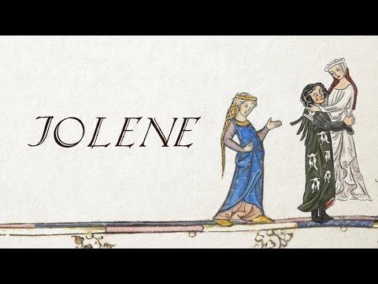
Notes:
Video Source: Hildegard von Blingin'. (2020, July 9). Jolene, By Dolly Parton (Bardcore/Medieval style) [Video]. YouTube. https://www.youtube.com/watch?v=ugqQlB5fpuc

Slide 3
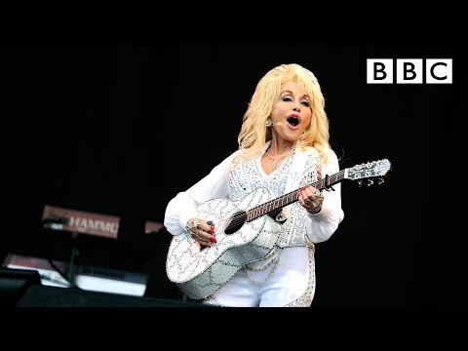
Notes:
Video Source: BBC. (2014, June 29). Dolly Parton performs Jolene at Glastonbury - BBC [Video]. YouTube. https://www.youtube.com/watch?v=nwBNBcFAFso

Slide 4
Wherefore Art Thou So Difficult, Shakespeare?
Understanding Shakespeare

Slide 5
Essential Question
How does language change over time?

Slide 6
Lesson Objectives
After completing this lesson, you will be able to:
Analyze texts to understand words used in Shakespearean English.
Use contextual clues and inferences to understand Shakespearean English.
Translate Shakespearean English into Modern English.

Slide 7
Stop and Jot
On the Jolene Lyric Comparison handout, compare the medieval and modern lyrics side-by-side.
For each stanza, mark the areas that have changed.
Write down any ideas you might have about the changes in the margin.

Slide 8
Elbow Partners
With an elbow partner, note of any trends you see between the two translations. For example:
Is “thee” used to replace a specific word?
Is “th” added to the end of some words?

Slide 9
Reflect and Consider
If you were reading a passage only in Middle English or Shakespeare’s English, how would you work out what was being said?
Discuss with your partner.
Share out with the class.

Slide 10
Why-Lighting
Form a group with others who have the same handout number (1, 2, 3, or 4).
Why-Light your passages:
Highlight areas that are difficult to understand.
Highlight words you’ve never seen before.
In the margins, hypothesize what you think those areas or words mean.
Discuss with your group members.

Slide 11
Jigsaw
Form new groups with someone who has each handout (1, 2, 3, and 4) represented.
Work together to translate your excerpts into student-friendly language.
Be sure to think about this question as you translate: How does language change over time?

Slide 12
Read Aloud
Once everyone in your group has finished translating, read your passages out loud in numbered order.
If parts of your passages don’t make sense, re-translate them and try again!

Slide 13
Blackout Poetry
Take a look at your original passages. Now that you have translated them into modern English, you have made them easier to understand.
Using a black marker and the original passage, create Blackout Poetry to summarize its meaning.

