Slide 1
The Conflict at the Washita River
Oklahoma History

Slide 2
I Notice, I Wonder
After viewing the image:
Write down at least one thing that you notice or observe in the image.
Write down at least one thing that you wonder or a question you have about the image.

Slide 3
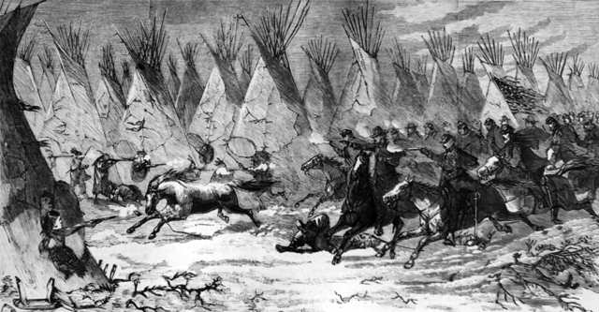
Image 1
Notes:
Image Source:
Harper’s Weekly. (1868, December 19). The Seventh U.S. Cavalry charging into Black Kettle’s village at daylight, Nov. 27, 1868 [Image]. Library of Congress. https://www.loc.gov/item/96521161/

Slide 4
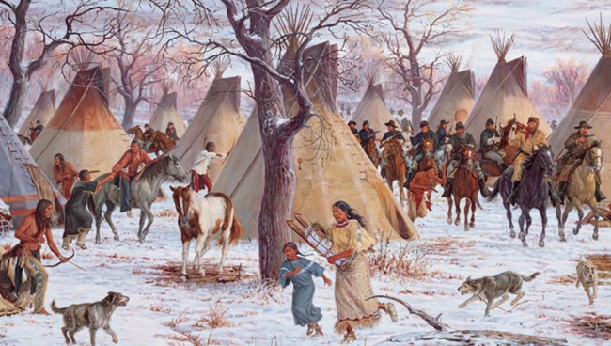
Image 2
Notes:
Image Source:
Lang, S. (2003). The 1868 battle of the Washita. National Park Service. https://www.nps.gov/waba/learn/historyculture/index.htm

Slide 5
Class Discussion
With your group, answer this question, and be prepared to share with the whole class:
What do you think is happening in these images? Justify your response using your prior knowledge and evidence from the images.

Slide 6
Essential Questions
Why was the conflict at the Washita River significant?
Should the conflict be remembered as a “battle” or as a “massacre”?
How do our interpretations of and the way we remember and label historical events affect our understanding of the world around us?

Slide 7
Learning Objectives
Describe the conflict at the Washita River and its significance.
Evaluate and justify whether the conflict at the Washita River should be remembered as a “battle” or a “massacre.”

Slide 8
Article Analysis
Analyze the article to identify Points of Most Significance (POMS).
For each point, summarize the most significant information from the previous section of the article.

Slide 9
History Frame
Working with your group, use the article and your POMS to complete the Conflict at the Washita history frame graphic organizer.

Slide 10
Battle or Massacre: Choose a Side
Based on what you have learned, do you think the engagement between the United States and the Cheyenne at the Washita River should be remembered as a “battle” or as a “massacre”?
Move to the side of the room with the sign that represents your choice. Be prepared to justify your choice using evidence.

Slide 11
Battle or Massacre: Definitions
Battle | A hostile encounter or engagement between two military forces; a fight between armed forces.
Massacre | The unnecessary, indiscriminate killing of a large number of people and/or animals; an act of killing a lot of people.
Notes:
Definitions from dictionary.com and dictionary.cambridge.org.

Slide 12
Class Discussion
How do our interpretations of and the way we remember and label historical events affect our understanding of the world around us?

Slide 13
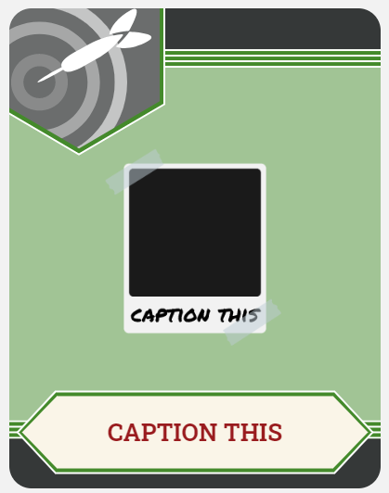
Caption This!
Choose one of the images from the beginning of the lesson.
Create a 1–3 sentence caption that explains what is happening in the image based on what you have learned about the conflict at the Washita River.

Slide 14
Image 1
Notes:
Image Source:
Harper’s Weekly. (1868, December 19). The Seventh U.S. Cavalry charging into Black Kettle’s village at daylight, Nov. 27, 1868 [Image]. Library of Congress. https://www.loc.gov/item/96521161/

Slide 15
Image 2
Notes:
Image Source:
Lang, S. (2003). The 1868 battle of the Washita. National Park Service. https://www.nps.gov/waba/learn/historyculture/index.htm

