Slide 1
Hey, Mickey!
Grades 2–5 Social Studies

Slide 2
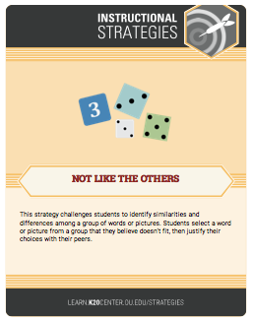
One of These Is “Not Like the Others”
Look at the four images and consider the following questions:
Which image does not belong with the other three?
Why does that image not belong?
How do the remaining three images connect with one another?

Slide 3
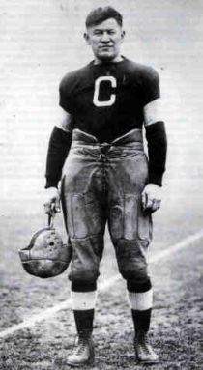
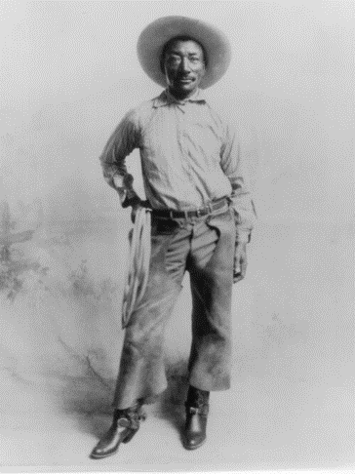
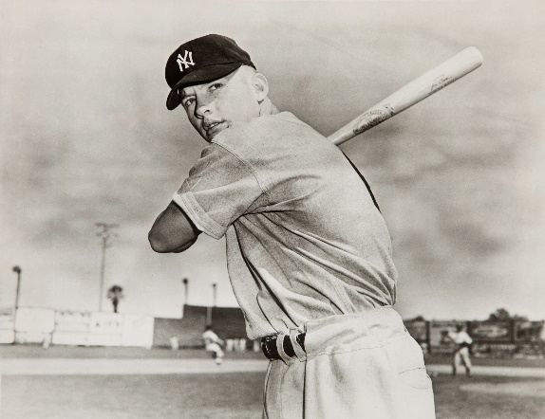
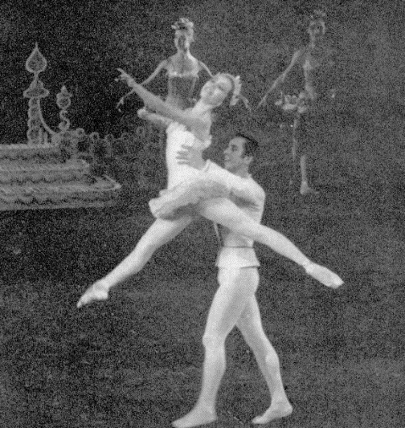
Not Like the Others
Bill Pickett
Mickey Mantle
Maria Tallchief
Jim Thorpe
Notes:
Athletes
Image Sources:
Unknown author. (ca. 1915-1920). Jim Thorpe as a football player [Digital image]. Wikimedia Commons. https://commons.wikimedia.org/wiki/File:Jim_Thorpe_football.png
New York Yankees. (1951). 1951 Mickey Mantle original news photograph used for 1951 Bowman rookie card [Digital image]. Wikimedia Commons. https://commons.wikimedia.org/wiki/File:Mickey_Mantle_1951.jpg
Unknown author. (ca. 1902). Bill Picket [sic] North Fort Worth Historical Society [Digital image]. Wikimedia Commons. https://commons.wikimedia.org/wiki/File:Bill_Picket_North_Fort_Worth_Historical_Society.jpg
Fehl, F. (1954, April). Maria Tallchief as the Sugar Plum Fairy and Nicholas Magallanes as her cavalier in the New York City Ballet’s 1954 production of The Nutcracker [Digital image]. Wikimedia Commons. https://commons.wikimedia.org/wiki/File:Maria_Tallchief_and_Nicholas_Magallanes_in_The_Nutcracker_1954_lift.png

Slide 4
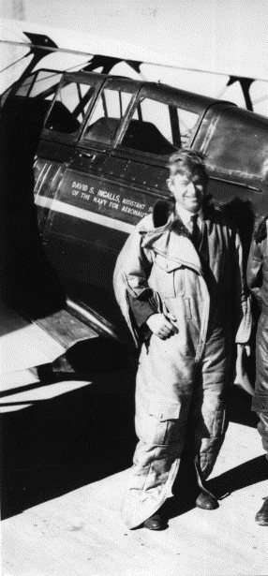
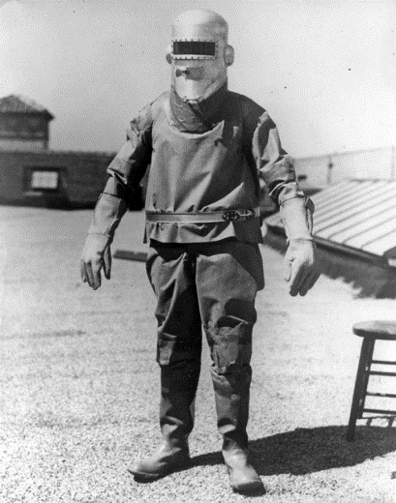
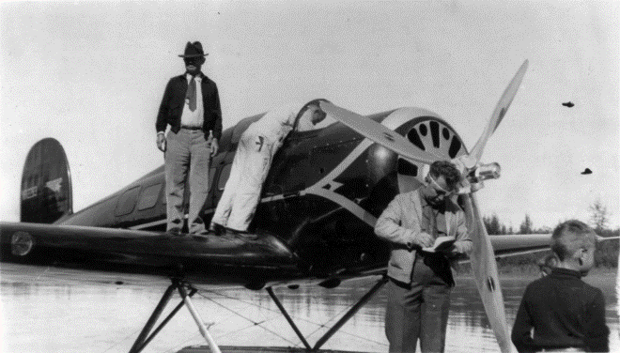
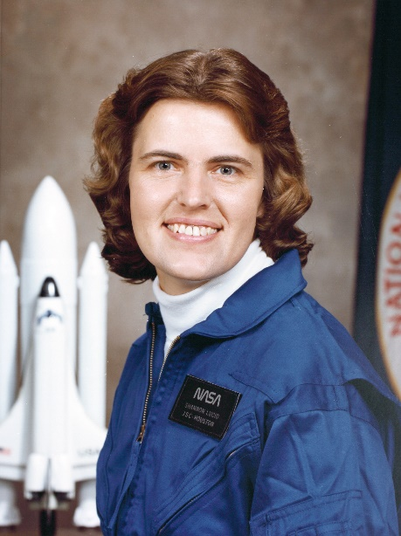
Not Like the Others
Will Rogers and Wiley Post
Wiley Post
Will Rogers
Shannon Lucid
Notes:
Aviators
Image Sources:
San Diego Air & Space Museum Archives. (1931). Photo of Frank M. Hawks on the right with Will Rogers on the left. While flying Will Rogers to a fund-raising campaign for the Red Cross to assist Oklahoma drought victims in, they became friends [Digital image]. Wikimedia Commons. https://commons.wikimedia.org/wiki/File:Photo_of_Frank_M._Hawks_on_the_right_with_Will_Rogers_on_the_left._While_flying_Will_Rogers_to_a_fund-raising_campaign_for_the_Red_Cross_to_assist_Oklahoma_drought_victims_in,_they_became_friends._(16952171407).jpg
Seppala, L. (ca. 1935, August 15). Will Rogers standing on wing of sea plane, facing slightly left; with Wiley Post at Fairbanks, Alaska, another man and a boy in photo [Digital image]. Wikimedia Commons. https://commons.wikimedia.org/wiki/File:Will_Rogers_and_Wiley_Post_cph.3b05600.jpg
NASA Image and Video Library. (1978, January). Shannon Lucid in 1978 at age 35 [Digital image]. Wikimedia Commons. https://commons.wikimedia.org/wiki/File:Shannon_Matilda_Wells_Lucid_1978.jpg
Unknown author. (1934). Full-length view of the first pressure suit made by Wiley Post, constructed at the BF Goodrich plant in California, 1934. This suit had no restraint system and Post was unable to bend his joints when pressurized. The book Spacesuits: The Smithsonian National Air and Space Collection states that this was the first of the three pressure suits made for Post [Digital image]. Wikimedia Commons. https://commons.wikimedia.org/wiki/File:Wiley_Post_-_Pressure_Suit_1.jpg

Slide 5
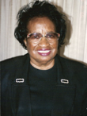
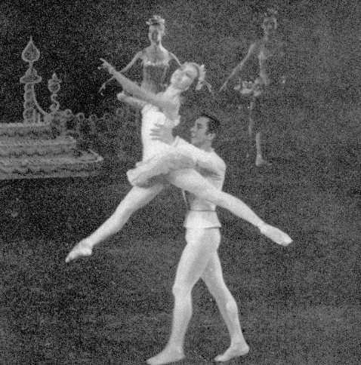
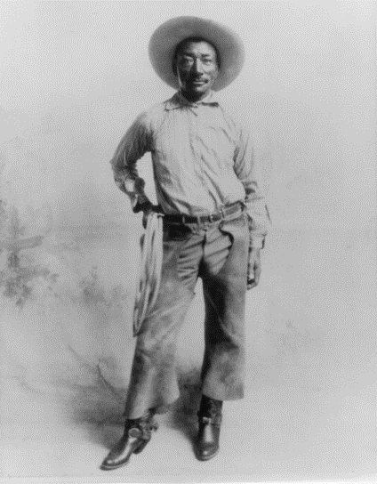
Not Like the Others
Maria Tallchief
Clara Luper
Shannon Miller
Bill Pickett
Notes:
3 Women and 1 Man
Image Sources:
Fehl, F. (1954, April). Maria Tallchief as the Sugar Plum Fairy and Nicholas Magallanes as her cavalier in the New York City Ballet’s 1954 production of The Nutcracker [Digital image]. Wikimedia Commons. https://commons.wikimedia.org/wiki/File:Maria_Tallchief_and_Nicholas_Magallanes_in_The_Nutcracker_1954_lift.png
Intel Free Press. (2013, December 27). The celebrity draw at the FitnessTech Summit on Jan. 7 will be two-time Olympic gold medalist and cancer survivor Shannon Miller [Digital image]. Wikimedia Commons. https://commons.wikimedia.org/wiki/File:Shannon_Miller_scheduled_to_be_at_CES_2014_.jpg
Unknown author. (ca. 1902). Bill Picket [sic] North Fort Worth Historical Society [Digital image]. Wikimedia Commons. https://commons.wikimedia.org/wiki/File:Bill_Picket_North_Fort_Worth_Historical_Society.jpg
Unknown author. (c. 1995). Photo of Clara Luper. Courtesy of Oklahoma Hall of Fame Archives, Oklahoma Hall of Fame at the Gaylord-Pickens Museum, Oklahoma City, OK.

Slide 6
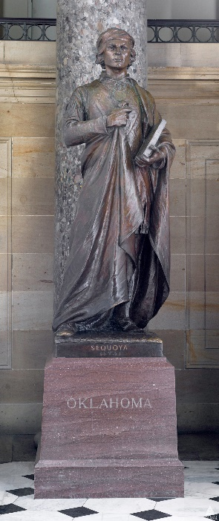
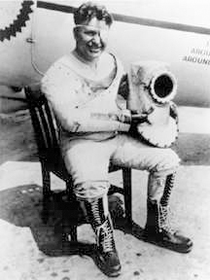
Not Like the Others
Wiley Post
Clara Luper
Jim Thorpe
Sequoya
Notes:
3 Men and 1 Woman
Image Sources:
Unknown author. (ca. 1915-1920). Jim Thorpe as a football player [Digital image]. Wikimedia Commons. https://commons.wikimedia.org/wiki/File:Jim_Thorpe_football.png
Unknown author. (ca. 1995). Photo of Clara Luper. Courtesy of Oklahoma Hall of Fame Archives, Oklahoma Hall of Fame at the Gaylord-Pickens Museum, Oklahoma City, OK.
U.S. Capitol (2011, October 11). Sequoya (1770?-1843) Oklahoma bronze by Vinnie Ream (completed by G. Julian Zolnay) given in 1917 National Statuary Hall U.S. Capitol [Digital image]. Wikimedia Commons. https://commons.wikimedia.org/wiki/File:Flickr_-_USCapitol_-_Sequoya_Statue.jpg
NASA. (ca. 1934). Photography of aviator Wiley Post in his third space suit [Digital image]. Wikimedia Commons. https://commons.wikimedia.org/wiki/File:Wiley_Post.jpg

Slide 7
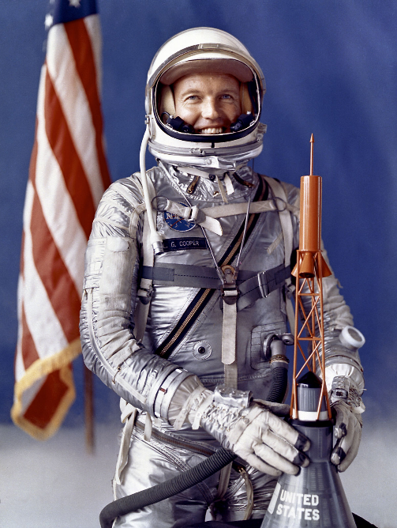
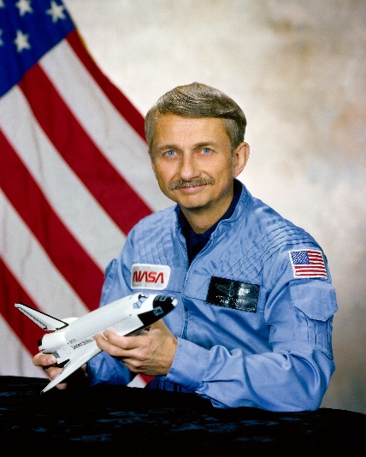
Not Like the Others
Owen K. Garriott
Shannon Lucid
Wiley Post
Leroy Gordon Cooper, Jr.
Notes:
NASA Astronauts
Image Sources:
NASA. (1962, September 25). Official portrait of L. Gordon Cooper Jr. in pressure suit and helmet [Digital image]. Wikimedia Commons. https://commons.wikimedia.org/wiki/File:Leroy_Gordon_Cooper_Junior.jpg
NASA Image and Video Library. (1978, January). Shannon Lucid in 1978 at age 35 [Digital image]. Wikimedia Commons. https://commons.wikimedia.org/wiki/File:Shannon_Matilda_Wells_Lucid_1978.jpg
Unknown author. (1934). Full-length view of the first pressure suit made by Wiley Post, constructed at the BF Goodrich plant in California, 1934. This suit had no restraint system and Post was unable to bend his joints when pressurized. The book Spacesuits: The Smithsonian National Air and Space Collection states that this was the first of the three pressure suits made for Post [Digital image]. Wikimedia Commons. https://commons.wikimedia.org/wiki/File:Wiley_Post_-_Pressure_Suit_1.jpg
NASA. (1981, March 24). Owen K. Garriot [sic] posing for a portrait, holding a model of the Space Shuttle [Digital image]. Wikimedia Commons. https://commons.wikimedia.org/wiki/File:Owen_K._Garriott_portrait.jpg

Slide 8
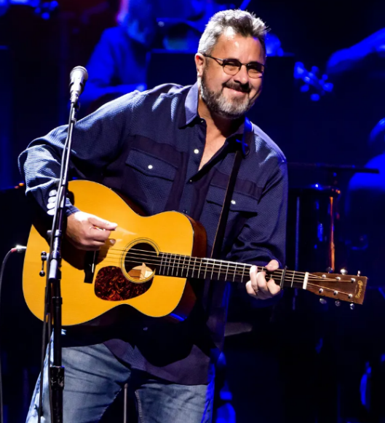
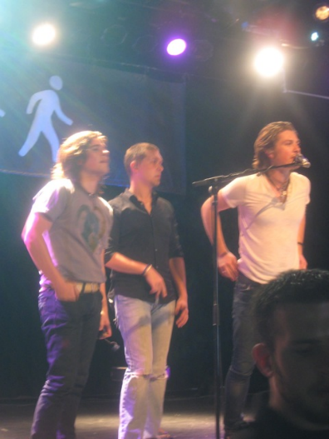
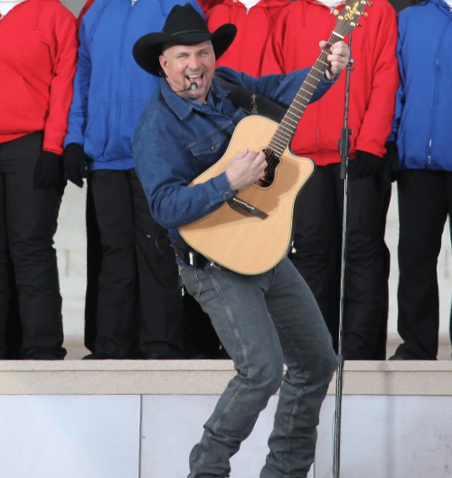
Not Like the Others
Hanson
Carrie Underwood
Vince Gill
Garth Brooks
Notes:
Singers/Songwriters
Image Sources:
Dephisticate. (2012, May 1). Carrie Underwood performing in Times Square, NYC, in 2012. Photo is a cropped and retouched version of a larger photo published at Flickr [Digital image]. Wikimedia Commons. https://commons.wikimedia.org/wiki/File:Carrie_Underwood_in_2012.jpg
Russell, D. (2019, February 26). Vince Gill with the Eagles [Digital image]. Wikimedia Commons. https://commons.wikimedia.org/wiki/File:Vince_Gill.png
Jurvetson, S. (2009, January 18). Singin’ American Pie [Digital image]. Wikimedia Commons. https://commons.wikimedia.org/wiki/File:Garth_Brooks_(3217544578).jpg
Maybellinechic. (2008, September 10). Hanson at the Vancouver date of their “Walk around the world tour” [Digital image]. Wikimedia Commons. https://commons.wikimedia.org/wiki/File:HansonVancouver2008.jpg

Slide 9
Essential Question
How did the contributions and work of notable Oklahomans help shape history?

Slide 10
Learning Objectives
Identify famous Oklahomans throughout history.
Analyze and describe the contributions of famous Oklahomans and their impact on history.

Slide 11
Card Sort
With your small group, sequence the major events in Mickey Mantle’s life.
It’s okay if you have two or more events with the same date. Place one above the other so you can see both.

Slide 12
Thinking Notes
*
!
?
??
The main idea
Your favorite part
Something you are unsure about
Something that is confusing to you

Slide 13
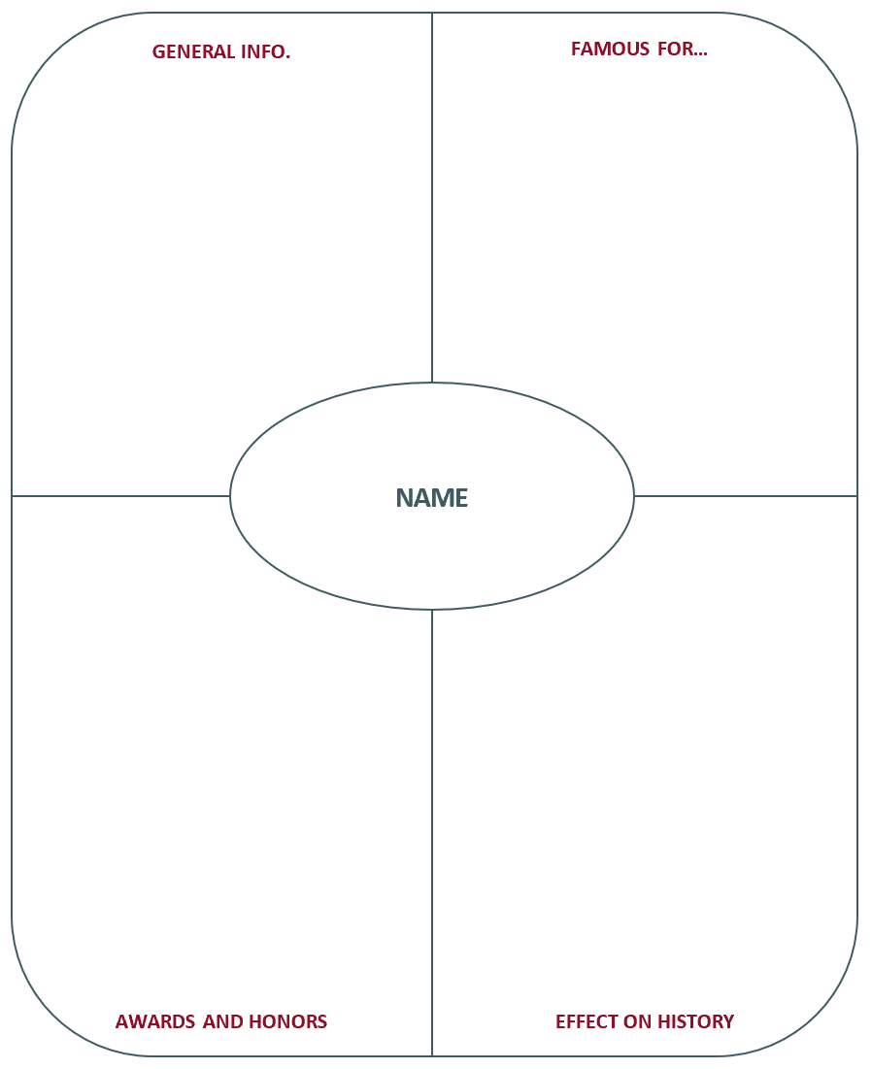
Frayer Model

Slide 14
Six-Word Memoir
Describe your famous Oklahoman using only six words.
Make sure to include this person’s impact on history
But NOT their name
Examples for Mickey Mantle:
Commerce Comet Switch Hits Seven Championships
Greatest Offensive Threat to Center Fielders

