Slide 1
Notes:
Instructor/Facilitator Notes:

Slide 2
Symbols Here, Symbols There, Symbols Everywhere
Social Studies
Notes:
Instructor/Facilitator Notes:

Slide 3
Essential Question
Why are symbols important?

Slide 4
Learning Objectives
Identify and explain the importance of various symbols of the United States.
Explain patriotic traditions.
Demonstrate appropriate flag etiquette and proper behavior during the playing of the Star-Spangled Banner and reciting of the Pledge of Allegiance.

Slide 5
Notes:
Video Source: DrewVan Media. (2013, April 27). The Star Spangled Banner [Video]. YouTube. https://www.youtube.com/watch?v=_QTOZGP-rr0

Slide 6
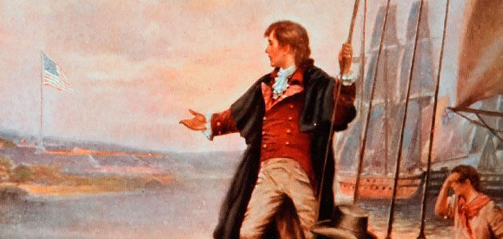
Francis Scott Key
More than 200 years ago, Francis Scott Key wrote The Star-Spangled Banner about the U.S. flag.
Notes:
Smithsonian. (2020, May 3). Francis Scott Key [Digital Image]. Wikimedia Commons. https://commons.wikimedia.org/w/index.php?search=Francis%20Scott%20Key&title=Special%3ASearch&ns0=1&ns6=1&ns12=1&ns14=1&ns100=1&ns106=1#/media/File:Francis-scott-key-large.jpg

Slide 7
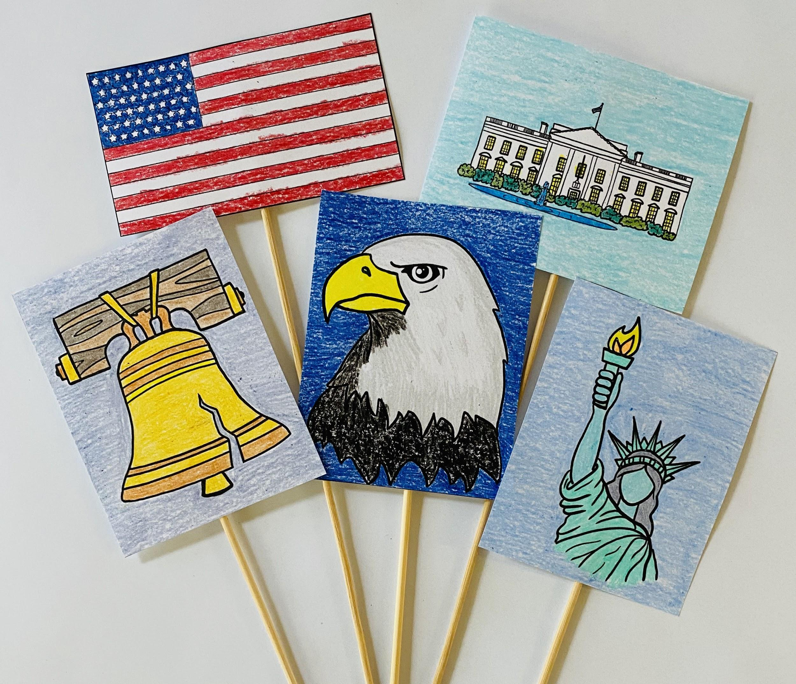
Symbols of the United States
Color the symbol.
Cut out the symbol.
Glue the symbol to a stick.

Slide 8
Symbol
An object that represents something.

Slide 9
U.S. Symbol
An object that represents the United States.

Slide 10
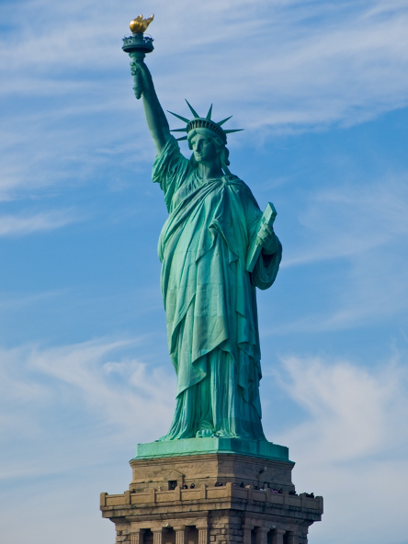
The Statue of Liberty
Notes:
Warby, W. (2007, November 13). Statue of Liberty 2007 [Digital Image]. Wikimedia Commons. https://commons.wikimedia.org/wiki/File:Statue_of_Liberty_2007.jpg

Slide 11
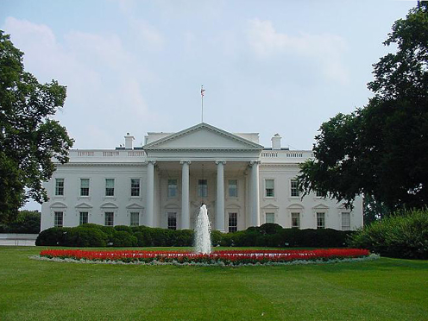
The White House
Notes:
Dahl, J. (2007, December 12). Hoban north portico [Digital image]. Wikimedia Commons. https://commons.wikimedia.org/wiki/File:HobanNorthPortico.jpg

Slide 12
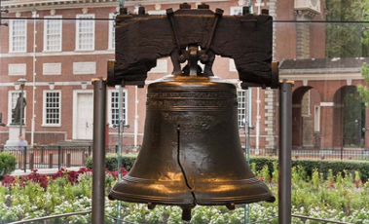
The Liberty Bell
Notes:
National Park Service. (n.d.). Liberty Bell [Digital image]. https://www.nps.gov/inde/planyourvisit/libertybellcenter.htm

Slide 13
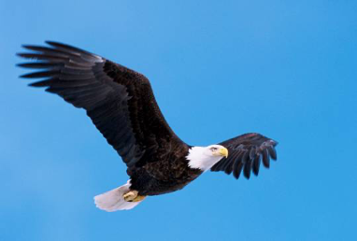
Bald Eagle
Notes:
USFWS. (2013, April 12). Bald eagle [Digital image]. https://www.fws.gov/yreka/baldeagle.html

Slide 14
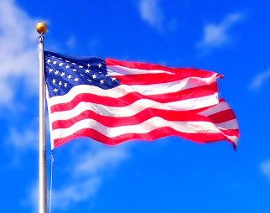
American Flag
Notes:
Mozart, M. (2014, March 20). American flag [Digital image]. https://www.flickr.com/photos/jeepersmedia/14687804116

Slide 15
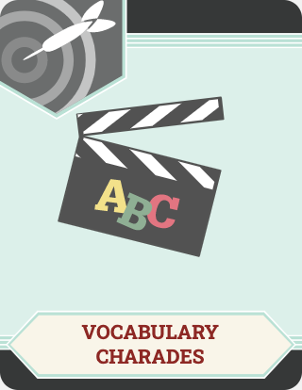
Vocabulary Charades
With your group:
Talk about what the symbol means.
Decide how you will act out the symbol for the class.

Slide 16
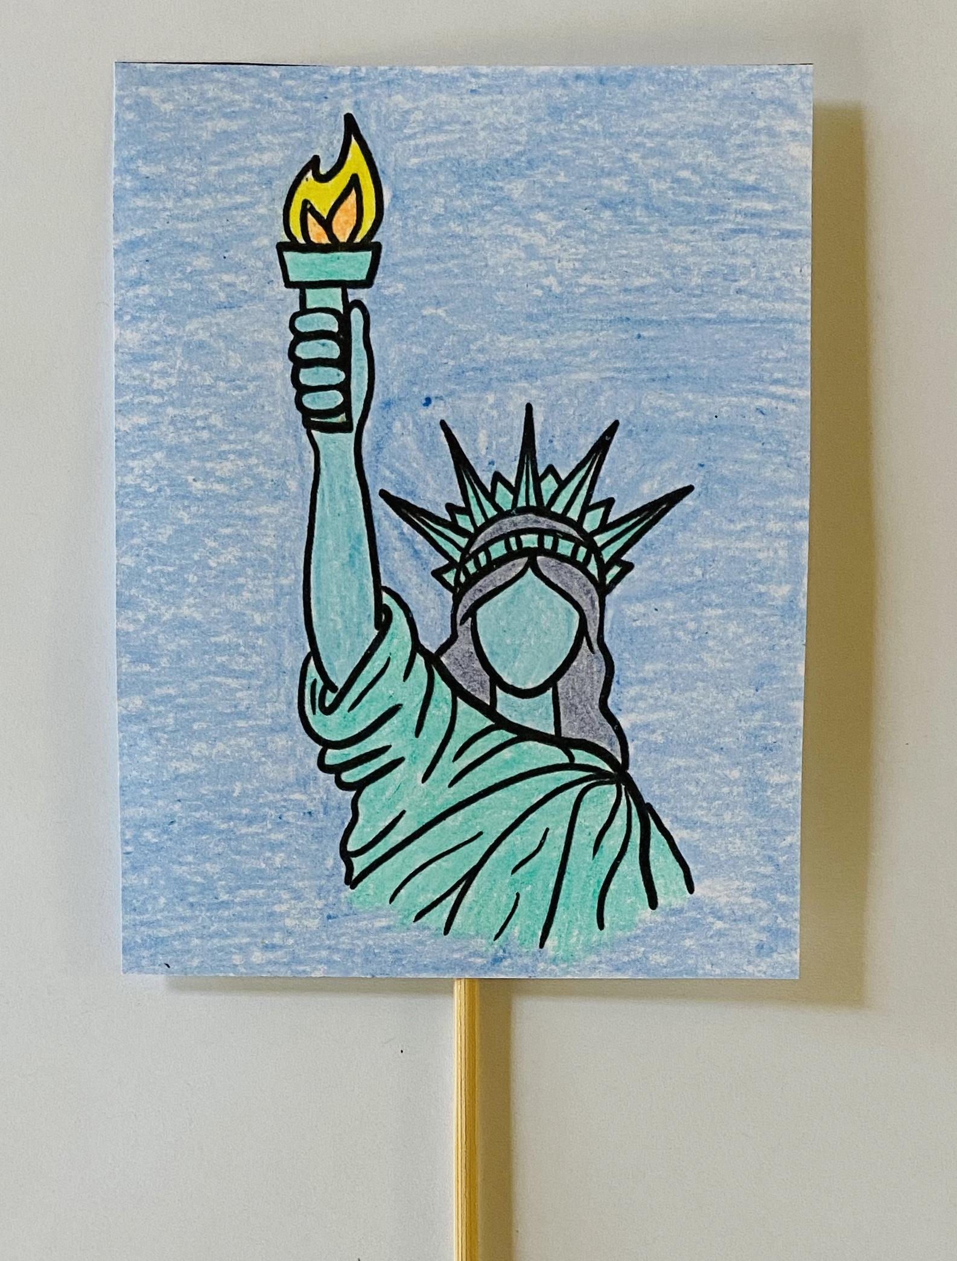
The Statue of Liberty
Talk about what the Statue of Liberty means.
Decide how you will act out the Statue of Liberty for the class.

Slide 17
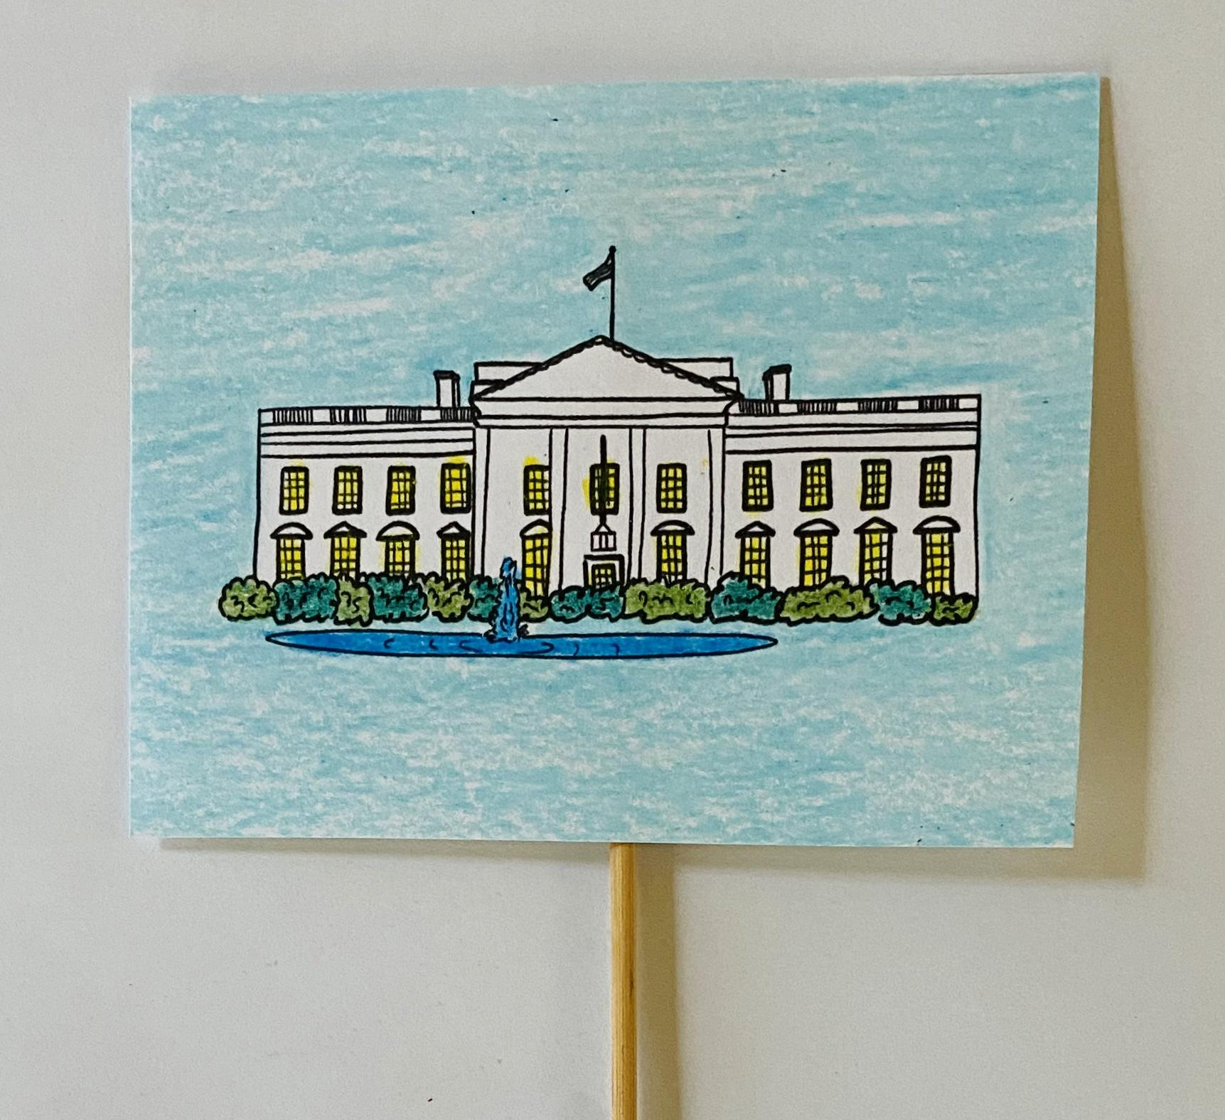
The White House
Talk about what the White House means.
Decide how you will act out the White House for the class.

Slide 18
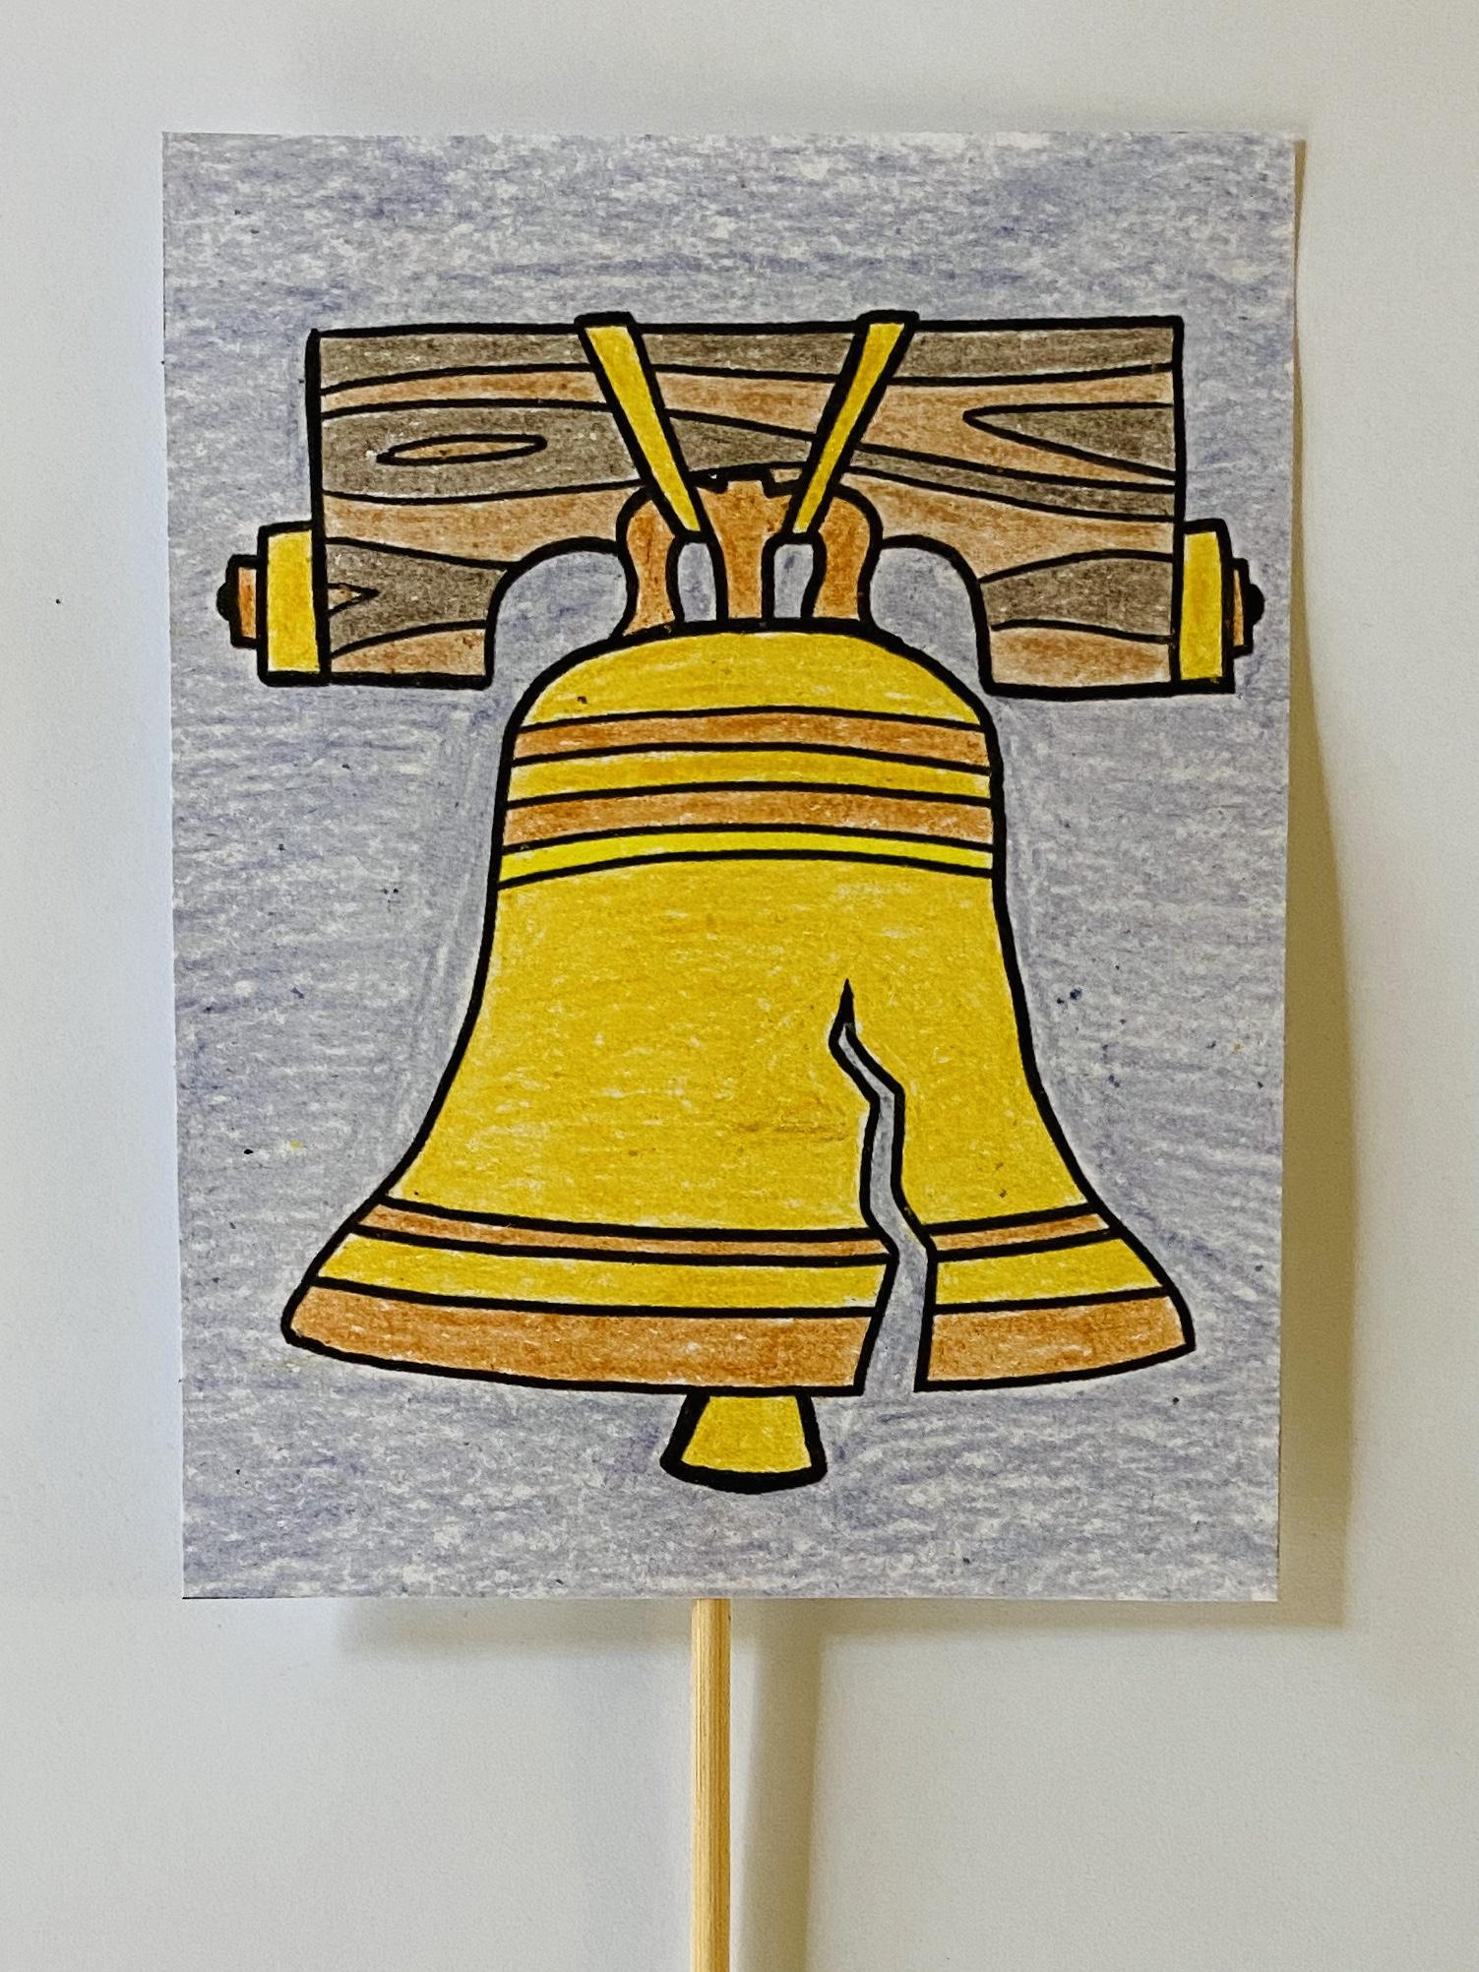
The Liberty Bell
Talk about what the Liberty Bell means.
Decide how you will act out the Liberty Bell for the class.

Slide 19
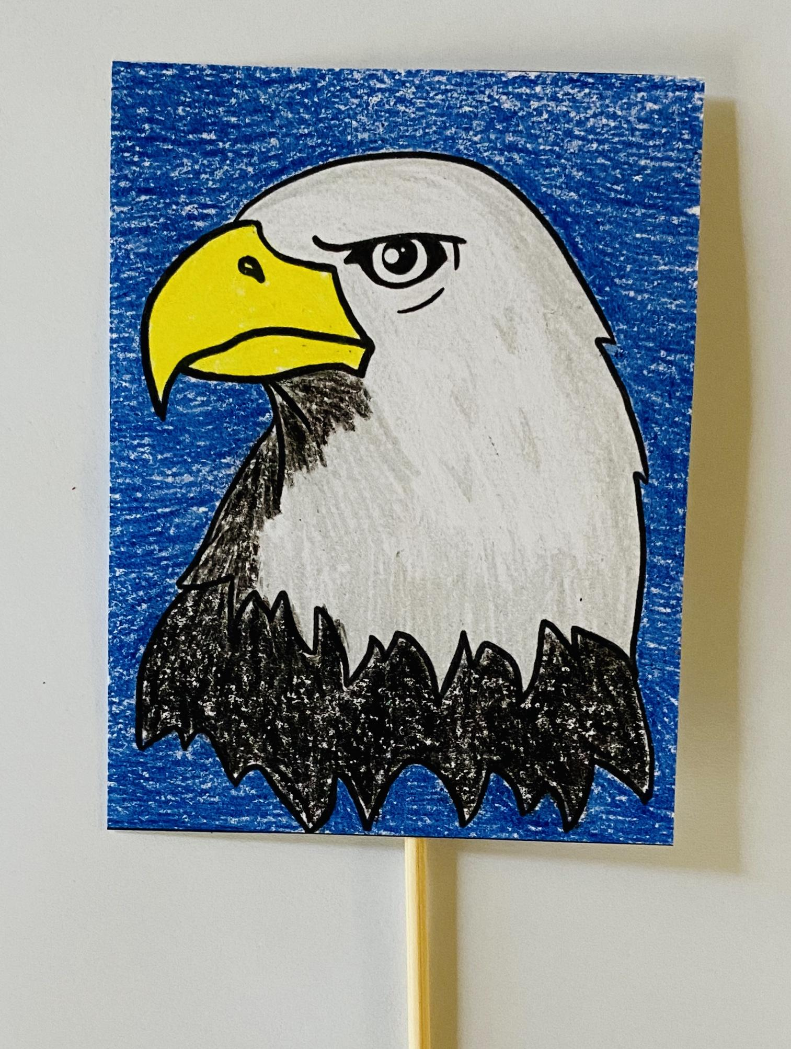
Bald Eagle
Talk about what the bald eagle means.
Decide how you will act out the bald eagle for the class.

Slide 20
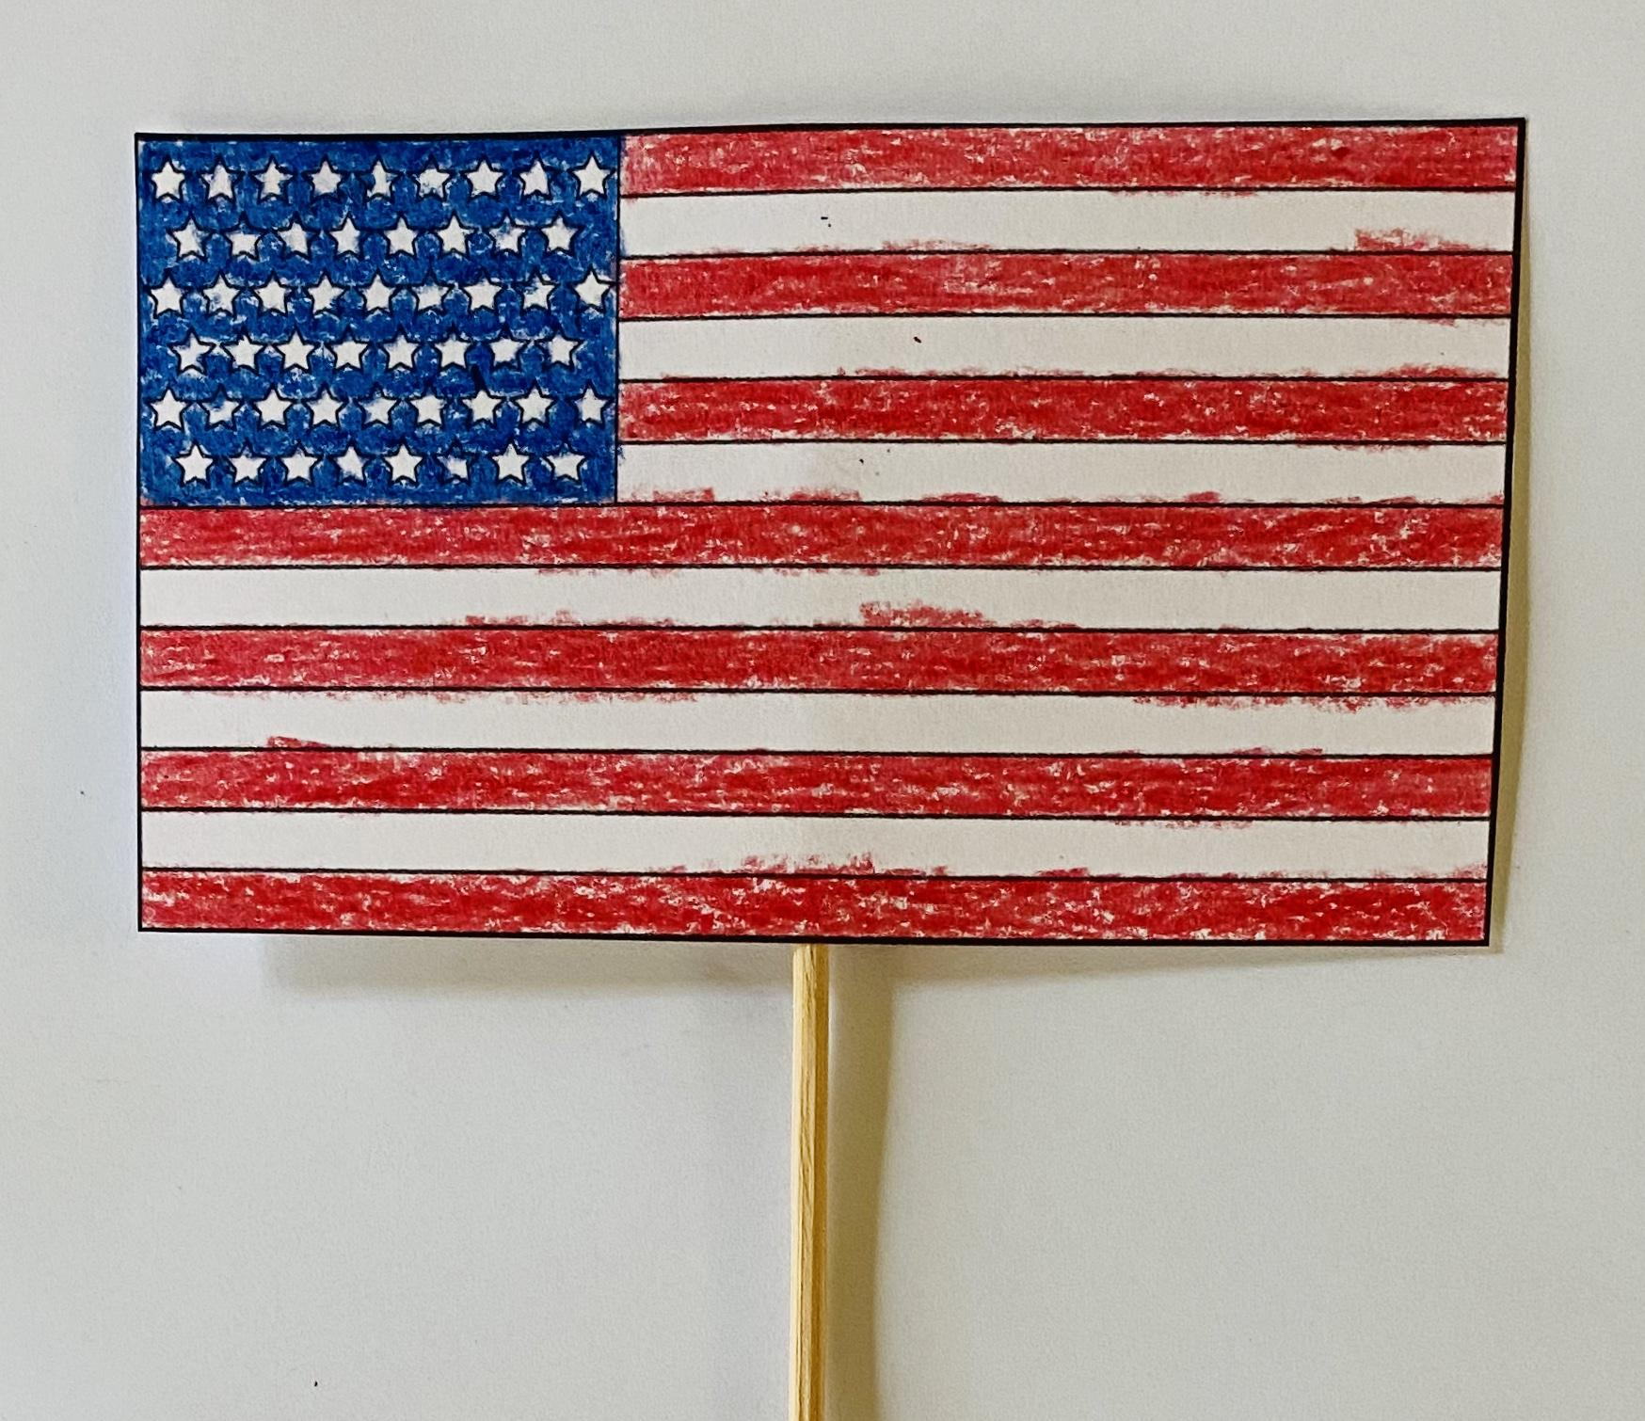
U.S. Flag
Talk about what the U.S. flag means.
Decide how you will act out the U.S. flag for the class.

Slide 21
Let’s Test Your Symbol Knowledge!

Slide 22
