Slide 1
Notes:
Instructor/Facilitator Notes:

Slide 2
Rock On
Patterns on Earth’s Surface
Notes:
Instructor/Facilitator Notes:

Slide 3
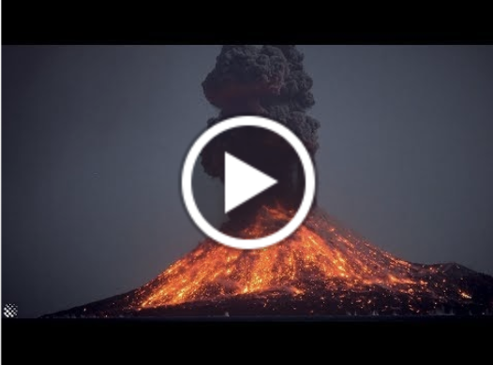
Notes:
Instructor/Facilitator Notes:

Slide 4
First Word, Last Word
L- Liquid
A- Ash
V- Volcano
A- Angry
Notes:
Instructor/Facilitator Notes:
If you have students who need support encourage a one word acrostic poem.

Slide 5
First Word, Last Word
L- Liquid magma flowing out
A- Ash exploding from the top
V- Volcano erupting all over
A- Angry bubbling mountain
Notes:
Instructor/Facilitator Notes:
Encourage your students to write sentences or phrases for their acrostic poem.

Slide 6
Essential Question
Where on Earth are earthquakes, volcanoes, and mountains found?
Notes:
Instructor/Facilitator Notes:

Slide 7
Learning Objectives
Recognize that maps will help you visualize the locations of earthquakes, volcanoes, and mountains on Earth.
Understand that mountains form when rock pushes against other rock, which also causes earthquakes.
Analyze a variety of maps and recognize that earthquakes, volcanoes, and mountains tend to be found in the same locations.
Notes:
Instructor/Facilitator Notes:

Slide 8
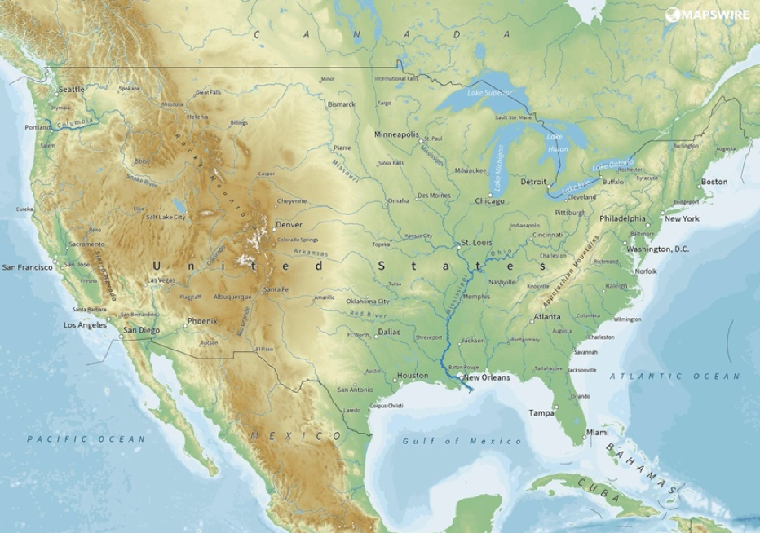
Topographical Map
Shows the shape of an area.
Physical Map of the United States [Digital image]. (2019). https://mapswire.com/countries/united-states/
Notes:
Instructor/Facilitator Notes:

Slide 9
Elevation
High Elevation
Low Elevation
The high and low points of land.
Shades of brown show where mountain ranges are located.
Shades of green show where flat land is located.
Physical Map of the United States [Digital image]. (2019). https://mapswire.com/countries/united-states/
Notes:
Instructor/Facilitator Notes:

Slide 10
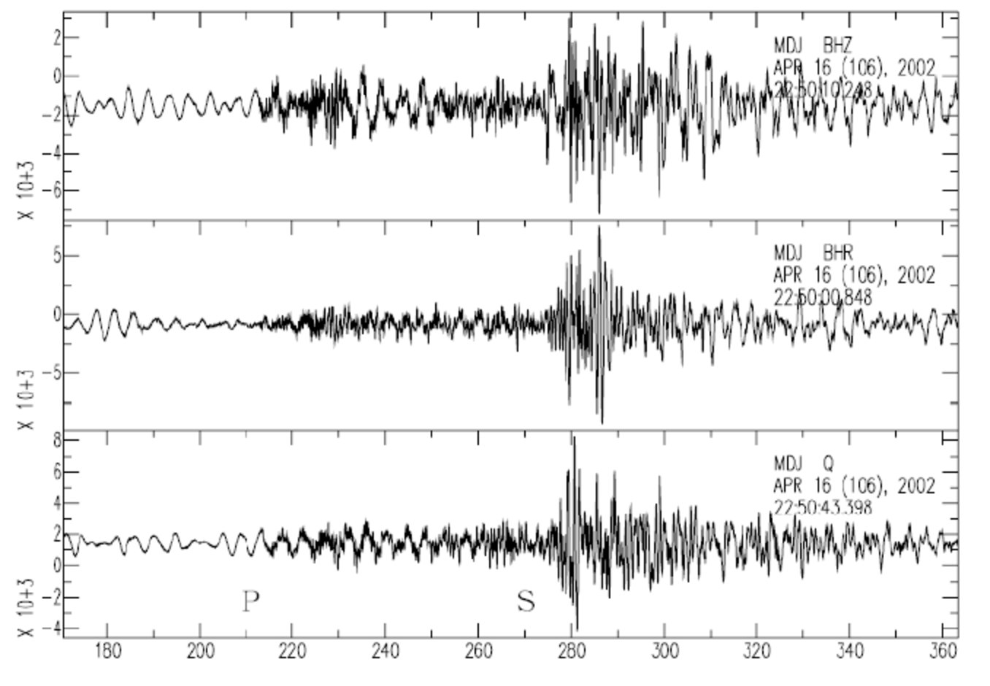
Earthquakes
The shaking of the surface of Earth from a sudden release of energy in the earth’s crust.
Physical Map of the United States [Digital image]. (2019). https://mapswire.com/countries/united-states/
Notes:
Instructor/Facilitator Notes:
https://commons.wikimedia.org/wiki/File:Seismic_wave_of_North_Korea_%E2%80%9Cnatural%E2%80%9D_earthquake_on_2002-04-17.tiff

Slide 11
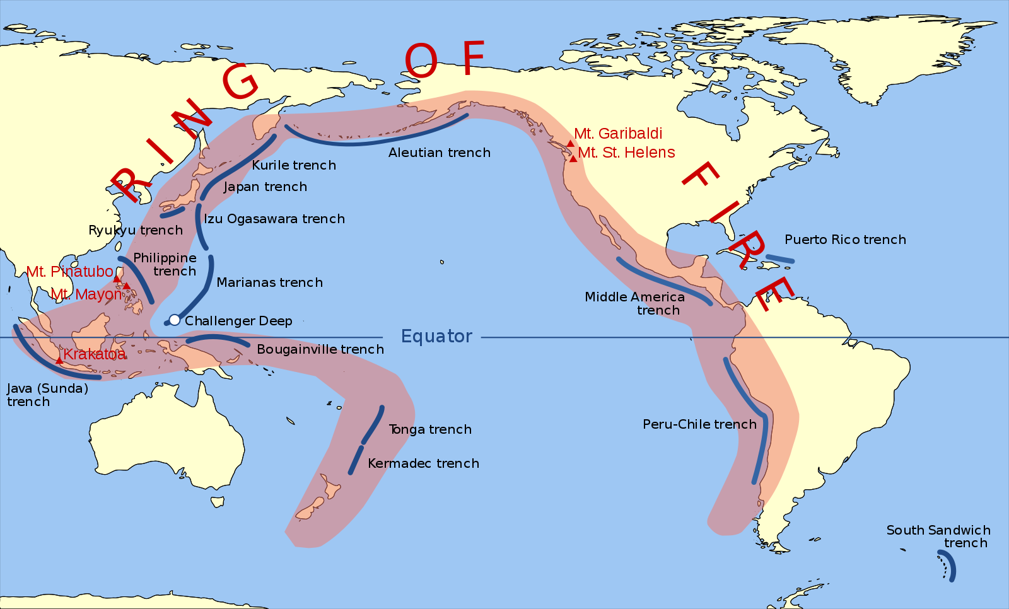
Ring Of Fire
About 90 percent of earthquakes that happen on Earth take place around the Pacific Ocean.
Gringer. (2009, February 11). Pacific Ring of Fire [Digital image]. https://commons.wikimedia.org/wiki/File:Pacific_Ring_of_Fire.svg
Notes:
Instructor/Facilitator Notes:
https://commons.wikimedia.org/wiki/File:Pacific_Ring_of_Fire.svg

Slide 12
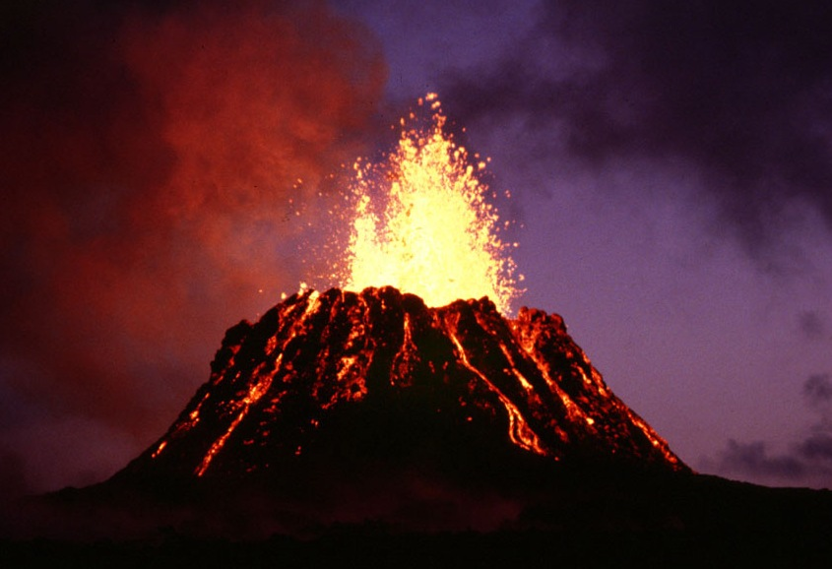
Volcano
A rupture, or break, in the crust that allows hot lava, ask, and gases to escape from below the earth’s surface.
Ulrich, USGS, G. E. (2008, July 20). Pu'u' 'O'o, a Volcanic Cone on Kilauea, Hawaii [Kilauea is the most active shield volcano in the world. The volcano erupted nonstop from 1983 to 2018 and it is part of the Hawaiian–Emperor seamount chain.]. https://commons.wikimedia.org/wiki/File:Puu_Oo_cropped.jpg
Notes:
Instructor/Facilitator Notes:
https://en.wikipedia.org/wiki/Hotspot_(geology)

Slide 13
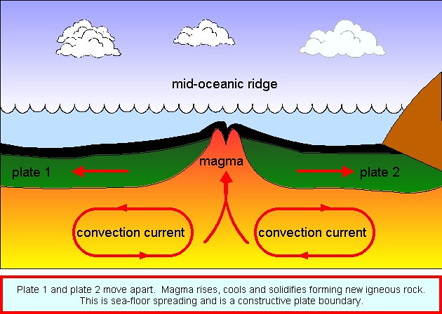
Oceanic Spreading Ridge
The fracture zone along the ocean bottom.
Benson, R. (2014, January 10). Seafloor Spreading [Digital image]. https://www.flickr.com/photos/114042825@N07/11877403915
Notes:
Instructor/Facilitator Notes:
https://www.flickr.com/photos/114042825@N07/11877403915

Slide 14
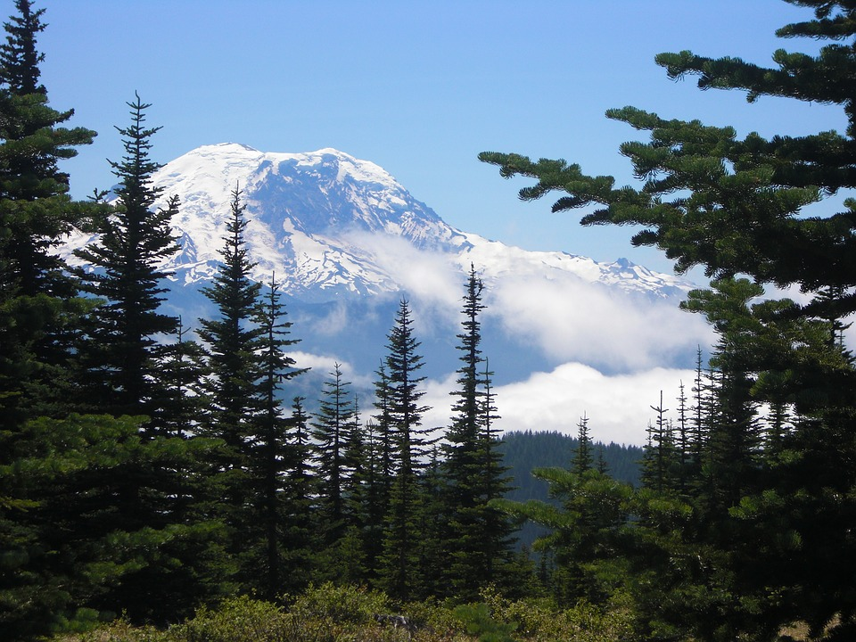
Mountains
Large landforms that rise about the surrounding area in the form of a peak.
[Digital image]. (2018, December 13). https://pixabay.com/photos/mount-rainier-mountain-rainier-3873701/
Notes:
Instructor/Facilitator Notes:
https://pixabay.com/photos/mount-rainier-mountain-rainier-3873701/

Slide 15
Reading Placeholder
Notes:
Instructor/Facilitator’s Notes:

Slide 16
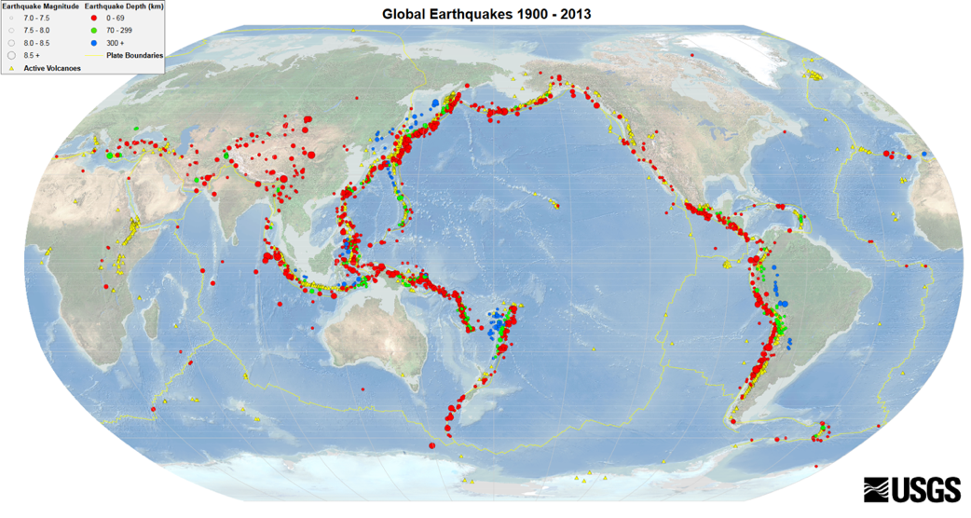
USGS. (n.d.). Global Earthquakes 1900-2013 [Digital image]. https://upload.wikimedia.org/wikipedia/commons/7/77/EQs_1900-2013_worldseis.png
Notes:
Instructor/Facilitator Notes:

Slide 17
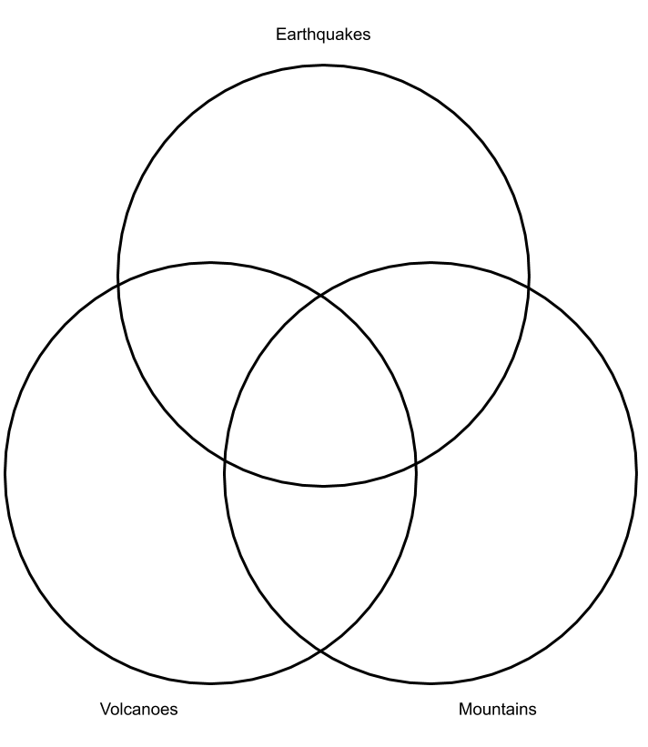
Venn Diagram
Compare and contrast the locations of earthquakes, volcanoes, and mountains.
Include the following:
2 or more ways EACH unique
2 or more ways each pair is similar
1 or more ways all three are similar
Notes:
Instructor/Facilitator Notes:

Slide 18
Include 2 or more ways earthquakes are unique.
Include 2 or more ways volcanoes are unique.
Include 2 or more ways mountains are unique.
Notes:
Instructor/Facilitator Notes:

Slide 19
Include 2 or more ways earthquakes and volcanoes are similar.
Include 2 or more ways earthquakes and mountains are similar.
Include 2 or more ways volcanoes and mountains are similar.
Notes:
Instructor/Facilitator Notes:

Slide 20
Include 1 or more ways earthquakes, volcanoes, and mountains are similar.
Notes:
Instructor/Facilitator Notes:

Slide 21
Venn Diagram
Compare and contrast the locations of earthquakes, volcanoes, and mountains.
Include the following:
2 or more ways EACH unique
2 or more ways each pair is similar
1 or more ways all three are similar
Notes:
Instructor/Facilitator Notes:

Slide 22
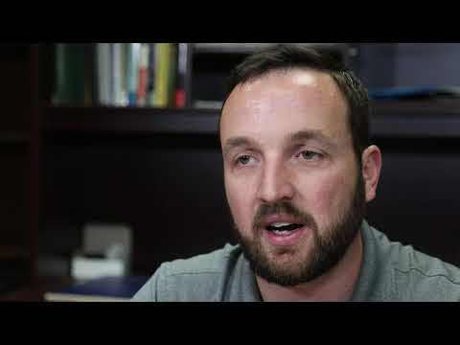
Notes:
Instructor/Facilitator Notes:

Slide 23
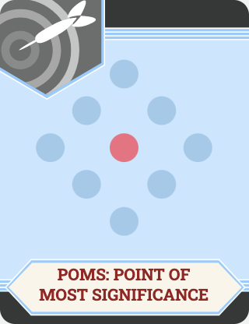
Point of Most Significance: POMS
What was the most important thing you heard during the video?
Notes:
Instructor/Facilitator’s Notes:

Slide 24
Notes:
Instructor/Facilitator Notes:

Slide 25
First Word, Last Word
P- Patterns can be found around the world
A- Active volcanoes spread magma all around
T- Tall mountains rise and form a peak
T- The shaking of the surface of Earth is called an earthquake
E- Elevation is the high and low points
R- Ring of Fire is where 90% of the activity happens
N- Natural events like earthquakes, volcano eruptions, and growing mountains happen every day
Notes:
Instructor/Facilitator Notes:

