Slide 1
Notes:
Instructor/Facilitator Notes:

Slide 2
Do Hungry Dragons Really Like Crunchy Tacos?
Adjectives
Notes:
Instructor/Facilitator Notes:

Slide 3
What do you love most about tacos?

Slide 4
Essential Question
How do adjectives make your writing better?

Slide 5
Learning Objectives
In this lesson, we will:
recognize adjectives in reading,
describe objects using adjectives, and
use adjectives in our writing.
Notes:
Instructor/Facilitator Notes:

Slide 6
Not Like the Others
Find the word that isn’t like the others.

Slide 7
Not Like the Others
Red
Big
Five
House

Slide 8
Not Like the Others
Bright
Loud
Grandpa
Sweet

Slide 9
Not Like the Others
Slow
Movie
Fresh
Round

Slide 10
Not Like the Others
Dog
Small
Hot
Green

Slide 11
Adjective
A word that describes a noun.

Slide 12
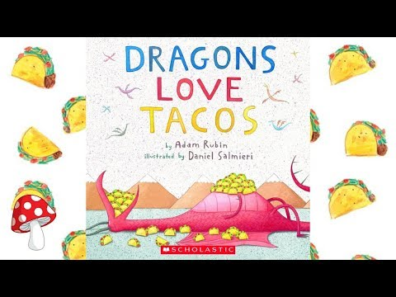
Notes:
Toadstools and Fairy Dust. (2018, September 10). Dragons love tacos by Adam Rubin (read aloud) | Storytime [Video]. https://youtu.be/GMTCZZp3RbQ

Slide 13
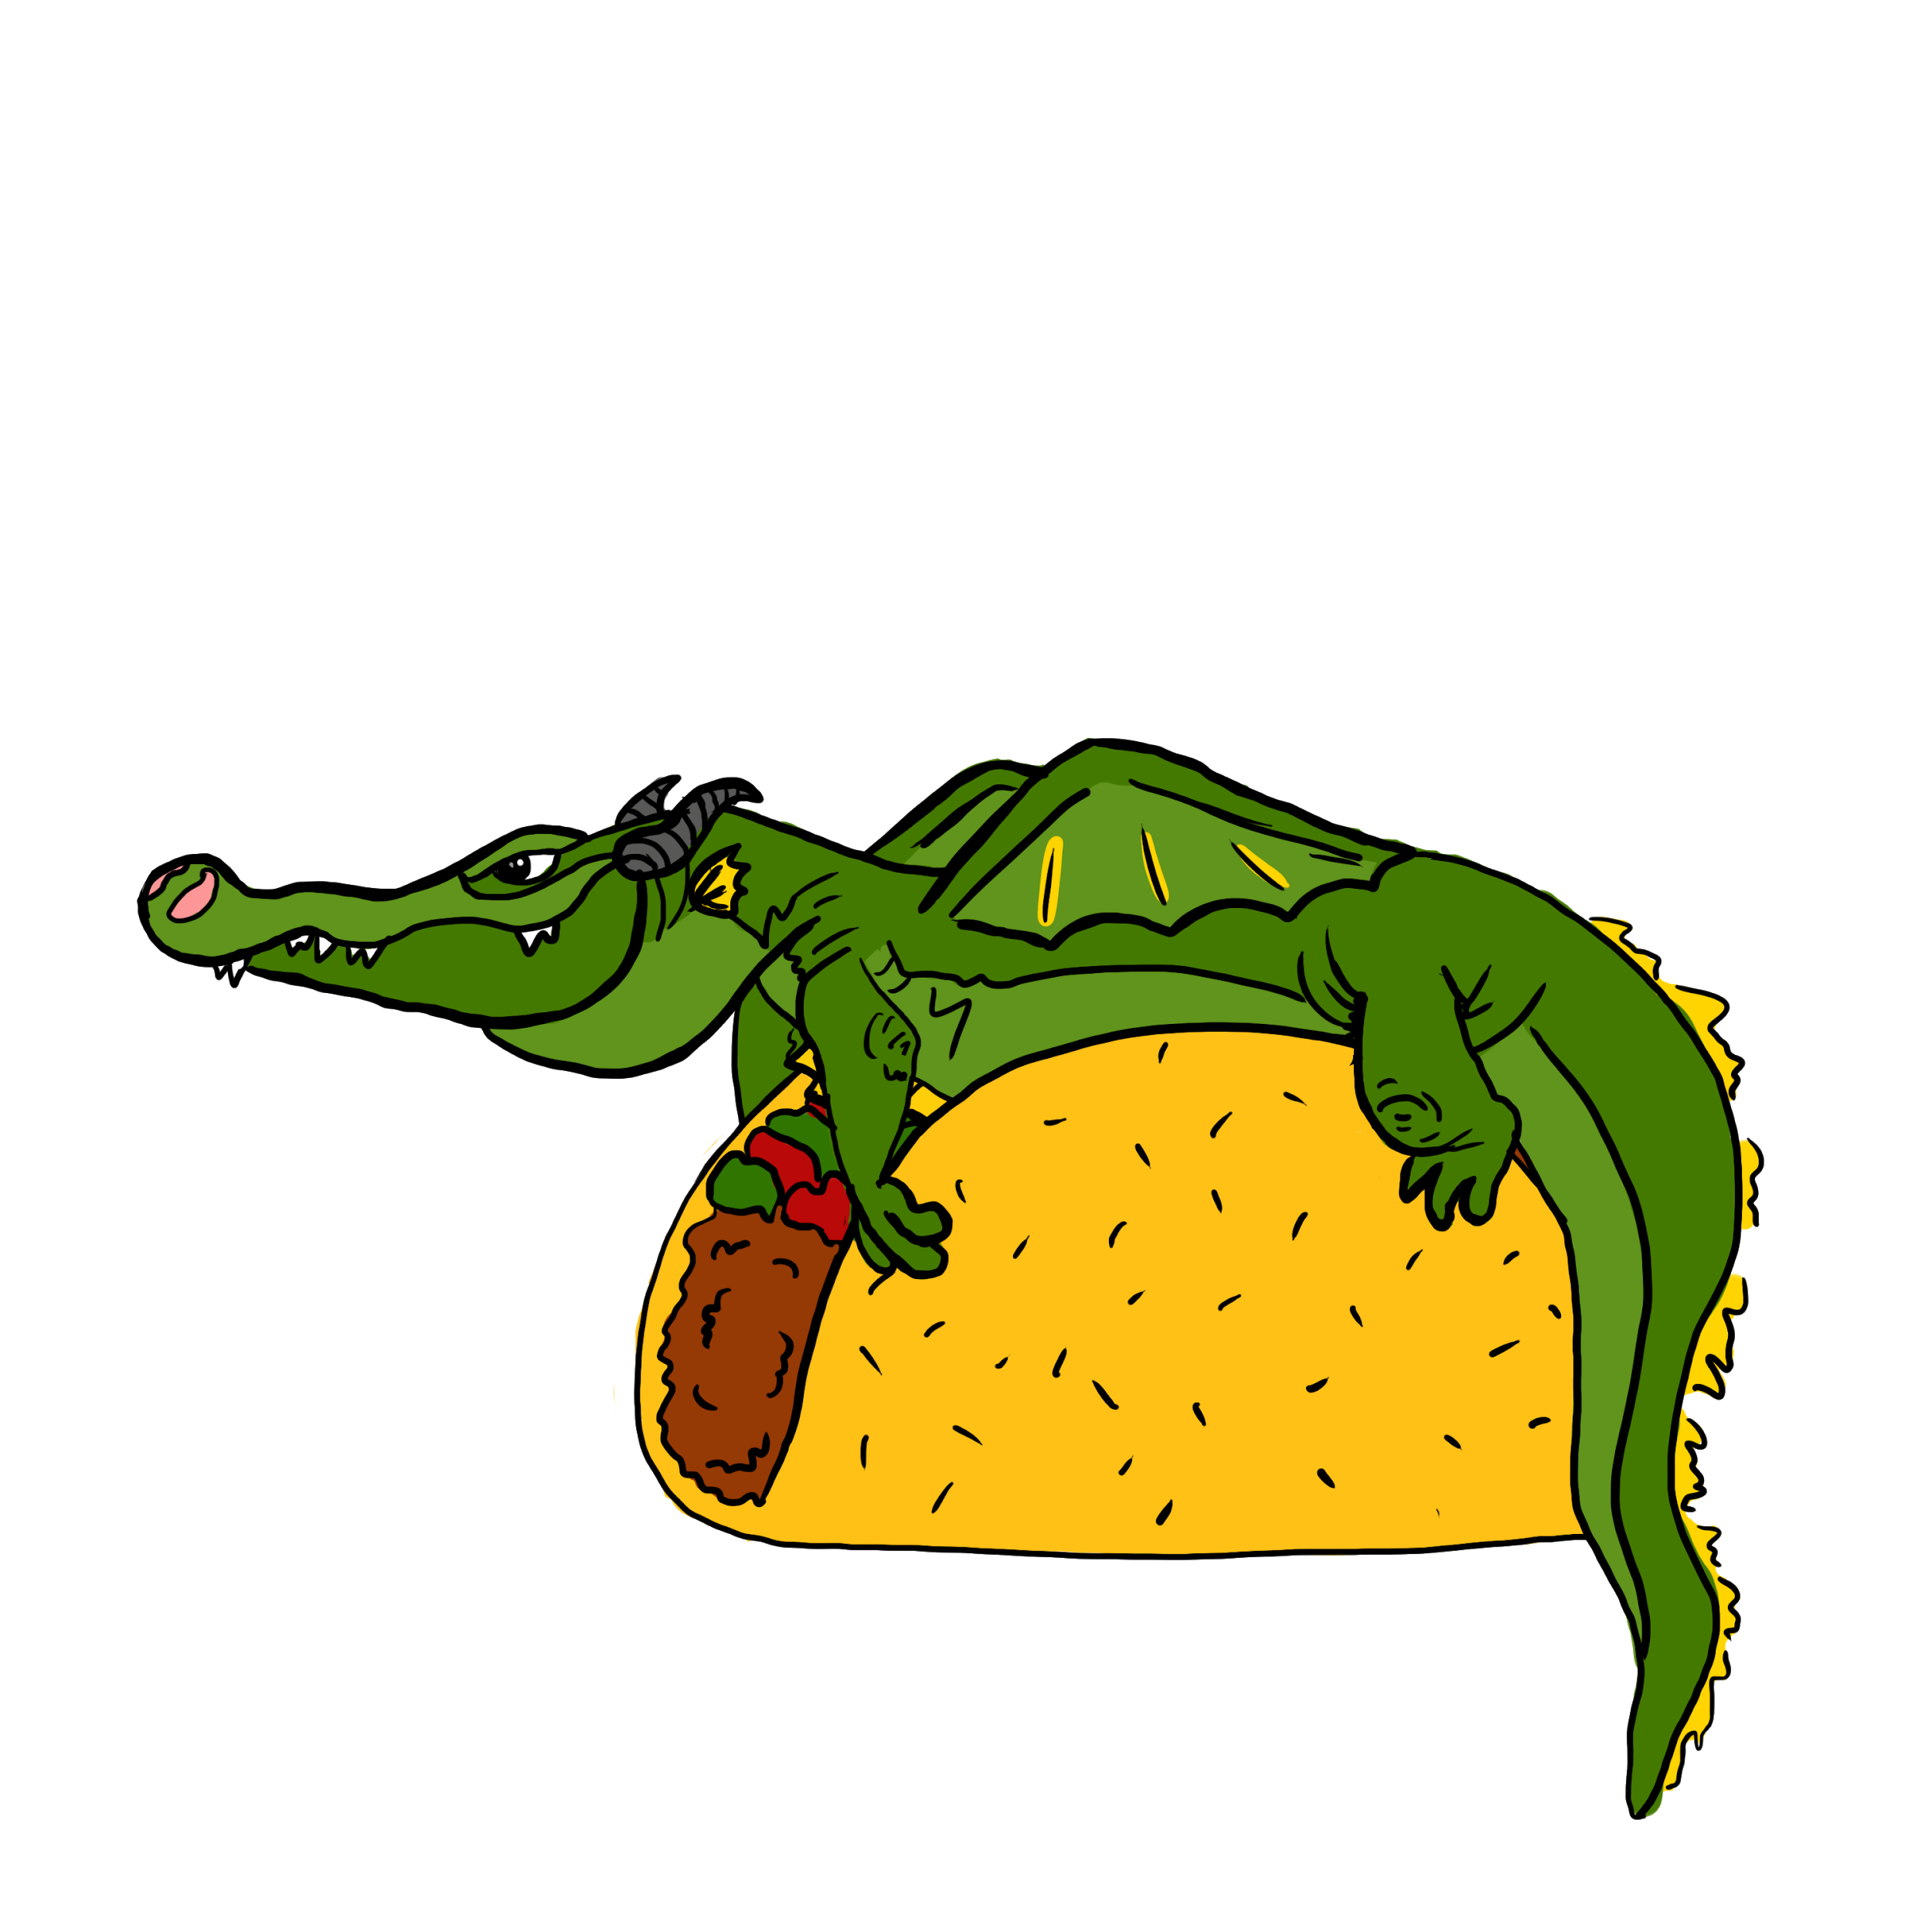
Can your classmates guess your food?
Look at the item in your bag but do not show it to anyone.
Write down adjectives to describe its color, texture, taste etc.
The more descriptive the better.
Can your classmates guess the food using just your description?

Slide 14
Make an Invitation for a Dragon Taco Party
Who: All My Big Green Dragon Friends
When: This Sunny Saturday at 1:00
Where: The Blue House on the Corner
What: We are going to eat 100 giant, spicy tacos!
Why: I have a lot of yellow cheese, crispy lettuce, juicy tomatoes, creamy sour cream, and crunchy taco shells. I want to make yummy tacos with all my dragon friends!

