Slide 2
Buckle Up
Physical Science

Slide 3
Essential Questions
What happens when two objects interact with each other?
What important constraints can help reduce changes occurring on an object in motion?

Slide 4
Lesson Objectives
Examine and explain evidence of Newton’s laws.
Identify real-world problems with solutions that require an understanding of the direction of energy by forces.
Carry out an investigation showing that the more time in which a collision occurs will decrease the force acting on an object.
Design constraints that minimize (reduce) the force on an object during a collision.

Slide 5
Noggin Versus Glass Compilation
While watching this video (2:50 to 3:17), think of what is occurring. What do you notice about it?
Notes:
Play video from 2:50-3:17.
List Posts. (2019, February 12). 3+ Minutes of people walking into glass compilation. [Video]. YouTube. https://youtu.be/ebdZIh0U4Os?t=170

Slide 6
Second Chance
While watching, consider the relationship between this video and the first clip.
Notes:
USDOTNHTSA. (2015, May 8). Second Chance. [Video]. YouTube. https://www.youtube.com/watch?v=L62ueMB0E5E

Slide 7
Initial Model
Create an initial model of the forces that occur during a collision (such as a car crash or a person running into glass doors).
Compare your model with your group members’ models. List similarities and differences among your peers.

Slide 8
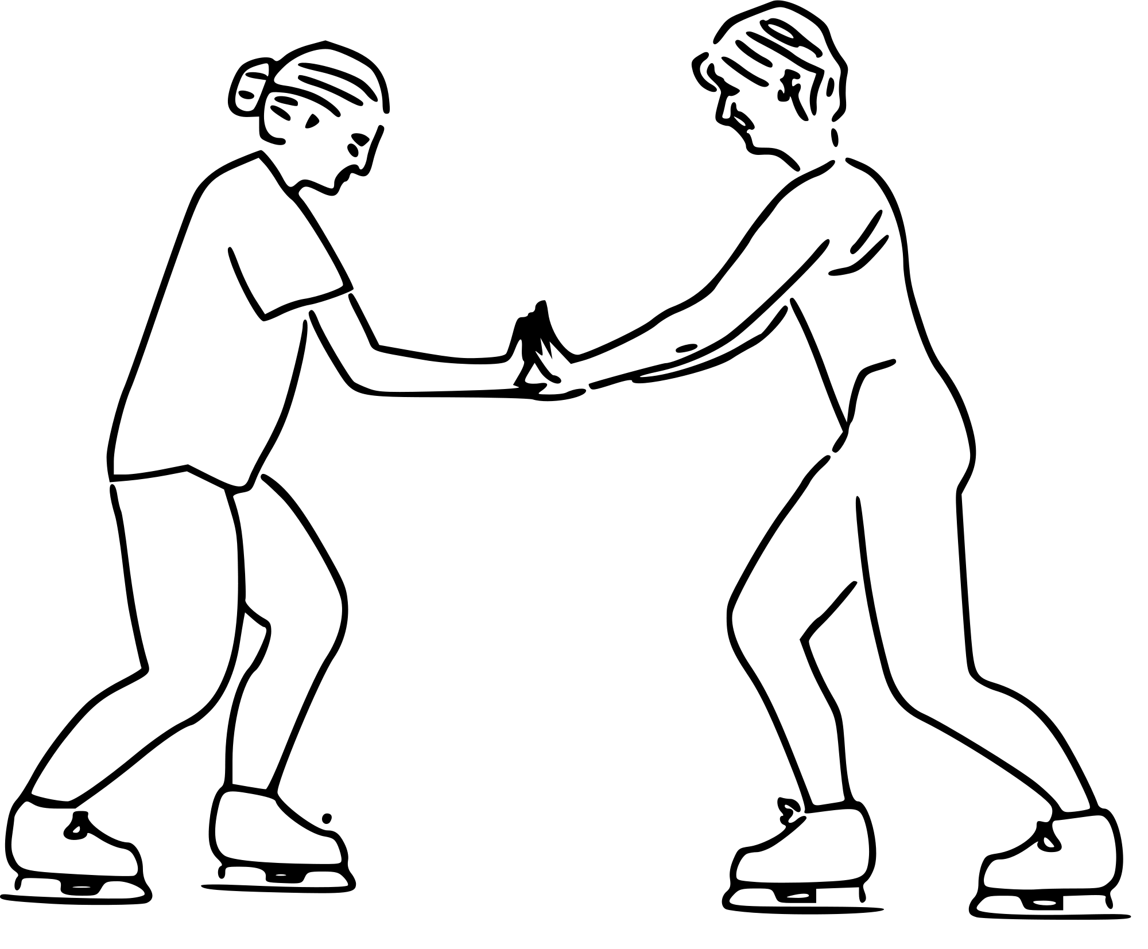
Newton’s Third Law of Motion
Isaac Newton was a physicist and mathematician who lived from 1642-1727.
Newton’s third law: for every action, there is an equal and opposite reaction.
These ice skaters illustrate Newton’s third law.
Notes:
Image source: Crowell, B. (2006, May 10). Skaters showing Newton's third law. Wikimedia Commons. https://commons.wikimedia.org/wiki/File:Skaters_showing_newtons_third_law.svg

Slide 9
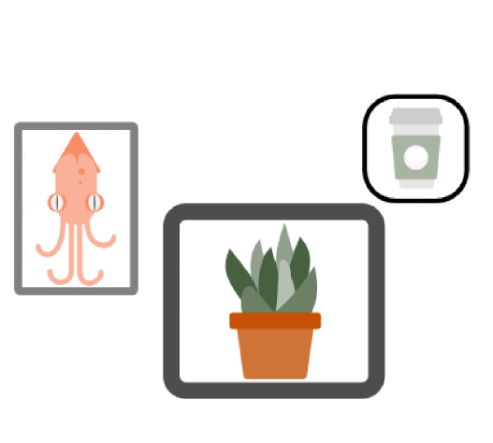
Pick a Pic
Choose a photo that shows a reaction similar to the ones we saw in the videos. Add your picture to Padlet.
In Padlet, add a hashtag to your photo that describes what the photo is about (“#carcrash”).
Do a Gallery Walk of your classmates’ pictures. Choose one that hasn’t been selected by another student yet. Add a hashtag and explain how it reflects Newton’s third law.
Notes:
Give students 15 minutes to find picture and add a hashtag in Padlet. Then, give students 15 minutes to respond to a classmate's picture.

Slide 10
C.R.U.S.H. & Smush
Do the following as you read “The Physics of Car Safety”:
Circle any new vocabulary. Look up each definition and, in the margin of the reading, record a sentence that uses each circled word correctly.
Read the article using your knowledge of the new vocabulary words.
Underline the vocabulary you already know.
Star the main ideas throughout the reading.
Highlight evidence that supports the main idea.
Summarize and condense (smush) the article into your own words.
Notes:
Allow students 40 minutes to complete this activity.
Note that students, when highlighting, should not highlight every line after the main idea. They should select key points that support the main ideas.
Students’ summaries should take each idea and pull all the evidence together to explain the article in 3-5 sentences.

Slide 11
Safety First Engineering
Let’s learn about two professions that need to understand the physics of car crashes, but from two vastly different angles.
What kind of research would they need to do on Newton’s laws in order to be successful at these jobs?
ICAP - Buckle Up
Notes:
This slide is for the ICAP version of the lesson.
An egg drop video may help to provide learners with some inspiration. For example: https://youtu.be/nsnyl8llfH4
K20 Center. (2020, December 14). ICAP - Buckle Up. YouTube. https://www.youtube.com/watch?v=3OBNpJQxQrs&feature=youtu.be

Slide 12
Safety First Engineering
Think of a job you are interested in pursuing or find fascinating.
How does that occupation institute safety procedures to reduce momentum on an object? Why are those safety precautions essential to that job?
Notes:
This slide is for the ICAP version of the lesson.

Slide 13
Safety First Engineering
Now it’s time to design your own collision model. (Inanimate objects only!)
Research different types of protective equipment used to reduce the impact of a collision.
Create three collisions, improving your safety precautions with each trial.
In the first trial, determine the effects of the collision on an object when no safety precautions are taken.
In the second trial, add a safety precaution of your choice, and determine what impact it has on the momentum of an object.
In the third trial, improve your safety precautions and determine how they decrease the momentum of an object during the impact.
Use the Safety First Engineering Instructions to guide your experiment.
*Be sure to check the rubric before designing and again before submission.
Notes:
An egg drop video may help to provide learners with some inspiration. For example: https://youtu.be/nsnyl8llfH4
This project can be done in class in groups of 2-4 students.

Slide 14
Let’s Present Our Findings
Create a Prezi, PowerPoint, or complete the Safety First Engineering Instructions packet to share your findings. Include the following:
Introduction
Objectives
List of materials used throughout the experiment
Procedure used to design and construct the model (including pictures)
Explanation of all three trials, especially relating to what your learned about reducing the momentum of the object in a collision
A completed version of the data table (also provided on page 3 of the Safety First Engineering Instructions packet)
A summary of the data table; this summary should incorporate learned terminology and should explain the role of speed, momentum, acceleration, and force.
Notes:
Remind students of submission and presentation dates.

