Slide 1
Hall of Injustice, Part 2
Guided Inquiry Research
ELA & Oklahoma History

Slide 2
Essential Questions
How does remembering historical events impact the present?
What are you curious about regarding the Tulsa Race Massacre (1921) and its impact on modern-day Tulsa, Oklahoma?

Slide 3
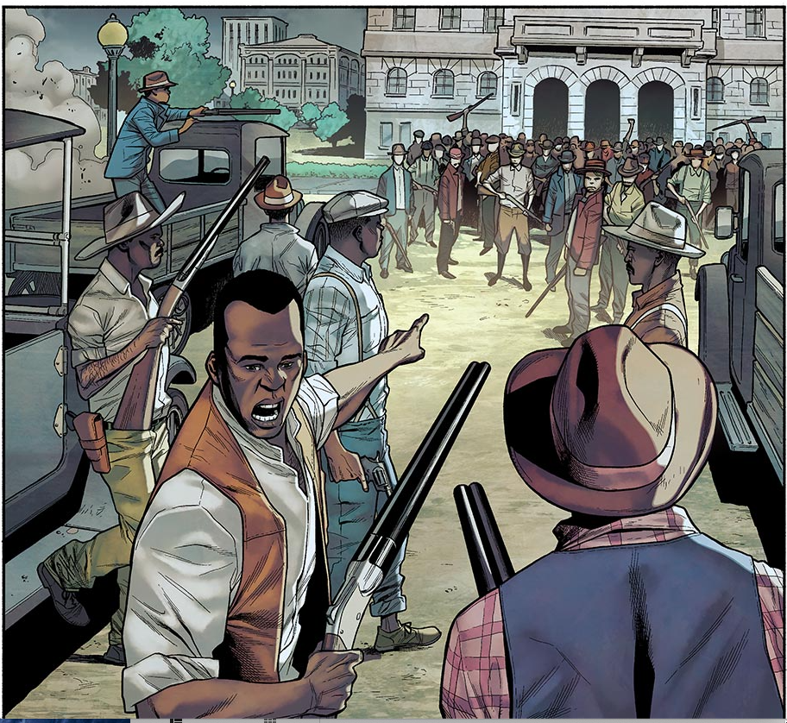
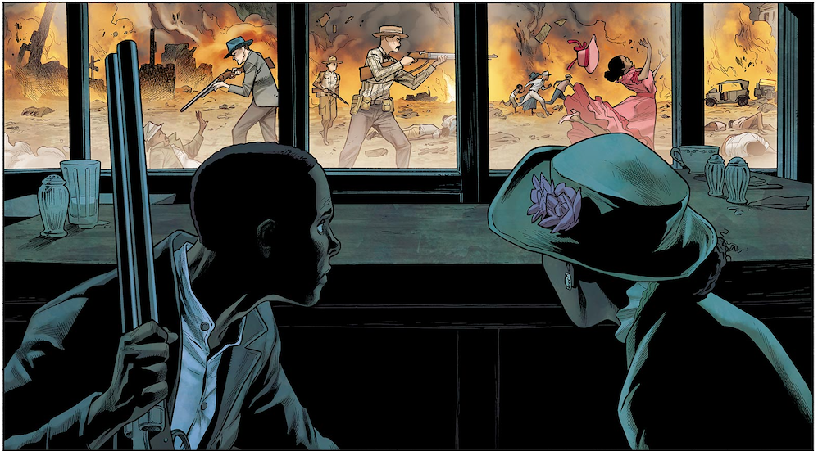
Caption This
Look closely at the images, paying attention to all the details.
Write a 1- or 2-sentence caption for each image, describing what is being shown.
Share your caption with an elbow partner.
Tulsa 1921, Image 1
Tulsa 1921, Image 2
Notes:
Image source: Chang, N., Henry, C., & Maiolo, M. (2019). The massacre of black Wall Street. The Atlantic/HBO. www.theatlantic.com/sponsored/hbo-2019/the-massacre-of-black-wall-street/3217/

Slide 4
Riot vs. Massacre
Brainstorm the similarities and differences between a riot and a massacre.
Summarize your ideas on page 2 of your “Labels Impact History” handout.
Choose one representative to share your group’s thoughts with the class.

Slide 5
Riot vs. Massacre
Read the definitions of riot and massacre below.
Look back at the two images. Would you categorize each image as a “riot” or a “massacre”? Why? Justify your answers using the definitions and details from the images.
Riot
noun
A violent disturbance of the peace by a crowd
verb
Take part in a violent public disturbance
Massacre
noun
An indiscriminate and brutal slaughter of people
verb
Deliberately and violently kill (a large number of people)
Notes:
Definition source: lexico.com

Slide 6
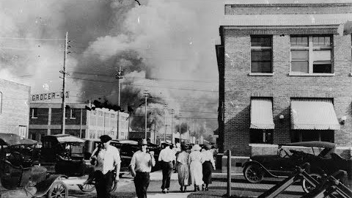
The Tulsa Race Massacre, Then and Now
Notes:
Video source: Tulsa Public Schools. (2018, June 1). The Tulsa race massacre; Then and now. [Video]. YouTube. https://www.youtube.com/watch?v=GhoAGJUDEvc

Slide 7
Labels Impact History
How I Know It
In the circle, respond to these questions:
  In the video, how do the speakers refer to the event—as a riot, or as a massacre?
  Based on what you now know, would you call it a riot or a massacre?
In the area outside the circle, explain where you found your information.
1
2

Slide 8
5Ws Resource Exploration
Choose one resource from each category.
Review the resource, then answer the 5Ws (and 1H!):
  Who is this resource about?
  What is the resource telling me?
  When did this event take place?
  Where did the event take place?
  Why is this information important?
  How does remembering history impact the present?

Slide 9
Inquiry Questions
Look at your three inquiry-based research questions from “Hall of Injustice, Part 1.”
Do you see one that you would like to research?
Do you need to write a new one based on your exploration?
Notes:
Note: If students did not complete Hall of Injustice: Part 1, you can take them through the Extend portion of that lesson to create their Inquiry-Based Research questions.

Slide 10
Research Time!
Using the Inquiry Log, research your Inquiry Question.
Use 3–5 sources to locate your answer.
Use the A-CLAP Strategy to evaluate your sources.
Use resources from the Resource Choice Board, or conduct your own search.
Remember that .edu, .gov, and .org are generally more reliable than .com.

Slide 11
A-CLAP Strategy for Resources
Authority: Is there an author, editor, publisher, or institution provided? Does the individual or organization list their qualifications or credentials?
Currency: Is there a date that shows when the source was published or last updated? Keep in mind that not knowing the date of publication for factual or statistical information can call its accuracy into question.
Leaning: Look for objective sources that present information with a minimum of bias and without the intention to persuade. If a debatable issue is covered, are both sides presented?
Accuracy: Based on the reading you have already done on the subject, can you corroborate this information with other sources? Is factual information referenced in footnotes or a "Works Cited" list?
Purpose: Judge whether the source is geared to a scholarly or nonprofessional audience. Is the information relevant to your needs? If online, use the URL or other linked websites to help you determine its purpose.
Assess the reliability of each source you use in your research.

Slide 12

Thesis Statements
A thesis statement is a one-sentence point of your essay.
Notes:
Video source: Tulsaccprof. (2012, Dec. 17). Writing an effective thesis statement [Video]. YouTube. https://www.youtube.com/watch?v=4sx42_C10zw

Slide 13
Formulating a Thesis Statement
Take your research question and turn it into a thesis statement with a topic, a claim, and specific main points.
Research Question | How does artwork in Tulsa reflect the events of the massacre, and how does art help people to remember and heal?
Topic | Artwork in Tulsa
Claim | Artwork reflects the events of the massacre.
Main Points | Artwork tells the story. Artwork helps people remember and heal. Artwork keeps the story alive.
Thesis Statement | Artwork in Tulsa reflects the events of the massacre of 1921 by telling the story, helping people remember and heal, and keeping the story alive for future generations.

Slide 14

More About Thesis Statements
Notes:
Video source: Andrew. (2013, April 21). How to write a thesis for beginners [Video]. YouTube. https://www.youtube.com/watch?v=wCzuAMVmIZ8

Slide 15
“Tell Me All About It” Informative Essay
Write an informative essay that includes all of the following:
Your thesis statement.
An answer to your research question.
Information from 3–5 sources, including both direct and indirect quotes.
A Works Cited page. (Refer to EasyBib.com for a citation generator.)
A connection to current events.

Slide 16

Commit and Toss
What is the purpose of street art?
Notes:
Image source: Pixabay. (n.d.). Brick wall. https://pixabay.com/photos/brick-wall-bricks-brick-background-1245825/

Slide 17
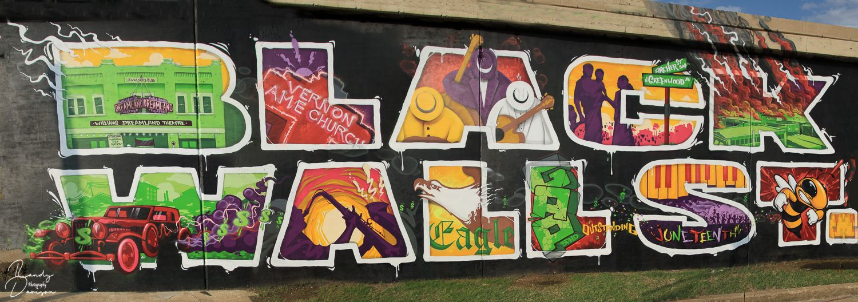
Black Wall Street Art

Slide 18

Hall of Injustice Research Poster
Create a graffiti-style Research Poster that
communicates a powerful message. Consider the following:
What did you find in your research that was most important, interesting, or astounding?
How might you visually share your research?
How might you incorporate charts, graphs, photos, or images?
Notes:
Source: NYU Libraries. (2020, May 18). How to create a research poster: Poster basics. Research Guides. https://guides.nyu.edu/posters

Slide 19
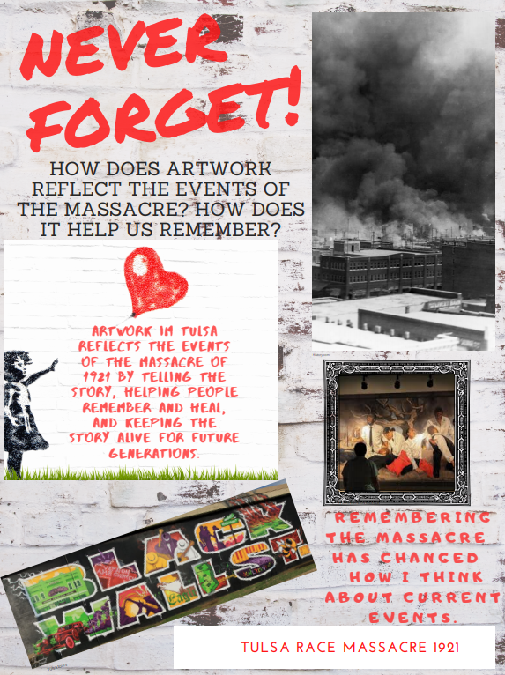
Poster Example
Graffiti Poster Components:
Title
Research question
Answer to question
(thesis statement)
Reflection statement:
“How has remembering the Tulsa Race Massacre impacted you?”
Photos, charts, or graphs

Slide 20
Poster Timeline
Complete a handwritten rough draft.
Create your poster using one of the following:
  Traditional art materials
  Canva (digital poster)
Canva Directions:
Create a Canva account and choose a poster layout.
Consider using a brick background to maintain the graffiti style.
Use the tools to create a poster that is uniquely yours.
Remember to save as you work and download your completed poster.

Slide 21

Elevator Speech
In your speech:
Explain the components of your poster.
Complete this thought:
My research poster has the most powerful message regarding the Tulsa Race Massacre because...

