Slide 1
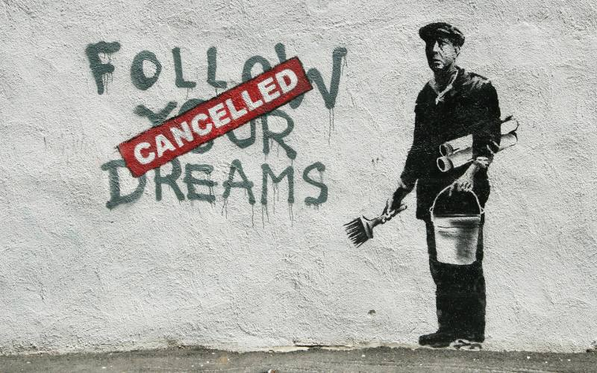
Notes:
Banksy. (2010). Follow your dreams: Cancelled. [Photograph]. WordPress. https://myfineartdotblog.wordpress.com/2018/09/23/follow-your-dreams-cancelled-banksy-analysis/

Slide 2
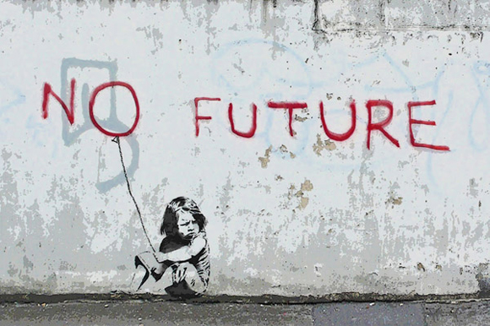
Notes:
Banksy. (2010). No future. [Photograph]. WordPress. https://apictureofpolitics.wordpress.com/2012/03/08/no-future-mural-is-short-lived/.

Slide 3
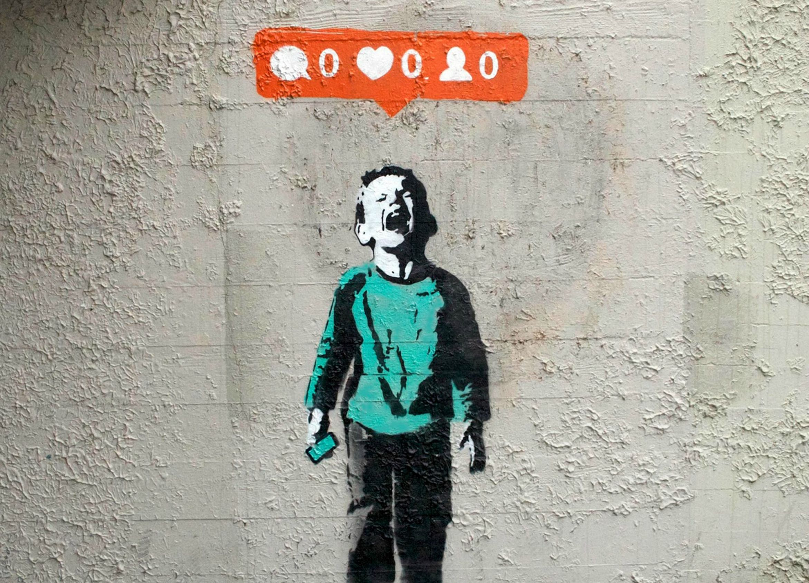
Notes:
Heart, I. (2014). Nobody likes me. [Photograph]. Iheartthestreetart.com. http://www.iheartthestreetart.com/street-2/.

Slide 4
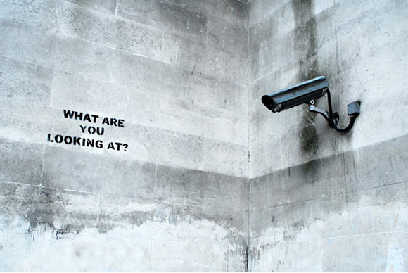
Notes:
Banksy. (2004). What are you looking at? [Photograph]. Blogger. http://adambacon.blogspot.com/2010/03/what-are-you-looking-at-banksy-2004.html.

Slide 5
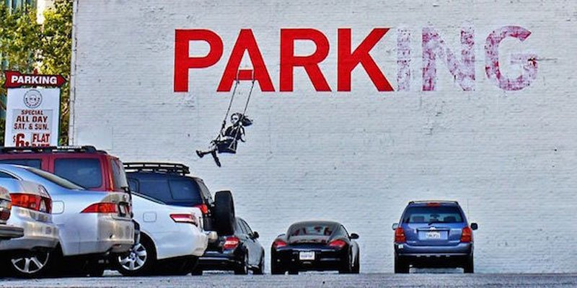
Notes:
Berrios, O. (2011, August 25). Photo of Banksy’s PARKing. [Photograph]. https://www.flickr.com/photos/ofernandezberrios/6078746621/in/photolist-agaaAe-iVfZzS-5AZW7D-iV8Fi4-7yVeCf-nRvgYB-oHv9HS-cKq5vh-iFZZUB-cnqJfu-2zLeYG-7W1yJg-7W4QNu-7yVfn7-7AMdeG-poTJHy-7W4MWQ-7yRsQT-iV9qHG-iV9vwv-iVg1QY-iVeQo9-iVcbM8-iV9xZW-iVaLFz-iVb8wW-iV8xyg-iVaWwt-9tw9ha-7W4N8y-7W1xCp-7W4Mj7-h8zu2P-3Krjfi-chXufW-4Gs92R-7yRtfa-7W1vSv-7W4Nob-7W1xkV-7W4PGh-7W4M2s-7W1x4M-6yetyH-7yRt6H-7ySsSk-4GwihS-7yVfv3-iV9rhP-Jtjeb%20

Slide 6
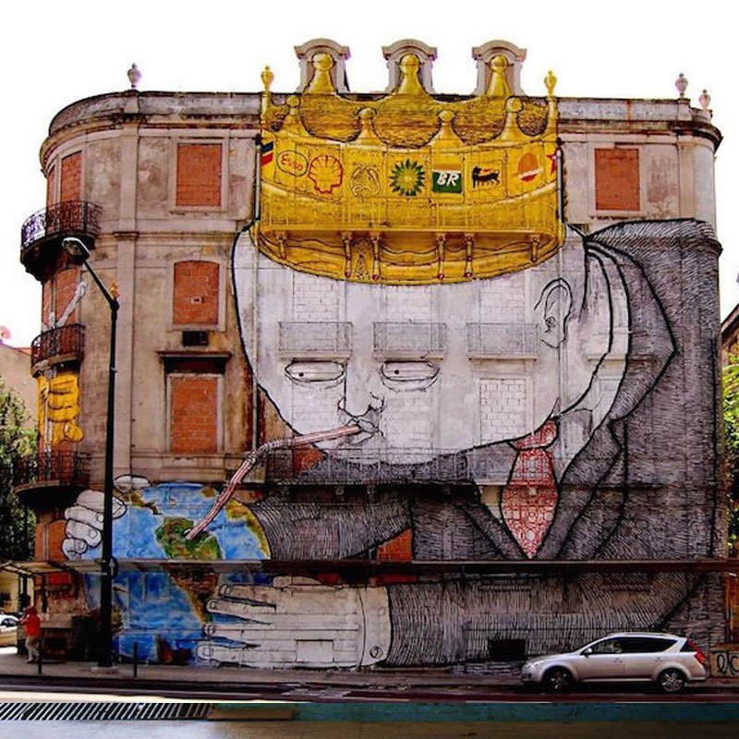
Notes:
OSGEMEOS & Blu. (2014). Big oil companies vs. world. [Photograph]. Urbancreativity.org. https://www.urbancreativity.org/uploads/1/0/7/2/10727553/journal2015_v1_n2_web_final_upt3.pdf

Slide 7
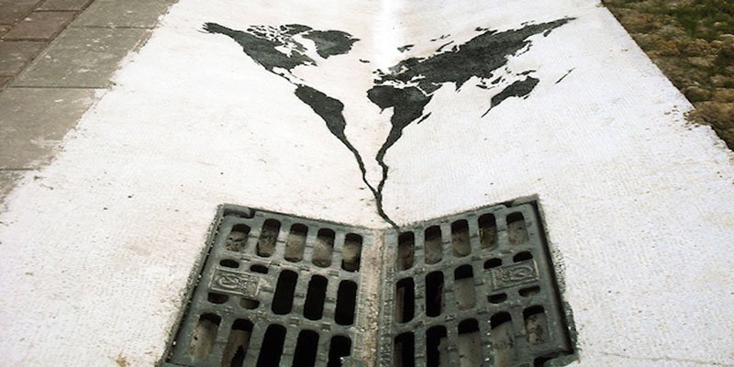
Notes:
(ALL RIGHTS RESERVED. This will need to be replaced or removed.)
Pejac. (2014).
The World is Going Down the Drain.[Photograph].Theculturetrip.com.https://theculturetrip.com/europe/united-kingdom/articles/street-art-and-society-9-murals-that-speak-powerful-truths/

Slide 8
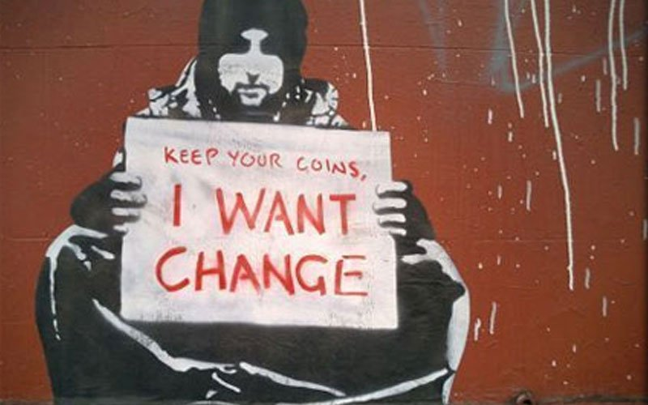
Notes:
Banksy. (2004). Keep your coins, I want change. [Photograph]. WordPress. https://wordpress57027.wordpress.com/2017/04/07/banksy-keep-your-coins-i-want-change/.

Slide 9
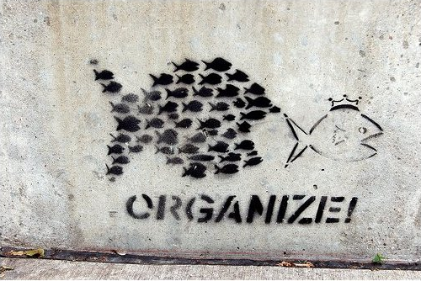
Notes:
Artist unknown. (2008). Organize. [Photograph]. DeviantArt. https://www.deviantart.com/seswei/art/Organize-74300083

Slide 10
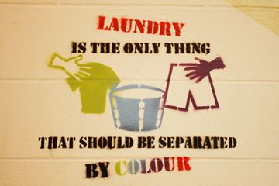
Notes:
(Will likely need permission)
Brownlee, A. (2014, May 14). Laundry is the only thing that should be separated by colour. [Photograph]. Muskokaregion.com. https://www.muskokaregion.com/news-story/4516845-students-use-graffiti-as-social-statement/.

Slide 11
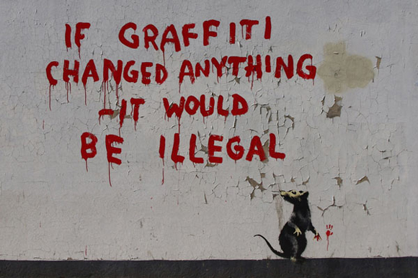
Notes:
(May not be usable)
Banksy. (2011). If graffiti changed anything - it would be illegal. [Photograph]. Widewalls. https://www.widewalls.ch/murals/banksy-if-graffiti-changed-anything-it-would-be-illegal/.

