Slide 1
Motivations in
“The Gift of the Magi”
Motivation in Characters
English Language Arts (ELA)

Slide 2
Essential Questions
What motivates people to take action?
How do we determine selfless actions?

Slide 3
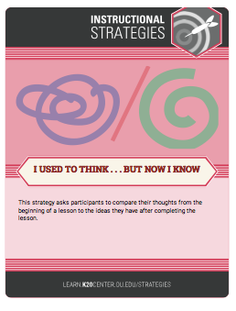
I Used to Think …
Let’s look at a slide show.
In the “I Used to Think” column, write down the emotions that these people feel or the things that motivate them.

Slide 4
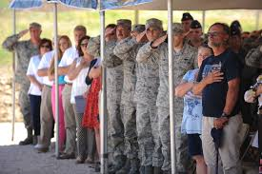
What are these people doing, and why?
Image source: Matthews, D. (2013, July 2). Ceremony honors NC Guardsmen killed fighting fire [Photograph]. Defense Visual Information
Distribution Service. https://static.dvidshub.net/media/thumbs/photos/1307/964528/250x166_q75.jpg
Notes:
Image source: Matthews, D. (2013, July 2). Ceremony honors NC Guardsmen killed fighting fire [Photograph]. Defense Visual Information Distribution Service. https://static.dvidshub.net/media/thumbs/photos/1307/964528/250x166_q75.jpg

Slide 5
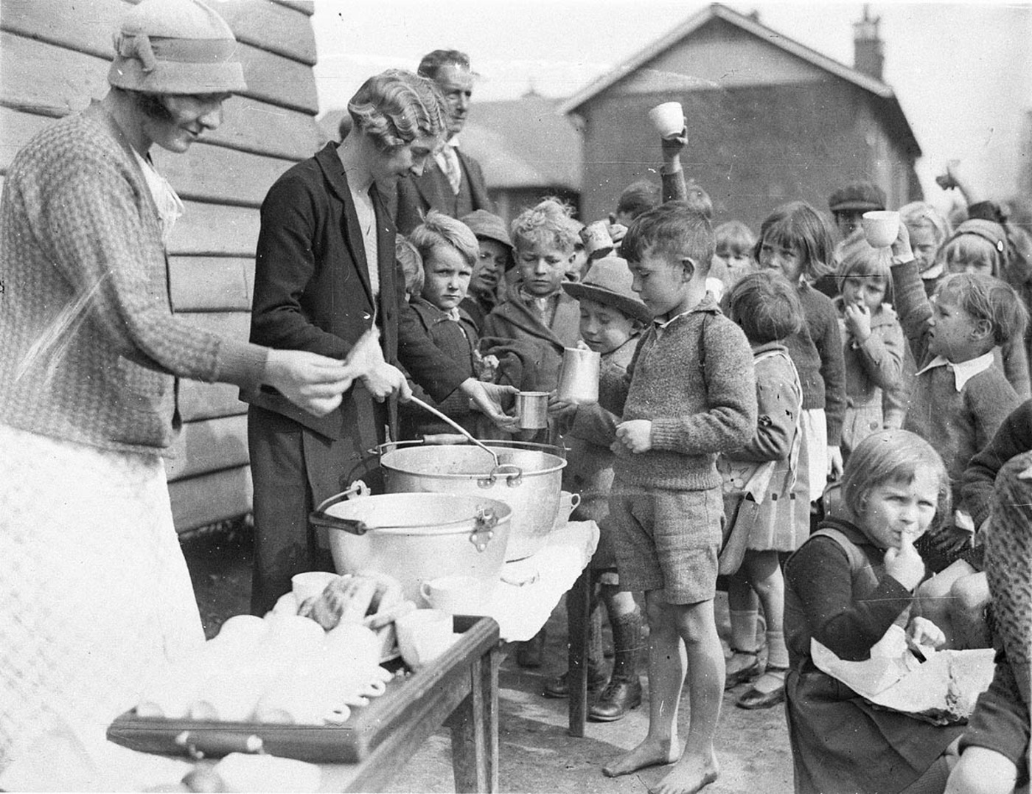
What is motivating the adults and children?
Image source: Hood, S. (1934, Aug. 2). Schoolchildren line up for tree issue of soup and a slice of bread in the Depression
[Photograph]. Wikimedia Commons. https://commons.wikimedia.org/wiki/File:Schoolchildren_line_up_for_free_issue_of_soup
_and_a_slice_of_bread_in_the_Depression,_Belmore_North_Public_School,_Sydney,_2_August_1934_-_Sam_Hood_(3550268287).jpg#filelinks
Notes:
Image source: Hood, S. (1934, Aug. 2). Schoolchildren line up for tree issue of soup and a slice of bread in the Depression [Photograph]. Wikimedia Commons. https://commons.wikimedia.org/wiki/File:Schoolchildren_line_up_for_free_issue_of_soup_and_a_slice_of_bread_in_the_Depression,_Belmore_North_Public_School,_Sydney,_2_August_1934_-_Sam_Hood_(3550268287).jpg#filelinks

Slide 6
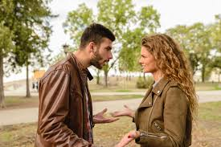
What is motivating this couple?
Notes:
Image source: https://pxhere.com/en/photo/1552621.
Public Domain

Slide 7
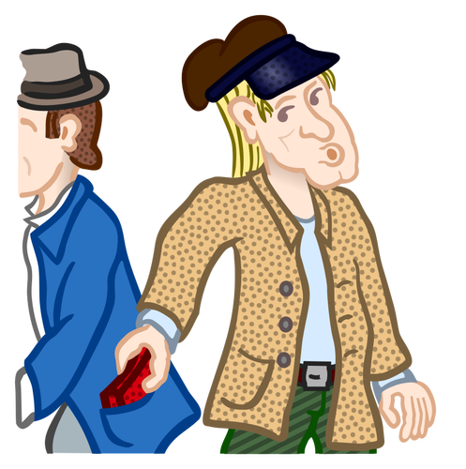
What do you see in this image?
Notes:
Image Source: https://www.pngkey.com/maxpic/u2e6r5w7e6o0i1q8/
Public Domain

Slide 8
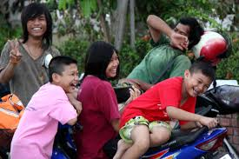
How do you think these people are feeling?
Notes:
Image source: https://pxhere.com/en/photo/852011

Slide 9
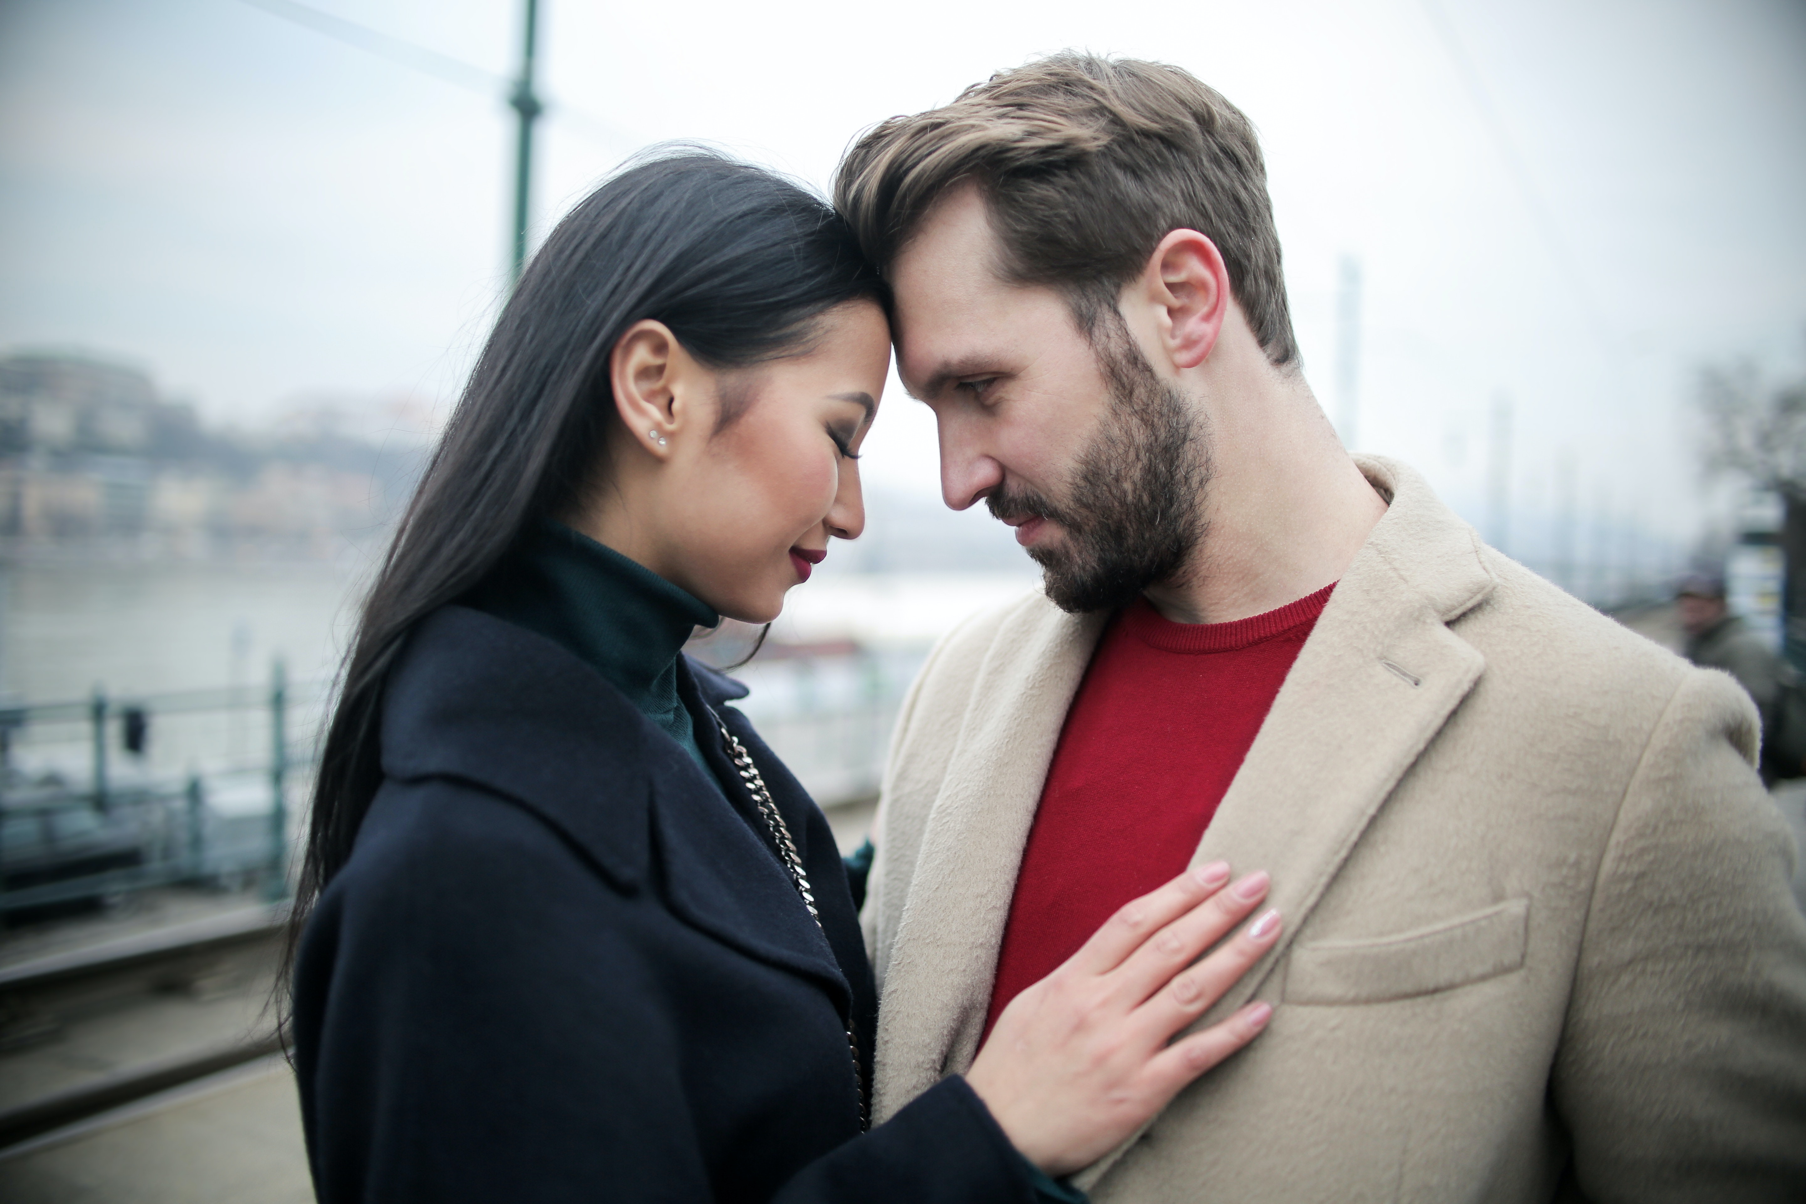
How do you think this couple is feeling?
Notes:
Image source: https://www.pexels.com/photo/happy-multiracial-couple-hugging-on-waterfront-while-having-romantic-date-in-city-3775605/

Slide 10

ABC Graffiti
Work in small groups to brainstorm words or phrases that connect to the following question:
What are different thoughts and feelings that motivate people?
Be prepared to move after time is called. You’ll only need the marker provided to your group.

Slide 11
What are different thoughts and feelings that motivate people?
Round 1
Round 2
Round 3
In your small group, generate words or phrases related to the topic for each letter of the alphabet.
Rotate to the next poster and read through the list. Add words and phrases for the letters that haven’t already been addressed.
Once again, rotate to the next poster and read through the list. Add words and phrases for the letters that haven’t already been addressed.

Slide 12

The Gift of the Magi: Why-Lighting
Read the story.
Highlight different actions of the husband in one color and the wife in another color.
When you highlight, make notes about what motivations or feelings the action represents and why.

Slide 13

The Gift of the Magi: Categorical Highlighting
Read the story.
Using two different colors (one for each character), highlight examples of each character’s action in the story.
When you highlight, note what you think the character is feeling and why.

Slide 14

Your Turn To Write
Use what you learned in the story and reflect on what it means to be selfless.
Compose a short, one-page update of the story The Gift of the Magi.
The story can be fiction. Or, it can be nonfiction, based on something that happened to you or a story in the news.

Slide 15
…But Now I Know
Let’s revisit each image in the slide show.
In the “But Now I Know” column, write down how your thoughts about an image have changed and note any clarifications you now have.

Slide 16
What are these people doing, and why?
Notes:
Image source: Matthews, D. (2013, July 2). Ceremony honors NC Guardsmen killed fighting fire [Photograph]. Defense Visual Information Distribution Service. https://static.dvidshub.net/media/thumbs/photos/1307/964528/250x166_q75.jpg

Slide 17
What is motivating the adults and children?
Notes:
Image source: Hood, S. (1934, Aug. 2). Schoolchildren line up for tree issue of soup and a slice of bread in the Depression [Photograph]. Wikimedia Commons. https://commons.wikimedia.org/wiki/File:Schoolchildren_line_up_for_free_issue_of_soup_and_a_slice_of_bread_in_the_Depression,_Belmore_North_Public_School,_Sydney,_2_August_1934_-_Sam_Hood_(3550268287).jpg#filelinks

Slide 18
What is motivating this couple?
Notes:
Image source: https://pxhere.com/en/photo/1552621.
Public Domain

Slide 19
What do you see in this image?
Notes:
Image Source: https://www.pngkey.com/maxpic/u2e6r5w7e6o0i1q8/
Public Domain

Slide 20
How do you think these people are feeling?
Notes:
Image source: https://pxhere.com/en/photo/852011

Slide 21
How do you think this couple is feeling?
Notes:
Image source: https://www.pexels.com/photo/happy-multiracial-couple-hugging-on-waterfront-while-having-romantic-date-in-city-3775605/

