Slide 2
Motivations in
“The Gift of the Magi”
Motivation in Characters

Slide 3
Learning Objectives
Analyze how characters’ values and beliefs influence behavior and the development of the plot.
Write a modern adaptation that reflects contemporary motivations and selfless actions.
Use strong and specific vocabulary to describe emotions and analyze what may motivate individuals to act.

Slide 4
Essential Questions
What motivates people to take action?
How do we determine selfless actions?

Slide 5

I Used to Think…
Let’s look at a slideshow.
In the “I Used to Think” column, write down the emotions that these people feel or the things that motivate them.
Notes:
K20 Center. (n.d.). I Used to think...But now I know. Strategies. https://learn.k20center.ou.edu/strategy/137

Slide 6
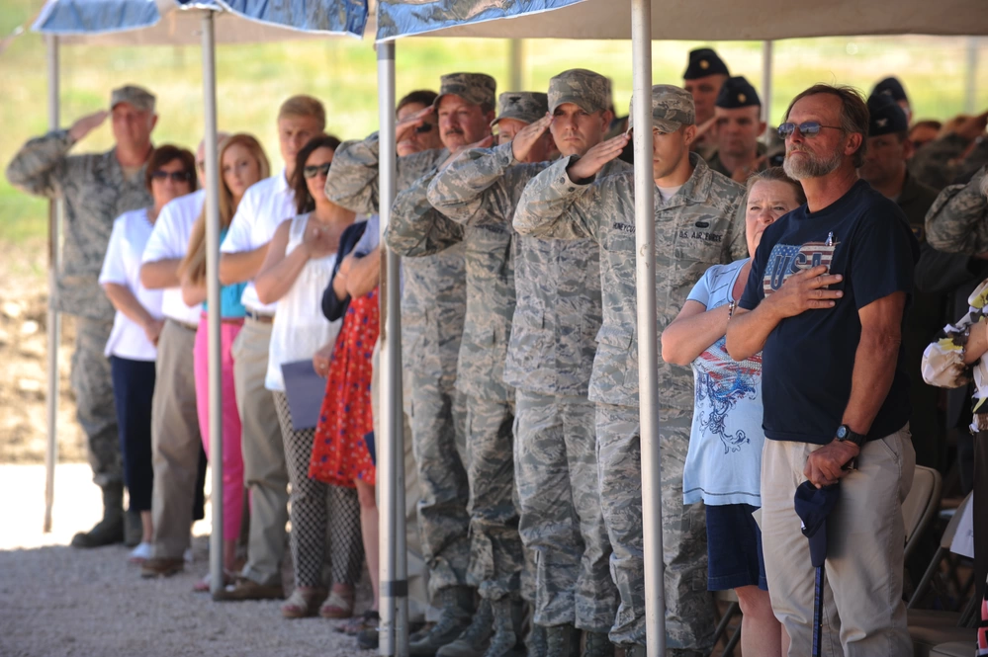
What are these people doing and why?
Notes:
Matthews, D. (2013, July 2). Ceremony honors NC Guardsmen killed fighting fire [Photograph]. Defense Visual Information Distribution Service. https://www.dvidshub.net/image/964528/ceremony-honors-nc-guardsmen-killed-fighting-fire

Slide 7
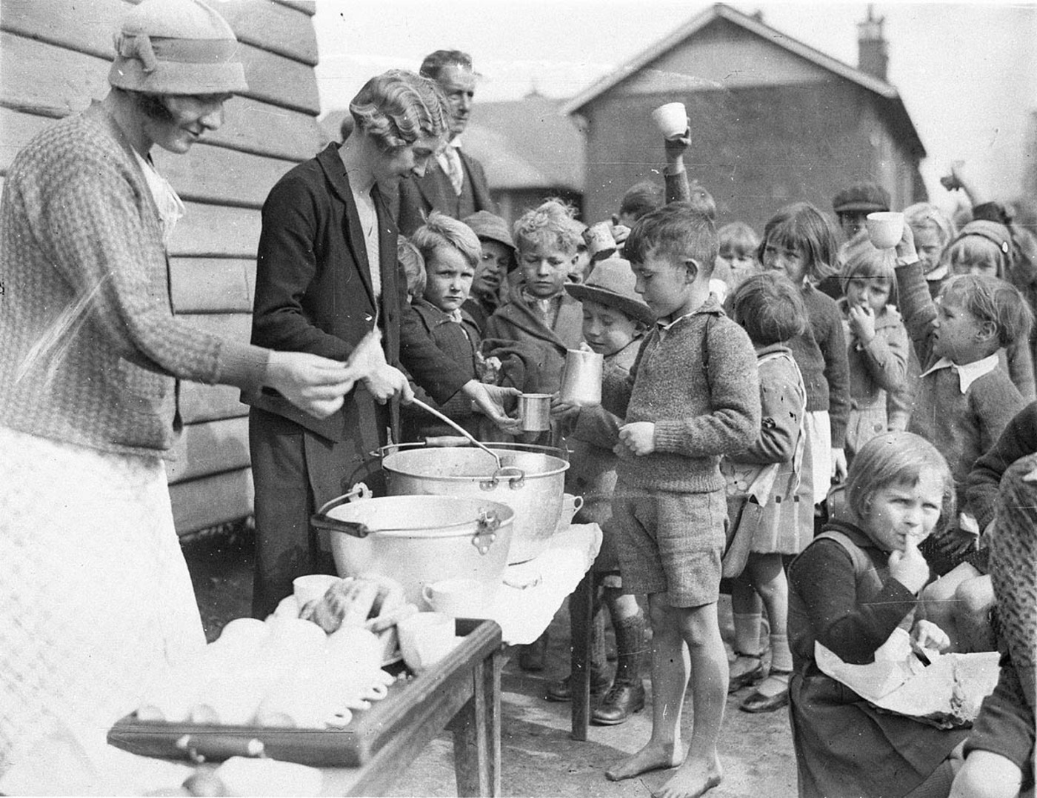
What is motivating the adults and children?
Notes:
Hood, S. (1934, Aug. 2). Schoolchildren line up for tree issue of soup and a slice of bread in the Depression [Photograph]. Wikimedia Commons. https://commons.wikimedia.org/wiki/File:Schoolchildren_line_up_for_free_issue_of_soup_and_a_slice_of_bread_in_the_Depression,_Belmore_North_Public_School,_Sydney,_2_August_1934_-_Sam_Hood_(3550268287).jpg

Slide 8
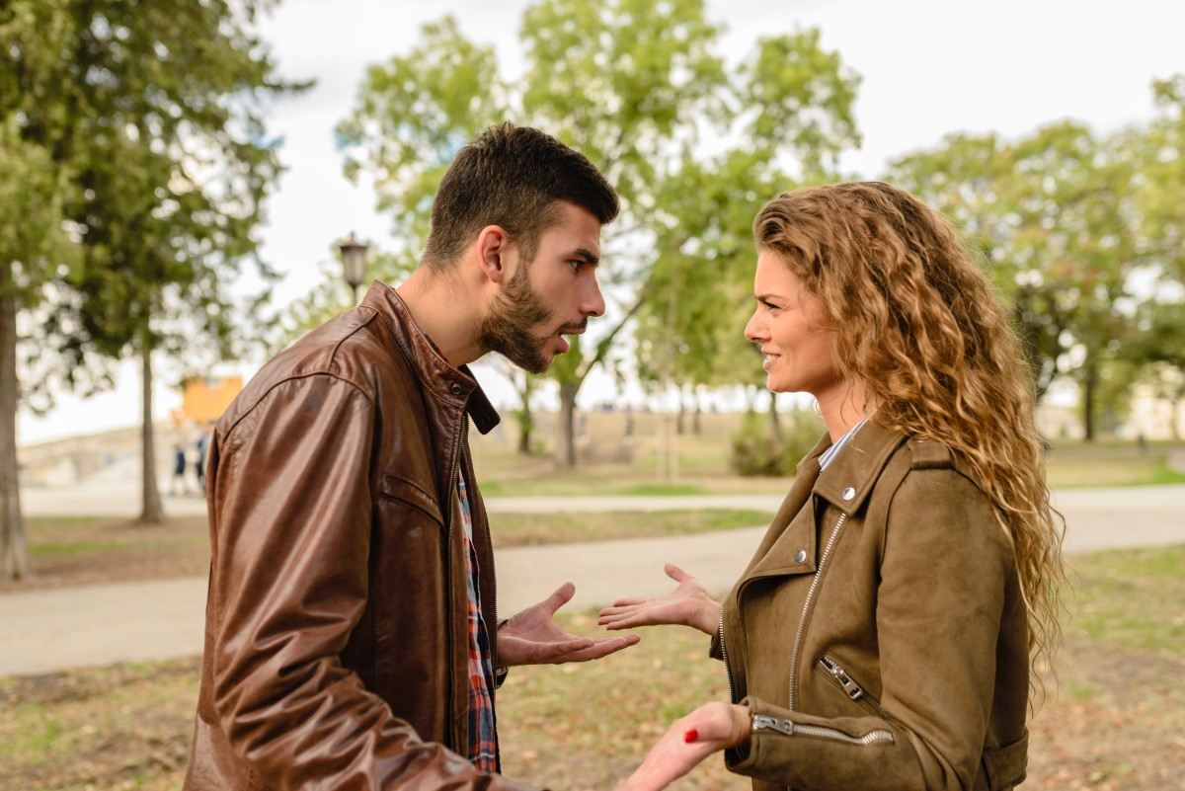
What is motivating this couple?
Notes:
Unknown. (2018). Two people arguing outside. PxHere. Retrieved from https://pxhere.com/en/photo/1552621.

Slide 9
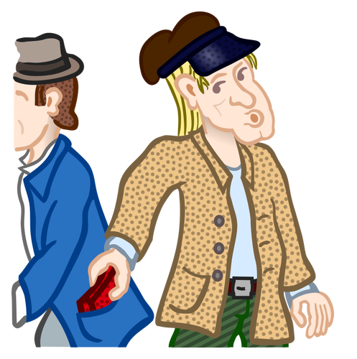
What do you see in this image?
Notes:
Unknown. (n.d.). Clipart of pickpocketer. pngkey.com Retrieved from https://www.pngkey.com/maxpic/u2e6r5w7e6o0i1q8/#google_vignette

Slide 10
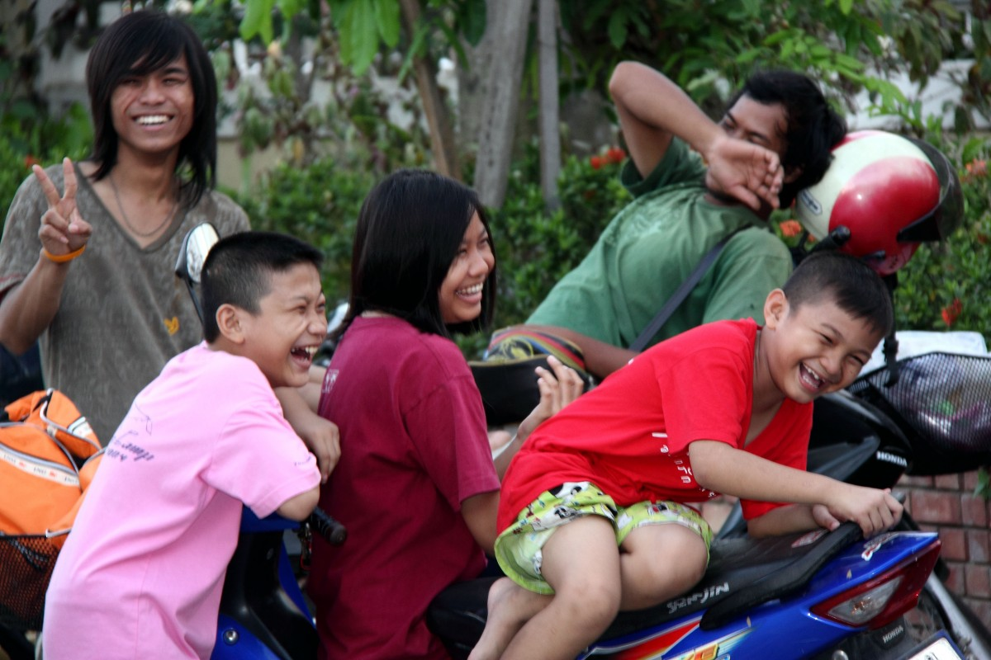
How do you think these people are feeling?
Notes:
Unknown. (2017). Smiling kids on dirt bikes. PxHere. Retrieved from https://pxhere.com/en/photo/852011

Slide 11
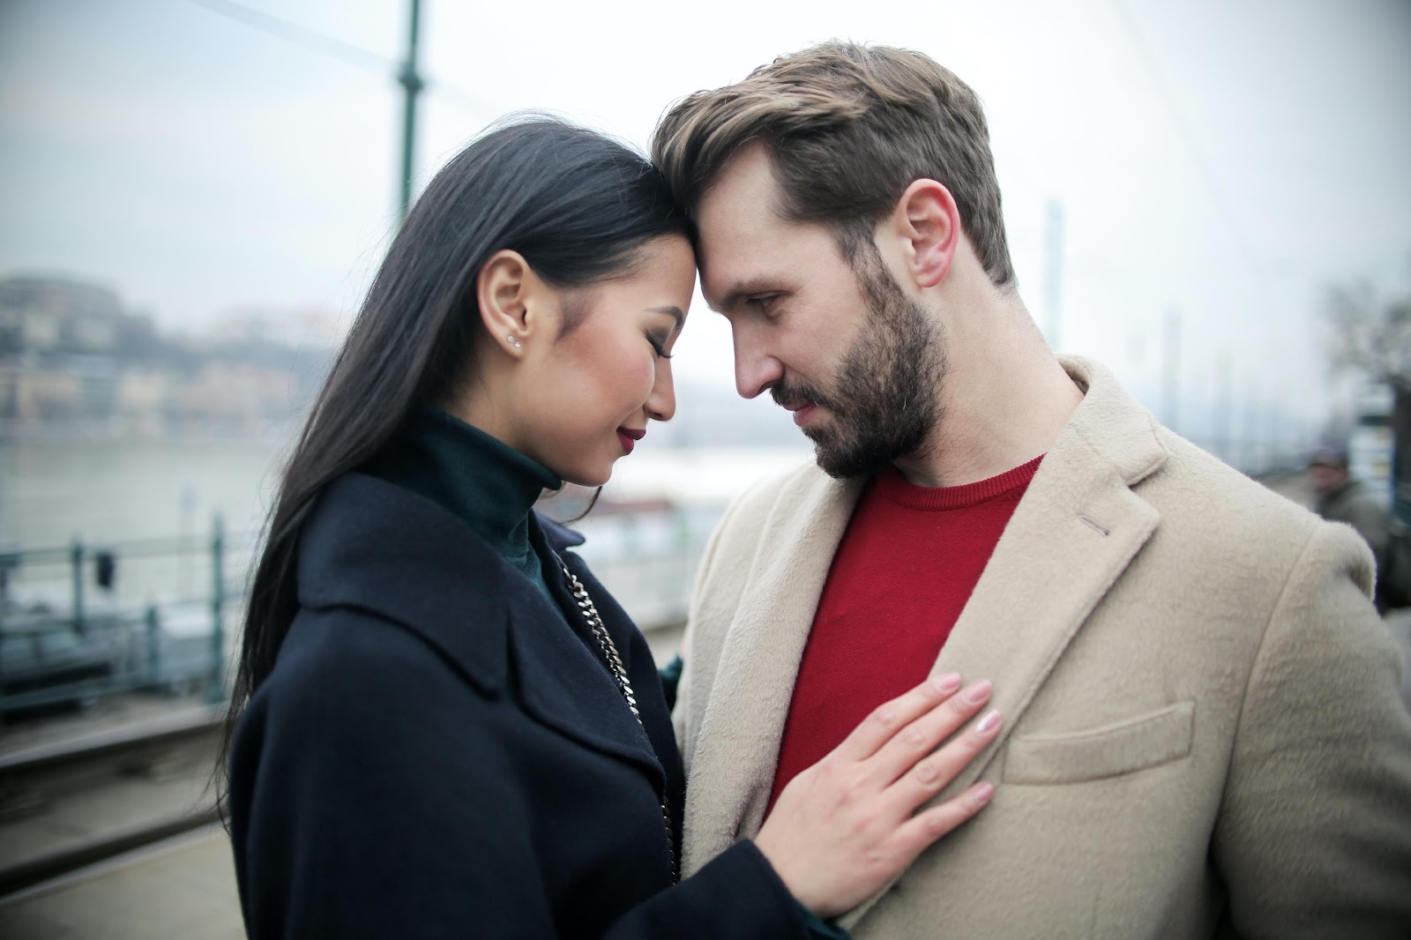
How do you think these people are feeling?
Notes:
Piacquadio, A. (2020). Happy multiracial couple hugging on waterfront while having romantic date in city. PxHere. Retrieved from https://www.pexels.com/photo/happy-multiracial-couple-hugging-on-waterfront-while-having-romantic-date-in-city-3775605/

Slide 12

ABC Graffiti
Work in small groups to brainstorm words or phrases that connect to the following question:
  What are different thoughts and feelings that motivate people?
Be prepared to move after time is called. You’ll only need the marker provided to your group.
Notes:
K20 Center. (n.d.). ABC Graffiti. Strategies. https://learn.k20center.ou.edu/strategy/96

Slide 13
What are different thoughts and feelings that motivate people?
Round 1
Round 2
In your small group, generate words or phrases related to the topic for each letter of the alphabet.
Rotate to the next poster and read through the list. Add words and phrases for the letters that have not already been addressed.
Round 3
Once again, rotate to the next poster and read through the list. Add words and phrases for the letters that have not already been addressed.

Slide 14

The Gift of the Magi: Why-Lighting
Read the story.
Highlight different actions of the husband in one color and the wife in another color.
When you highlight, make notes about what motivations or feelings the action represents and why.
Notes:
K20 Center. (n.d.). Why-lighting. Strategies. https://learn.k20center.ou.edu/strategy/128

Slide 15

The Gift of the Magi: Categorical Highlighting
Read the story.
Using two different colors (one for each character), highlight examples of each character’s action in the story.
When you highlight, note what you think the character is feeling and why.
Notes:
K20 Center. (n.d.). Categorical highlighting. Strategies. https://learn.k20center.ou.edu/strategy/192

Slide 16

Your Turn To Write
Use what you learned in the story and reflect on what it means to be selfless.
Compose a short, one-page update of the story “The Gift of the Magi.”
The story can be fiction. Or, it can be nonfiction, based on something that happened to you or a story in the news.

Slide 17
…But Now I Know
Let’s revisit each image in the slide show.
In the “But Now I Know” column, write down how your thoughts about an image have changed and note any clarifications you now have.
Notes:
K20 Center. (n.d.). I Used to think...But now I know. Strategies. https://learn.k20center.ou.edu/strategy/137

Slide 18
What are these people doing and why?
Notes:
Matthews, D. (2013, July 2). Ceremony honors NC Guardsmen killed fighting fire [Photograph]. Defense Visual Information Distribution Service. https://www.dvidshub.net/image/964528/ceremony-honors-nc-guardsmen-killed-fighting-fire

Slide 19
What is motivating the adults and children?
Notes:
Hood, S. (1934, Aug. 2). Schoolchildren line up for tree issue of soup and a slice of bread in the Depression [Photograph]. Wikimedia Commons. https://commons.wikimedia.org/wiki/File:Schoolchildren_line_up_for_free_issue_of_soup_and_a_slice_of_bread_in_the_Depression,_Belmore_North_Public_School,_Sydney,_2_August_1934_-_Sam_Hood_(3550268287).jpg

Slide 20
What is motivating this couple?
Notes:
Unknown. (2018). Two people arguing outside. PxHere. Retrieved from https://pxhere.com/en/photo/1552621.

Slide 21
What do you see in this image?
Notes:
Unknown. (n.d.). Clipart of pickpocketer. pngkey.com Retrieved from https://www.pngkey.com/maxpic/u2e6r5w7e6o0i1q8/#google_vignette

Slide 22
How do you think these people are feeling?
Notes:
Unknown. (2017). Smiling kids on dirt bikes. PxHere. Retrieved from https://pxhere.com/en/photo/852011

Slide 23
How do you think these people are feeling?
Notes:
Piacquadio, A. (2020). Happy multiracial couple hugging on waterfront while having romantic date in city. PxHere. Retrieved from https://www.pexels.com/photo/happy-multiracial-couple-hugging-on-waterfront-while-having-romantic-date-in-city-3775605/

