Slide 2
Presenting With Confidence
Speech and Debate

Slide 3
Essential Questions
What does confidence look and feel like?
Is confidence innate or learned?
How can you manage feelings to appear and feel more confident?

Slide 4
Objectives
By the end of this lesson, we will be able to:
Describe what performance anxiety is through the senses.
Practice methods of managing performance anxiety.

Slide 5
Word Cloud
Consider the following question:
  What words come to mind when you think about talking or presenting in front of an audience?
(embed code here or exit out to the website)

Slide 6
I Think I’ll Feel…
Consider your feelings in anticipation of sharing your speech in front of your assigned group.
On the handout provided, complete the left-hand column only.

Slide 7
Speech Time!
In your groups, take turns presenting your speech.
While you are speaking, try to make a mental note of how you are feeling.

Slide 8
But I Actually Felt…
Consider your feelings after sharing your speech in front of your assigned group.
On the handout provided, now complete the right-hand column.

Slide 9

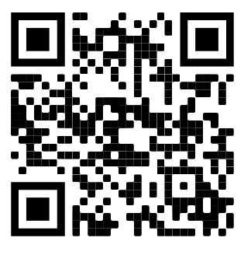

Presenting With Confidence
Watch your group’s assigned video, linked below.
Use the Note Catcher handout to collect new ideas that can help you prepare for speaking in front of a group.
  Consider techniques that are outward-facing and inward-facing.
http://bit.ly/2U6Qb6Y
http://bit.ly/2GuwwGi
http://bit.ly/311omi4

Slide 10
Presenting With Confidence
Share with the class any ideas and techniques for managing performance anxiety that you found in your video.
(embed screenshot of your word cloud here, or exit out to the website)

Slide 11
Presentation Planning Tool
You will be creating a plan to help you prepare to manage your nerves before your next presentation.
You can create this in the form of a checklist or some other tool that you can use in the future.

Slide 12
Presentation Planning Guidelines
You have the freedom to design this in a way that will be most useful for you.
Consider a timeline of steps or stages (e.g., one week before, one day before, on the day of the speech) or possibly a checklist of preparation priorities.
Be sure to include a balance of inward-facing and outward-facing techniques.
Your final product must include a minimum of six tips and techniques that you will use to prepare for your
next presentation.

Slide 13

Video Reflection
What did you do in this lesson?
So what? Why is this important?
Now what? How will you apply this
going forward?

