Slide 2
Is Pizza Epic?
Word Choice

Slide 3
Essential Question
How can word choice affect communication?

Slide 4
Lesson Objectives
Identify misused/overused words and phrases and revise with more precise language.

Slide 5
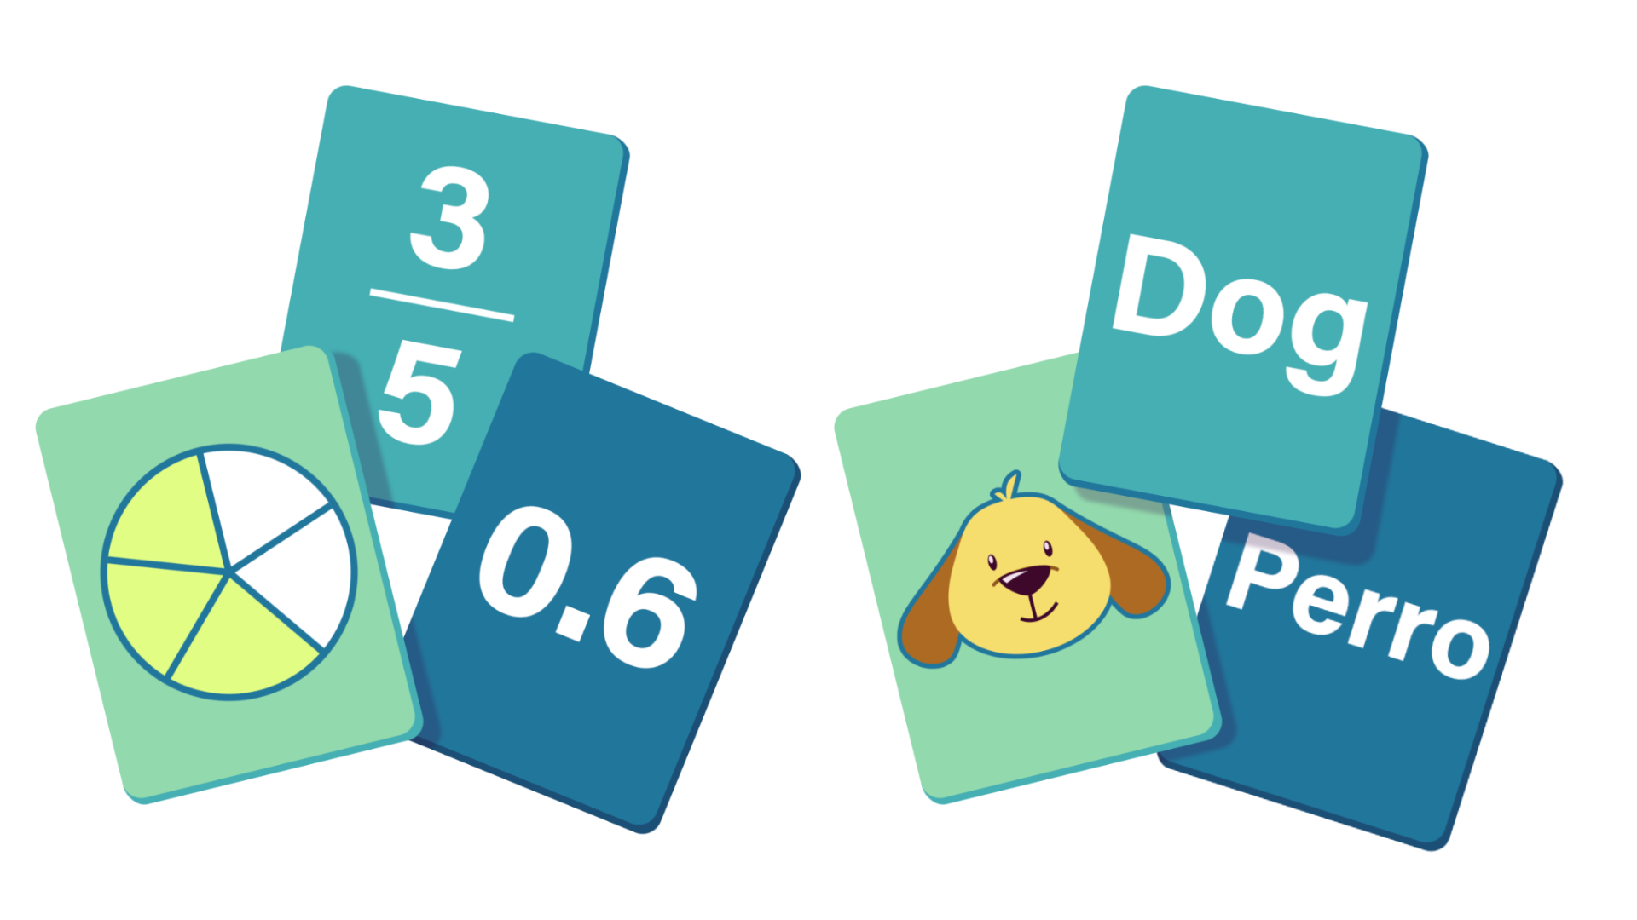
Matching Challenge: Part 1
Look through Card Match Set 1
Match each image with the definition that most closely matches it.
Do your best!

Slide 6
Matching Challenge: Part 1
Which definitions did you choose for each image?
How did you choose which definition went with each image?

Slide 7
Matching Challenge: Part 2
Look through Card Match Set 2
Match each image with the definition that most closely matches it.

Slide 8
Matching Challenge: Part 2
Which definitions did you choose for each image?
How did you choose which definition went with each image?
In which round could you find a description for each image more quickly? Why?

Slide 9
Card Match Set 1: Word Reveal
Epic: Relating to a long poem, typically one derived from ancient oral tradition, narrating the deeds and adventures of heroic or legendary figures or the history of a nation. | Unbelievable: So great or extreme as to be difficult to believe; extraordinary.
Awesome: extremely impressive or daunting; inspiring great admiration, apprehension, or fear. | Random: made, done, happening, or chosen without method or conscious decision.
Fantastic: Imaginative or fanciful; remote from reality. | Unique: being the only one of its kind; unlike anything else.

Slide 10
IS PIZZA EPIC?
Epic: relating to a long poem, typically one derived from ancient oral tradition, narrating the deeds and adventures of heroic or legendary figures or the history of a nation

Slide 11
Overused and Misused
Why does precision in word choice matter?
For what audience would you be particularly careful about your word choice?
For what purpose would you be particularly careful about your word choice?

Slide 12
Add to the list
Write 4 misused/overused words and phrases.
For each word/phrase, write the “problem” with the word choice in the “Consider That” column and alternatives to the word or phrase in the “Consider Using” column.

Slide 13
Claim, Evidence, and Reasoning (CER)
Write a claim about which word or phrase should be reconsidered due to overuse or misuse.
Back up the claim with evidence (from the “Consider That” and “Consider Using” columns).
Support the evidence with reasoning. (Why do the alternatives for this word or phrase more appropriately suit a particular purpose or audience?)

Slide 14
Yes, Because…
Line up in 2 even rows facing each other.
Each pair will refer to the handouts as we move down the line.
Partner 1 tells us about a word we should reconsider using.
Partner 2 says, “Yes, because…”, and proceeds to explain why.

