Slide 2
And We’re Rolling! With Digital Storytelling and Green Screen Video Production
Digital Storytelling with Green Screen

Slide 3
Warm-Up
What is the best part of your school?
Go to www.autodraw.com.
You can think concretely or abstractly.
Show your response, and be prepared to explain why!
Notes:
AutoDraw. (n.d.). AutoDraw. https://www.autodraw.com/

Slide 4
Essential Question
What makes good storytelling for an audience?

Slide 5
Lesson Objectives
After this lesson, we will be able to:
Create projects that showcase creativity, teamwork, and writing across the curriculum.
Use a green screen and the Do Ink app to report on a project.

Slide 6
Digital Storytelling
What is it?
How can you integrate it?

Slide 7
Digital Storytelling Process
Select a topic.
Research the content.
Write the script or create a storyboard.
Collect images and videos that enhance and tell the story wanting to be told.
Import and arrange the images (using tech tools like Do Ink and iMovie).
Insert narration, audio, and/or music.
Select the way that this story can be shared and who it will be shared with.

Slide 8
Story Topics
What digital story do you want to tell?
Morning announcements
Sight words
Real-world problems
Classroom routines
What else? Why?

Slide 9
Get Moving!
Find a partner and establish your topic.
Using the events brainstormed on your storyboard:
Create a quick 30-second video with your partner in front of your green screen.
Take a few pictures that symbolize your topic.
Take some pictures in front of the green screen, and some without the green screen.
Get creative and have fun!

Slide 10
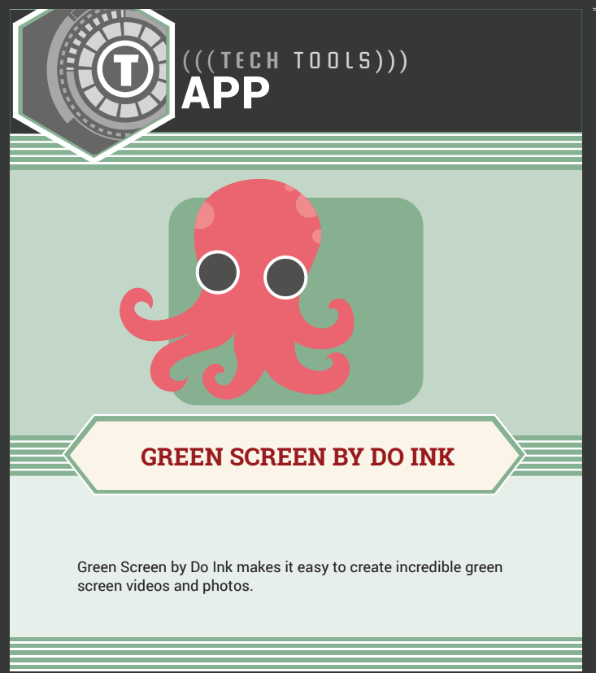
Scavenger Hunt
How well do you know the Do Ink app?
With your partner, use the provided Scavenger Hunt to identify and explore key features of the application.
As you work through the list, upload the videos and pictures you took into Do Ink.

Slide 11
Step into the Production Room
Using your digital storytelling experience from Do Ink:
Open iMovie.
Choose “New Project.”
Import your media from Do Ink into iMovie.
Record a script. Use your storyboard template as an outline and guide.
Add effects and background sound.
Export to your camera roll to share it with an audience.
Ask questions as needed!

Slide 12
Audience, take your seats!
Show and explain your collaboration and production.

