Slide 2
Ecosystems, Human Activity, and Interactions, Oh My!
5th Grade Science—Human/Environment Interaction

Slide 3
Essential Question
As a scientist, what would be your recommended solution to predators in an ecosystem?

Slide 4
Lesson Objectives
We will be able to:
Demonstrate a deeper understanding of the forces that impact apex predators.
Illustrate an understanding of the importance of keystone species in an ecosystem.

Slide 5
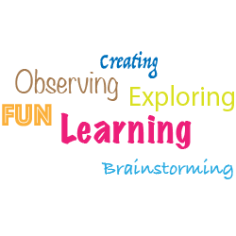
Word Cloud
Today’s theme is human/environment interaction.
Go to https://worditout.com/ or https://wordart.com/my-word-art.
First, enter the term “ecosystem.”
Then, enter any other terms you know of associated with the theme.

Slide 6
Effect Statement
You have a picture of one animal. In your group, create an effect statement for the data included with your animal.
Example: “Because ________________________________, then __________________________________________.”

Slide 7
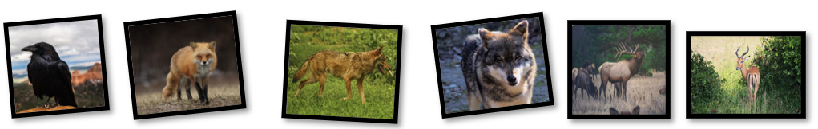
Relationship Map
Organize the animal cards you’ve been given as you see fit.
Be ready to share out why you are organizing your cards the way you are.

Slide 8
Effect Statements
Revisit the effect statement you created for your first animal card. Now, look at the data on the back of the rest of the animal cards.
What are the different causes from the data set that relate to their first effect statement?
What problems exist in this ecosystem based on your cause statements?

Slide 9
As a group of scientists, what would be your recommended solution to the problems presented in this data?

Slide 10

Wolves Keep Yellowstone in Balance
What do you notice about the individual species?
What do you notice about the relationship between the species?
What do you wonder about the Gray Wolf as an apex predator?
Has your recommended solution to the problems presented in the data changed? How so?

Slide 11

Claim, Evidence, Reasoning
What is the right thing to do when an apex predator is affecting other species?
Present your solution using [insert app] and include the following three elements:
One problem
Evidence
Reasoning

Slide 12
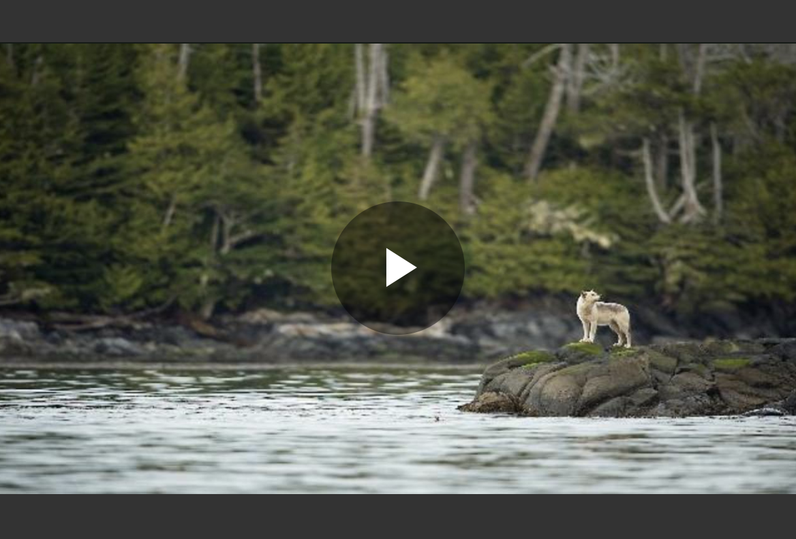
Wolves of Yellowstone
Notes:
National Geographic. (2015, January 30). Wolves of Yellowstone [Video]. https://www.nationalgeographic.org/media/wolves-yellowstone/

Slide 13
Were the wolves important to the health of Yellowstone?
Yes! Species that are integral to the ecosystem and food chain are called keystone species. The Gray Wolf is a keystone species in Yellowstone.

Slide 14
Word Cloud Revisited
Today’s theme is still human/environment interaction.
Go to https://worditout.com/ or https://wordart.com/my-word-art.
First, enter the term “ecosystem.”
Then, enter any other terms, including new terms you now know of after the lesson, that are associated with the theme.
Have the word clouds changed? What new terms did you add and why?

